Slide 1
OBHR 2P91
Organizational Behaviour
Barry Wright, PhD
bwright@brocku.ca
(905) 688- 5550 ext 5034
Goodman 457
http://spartan.ac.brocku.ca/~bwright/
(Barry Wright home page)

Slide 2
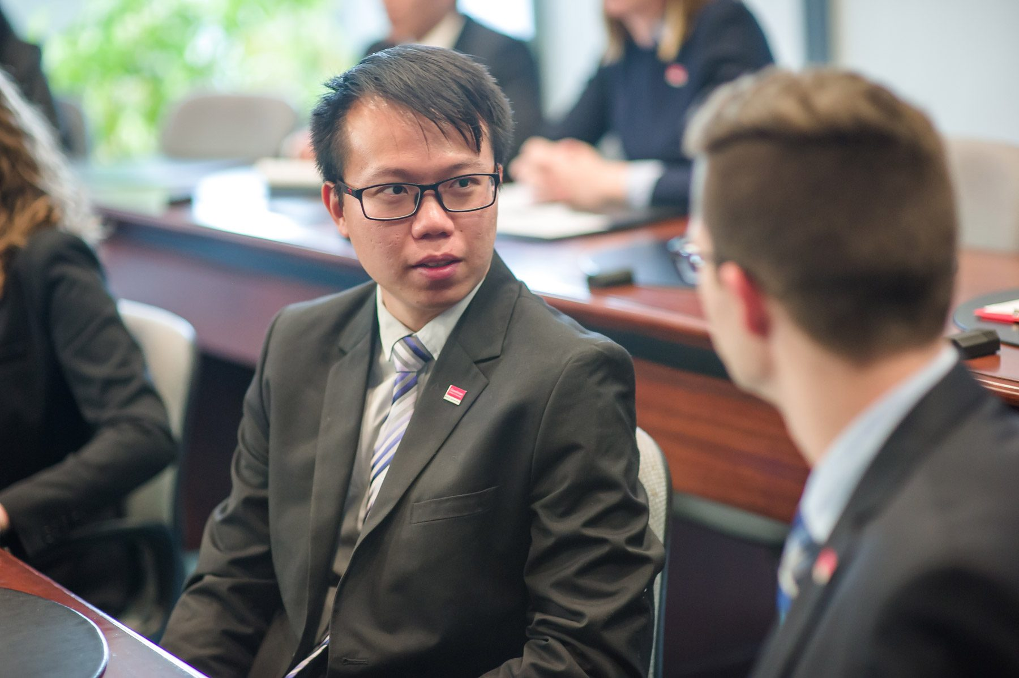
Course Objectives
Understand Management Theories
Appreciate How and When to Apply Them
Experiment and Take Risks
Further Kindle your Passion to Lead
Expand your Personal Managing and Leadership Skill Set

Slide 3
How do we learn
1) Trial and Error
2) By Watching Others
3) Education
Job experiences
Role Models
Training

Slide 4

Text
Schermerhorn, Bachrach and Wright
FOURTH CANADIAN
(buy the Wright one)
Other Readings assigned through ABI inform

Slide 5
Assessment
Individual Assignment 30% Case + Answer
Progress test 20% During Class
Participation 15% Each class
Group Project 35% Experiential Learning Consulting Project
Questions?

Slide 6
Participation: Starting Next Week
Reading Insight and Reflection:
2 Readings insights from chapter(s) assigned for the week
  Highlight the insight / discuss why this point is of interest to you.
  Relate it to your past personal experience or previous understanding of the issue.
1 Reflection Insight:
  pick one of the insight from the previous week’s class and discuss how this interesting point will influence your leadership approach in the future. Be ACTION oriented.
One page – typed, handed in at the START of class.

Slide 7




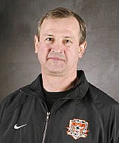








My Background

Slide 8

Get to know your neighbour!
Partner-up - FORM
  Family,
  Occupation,
  Recreation,
  MESSAGE – how you are connected
Find two connections and Introduce your new friend

Slide 9
Four Functions of Management
Planning - direction, goals, mission
Organizing - what, how, when, where things need to be done
Leading - directing and motivating
Controlling - monitoring activities
Achieve Organization’s Purpose

Slide 10
Time Functioning
First Middle Top
Leading 51 36 22
Organizing 24 33 36
Planning 15 18 28
Controlling 10 13 14
Mahoney etal., (1965) The Job(s) of Management.
Do you think this has changed?

Slide 11
Who are Managers?
Top
Middle Traditional
First-line Perspective
Operators
Hierarchy - many layers
Line
Staff

Slide 12
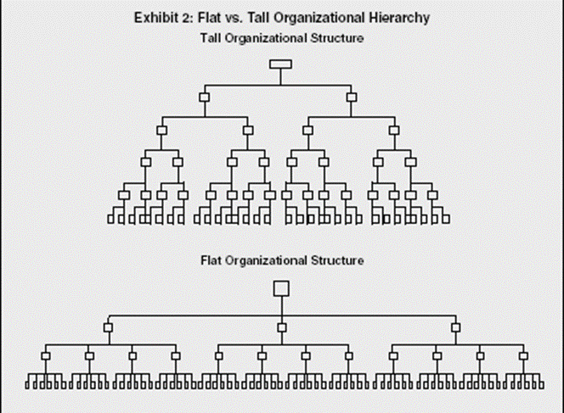
New world of work …
What different managerial skills might you need to develop with this change?
List 3
Chat with your neighbours

Slide 13
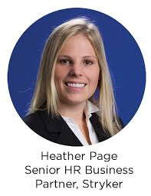
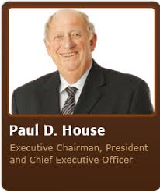
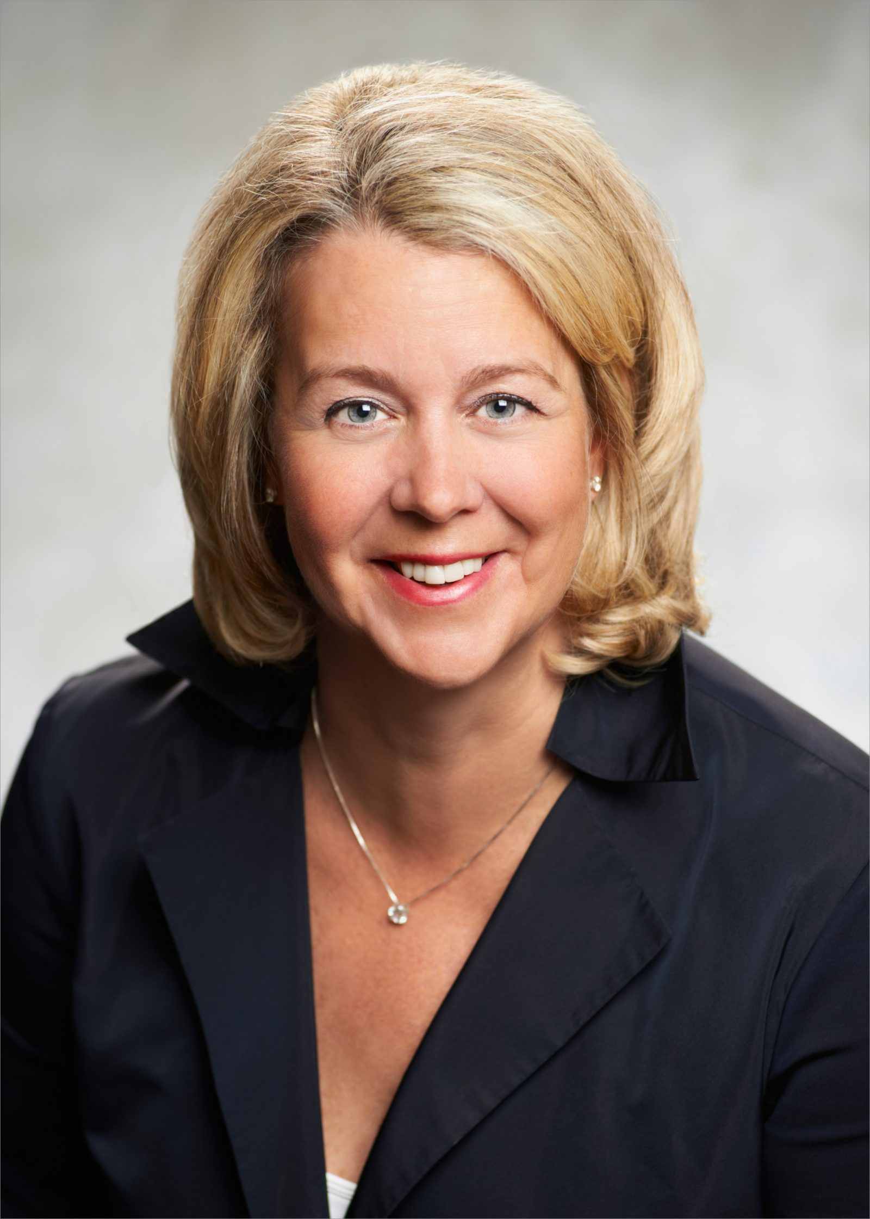
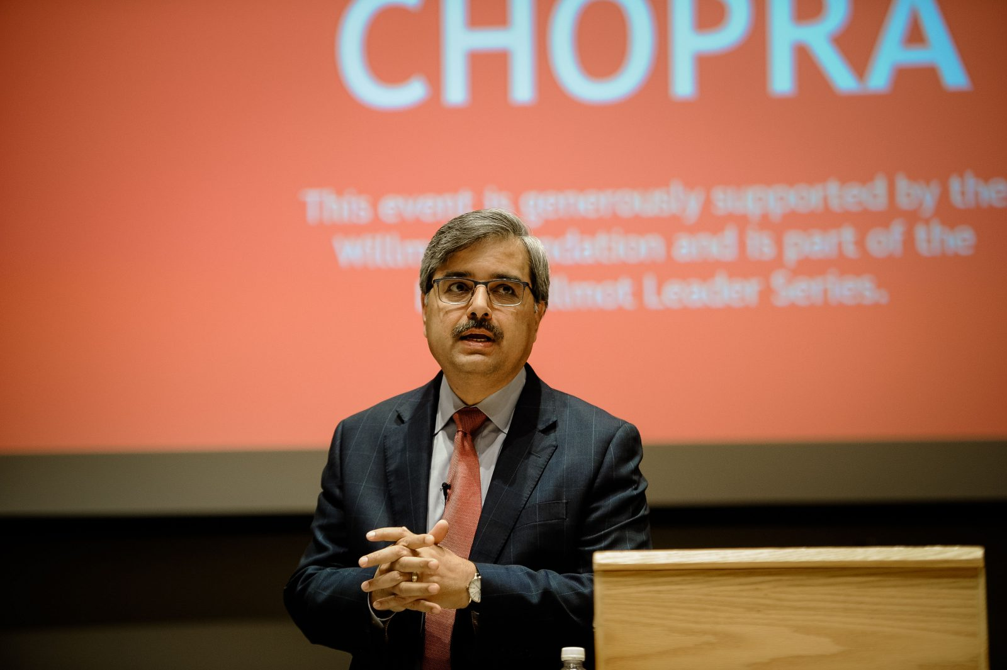
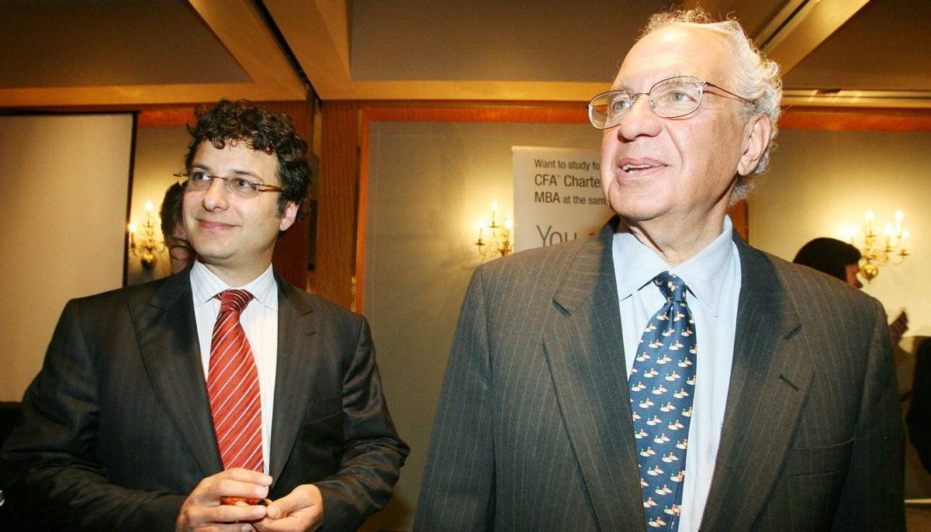
Reflection
My Best Manager
List his or her best attributes
Form a small group and share your list
Come up with a single list of best attributes

Slide 14
Essential Managerial Skills
  Skill — the ability to translate knowledge into action that results in desired performance.
  Technical skill — the ability to apply a special proficiency or expertise to perform particular tasks.
  Human skill (EQ) — the ability to work well in cooperation with others.
  Conceptual skill — the ability to think critically and analytically to solve complex problems.

Slide 15

The Future of Work
Find three things that are ‘interesting’ to you.

Slide 16

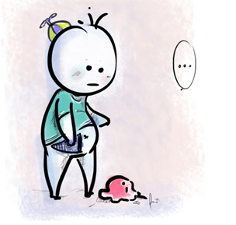
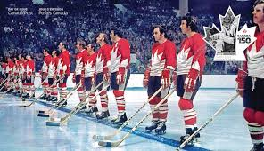
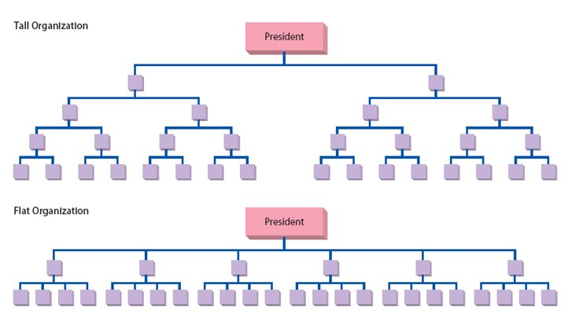



New Management
Purpose and Values (versus Rules and Regulations)
Team based (Smaller Units)
Empowerment (Flatter structures)
Self-Leadership
New power bases (Knowledge based)
Change Agents

Slide 17
Personal Survival Skills (1.1 Management Smarts)
Is this you?
Mastery – good at something
General – know a lot about a lot of things
aka Deep Generalist
Contacts – You need to know lots of people (networking)
Entrepreneurship – act like you are running your own business (opportunities)
Love Technology – embrace and utilize
Marketing – promote self, communicate
Passion for renewal – continuous learning

Slide 18
Who are the HOT new companies?
Small group task – come up with recent success stories (organizations)
Be prepared to share your group’s thoughts
What makes them Hot?
Are they sustainable? (do they have a sustainable competitive advantage?)

Slide 19
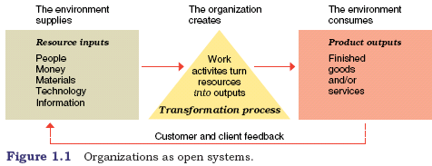
Organizations
As Open systems …
inputs, throughputs, outputs

Slide 20
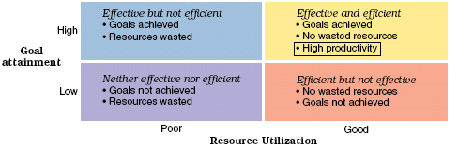
Organizations
As being Efficient and Effective

Slide 21
Mini Case
You have just been hired as the new head of an audit team for a national accounting organization. With your experience, you feel technically prepared however this is your first appointment as a manager. There are 12 members on the team of diverse demographic and cultural backgrounds, as well as work experience. This is intense workload and lots of performance pressure. How will you manage the team to successfully achieve high levels of performance?

Slide 22
Answer Format
Brief Summary (use business language)
Problem Statement … one line!
Theories (helpful to generate options or support BEST)
Three options – must be good ones!
Best (based upon criteria) – support your choice
Action Plan (30/6/2)

Slide 23

Next Day
Purchase Text
Read:
  Chapters 1: Dynamic New Workplace;
  Chapter 17:Team Work (p. 325)
    Read Case p. 404
    Be prepared to answer Q 1, 2, 5
Complete: One page summary
Prepare to Form into a Group of FIVE people

