Slide 1
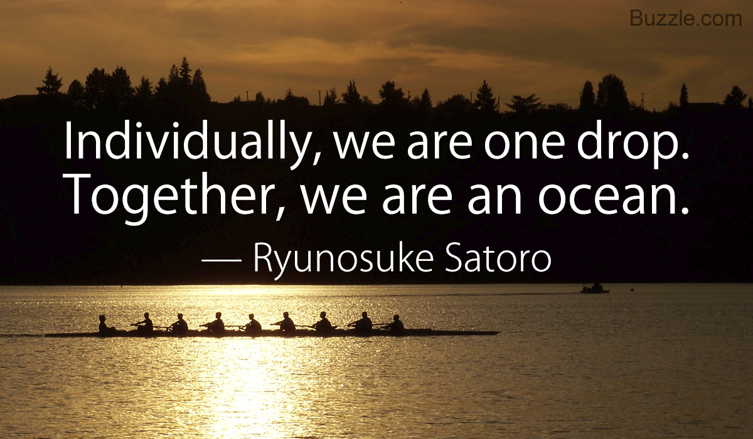
Team Work

Slide 2
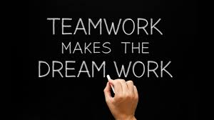
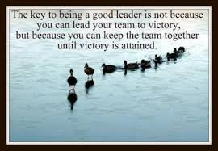
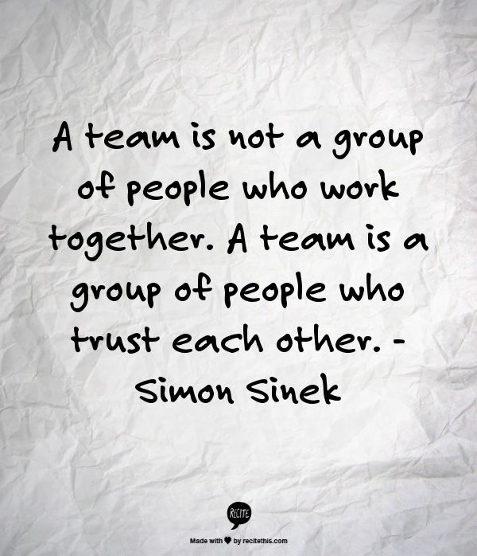
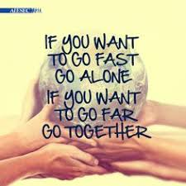
Check - In
Questions?
Personal Reflection – in the moment.

Slide 3

Agenda: Topics
Purpose
Build Teamwork Skills
How
Stand on the shoulders of giants:
  Review Team Research
  Summit Series
What
Form Teams
Draw from the Themes – Draw from your Wisdom – Draw from each Other
28-8 Teammates

Slide 4
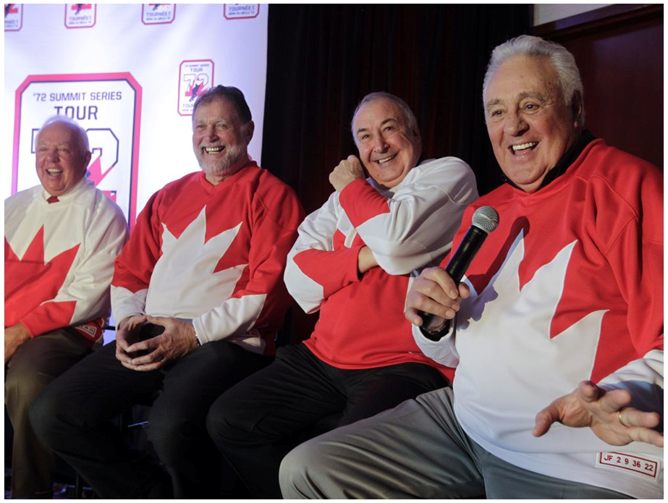
Personal Experience with Teams
Good things …
Less Good things …

Slide 5
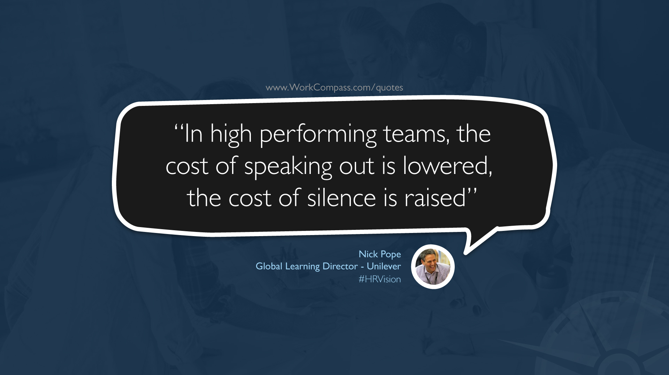
Task:
As we review ‘teamship’ research, come up with your 3 BIG Insights.

Slide 6
Stages of Group Development
Forming
  The first stage in group development, characterized by much uncertainty
Storming
  The second stage in group development, characterized by intragroup conflict
Norming
  The third stage in group development, characterized by close relationships and cohesiveness
Performing
  The fourth stage in group development, when the group is fully functional
Adjourning
  The final stage in group development for temporary groups, characterized by concern with wrapping up activities rather than task performance
Notes:
This material is found on page 164-165.

Slide 7
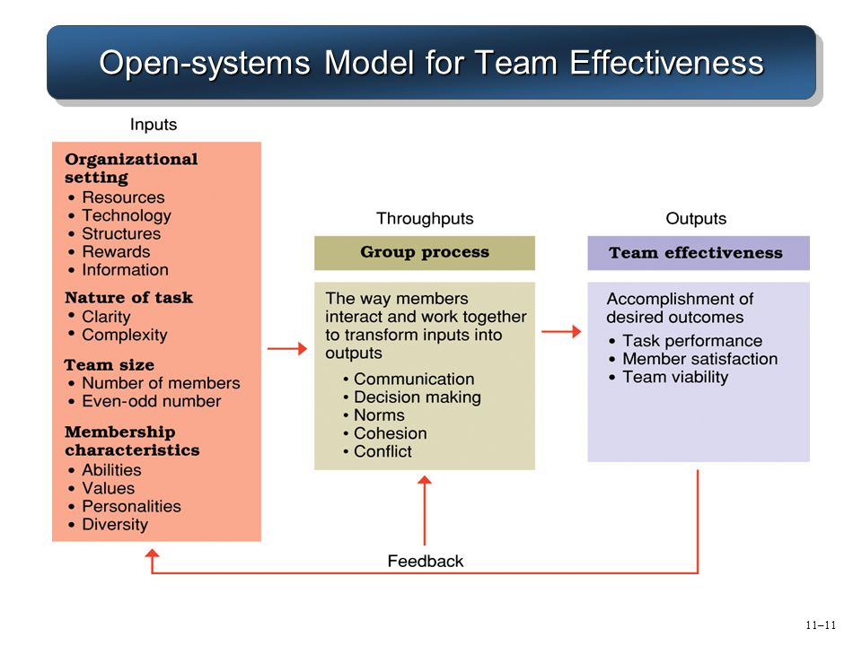
Open-systems Model for Team Effectiveness
Old but good – McGrath, 1964

Slide 8
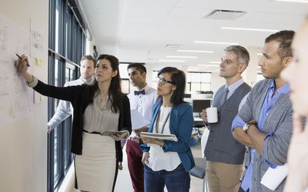
Norms and Conformity
Roles = a set of expected behaviours
  we all play multiple roles each day;
  List several roles you play …
Norms = acceptable standards shared by a group’s membership
Describe “norms” of …
  hockey teams
  dining for the first time at your friend’s parents place
  Boxing Day sales
  a university class

Slide 9
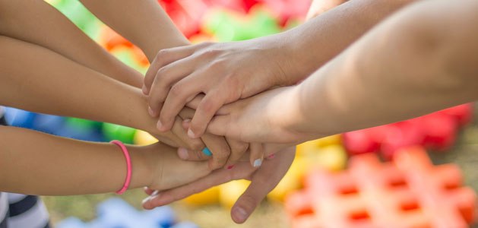
Business Norms
What cues do business organization give concerning their norms?
Tend to focus on effort and performance
Example: Solomon Asch and group conformity

Slide 10
Interaction of Norms and Cohesiveness on Performance
Performance
High
Medium
High
Perf.
Norms
Lowest
Low
Low
Low
Cohesiveness
High

Slide 11
Motivation
Why we work determines how we work.
Play is when you are motivated by the work itself.
Purpose is when the direct outcome of the work fits your identity.
Insight: Explain the why (for me and we)

Slide 12
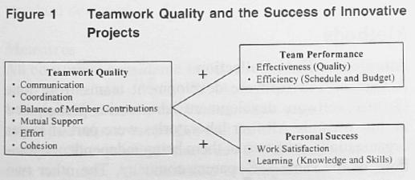
Team Research: Interactions
Quality of interactions: Most valued team skills include: active listening, collective problem solving, taking responsibility, giving positive feedback plus …

Slide 13
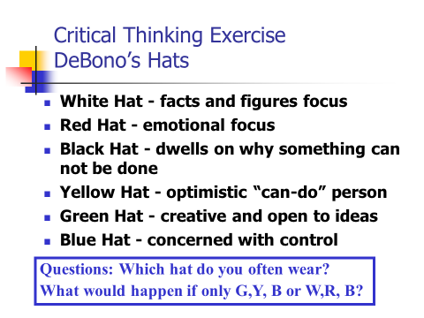
Group Decision Making
Factors
Member Status
Conflict Orientation
Group think
  contrary minded
Group shift
  riskier decisions

Slide 14
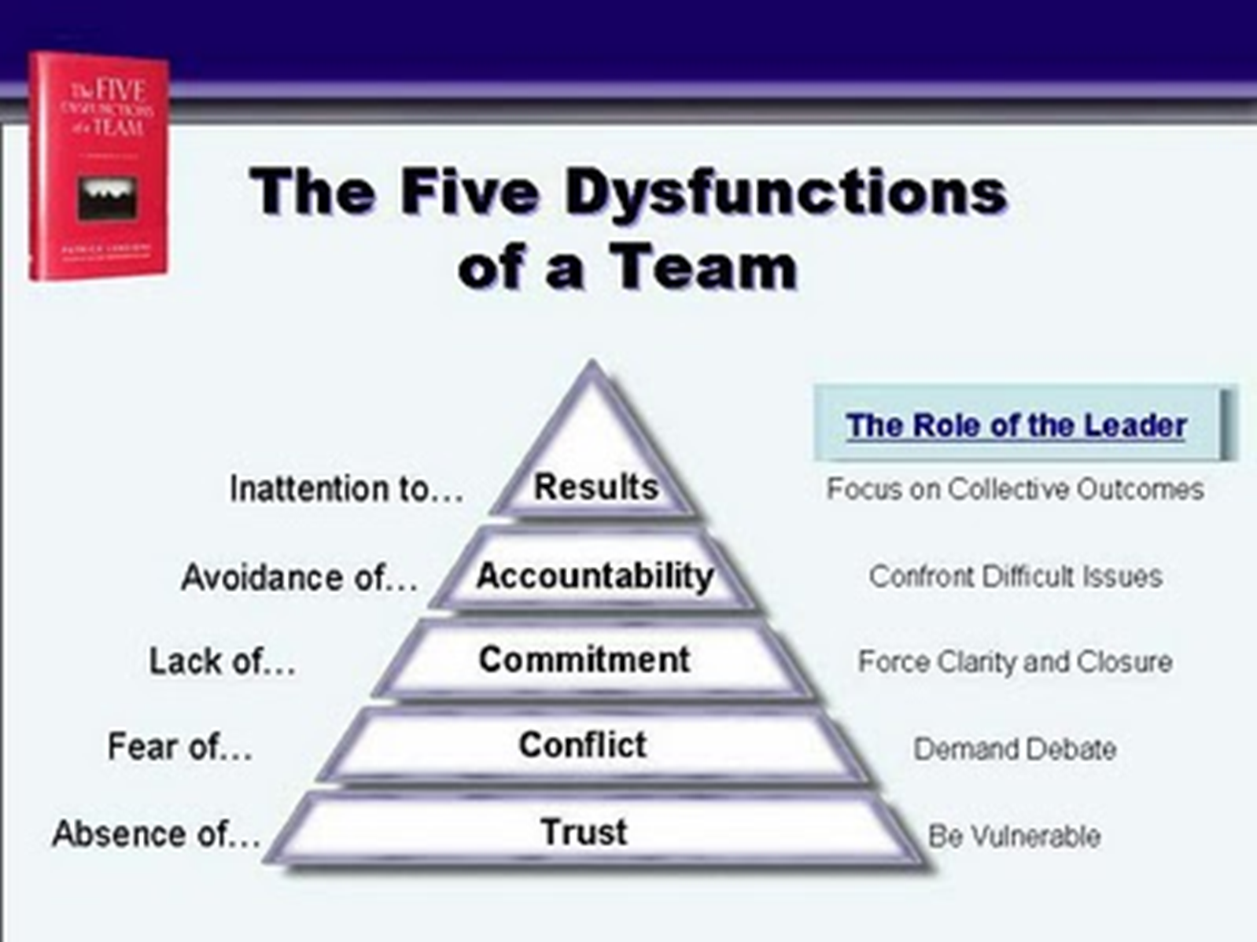
Team Research: Dysfunctions
Dysfunctional: 70% of workers say they have been on dysfunctional teams as a result of:
  absence of trust,
  high conflict,
  lack of commitment,
  low accountability,
  inattention to results

Slide 15
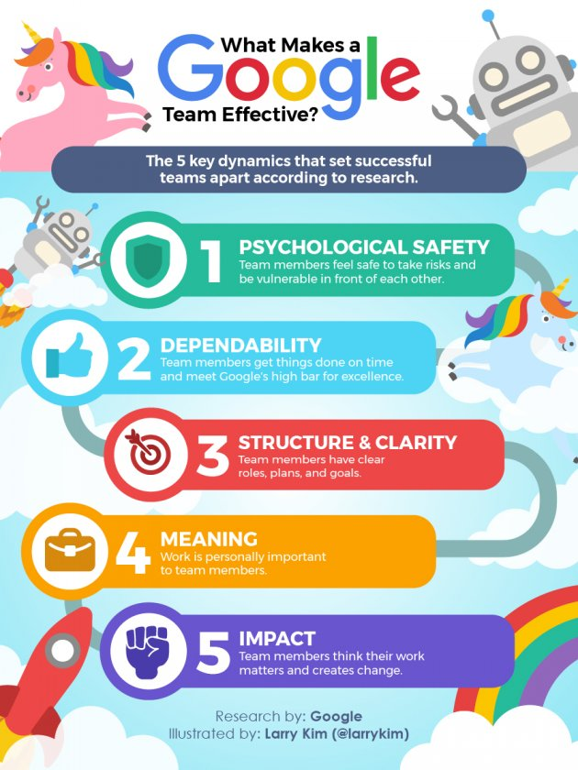
Team Work:
What might we learn from Google?

Slide 16
Summary
Your BIG Insights on ‘Teamship’ Research?
Reflect, then BIG group Share …

Slide 17

Team 72 Canada
Case:
Questions
1) Stages of Group Development
2) Harry Sinden – Cohesiveness
3) Perceptions - Actions
“Everyone one of us guys, thirty-five guys who came out to play for Team Canada. We did it because we love our country and not for any other reason.” Phil Esposito

Slide 18
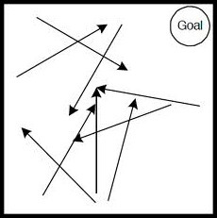
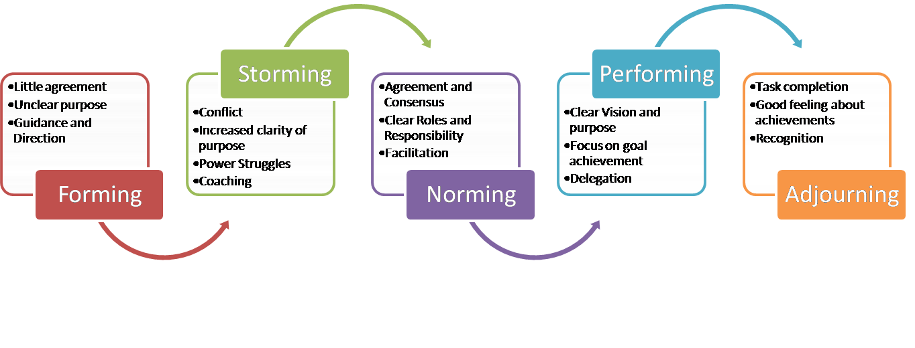
Theory (Tuckman) and TC 72
From Many to ONE
Finding Purpose
Playing to Win
Come Ready to Play
Overcoming Adversity: Can-do
Team
Chaos
Team Canada 1972

Slide 19
The Best Team Ever.
“Everyone one of us guys, thirty-five guys who came out to play for Team Canada. We did it because we love our country and not for any other reason.” Phil Esposito
In 1972 we overcame incredible adversity to emerge victorious.
To do so we had to become a team, not just a collection of talented individuals.
We have looked back and extracted the lessons learned to help organizations to unleash the Power of 28-8 Teamwork.

Slide 20
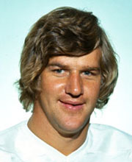
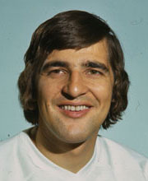
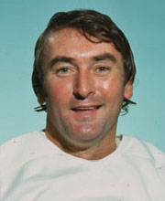

The Power of Teamwork is the Lasting Legacy of TC72
"What that team did, I don't think there has been a greater feat in sports. It was an unbelievable comeback against a great Russian team. I've never seen anything like it." Bobby Orr
"I was a member of nine Stanley Cup teams, but this was the greatest experience of my career." Serge Savard
"It turned out to be more than just a hockey series. A lot of pride came into play - pride in yourself, pride in your team, pride in your country." Ed Johnston

Slide 21
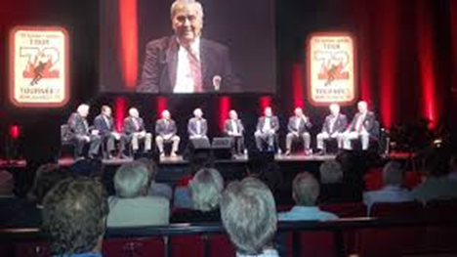
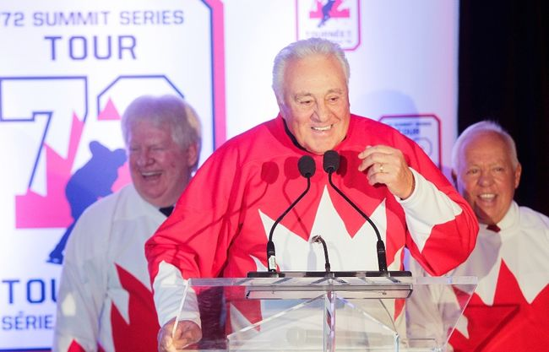
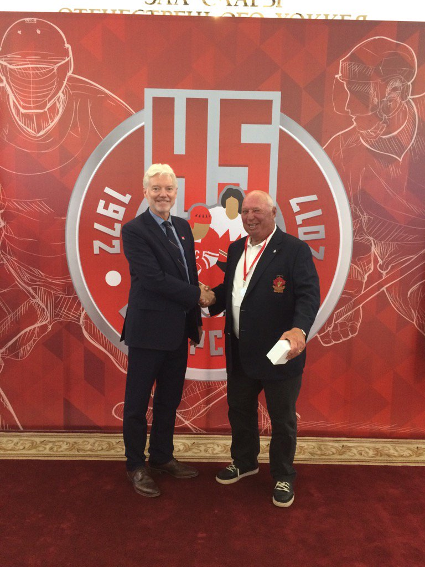
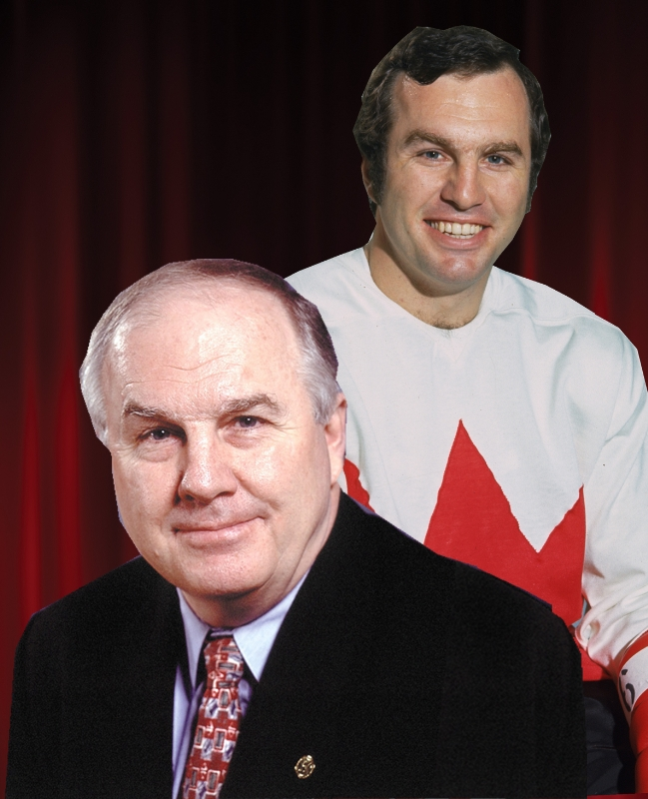
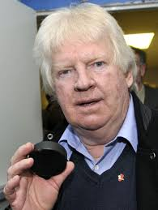
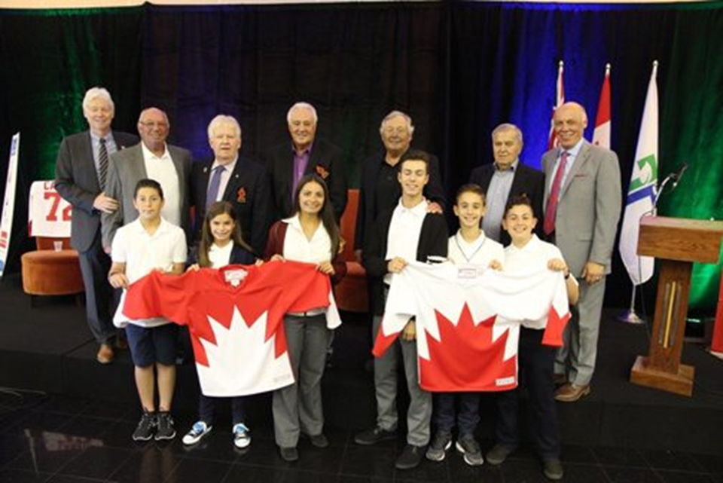
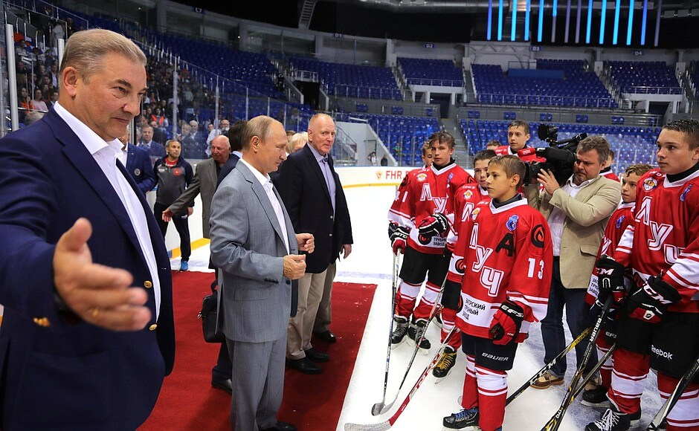
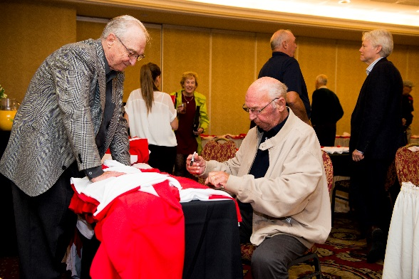
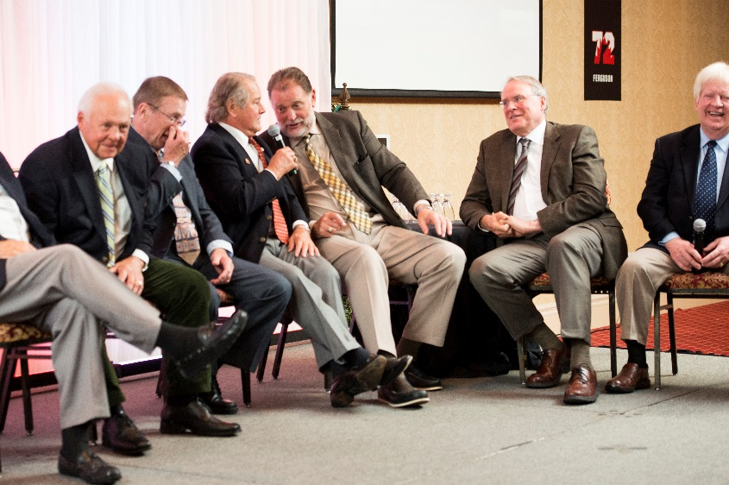
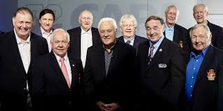

The Story behind 28-8
The Tour
The Proud Grad
The Call
The Puck
28-8 Legacy Program
The Start

Slide 22
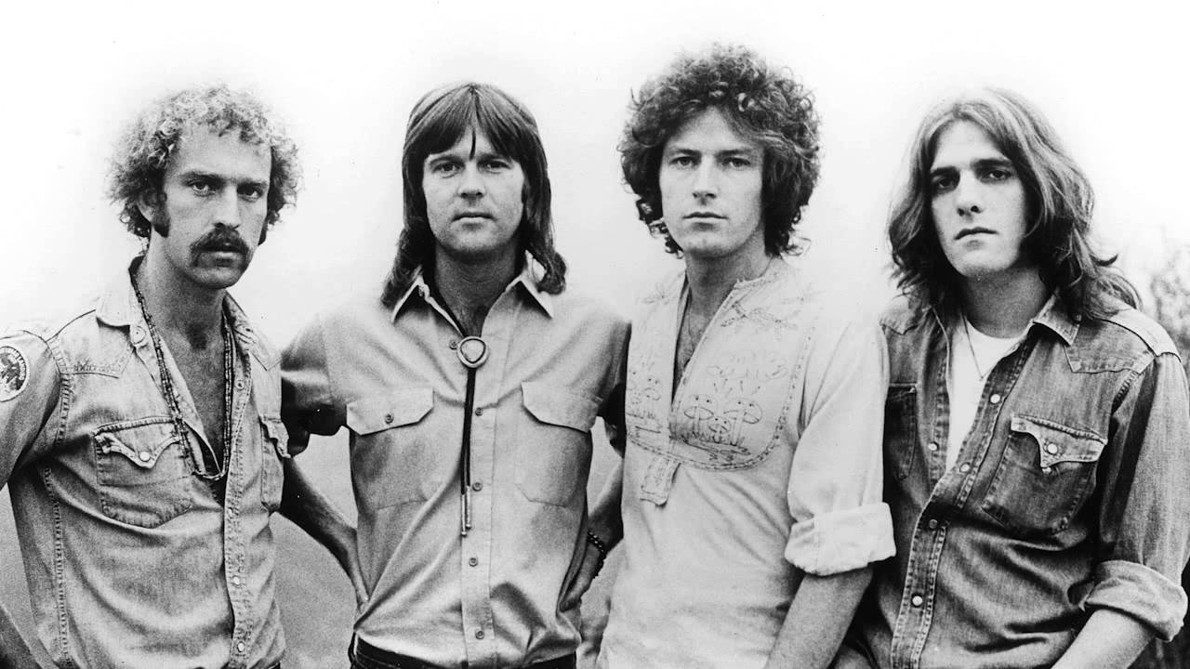
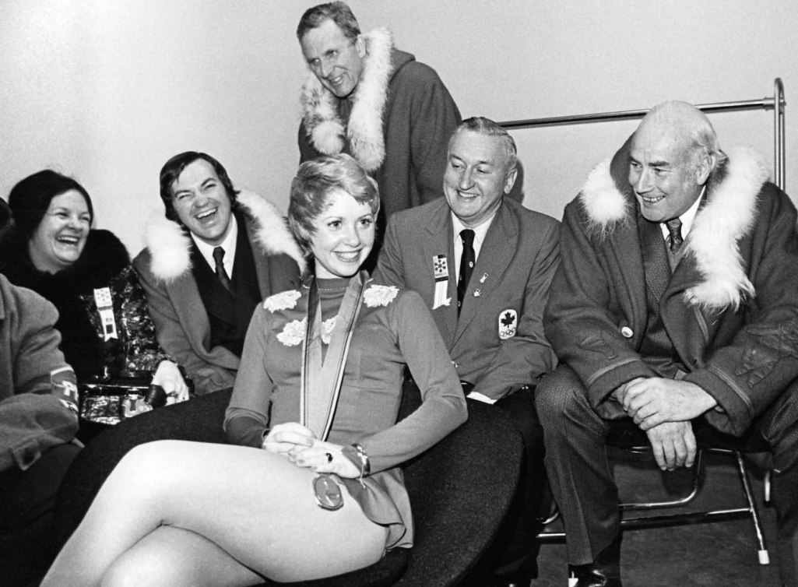
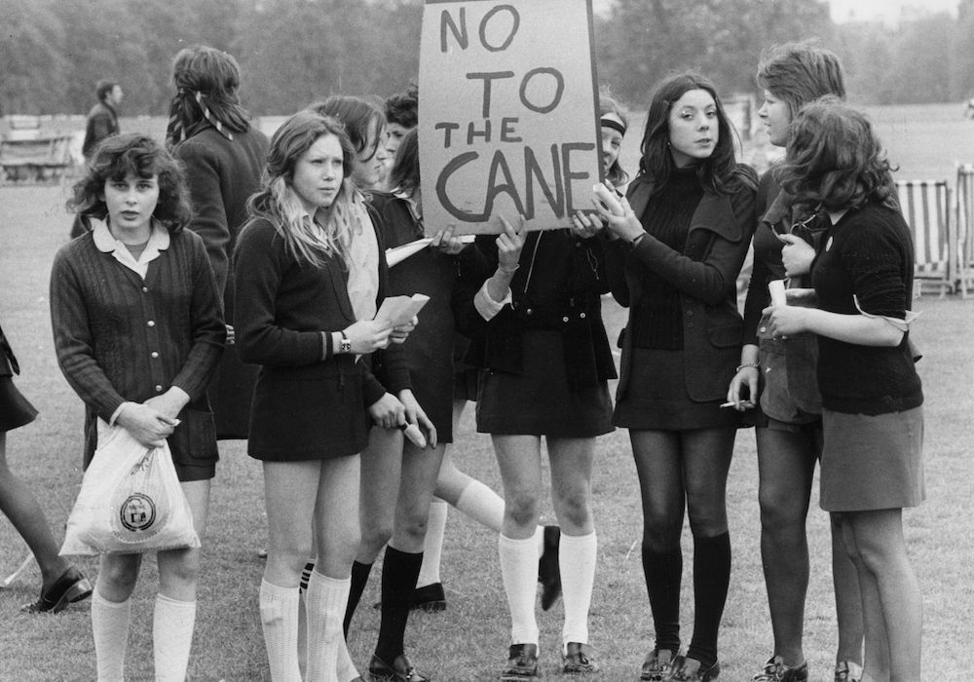
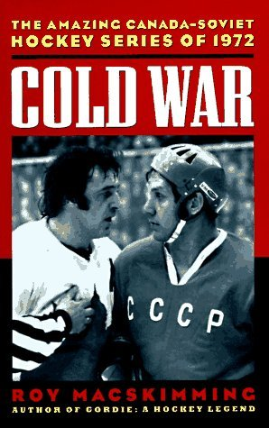
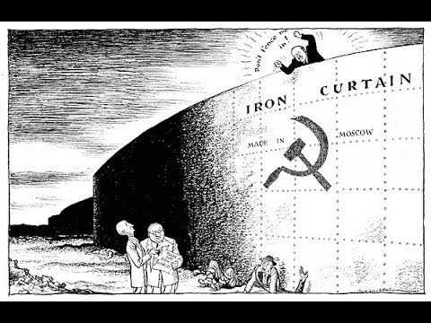
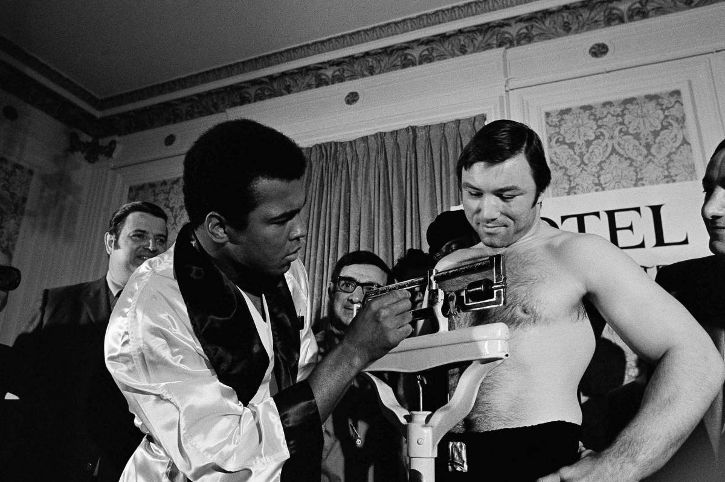
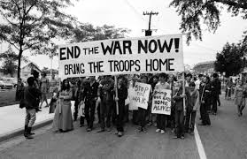
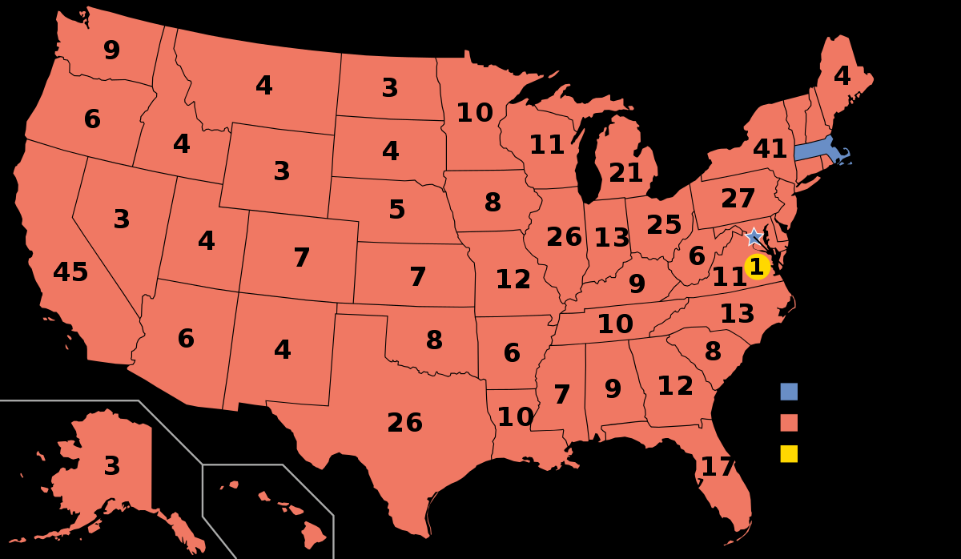
Set the Stage …

Slide 23
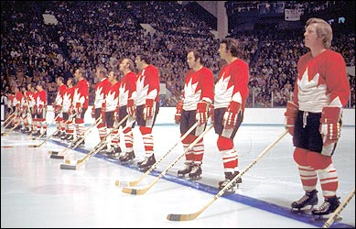
September 1972
Task:
Team Lessons Learned
Training Camp – Game 1
Games 2 – 3 – 4
Sweden and Moscow 5 – 6 – 7
Moscow 8 and Home

Slide 24
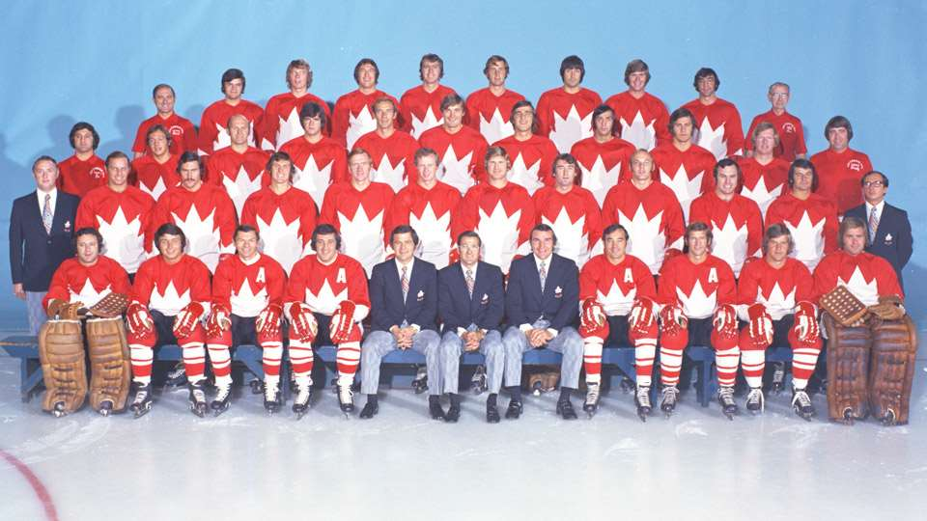
Team of the Century

Slide 25
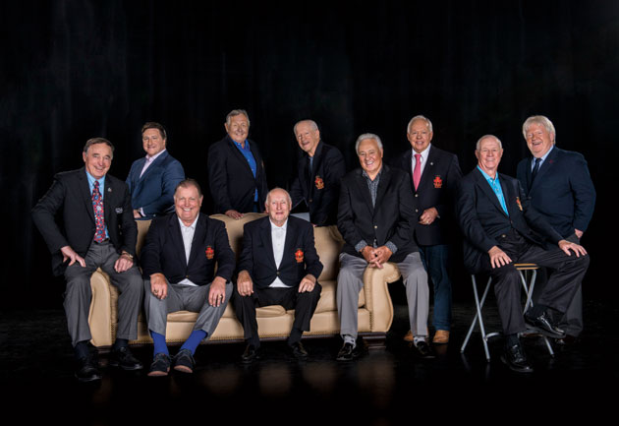


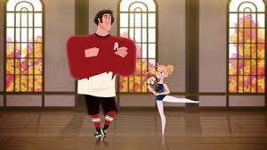
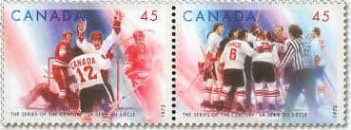
1999: Voted “The Team of the Century” by the Canadian Press/La Press Canadienne
2000: Team Canada 1972 Royal Mint Millennium Tribute Monument
2005: Team Canada 1972 is inducted into the Canada’s Sports Hall of Fame, the first team to be inducted into the Hall
2012: Presented with a Star on Canada’s Walk of Fame
2017: Canada Post honours Team Canada 1972
2017: Thirteen team members are recognized as members of the NHL’s Top 100 Players

Slide 26
Team Canada 72 Value Proposition
Come Ready to Play: Prepared, Engaged, Produce
From Many to ONE: Own Your Role PLUS Cohesion, Selflessness, Trust
Find Purpose: Ignite your O’Canada moment
Overcome Adversity: Perseverance, Grit, Passion
Playing to Win: 28-8 Teammates
The Team Canada 72 Teamwork Model will help you leverage the power of teamwork.

Slide 27
Come Ready to Play: Add PEP
Prepared: Understand that individually we need to Add Value; Draw from your Strengths; Have a Growth Mindset;
Engaged: Have non-negotiable daily routines; Span Boundaries – connect with others; (Recognize the challenge of The Bad Apple – start by looking at self)
Produce: Create a daily goal; We are all Responsible for our own Work Ethic; Positive Self-Talk;
Coach: Principled leadership.

Slide 28
Teamwork Time
Build on ‘Come Ready to Play’ theme
Take out your phone (aka camera)
FIVE minutes to take FIVE pictures that represent …
  A personal strength
  When you are at your best
  A learning point from today
  Area of personal challenge
  A creative Selfie

Slide 29
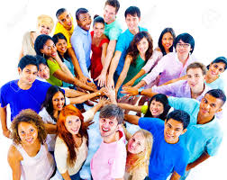
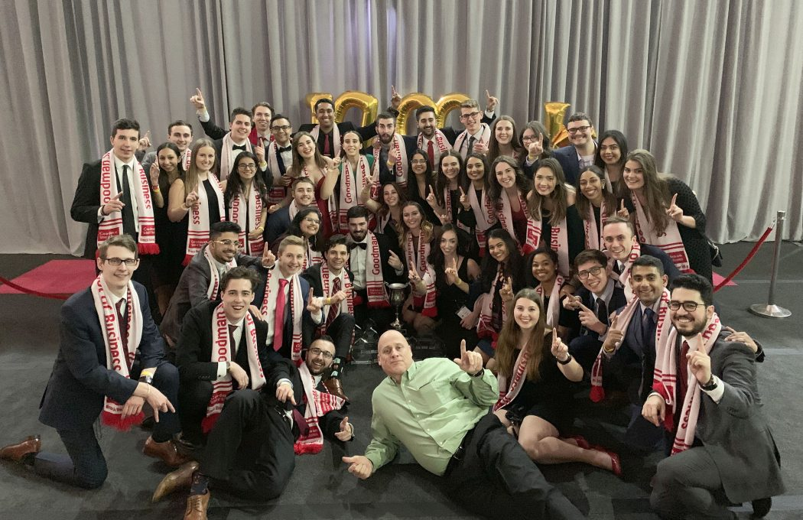

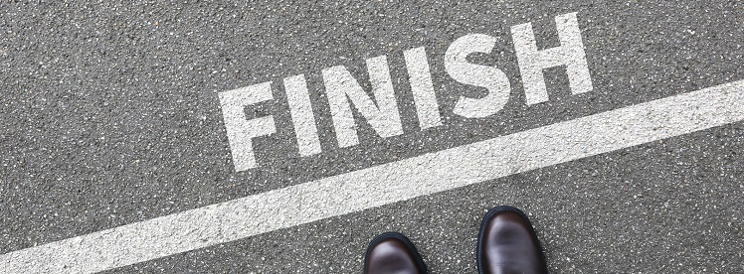
Come Ready to Play

Slide 30
From Many to One (Play the COST)
Cohesion/Build Belonging:
  Shared values and standards;
  Many lines of sight results in diversity of thought;
  Stronger together (individual stick versus bundle).
Ownership:
  Know and own your ROLE – play to your strengths;
  Focused on team performance norms (make a contract).
Selflessness/Build belonging:
  Dedicated to Team success;
  The best Team members anticipate the needs of one another;
  Continually communicate the Why.
Trust:
  Count on each other when it counts (DWYSYWD);
  High integrity always.
Coach: Building TEAM Culture by helping them perform a ‘Work with Excellence’ approach.

Slide 31
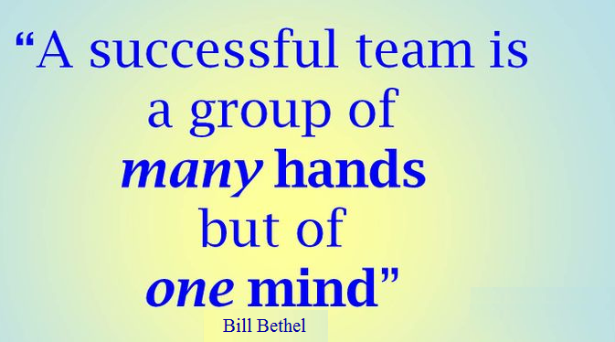
Teamwork time
Build on the “From many to One” theme.

Slide 32
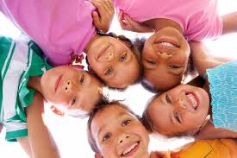

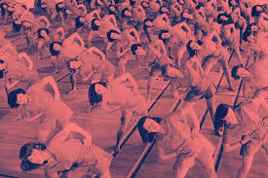

From Many to ONE
Team
Purpose

Slide 33
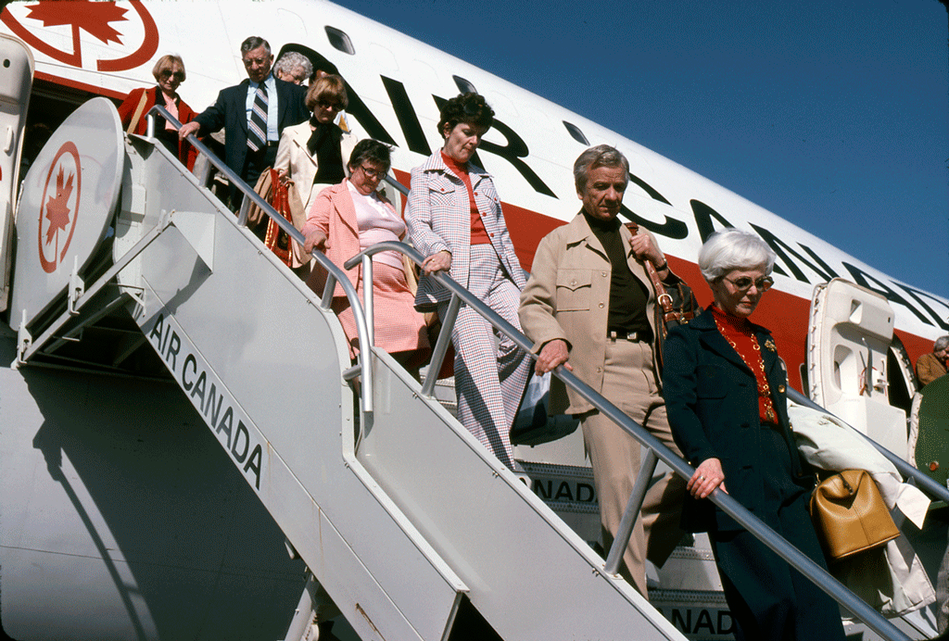
In September 1972, at the height of the Cold War, over 1,750 hockey fans from Canada fly to Moscow on a package tour offered by Air Canada to watch the remaining four Summit Series games at the Luzhniki Ice Palace. The package (offered in conjunction with Hockey Canada) includes transportation, accommodation and meals – and some of the best hockey ever played! On September 22, in game five, Canada led 4–1, but ended up losing 5–4. Despite the loss, all 3,000 Canadian fans sang the national anthem as Team Canada left the ice. Canada won the remaining three games in a row, to take the series.

Slide 34
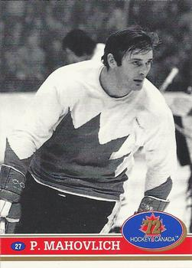


Find Purpose
TC72: Playing for Canada
Igniting Purpose by finding the Catalyst (vision)
Coach: Find ways to Embrace the Catalyst (vision)

Slide 35

Overcoming Adversity: Can-Do Attitude
Grit: Everyone has a bad day; Get up; Surgite.
Perseverance: Scoreboard – adjust when we know where we stand (results driven).
Passion: Self-talk; Team Talk – build each other up.
Coach: External support and encouragement.
Time for an EE

Slide 36

Teamwork time
Build on the “Overcoming Adversity – Can-DO” Theme.
10 different NHL cultures – fractured group
Underprepared physically nor emotionally – friendly series
Poor scouting reports
Different game – stick work, ice surface
Injuries
Booed on home ice; Ambassador name calling
Desertion – Strangers in a Strange land
Officiating – two referees (i.e. 31 versus 4)
Stolen food, early morning phone calls, bugged rooms
Broken promises

Slide 37

28-8 Teammates: Playing to Win

Slide 38


Added Insight:
Draw upon the Power of Teams in Two, Three, Six or more… , Six, 37.
Stapleton and White
Ellis, Clarke and Henderson
Park, Savard, Esposito, Cournoyer, Hull, and Dryden

Slide 39
Team Canada 72 Value Proposition
Come Ready to Play: Prepared, Engaged, Produce
From Many to ONE: Own Your Role PLUS Cohesion, Selflessness, Trust
Find Purpose: Ignite your O’Canada moment
Overcome Adversity: Perseverance, Grit, Passion
Playing to Win: 28-8 Teammates
The Team Canada 72 Teamwork Model will help you leverage the power of teamwork.

Slide 40

The Power of Teamwork

Slide 41
Next Class
Questions?
Read and Hand-in One Pager on:
  Cpt. 2: Management Learning: Past to Present;
  Cpt. 3: Ethical Behaviour;

