Slide 1
Management
2: Past to Present (and Beyond)
3: Ethics
Present Like a Pro (time permitting)

Slide 2
Agenda
Questions
Group Assignment
Reflections
Chapter 2 – Past to Present
Chapter 3 – Ethics
Present like a Pro – “Commercial”
Next Day

Slide 3

Last Week
What was a ‘reflection’ point from last week for you?

Slide 4
Development of Major Management Theories
Development of Management Theories
Historical
Background
preclassical
contri-
butions
The Early Years
classical
theorists
The Early Years
human
resources
approach
The Early Years
quantitative
approach
Recent Years
integrative
approaches
Scientific
management
Operations
research
Process
Early advocates
General
administrative
theorists
Systems
Hawthorne
studies
Management
science
Contingency
Human relations
movement
Behavioral
science theorists
Notes:
Fig. 2-1 Development of Major Management Theories
Management has been evolving for thousands of years.
Management is a field that has only undergone systematic investigation, acquired a common body of knowledge and become a formal discipline of study, in the past several hundred years and most particularly, in the last century.
Historical examples of contributors include Adam Smith (division of labor), the advent of the industrial revolution and the machine age, and the establishment of large business by such entrepreneurs as Carnegie and Rockefeller who helped to formalize management practices.
The classical theorists are divided into two groups:
SCIENTIFIC MANAGEMENT: Taylor and the “one best way” for a job to be done; the Gilbreths and their therbligs classification scheme; and Henry Gantt and his chart for managers used as a scheduling device for planning and controlling work.
GENERAL ADMINISTRATIVE THEORISTS: Writers who developed general theories of what managers do and what constitutes good management practice.
Henri Fayol developed 14 principles of management (p. 42) which he considered to be universal truths of management that are shared by all managers in all type of organizations and that can be taught in school.
Max Weber developed a theory of the bureaucracy, an ideal type structure
(p. 43). Like scientific management, it emphasizes rationality, predictability, impersonality, technical competence, and authoritarianism. His “ideal type” can be used to describe many contemporary organizations.

Slide 5
Historical Background
Division of Labour
  Adam Smith (1776) - “The Wealth of Nations” Invisible hand of the market; also showed how division of labour could be successfully utilized
  Industrial Revolution - UK
  Henry Ford - “Fordism”

Slide 6
Classical Contributors
Scientific Management
  Frederick W Taylor -
  “ONE BEST WAY”
  Bethlehem/Midvale Steel
  Principles:
    1) Develop a Science for work
    2) Scientifically select, train, and develop workers
    3) Co-operate with workers to ensure all is done this way
    4) Divide work equally
  A “high” priced man - Schmidt

Slide 7
One Best Way
POINT - COUNTER POINT
Do you agree that there is “one best way” to do any job?

Slide 8
General Administrative Theorists
Professional Metaphor
Max Weber (1890s) - Bureaucracy;
Iron-cage of Rationality
Henri Fayol (1916) - 14 principles of Management
Mary Parket Follett (1933) - Spirit of compromise and co-operation

Slide 9
Human Resources Approach
Elton Mayo - Hawthorne Studies
Maslow – Hierarchy of needs
McGregor – Theory X and Y
Chester Barnard - “Functions of the Executive” - authority comes from willingness of subordinates to accept it.

Slide 10
Quantitative School
Post-WW 2
Numbers Driven
Operations management; TQM; Cost Accounting;

Slide 11
Contemporary Schools
Systems
  Ecology
Contingency School
  No universal answer
  Outcomes “depend” on certain things
Cultural School
  Organizational culture
Global Awareness
Knowledge Management
Evidence-Based MGMT

Slide 12
Next Metaphor??
Where is business heading now?

Slide 13

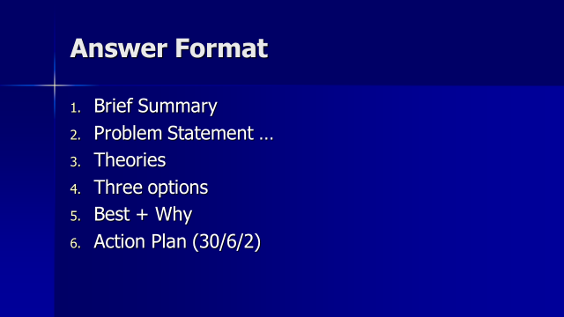
What would you do …
Great Idea
4 x 10 hours Vs 5 x 8
Boss from Missouri
How might you design a research study?
PS What school of thought is your boss?

Slide 14
Personal Management Moment
Lateral Thinking …
26 = L of the A
7 = D of the W
1001 = A.N.
12 = S of the Z

Slide 15
Chapter 3: Study Questions
What is ethical behavior?
How do ethical dilemmas complicate the workplace?
How can high ethical standards be maintained?
What is corporate social responsibility?
How do organizations and governments work together in society?

Slide 16
What is Interesting?
Stand-up.
Walk around to you find someone who had a different ‘interesting’ point from Chapter 3.
Chat with them about it and, also, what their other interesting point was for the chapter.

Slide 17
Heinz’s Dilemma
A woman was near death from a special kind of cancer. There was one drug that the doctors thought might save her. It was a form of radium that the druggist in the town had discovered. The drug was expensive to make, but the druggist was charging 10 times the price (he paid $200 but charges $2000). The sick woman's husband – Heinz went to everyone to borrow the money but all he could raise was $1000. He told the druggist that his wife was dying and asked him to sell it cheaper or let him pay later. The druggist refused. So, Heinz grew desperate and began to think about breaking into the store to steal the drug.

Slide 18
Answer the following questions Y/N
Would it be alright for Heinz to steal the drug?
Did the druggist have the right to charge that much for the drug?
Did Heinz have an obligation to steal the drug for his wife?
What if he and his wife did not get along?
Suppose it was not his wife but his best friend?
Suppose if was someone that was just an acquaintance? Or read about the women in the paper?
Would it be OK to steal to save his life?
Suppose he was caught breaking in – should he go to prison?

Slide 19
What is ethical behavior?
Ethics
  Code of moral principles.
  Set standards of “good” and “bad” or “right” and “wrong.”
Ethical behavior
  What is accepted as “good” and “right” in the context of the governing moral code.

Slide 20
What is ethical behavior?
Law, values, and ethical behavior:
  Legal behavior is not necessarily ethical behavior. (Examples?)
  Values help determine individual ethical behavior.

Slide 21
What is ethical behavior?
Utilitarian view of ethics — greatest good to the greatest number of people.
Individualism view of ethics — primary commitment is to one’s long-term self-interests.
Moral-rights view of ethics — respects and protects the fundamental rights of all people.
Justice view of ethics — fair and impartial treatment of people according to legal rules and standards.
Where you stand determines your view

Slide 22
Defining Issues
A man has been sentenced to prison for 10 years. After one year, however, he escaped from prison, moved to a new area of the country, and took on the name of Thompson. For eight years he worked hard and gradually he saved enough money to start his own business, He was fair to his customers, gave his employees top wages, and gave most of his profits to charity. Then one day, Mrs. Jones, an old neighbour, recognized him as the man who had escaped from prison 8 years before and whom the police had been looking for.
Should Mrs. Jones report him to the police and have him sent back to Prison?
Should report him Can’t decide Not report him

Slide 23
Importance
1 = great importance 2 = of much importance, 3 = of some importance,
4 = of little importance 5 = of no importance
Hasn’t he been good enough for a long time now?
Every time someone escapes punishment doesn’t that encourage more crime?
Wouldn’t we be better off without the oppression of prisons?
Hasn’t he paid his debt to society?
Would society be failing to be fair with Thompson?
What benefit would going back to prison serve?
How could anyone be so cruel to send him back?
Would it be fair to other prisoners who served their full sentence?
Was Mrs. Jones a good friend to Thompson?
Isn’t it a citizen’s duty to report escaped prisoners?
How would the public be best served?
Would prison do any good for Mr. Thompson?

Slide 24
What is ethical behavior?
Kohlberg
Obedience and punishment – deference to superior power
Egotistical orientation – self needs
Good boy orientation – pleasing/ helping others
Doing duty – respect for authority
Legalistic – avoidance of violation of rights
Principle orientation – to social rules but also principles of logic and consistency

Slide 25
Importance
1 = great importance 2 = of much importance, 3 = of some importance,
4 = of little importance 5 = of no importance
Hasn’t he been good enough for a long time now? 3
Every time someone escapes punishment doesn’t that encourage more crime? 4
Wouldn’t we be better off without the oppression of prisons? (anti)
Hasn’t he paid his debt to society? 4
Would society be failing to be fair with Thompson? 6
How could anyone be so cruel to send him back? 3
Would it be fair to other prisoners who served their full sentence? 4
Was Mrs. Jones a good friend to Thompson? 3
Isn’t it a citizen’s duty to report escaped prisoners? 4
How would the public be best served? 5
Would prison do any good for Mr. Thompson? 5

Slide 26
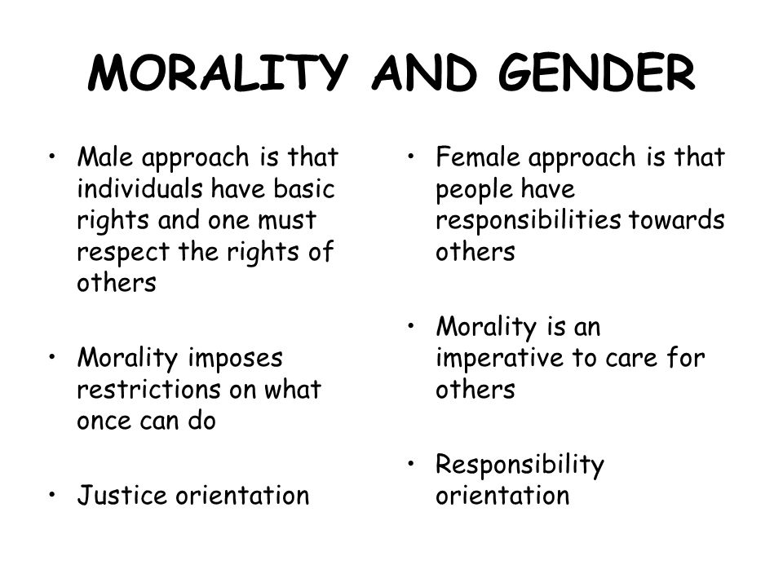

In a different VOICE

Slide 27
What is ethical behavior?
Cultural issues in ethical behavior:
  Cultural relativism
    Ethical behavior is always determined by cultural context.
  Cultural universalism
    Behavior that is unacceptable in one’s home environment should not be acceptable anywhere else. (What is a tip?)

Slide 28
How do ethical dilemmas complicate the workplace?
An ethical dilemma occurs when choices, although having potential for personal and/or organizational benefit, may be considered unethical.
Ethical dilemmas include:
  Discrimination
  Sexual harassment
  Conflicts of interest
  Customer confidence
  Organizational resources

Slide 29
A supplier sends a basket of expensive foodstuffs to your home at the Holiday season with a card: "We hope you and your family enjoy the goodies”. What action(s) might you want to take?
The purchasing manager for a large company agrees to give you an order (their first), expecting you agree to make a $200 donation to his favorite charity, a local youth sports team. How do you respond?
You are in a head-to-head battle with your arch competitor, Evil Enterprises. One of your co-workers approaches you. He has recently joined your company after having worked for that competitor for several years. He suggests, "I made notes on all of Evil's bids when I could get the data. They use some clear cost standards. Would you like me to bring my notes to the office tomorrow and let you look through them?" How do you respond?

Slide 30
How do ethical dilemmas complicate the workplace?
Ethical behavior can be rationalized by convincing yourself that:
  Behavior is not really illegal.
  Behavior is really in everyone’s best interests.
  Nobody will ever find out.
  The organization will “protect” you.
  How do you know? Take the: The Front Page Challenge.

Slide 31
How do ethical dilemmas complicate the workplace?
Factors influencing ethical behavior include:
  The person
    Family influences, religious values, personal standards, and personal needs.
  The organization
    Supervisory behavior, peer group norms and behavior, and policy statements and written rules.
  The environment
    Government laws and regulations, societal norms and values, and competitive climate in an industry.

Slide 32
How can high ethical standards be maintained?
Ethical role models:
  Top managers serve as ethical role models.
  All managers can influence the ethical behavior of people who work for and with them.
  Excessive pressure can foster unethical behavior.
  Managers should be realistic in setting performance goals for others.

Slide 33
How can high ethical standards be maintained?
Barriers to whistle blowing include:
  Strict chain of command
  Strong work group identities
  Ambiguous priorities
Organizational methods for overcoming whistle blowing barriers:
  Ethics staff units who serve as ethics advocates
  Moral quality circles

Slide 34
How can high ethical standards be maintained?
Codes of ethics:
  Formal statement of an organization’s values and ethical principles regarding how to behave in situations susceptible to the creation of ethical dilemmas.
Areas often covered by codes of ethics:
  Bribes and kickbacks
  Political contributions
  Honesty of books or records
  Customer/supplier relationships
  Confidentiality of corporate information

Slide 35
What is corporate social responsibility?
Corporate social responsibility:
  Looks at ethical issues on the organization level.
  Obligates organizations to act in ways that serve both its own interests and the interests of society at large.

Slide 36
What is corporate social responsibility?
Perspectives on social responsibility:
  Classical view—
    Management’s only responsibility is to maximize profits.
  Socioeconomic view—
    Management must be concerned for the broader social welfare, not just profits.

Slide 37
What is corporate social responsibility?
Arguments against social responsibility:
  Reduced business profits
  Higher business costs
  Dilution of business purpose
  Too much social power for business
  Lack of public accountability
Arguments in favor of social responsibility:
  Adds long-run profits
  Improved public image
  Avoids more government regulation
  Businesses have resources and ethical obligation
Recent examples?

Slide 38
What is corporate social responsibility?
Beliefs that guide socially responsible business practices:
  People do their best with a balance of work and family life.
  Organizations perform best in healthy communities.
  Organizations gain by respecting the natural environment.
  Organizations must be managed and led for long-term success.
  Organizations must protect their reputations.

Slide 39
Next Day
Service Learning Project Discussion
Planning (cpt 8) and Strategy (cpt 10)
Two and One participation
Team Contract due next week

