Slide 1
Experiential Education

Slide 2
Experiential Learning in Goodman
Connecting students with community partners in a variety of ways
  Service-Learning
  Live Case Studies
  Simulations
  Field Courses
The goal is to provide students with a hands-on approach to learning with relevant projects and experiences.
Experiential can take on different forms depending on which program/course you’re in.

Slide 3
What Students report getting out of Experiential Projects
Students report:
Work experience on my resume.
Have a new understanding of services in my community.
Have a better understanding of course material
Have something I could speak about in a job interview about how I have applied my business skills.
Feel good knowing I made a difference for a community serving organization.
I’m more motivated by this type of project.

Slide 4
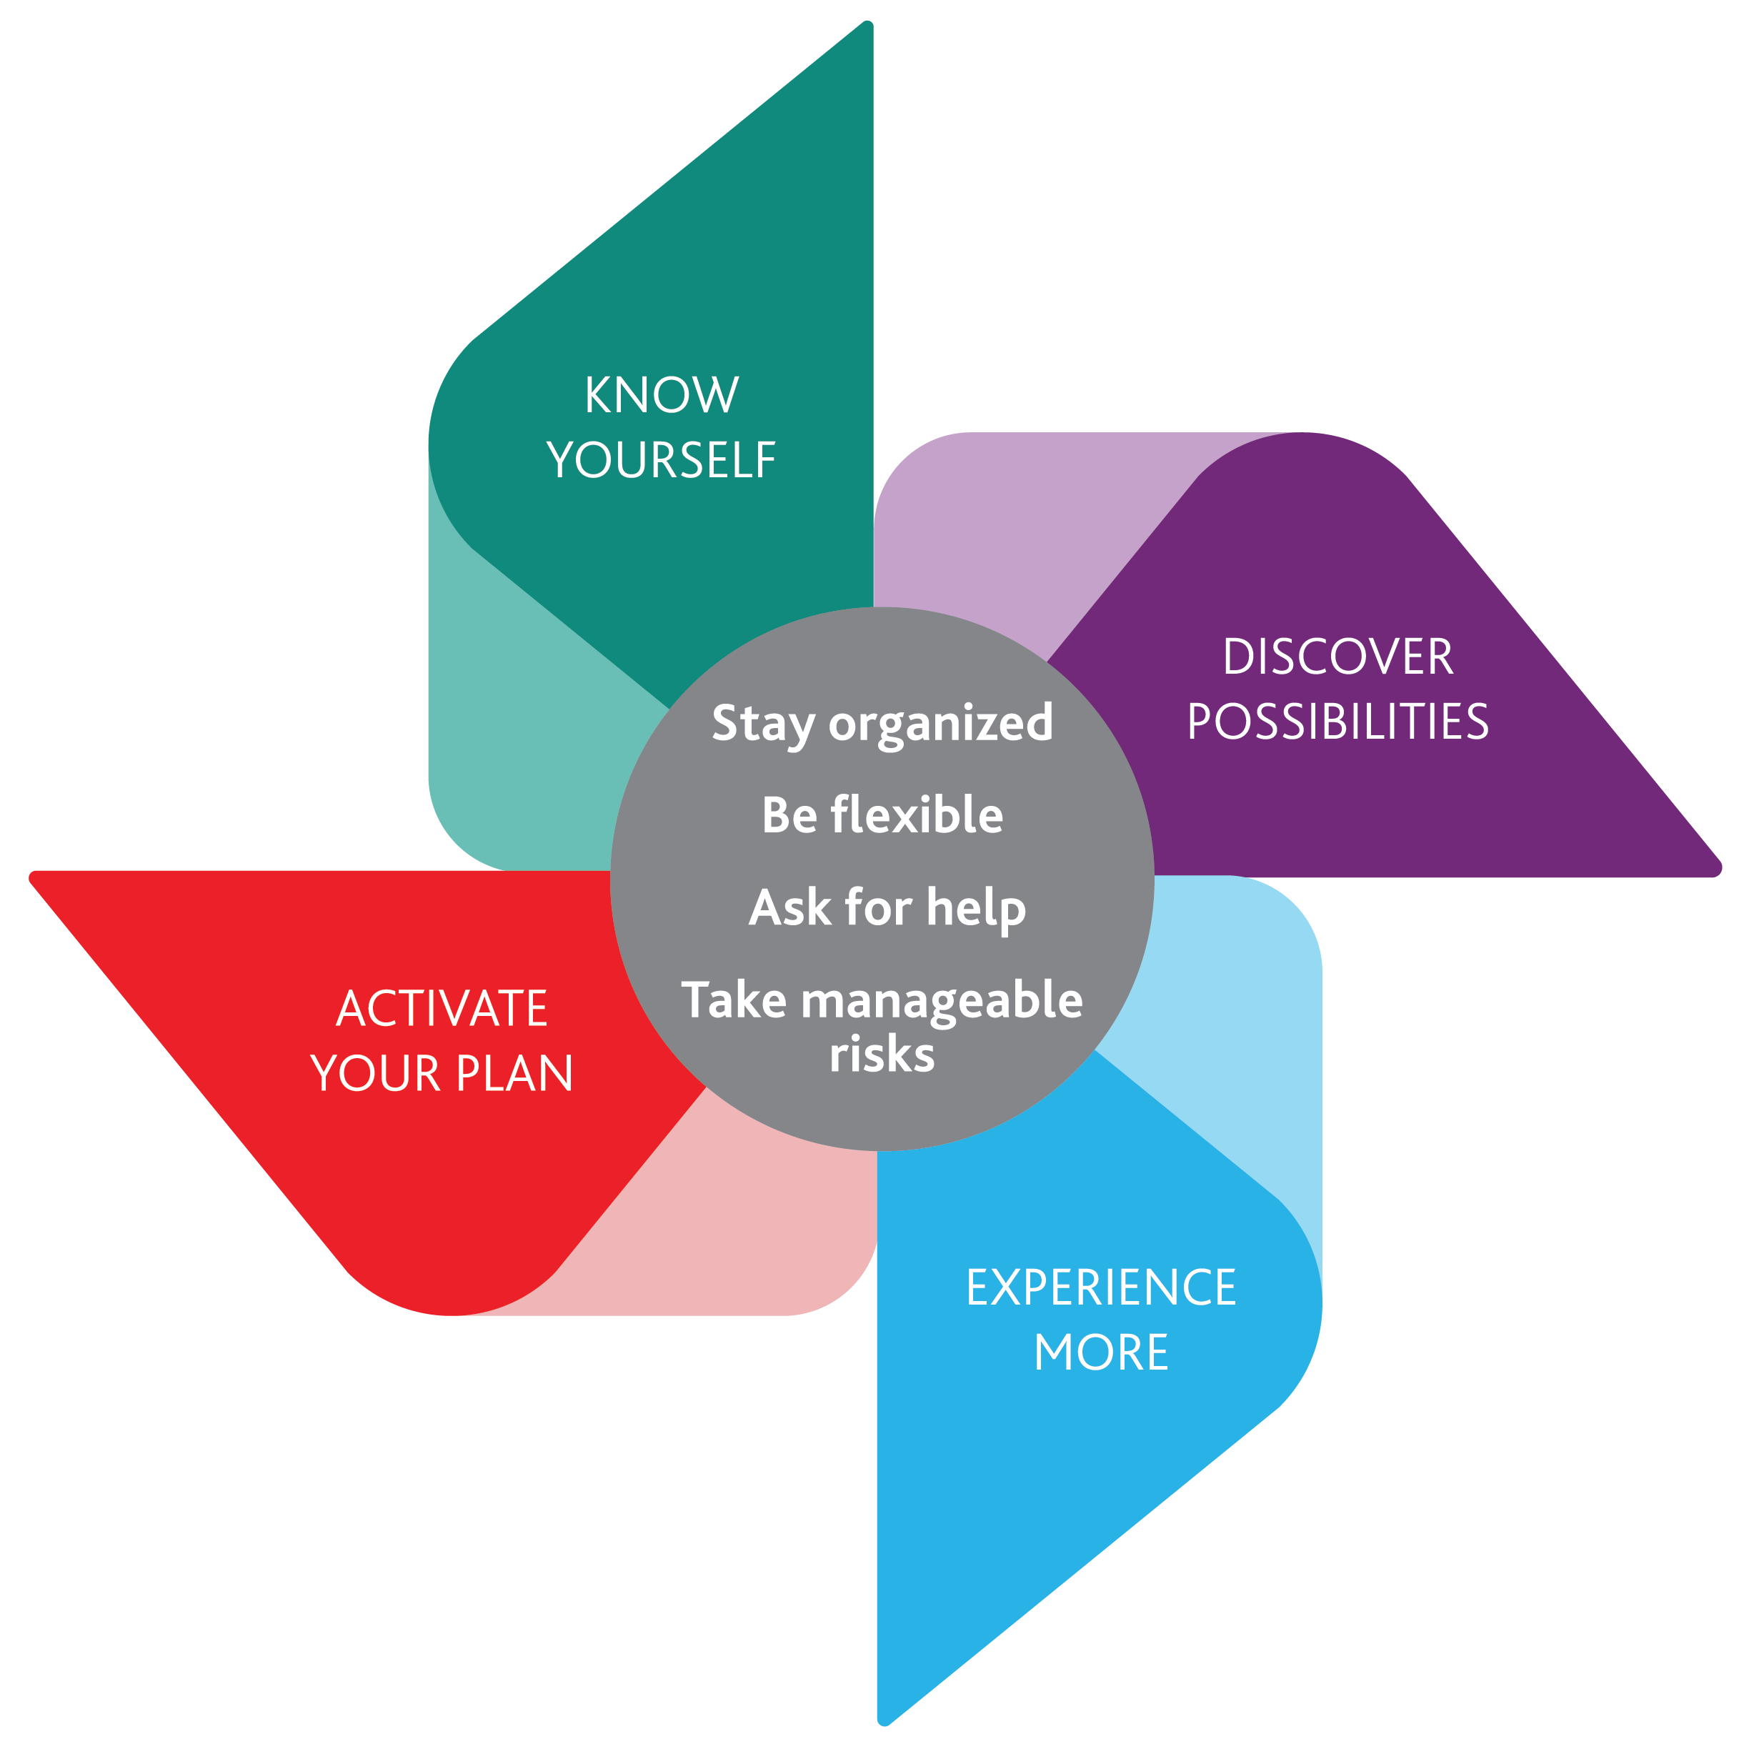
CCEE Career Model – Experiential and your Career
How can you develop your own…
Curiosity – explore new learning opportunities
  Career path exploration, engaging with your course material in a new way.
Persistence – make an effort despite setbacks
  Use problem solving when dealing with roadblocks.
Flexibility – be flexible to changing attitudes and circumstances.
  Adaptability in your team and with your community partner.
Optimism – consider new opportunities as possibilities and achievable
  View this opportunity as a semester long interview.
Risk Taking – take action even in uncertain situations.
  See opportunities beyond your project for employment.
Notes:
Community Partners for Experiential projects are also co-op, summer job and career employers.
Experiential projects are a great way to showcase your skills to a community partner that may be interested in hiring.
View this experience as semester long interview.
If you see the opportunity to continue working with your community partner. Let us know!
Three students obtained full-time positions as a direct result of their projects last year.

Slide 5
Experiential & Your Portfolio
Showcasing your experiential project on your resume/LinkedIN is a great way to differentiate yourself from other job applicants.
It is important to list these experiences appropriately.
  Please refer to the documents on Sakai before you list any of your experiences.
Highlight the skills that employers are looking for.
If you are unsure, please reach out to the experiential team to review before you finalize.
Utilize the career resources on campus!
  Goodman Career & CareerZone

Slide 6
Agenda
Project description & Timeline
Communication Strategies
3 experiential hang ups/roadblocks
Drop-in session
Community Partner(s)

Slide 7
Project Description
Project Description
Your group’s objective is to present a detailed diagnosis of how the organization, with its distinct capabilities should navigate its HR resources (e.g., human capital, intellectual capital, social capital, knowledge, etc.) to deal effectively with the HR challenge that was identified and selected.
Presentation of solution to Client and Professor
Final report – To be given to your community partner.
Final step – Self Assessment

Slide 8
Timeline
Experiential Introduction – Today
Community partner visit – Today
Bring NDA package – Next Wednesday (Jan 30th)
Team Contract – Feb 6th
Progress Presentation – March 6th
Final presentations – April 3
Additional time to contact/meet with your community partner to be determined.

Slide 9
Communication strategy
CHALLENGE: Many of our community partners have multiple teams.
Single point of contact for the team
  Someone who regularly checks email
Team ID in email subject
  Eg. “Project Name – Team Name” Not just once… but every time you email
  Continuous email stream… explain the strategy to client so they understand the importance too
First email
  Introduce the team + meeting goals
  Give 2-3 potential dates/times for a site visit
Thank you email… details in project outline
Interim Report… summary of action plan in email body… attach full report
NOTE: not all team members must be present at client meetings but the workload needs to be balanced.

Slide 10
3 Project Concerns from Students: Go to whom for what?
        Connection to course Professor
        material
Concerns about Dan or David
team function
Community partner Dan or David
communication concerns

Slide 11

Service Learning: Willowbank
Lorri Gillanders – Board Member
Proprietor, Grace House B&B, Niagara-on-the-Lake, ON
Lorri Gillanders grew up in Niagara and attended the University of Waterloo in Systems Design Engineering. Her career has included positions of specific technology expertise, program and business management at IBM, Digital Equipment and Cisco Networks. The majority of Lorri’s professional experience was in Vancouver, where she was a member of the Vancouver Board of Trade and a successful Chairman of SDSS fundraising for DryGrad for 2 consecutive years. She briefly represented Cisco on the fundraising committee of the Board of the Vancouver Opera. Lorri considers her primary strengths to be in managing diverse businesses, and delivering programs on time/on budget. She sees as particularly important clear, effective communications. Throughout her career she has been successful in building strong teams, business planning and attaining financial targets. Lorri has always had a passion for architecture and building, and comes from a family of educators. She moved to Niagara on the Lake in 2014, bought and restored the Circa 1825 Grace House in the Old Town, where she currently runs a small bed and breakfast. Lorri is an avid cook, traveller, sailor, and terrible golfer.
Service Learning Task:
Creating a High Performance Team
Students / Staff / Board

Slide 12
Drop-in Presentation Session
Book a 15 minute consultation with EEC’s.
Run through your slides and receive feedback on your presentation skills/style.
Receive helpful tips about presentation day and pitching to your community partner.
Ask questions about formatting, presentation flow, team dynamics, slide style.
Registering for this session has no impact on your grade.
Sessions will run on Thursday, March 21st and Friday, March 22nd.
Registration will occur through CareerZone beginning on February 28th. Limited time slots available, book early.

Slide 13
Final Presentation Tips
Dress professionally
Try not to use notes if possible
Create a professional presentation
  Check for spelling errors, ensure your technology works
  Put your presentation on a USB – technology is unpredictable on campus!
Determine your group/presentation dynamic
Be a respectful audience member
  Do not go in and out while other groups are presenting

Slide 14
Extra Resources
Posted on Barry’s web page
  These slides
  Confidentiality Agreement & Team Contract
  Resume & LinkedIN Resources
  Career Action Plan Worksheet

Slide 15
Goodman Career Events
Exploring Careers in Accounting and Finance
Wednesday, January 23rd 5PM – 7PM
Grad Send-Off
Wednesday February 6th 1PM – 3PM
Register on Campus Career Events Calendar
Exploring Careers in Entrepreneurship
Wednesday, February 13th 5PM – 7PM
A Day in Toronto with Goodman Career
Friday, February 15th
Application Deadline is Sunday, January 20th
Details on Goodman Career Event Calendar and Goodman Career Job Board

Slide 16
Contact Info
David DiPietro
ddipietro@brocku.ca
Ext. 5933
Dan Lonergan
dlonergan@brocku.ca
Ext.5023
GSB 349
@BrockExpEd

