Slide 1
A-Team
FORM FamilyOccupationRecreationMessage

Slide 2
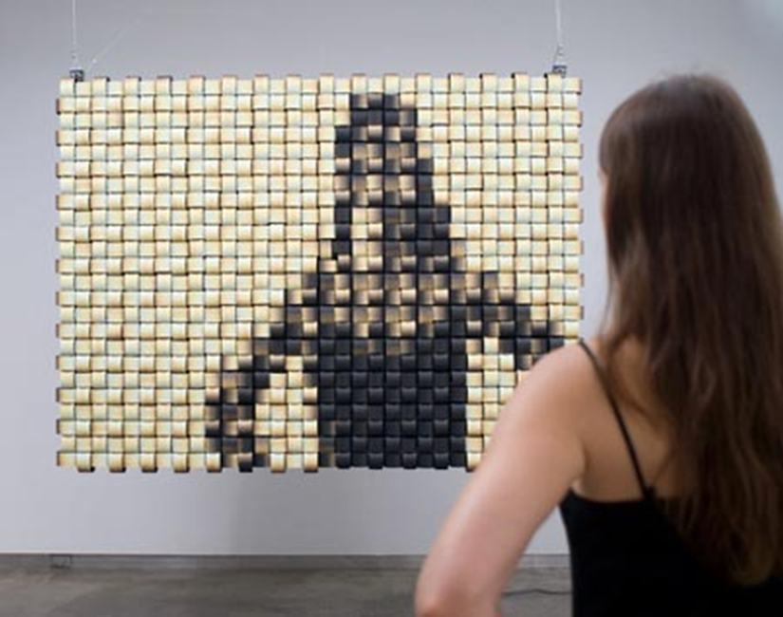
OBHR 2P91: Leadership
Who are you NOW?

Slide 3
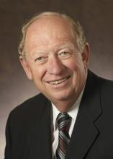
Let me tell you a Story
Paul House
CEO and President
Tim Hortons

Slide 4
Identify your values
Acceptance
Accomplishment
Adaptability
Adventure
Affection
Altruism
Balance
Beauty
Being the best
Belonging
Bliss
Bravery
Brilliance
Calmness
Camaraderie
Candor
Certainty
Challenge
Cheerfulness
Clarity
Cleverness
Commitment
Compassion
Confidence
Conviction
Courage
Creativity
Curiosity
Daring
Determination
Dignity
Duty
Education
Empathy
Encouragement
Enthusiasm
Excellence
Fairness
Family
Fascination
Flexibility
Friendliness
Fun
Generosity
Happiness
Harmony
Health
Honesty
Humour
Imagination
Integrity
Intelligence
Intuition
Justice
Leadership
Learning
Loyalty
Optimism
Pragmatism
Professionalism
Reflection
Reliability
Resourcefulness
Self-control
Selflessness
Teamwork
Trustworthiness
Vigor
Virtue
Vision
Wisdom
Zeal
Pick your top 5 or 6
(or add your own)

Slide 5

Imagine
You are the CEO of your own company.
You have decided to take a well-deserved six month sabbatical to focus on the future.
But, before you depart, those with whom you work need to know the principles that you believe should guide them in their decisions and actions. They need to know your values and beliefs.
Write them your one-page “Leadership Credo” of what your principles are based upon what values you hold dear.

Slide 6

David Badilotti: Café David
Day by day, week by week, month by month:
Do what is right and what is ethical, for yourself and for others, and pay the cost required.
Persevere in the face of adversity, learning the lessons of failure to ultimately succeed.
Striving for the ideal, recognize the practical.
Live a life, not of regrets, but of no wrongs un-righted, of no sins un-atoned for and of no forgiveness un-granted.
Follow the roads less traveled by and often swim upstream.
Believe so passionately, so totally, and so transparently that your being lights a path.
Be the vanguard of something greater than self and that surpasses you.
And, have fun!

Slide 7
Credo Memo
Find a trusted new colleague
Chat about your Credo with each other
Similarities?
Differences?

Slide 8
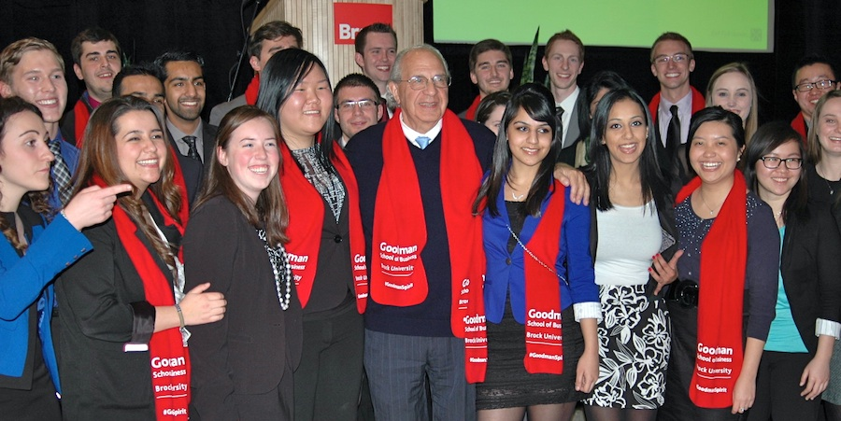
Who are you now?
Are you the same person you were 30 minutes ago?
Welcome to
The Goodman School

