Slide 1
Agenda – Sept 26th
Today: Chapter 4 Discussion
Next Day: Distinguished Leader
Next, next Day: Chapter 5

Slide 2
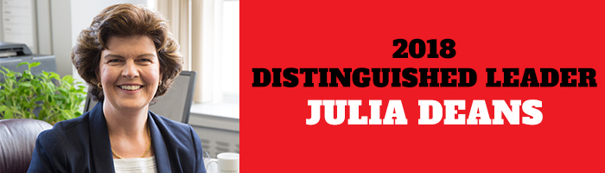
The Goodman School of Business is pleased to announce that our 2018 Distinguished Leader is Julia Deans, a prominent business leader and lawyer
.
Wednesday, Oct. 3 at 2:30 p.m. in the Goodman School of Business atrium. The lecture will be followed by a reception.
Deans’ career has been dedicated to tackling social and economic challenges. Currently she is the founding CEO of the Canadian Children’s Literacy Foundation, a non-profit that aims to ensure all Canadian children are skilled and confident readers by the end of grade school. She has a passion for entrepreneurial start-ups and has served as the CEO of Futurpreneur Canada, a national non-profit organization that has helped more than 10,000 Canadians aged 18-39 launch start-ups, and was also the founding CEO of CivicAction where she built the influential organization from an initial project.
https://brocku.ca/goodman/distinguished-leader/registration/

Slide 3
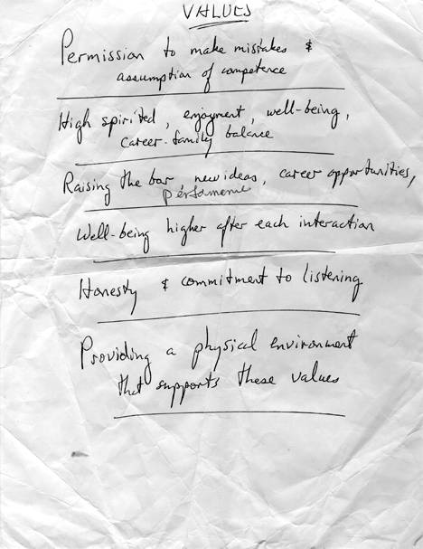
Chapter 4 – Set the Example
Personify the shared values
Teach others to model the values
Do a personnel audit
Develop a routine for questioning
Put storytelling on your meeting agenda

Slide 7
Story Telling Secrets
Find your Story
  Break down the story into an outline of events
  Write out the story in your own words (or draw it if you prefer as a storyboard)
  Tell your self the story by looking at your notes (repeat, repeat, repeat)
  Think about the story – are there parts that really do not need to be there – cross them off
  Tell your self the story by looking at your notes (repeat, repeat, repeat)
  Tell a friend (no notes or storyboard)
  As you get more confident – add emotions to the tale including your own ….THEN TELL YOUR STORY

Slide 8

Story Time …
Practical Leadership Moment
This is your opportunity to tell your leadership story.
Imagine you are presenting to this group of people.
Tell your leadership story!

Slide 9
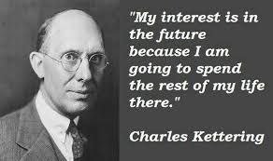
Next, Next Day …
Read Chapter 5 – Envision the Future
Task: Become a futurist
  Find a “new” idea that is out there in the world.
  Search for the novel
  Search for the practical
  Search for the future

