Slide 1

Dark Side
Of leadership

Slide 2
Insights?
Pair up in groups of three and work individually on this one …
OK, how about groups of three – share your insights and come to ONE really interesting insight. (10 Minutes)
Put it on the Board (5 minutes)
Group Discussion (30 minutes)
Barry’s insights (5 minutes)
Group Discussion How to Guard Against (10 minutes)

Slide 3
One article …
Soebowo Musa (2016)
Dark leadership is seldom absolutely or entirely destructive
Dark leadership often involves dominance, coercion, and manipulation rather than influence, persuasion, and commitment.
Dark leadership has a selfish orientation.
Dark leadership outcomes compromise the quality of life for constituents and detract from the organization’s main purposes.
Destructive organizational outcomes are not exclusively the result of dark leadership, but are also products of susceptible followers and conducive environments

Slide 4
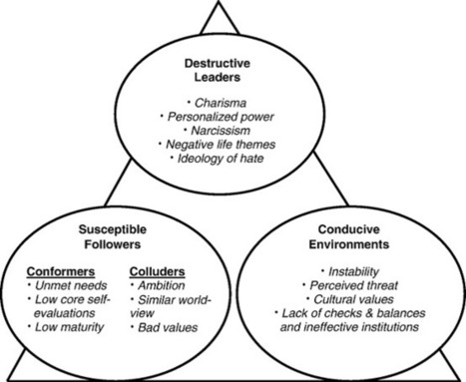
LEADERS: Charisma (vision, self-presentational skills, and personal energy), Personalized Power (describe dissidents and rivals in terms designed to devalue and isolate them while promoting in-group solidarity), Narcissism (dominance, grandiosity, arrogance, entitlement, and the selfish pursuit of pleasure), Negative Life Themes (destructive image of the world and his or her role in the world), Ideology of Hate (legitimizes the use of violence and retribution).
+ Fear

Slide 5
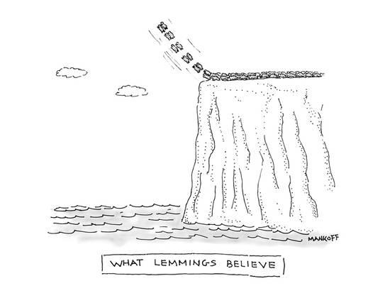
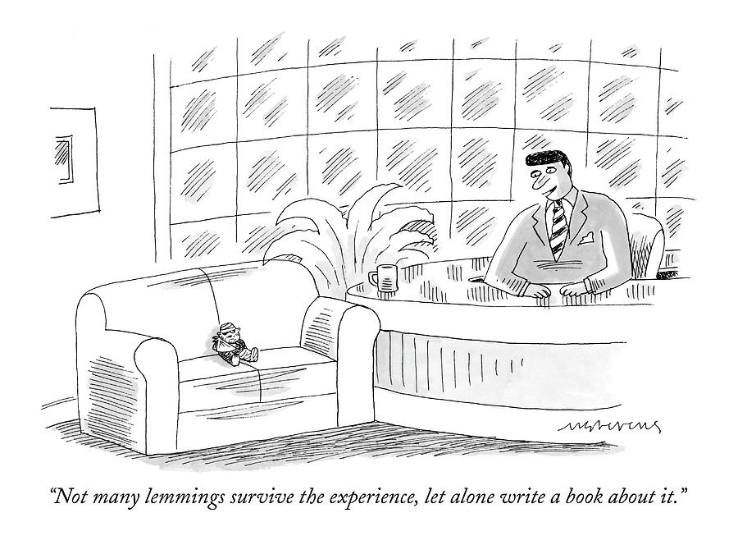
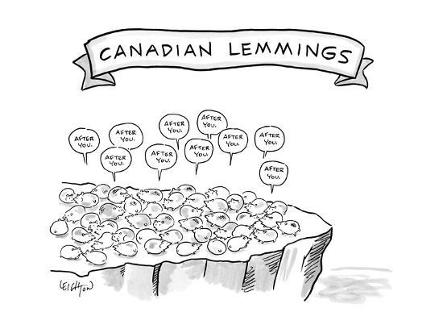

Slide 6
Burke (2006) Why Leaders Fail: Exploring the Dark Side. International Journal of Manpower, Vol. 27 , pp. 91-100.
Incompetent – leadership that lacks the will or skill to create effective action or positive change.
Rigid – leadership that is stiff, unyielding, unable or unwilling to adapt to the new.
Intemperate – leadership that is lacking in self-control.
Callous – leadership that is uncaring, unkind, ignoring the needs of others.
Corrupt – leadership that lies, cheats, steals, places self-interest first.
Insular – leadership that ignores the needs and welfare of those outside the group.
Evil – leadership that does psychological or physical harm to others.

Slide 7
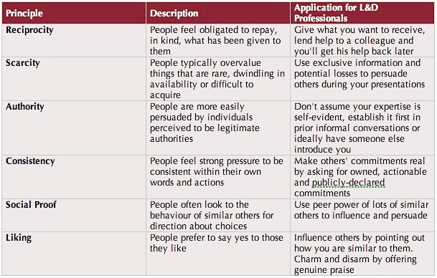
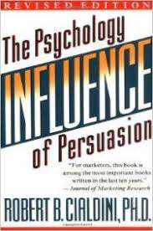

Slide 8
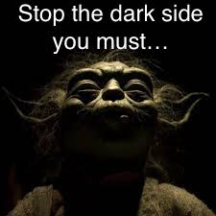
Insights?
Pair up in groups of three and work individually on this one …
OK, how about groups of three – share your insights and come to ONE really interesting insight. (10 Minutes)
Put it on the Board (5 minutes)
Group Discussion (30 minutes)
Barry’s insights (5 minutes)
Group Discussion How to Guard Against (10 minutes)

Slide 9
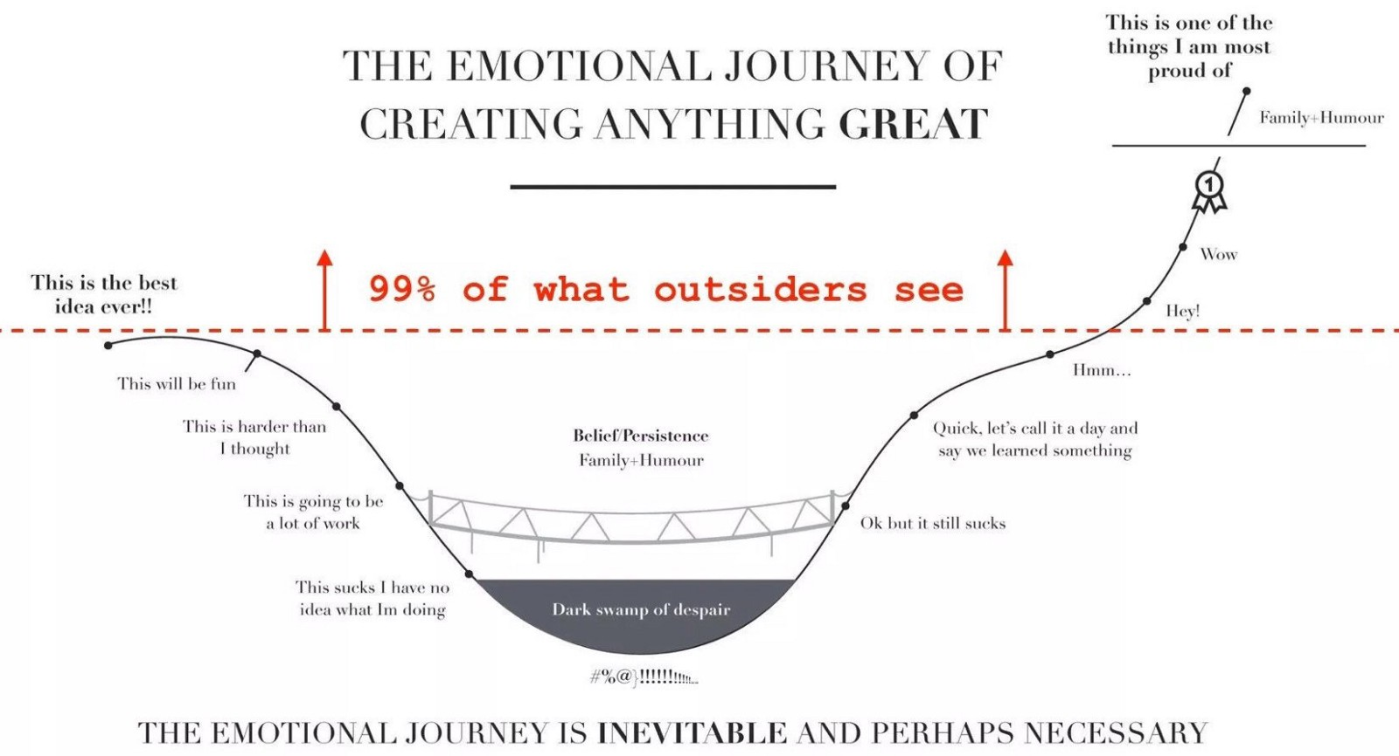

Slide 10
Group Time: Leadership Day
I will wander around to chat with each group.
Keys to Success:
  Active (Engaged)
  Insight (pick ONE Big leadership message)
  Focused (Align with your KEY message)
NEXT Class: Chapter 8 – Experiment and Take Risks

