Slide 1


The Power of Teamwork
Engaging the Lessons Learned from
Canada’s Team of the Century
Story Driven – Theory Based – Collectively Embraced

Slide 2
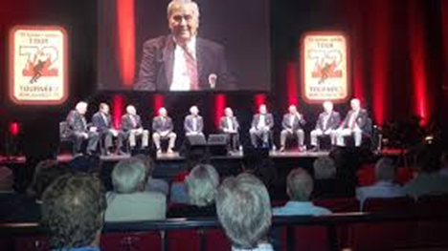
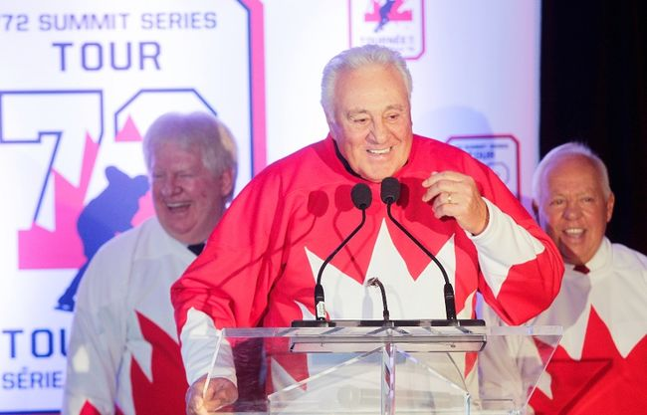
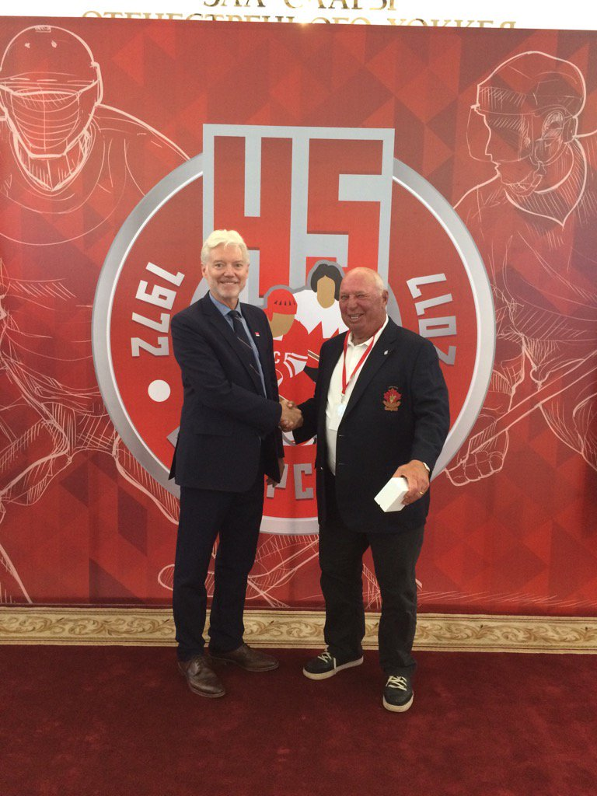
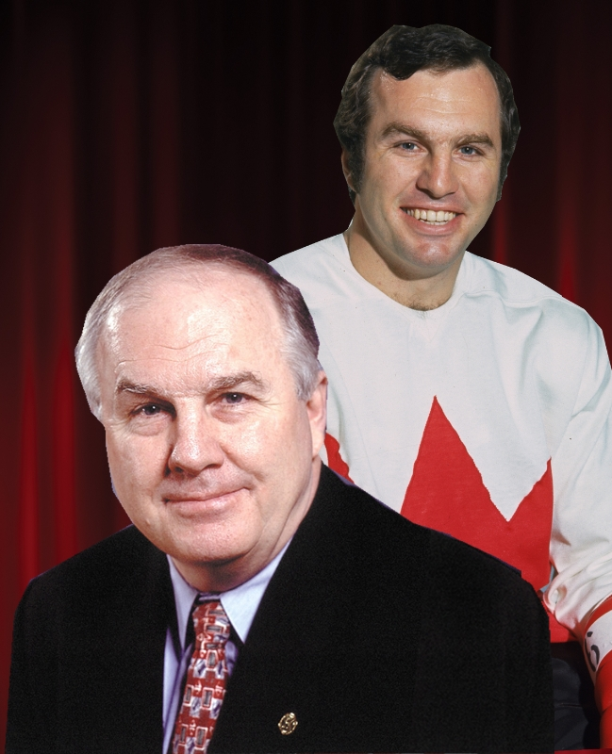
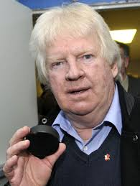
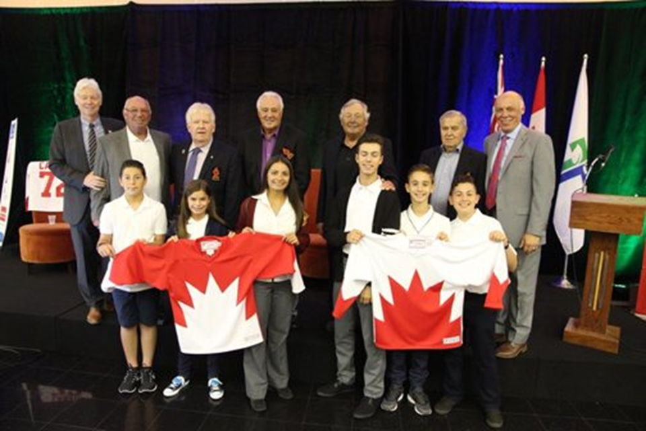
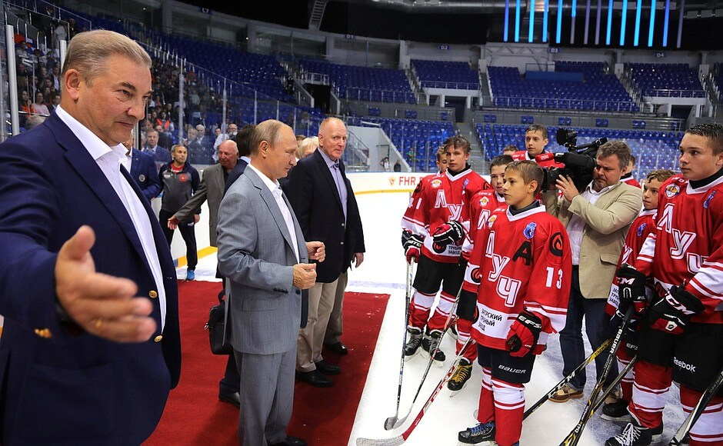
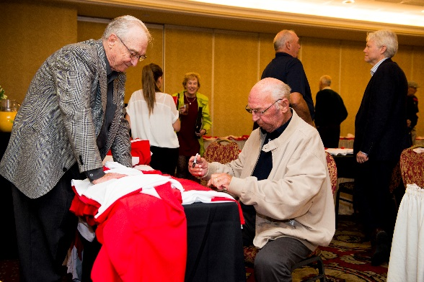
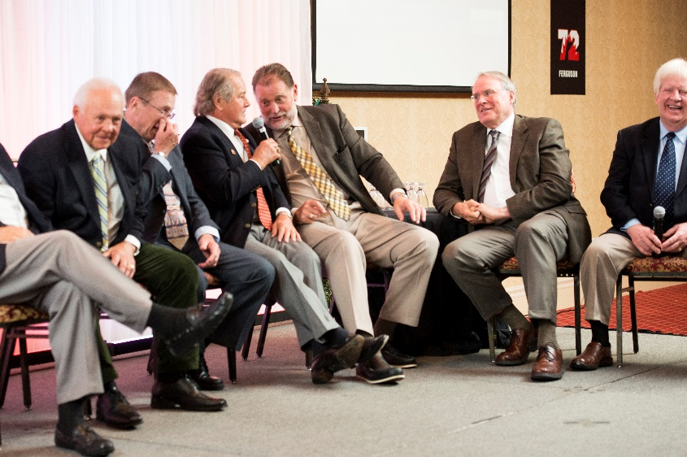
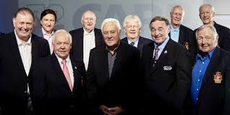

The Story behind 28-8
The Tour
The Proud Grad
The Call
The Puck
28-8 Legacy Program
The Start

Slide 3
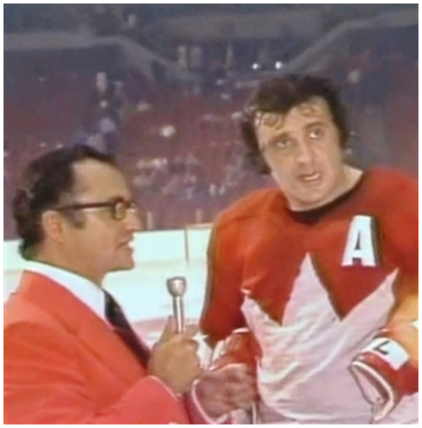
The Best Team Ever.
“Everyone one of us guys, thirty-five guys who came out to play for Team Canada. We did it because we love our country and not for any other reason.” Phil Esposito
In 1972 the team overcame incredible adversity to emerge victorious.
To do so they had to become a team, not just a collection of talented individuals.
We have looked back and extracted the lessons learned to help organizations to unleash the Power of Teamwork.

Slide 4
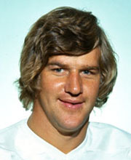
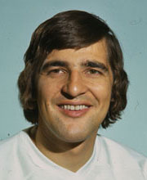
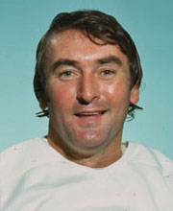

The Power of Teamwork is the Lasting Legacy of TC72
"What that team did, I don't think there has been a greater feat in sports. It was an unbelievable comeback against a great Russian team. I've never seen anything like it." Bobby Orr
"I was a member of nine Stanley Cup teams, but this was the greatest experience of my career." Serge Savard
"It turned out to be more than just a hockey series. A lot of pride came into play - pride in yourself, pride in your team, pride in your country." Ed Johnston

Slide 5
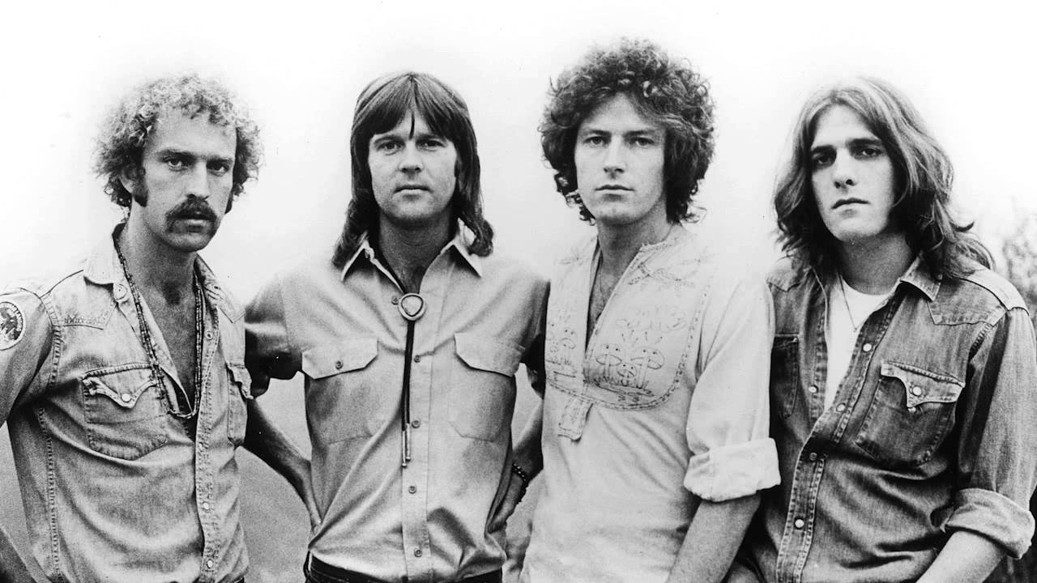
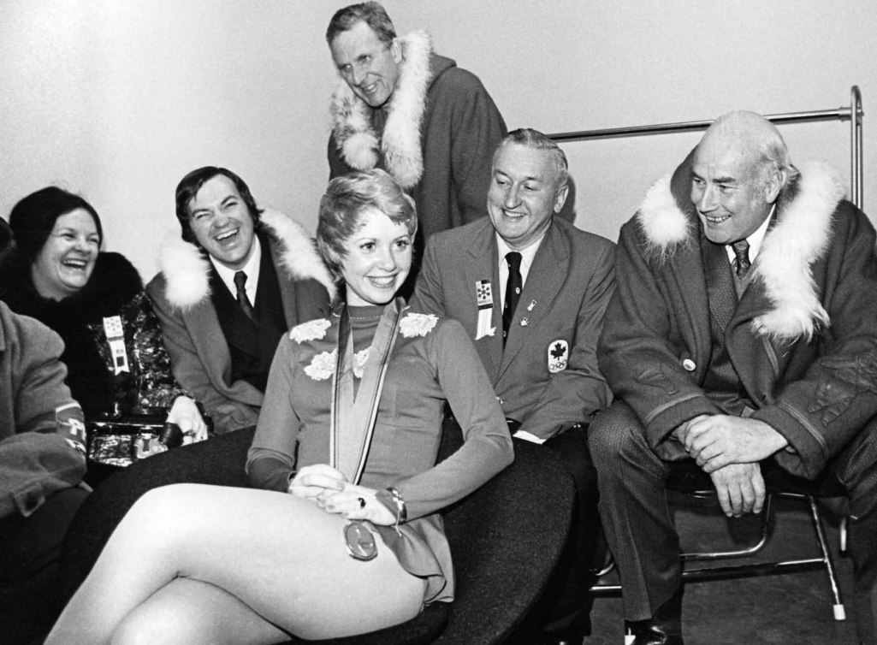
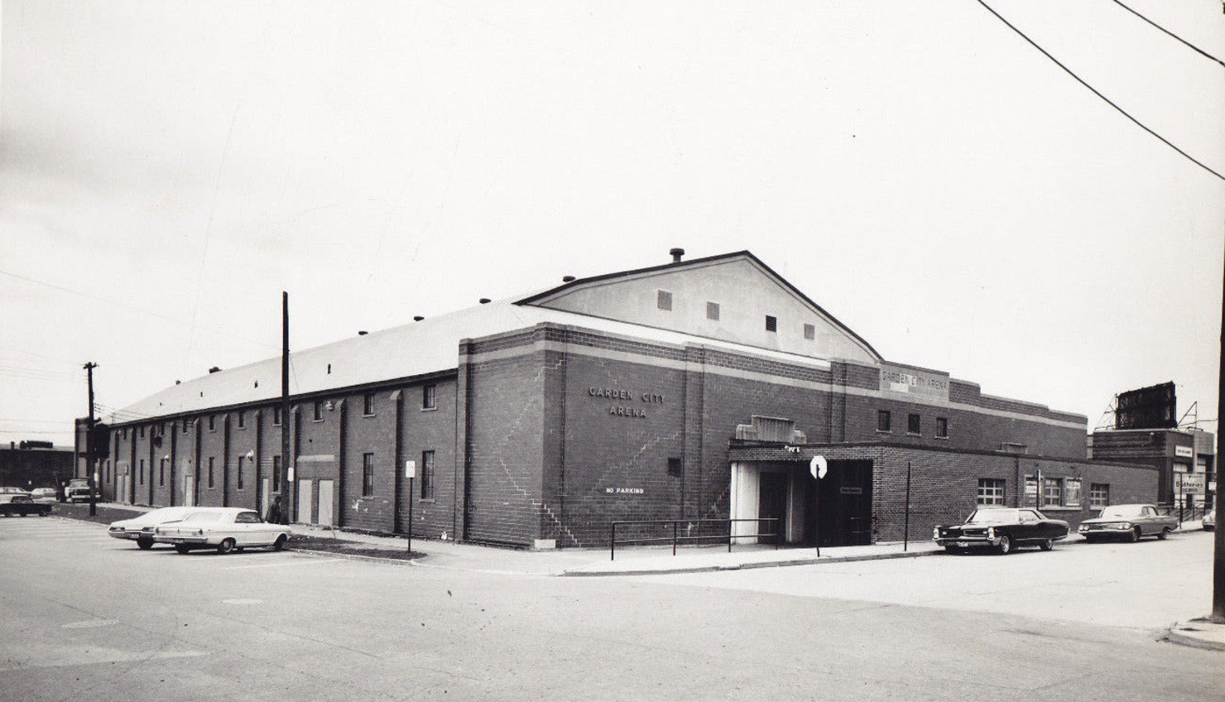

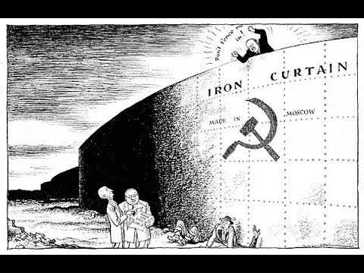
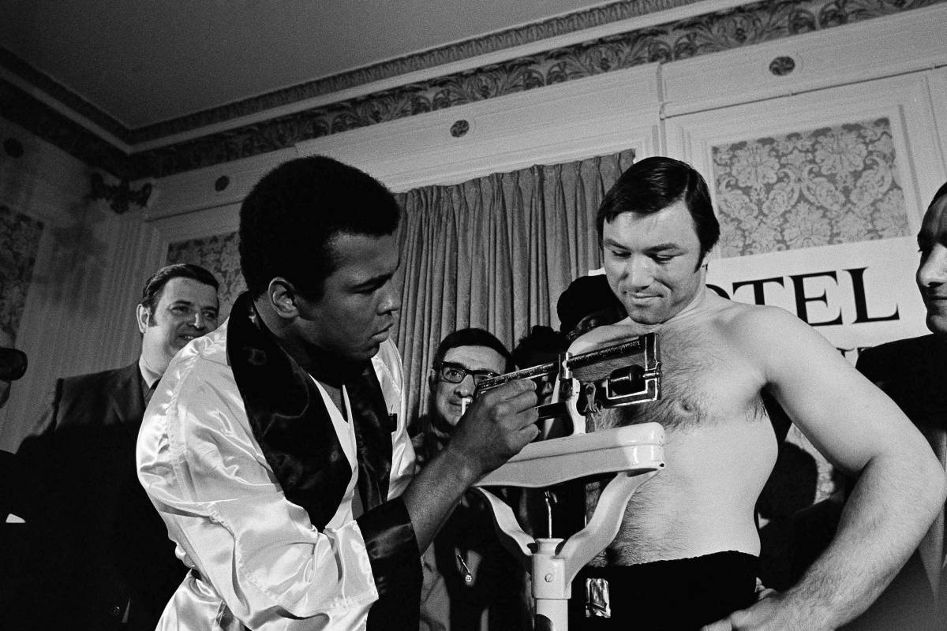
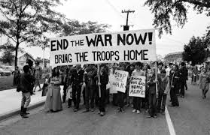
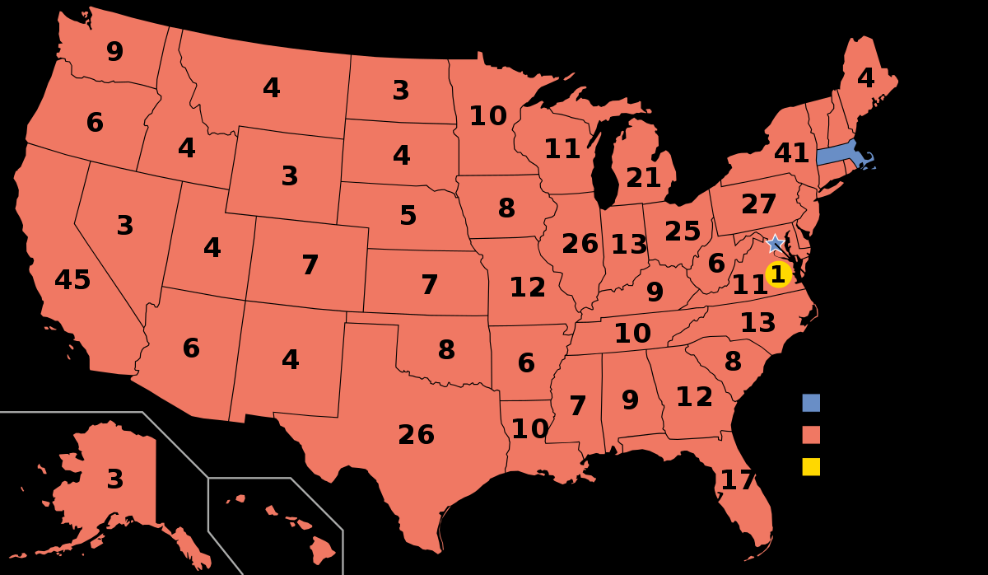
Set the Stage …

Slide 6
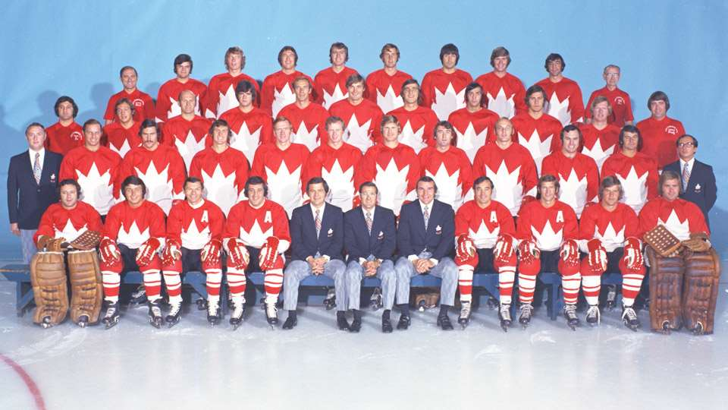
Team of the Century

Slide 7
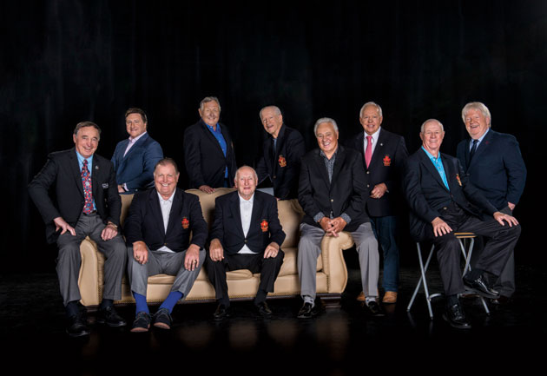


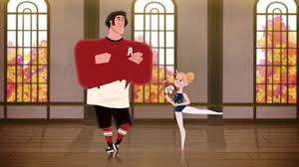
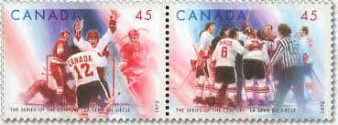
1999: Voted “The Team of the Century” by the Canadian Press/La Press Canadienne
2000: Team Canada 1972 Royal Mint Millennium Tribute Monument
2005: Team Canada 1972 is inducted into the Canada’s Sports Hall of Fame, the first team to be inducted into the Hall
2012: Presented with a Star on Canada’s Walk of Fame
2017: Canada Post honours Team Canada 1972
2017: Thirteen team members are recognized as members of the NHL’s Top 100 Players

Slide 8
28-8 Power of Teamwork Themes
Come Ready to Play: We are all Individually Responsible
From Many to ONE: Individual Commitment to a Group Outcome
Find Purpose: Ignite our O’Canada moment
Overcome Adversity: Can-do Attitude
Playing to Win: 28-8 Trusted Teammates
Leverage the Power of Teamwork.

Slide 9
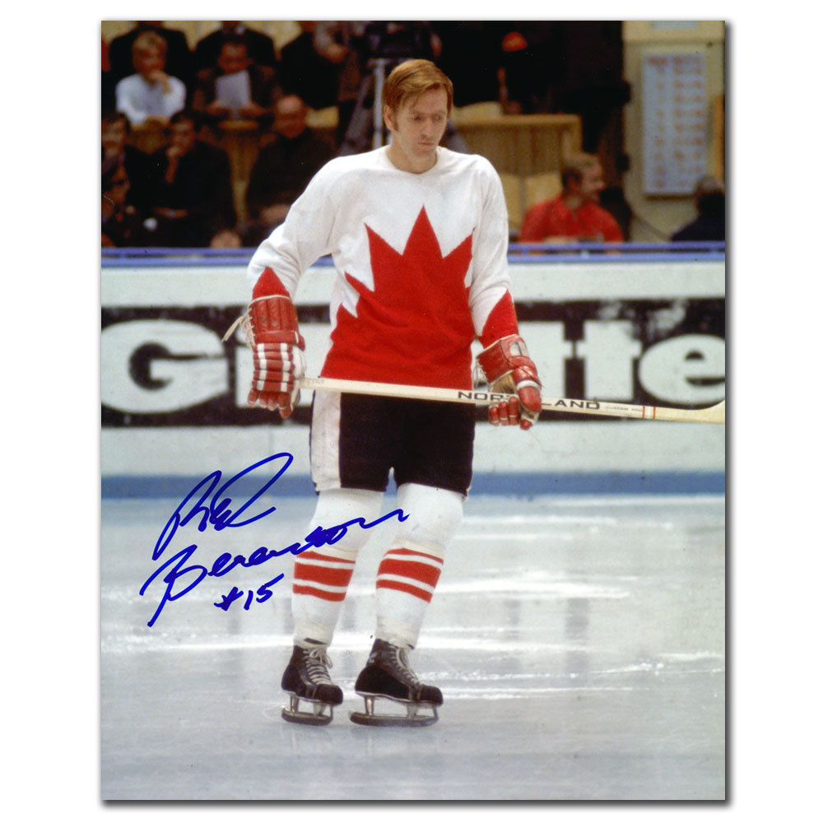
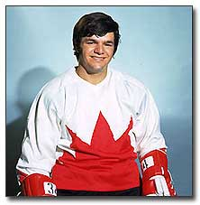
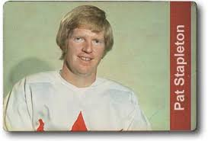
Come Ready to Play:
Understand that individually WE each need to Add Value
Prepared: Responsible for our own good Work; Draw from personal Strengths
Accountable: DWYSYWD
Committed: Span Boundaries – connect and engage

Slide 10
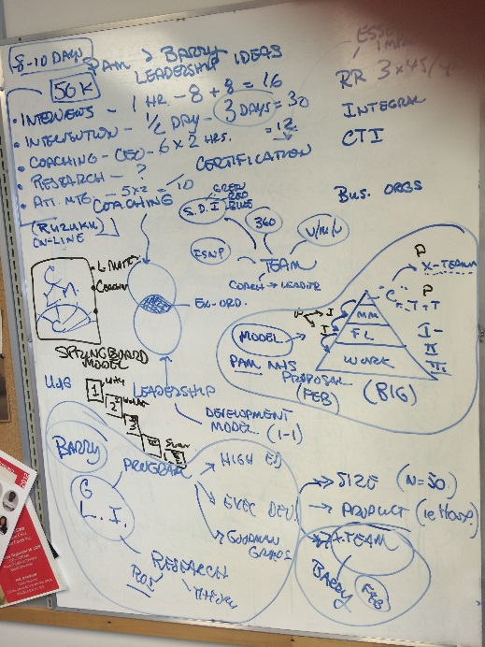
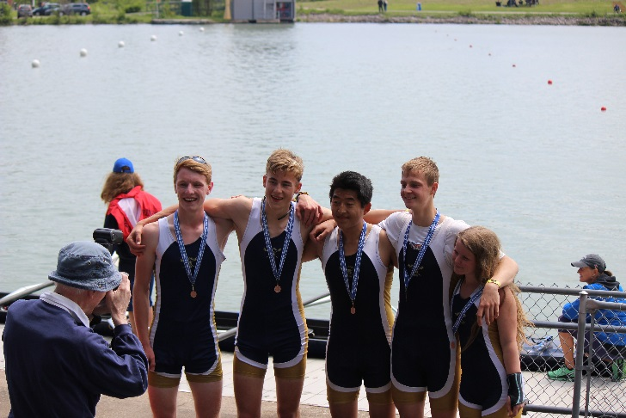

Take out your phone (camera) 5 min.
First: Photo of your Strength
Second: Photo of when you work best
Third: Photo of your own personal challenge

Slide 11

Mingle and Share
  Strength
  Work Best
  Challenge

Slide 12
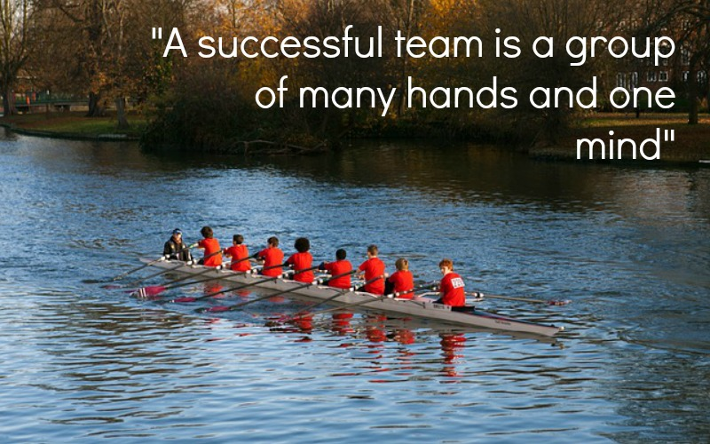
From Many to ONE

Slide 13
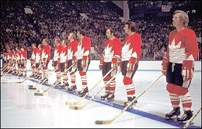
From Many to One
  Shared values (same song sheet)
    Team performance norms and standards
  Count on each other (especially when it counts)
  Know and Own your Role (play to your strengths)
  Be Flexible (and have a Sense of Humour)
Shared – Trust – Ownership – Cohesive

Slide 14
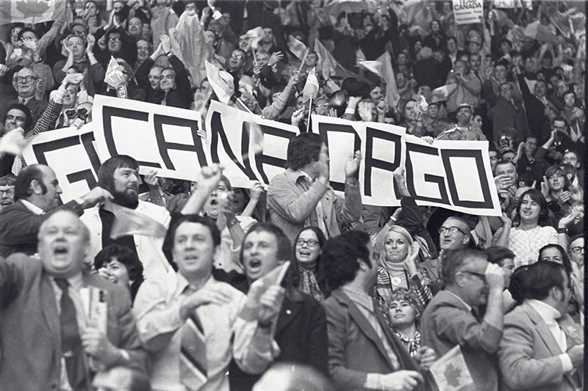
Finding Purpose
On September 22, in game five, Canada led 4–1, but ended up losing 5–4. Despite the loss, all 3,000 Canadian fans sang the national anthem as Team Canada left the ice. Canada won the remaining three games in a row, to take the series.

Slide 15
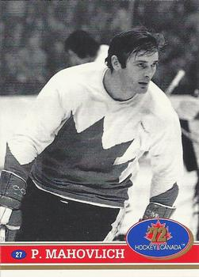


Find Purpose: Why are WE here?
What are WE playing for?

Slide 16

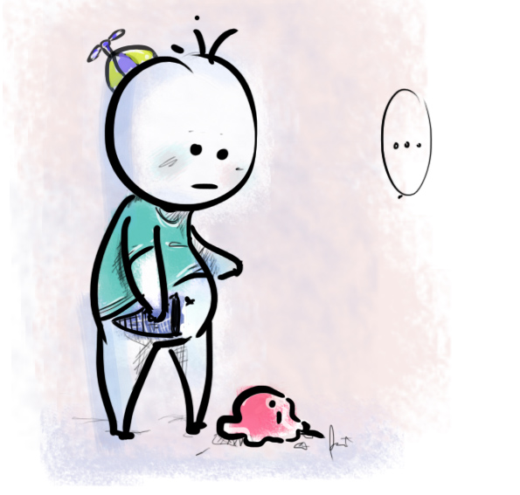
Being On PURPOSE versus On Task.
Let me tell you a story …

Slide 17
Story: 28-8 Adversity
10 different NHL cultures – started as a fractured group
Underprepared physically and emotionally – friendly series
Poor scouting reports
Different game – stick work, ice surface, rules
Officiating – two referees (i.e. 31 versus 4)
Injuries
Emotional: Booed on home ice; Ambassador name calling
Stolen food, broken promises, phone calls, bugged rooms
Desertion – Strangers in a Strange land

Slide 18
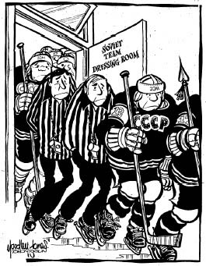
Overcoming Adversity:
Can-Do Attitude
Grit: Everyone has a bad day; Get up; Surgite.
Perseverance: Scoreboard – adjust when we know where we stand (results driven).
Passion: Self-talk; Team Talk – build each other up.

Slide 19
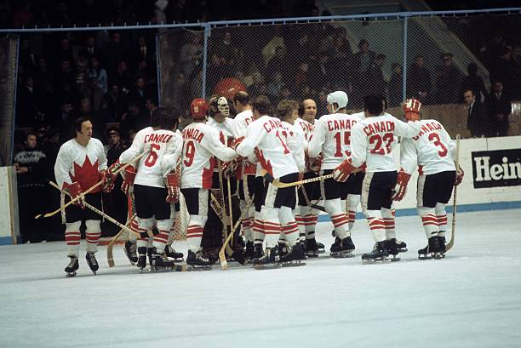
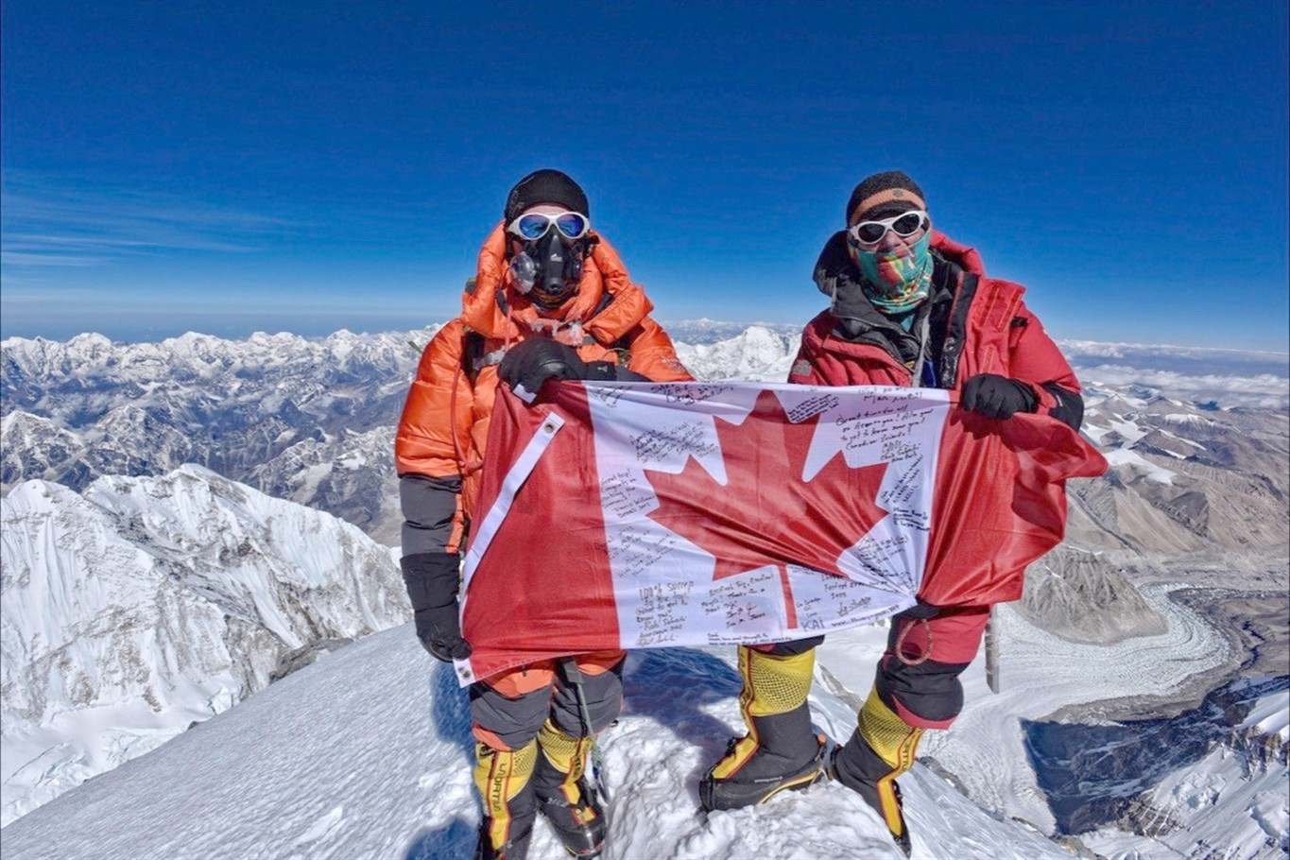
28-8 Trusted Teammates:
Playing to Win
Fixed on the Goal (+ Priorities)
Harry Sinden – no doubt, next shift, belief

Slide 20
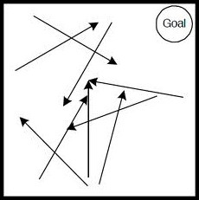
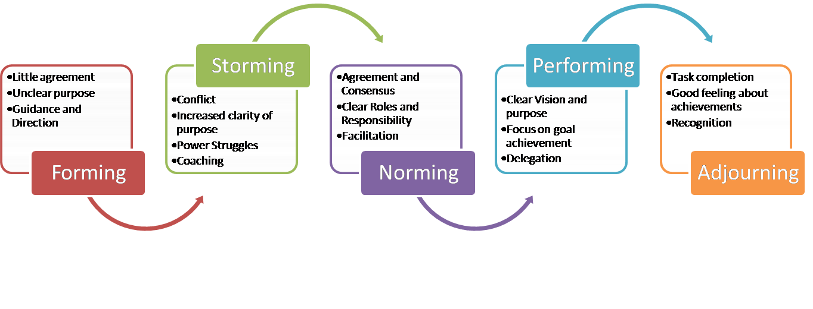
Theory (Tuckman) and TC 72
From Many to ONE
Finding Purpose
Playing to Win
Come Ready to Play
Overcoming Adversity: Can-do
Team
Chaos
Team Canada 1972
Team …

Slide 21
Next Steps: Who are you now?
Ask yourself …
What value will I add? Come Ready to Play
Where might we go together? From Many to ONE
Why are we here? Our PURPOSE
When the going gets tough what will I do? Can-Do Attitude
How will I lift others? Playing to Win as a 28-8 Trusted Teammate

Slide 22
NEXT Day
Chapter 9
Remember – November 15
Project or Case Exam

