Slide 1
Change
Take Two

Slide 2

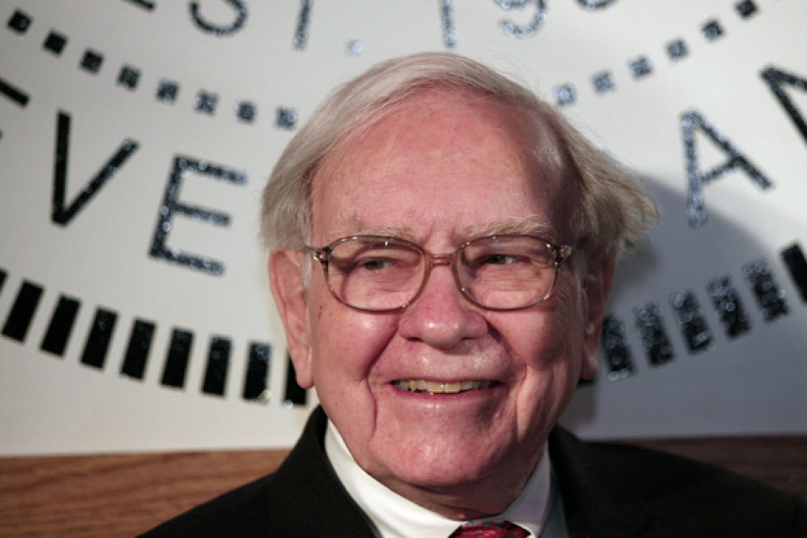


Adaptable Firms (People)

Slide 3



Famous (not changing) Failures

Slide 4
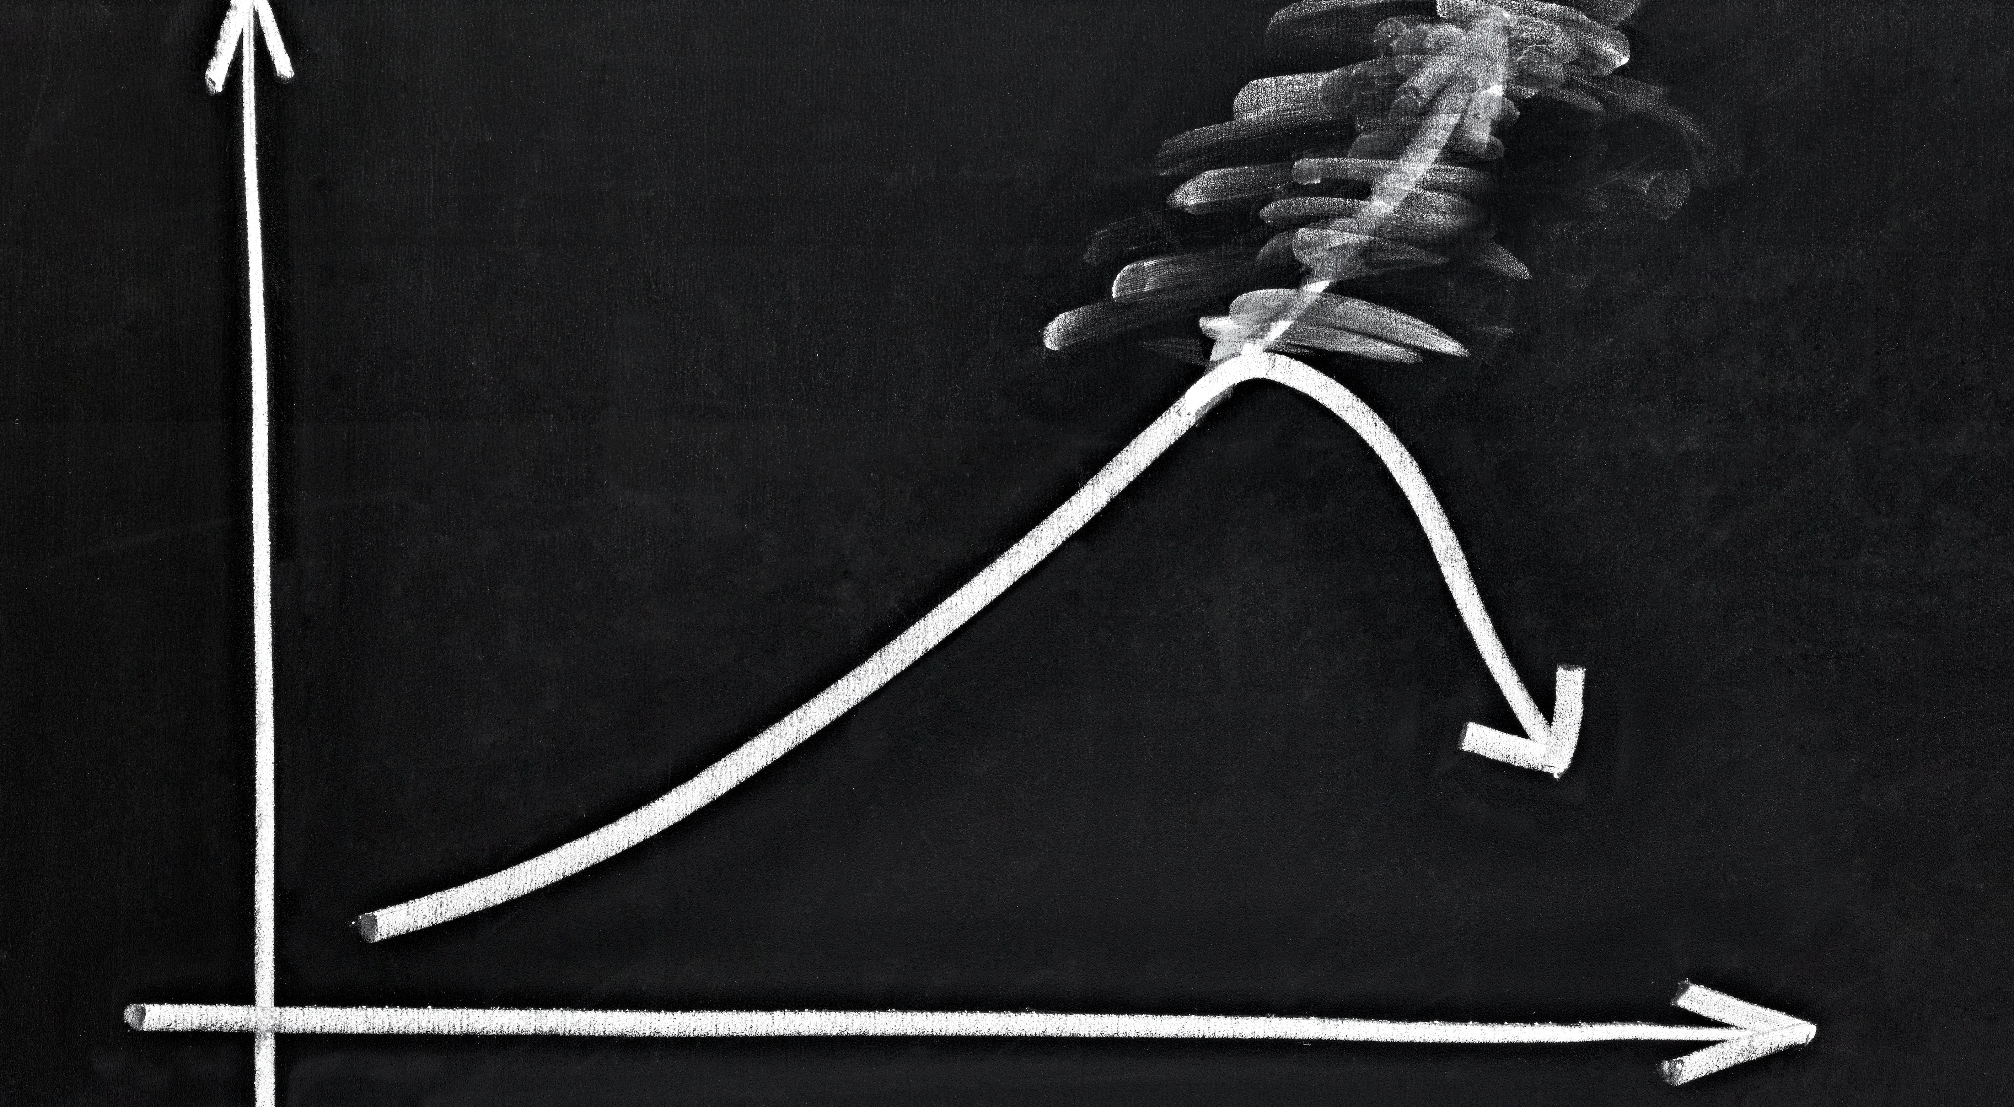
Famous (missteps) Failures
Founded in 1982, Compaq became the world’s largest supplier of PCs during the 1990s.
Compaq wanted to dominate nearly every aspect of the computer industry, but its M&A activity seemed to distract company executives from the very successful business of selling PCs to corporations. Excess inventory and unexpected price competition in PCs saw Compaq’s profits wiped away.

Slide 5
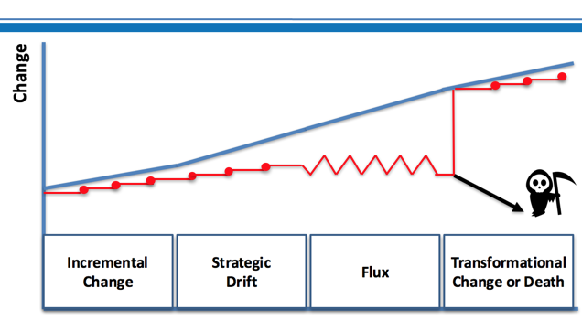
From Incremental to Strategic Drift

Slide 6
Why Does Strategic Drift Happen?
Strategic drift usually arises from a combination of factors, including:
Business failing to adapt to a changing external environment (for example social or technological change)
A discovery that what worked before (in terms of competitiveness) doesn’t work anymore
Complacency sets in – often built on previous success which management assume will continue
Senior management deny there is a problem, even when faced with the evidence

Slide 7

Our Article

Slide 8


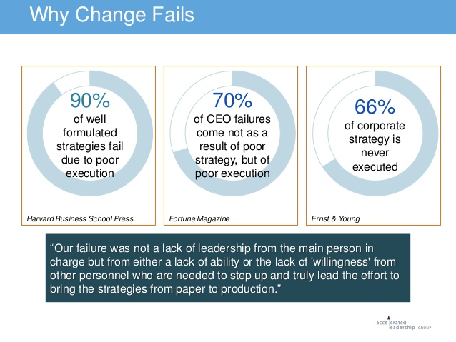
What is your Take-away?

Slide 9
Next Reading:
Readiness for Change: Contributions for Employee's Level of Individual Change and Turnover Intentions
Pedro Neves
Journal of Change Management
Start building your change model (put the pieces together).

