Slide 1
(Successfully) Enacting Organizational Change

Slide 2
Challenge of Change
There is nothing more difficult to take in hand, more perilous to conduct, or more uncertain in its success, than to take the lead in the introduction of a new order of things.
Nicolo Machiavelli - The Prince.

Slide 3

What is Organizational Change?
Organizational change occurs when an organization restructures resources to create value and improve effectiveness.

Slide 4

Please finish this quote
Change done to us …
Change done by us …
Notes:
How does that make us feel? (show each statement)
Why is that?
At the root, change done to us, we’re being asked to comply.
* People respond by doing what’s asked
Change done by us, we’re committed to it, we’re going to get it done no matter what
* People respond by doing what it takes.
Commitment vs. compliance

Slide 5
生き甲斐
Good at
Get paid for
Love
Needed
Notes:
Who can read Japanese … I’ve already given you a hint
So, I got this morning up and I am here today because I love what I do, I get paid for it, there is a need for learning, especially change process and you can tell me if I am good at it.
So right here and right now, with you is my Ikigai.
So let me tell you a bit about me

Slide 6
生き甲斐
IKIGAI (Ick-ee-guy)
‘purpose in life’, or
‘thing that you live for’, or
‘thing that gets you out of bed in the morning’
The Japanese population amongst the longest living worldwide
Love
Good at
IKIGAI
Need
$$$
Finding your ikigai: the Japanese secret to health and happiness
http://www.telegraph.co.uk/health-fitness/mind/finding-ikigai-japanese-secret-health-happiness/
Notes:
Who can read Japanese … I’ve already given you a hint
So, I got this morning up and I am here today because I love what I do, I get paid for it, there is a need for learning, especially change process and you can tell me if I am good at it.
So right here and right now, with you is my Ikigai.
So let me tell you a bit about me
If playing video, start from 8 mins onwards

Slide 7

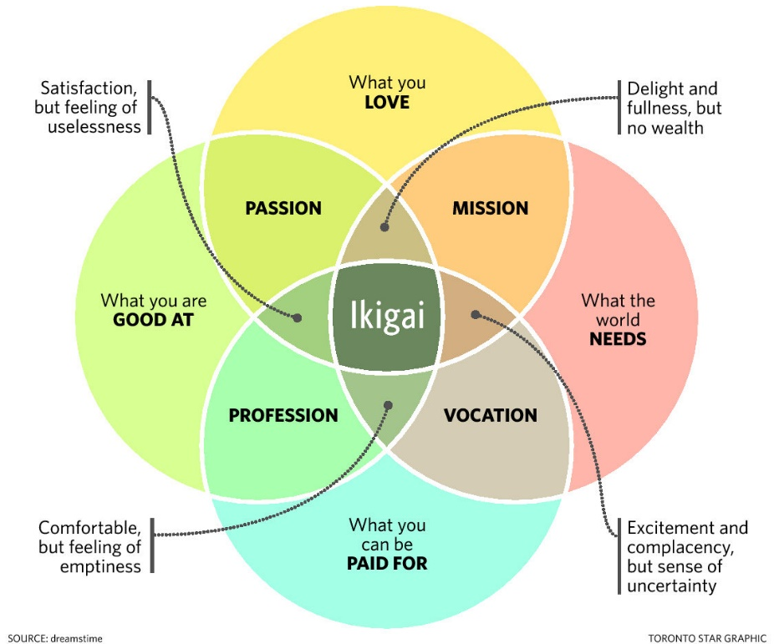
生き甲斐
Notes:
What is your purpose in life?
Ikigai is “purpose in action,”
In a 2001 research paper on ikigai, co-author Akihiro Hasegawa, a clinical psychologist and associate professor at Toyo Eiwa University, placed the word ikigai as part of everyday Japanese language. It is composed of two words: iki, which means life and gai, whichdescribes value or worth.
Hasegawa points out that in English, the word life means both lifetime and everyday life. So, ikigai translated as life’s purpose sounds very grand. “But in Japan we have jinsei, which means lifetime and seikatsu, which means everyday life,” he says. The concept of ikigai aligns more to seikatsu and, through his research, Hasegawa discovered that Japanese people believe that the sum of small joys in everyday life results in more fulfilling life as a whole.
ikigai is about feeling your work makes a difference in people’s lives.

Slide 8





Agenda
Review
Relevant
Theories
Assess for Change
Implement
the Change
Review
Case
Construct
Change
Plan
Debrief
Notes:
The majority of today will be hands-on learning in your simulation teams where you will be leading a change project.
“What other expectations that you have of me to keep in mind in terms of how we run the day?”

Slide 9

Change Prevalence
A recent study n=309
HRM executives
100% were going through change
  merger,
  acquisition,
  divestiture,
  global competition,
  restructuring

Slide 10
Please finish this quote
Change done to us …
Change done by us …
At the root, change done to us, we’re being asked to comply.
* People respond by doing what’s asked
Compliance
Change done by us, we’re committed to it, we’re going to get it done no matter what
* People respond by doing what it takes.
Commitment
Notes:
How does that make us feel? (show each statement)
Why is that?
At the root, change done to us, we’re being asked to comply.
* People respond by doing what’s asked
Change done by us, we’re committed to it, we’re going to get it done no matter what
* People respond by doing what it takes.
Commitment vs. compliance

Slide 11
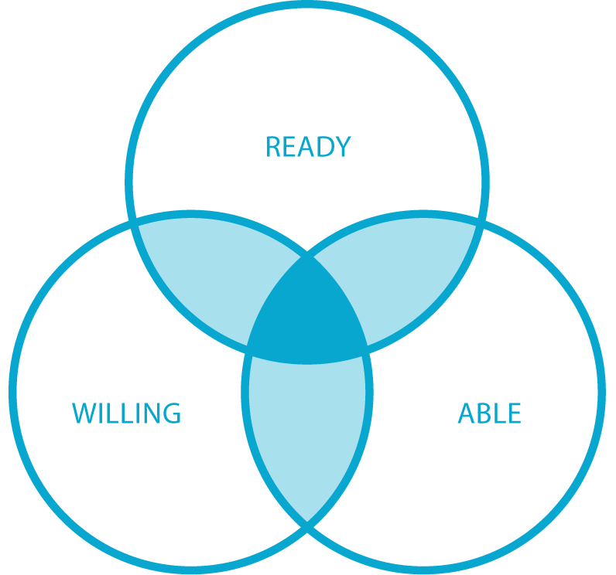
What is Change?
Change as a discipline refers
to the collection of tools, techniques, and mindsets that help organizations ensure their people are ready to engage, willing to commit and able to do what it takes to realize the full potential of great solutions.
Notes:
Commitment (Willingness) is a big part of change, but it’s not everything.
People also need to be ‘ready’ – have the capacity to change.
And they need to be ‘able’ – have the capability (skills, knowledge) to change.
What does not able sound like? “I can’t”
What does not ready sound like? “I won’t”
What does not ready sound like? “Not now”

Slide 12
Types of Change …
Content of Change
Kaikaku
Radical change
Revolutionary change
Crisis situation
Top down
Rare
Episodic
Examples: M&As, restructurings, change of leadership
Kaizen
Emergent change
Organic change
Part of daily life
Bottom up
Frequent
Continuous
Examples: project work, changing values
Notes:
There are many types and levels of change … but there is a simple formula

Slide 13

A Formula for Change
Choice of Change Strategy =
f(Content of Change, Organization’s DNA)
Notes:
I shared with you that I have a foot in business and a foot in science, so when I can, I take a scientific lens to business concepts
So lets review a few change models – strategic tools

Slide 14
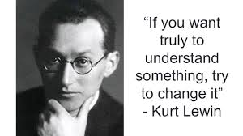
Lewin’s Three Step Change Model
The three step change model
  Unfreeze – shock a system out of stasis
  Move – make purposeful adjustments
  Refreze – consolidate change by systematically engraining adjustments
Kurt Lewin, 1890 – 1947
Founding father of social, applied and organizational pyschology
Also known for:
Gestalt Psychology
Action research
Force-field analysis
Notes:
Gestalt psychology or gestaltism is a philosophy of mind of the Berlin School of experimental psychology. Gestalt psychology is an attempt to understand the laws behind the ability to acquire and maintain meaningful perceptions in an apparently chaotic world. The central principle of gestalt psychology is that the mind forms a global whole with self-organizing tendencies.

Slide 15

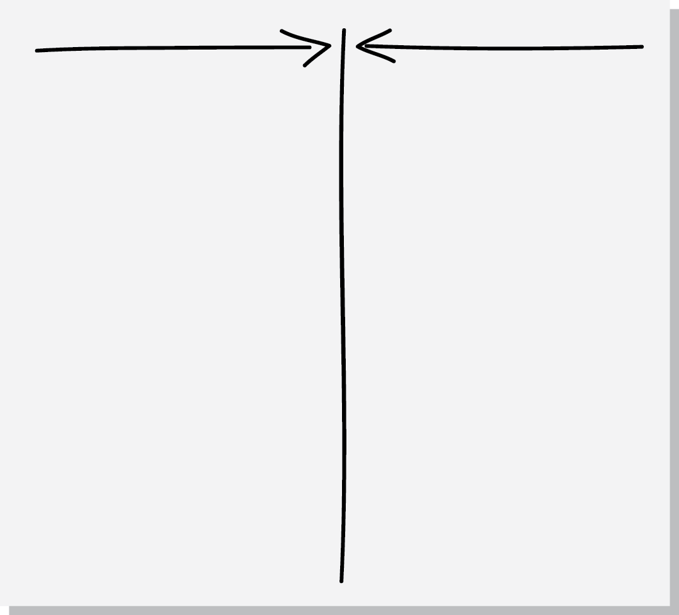
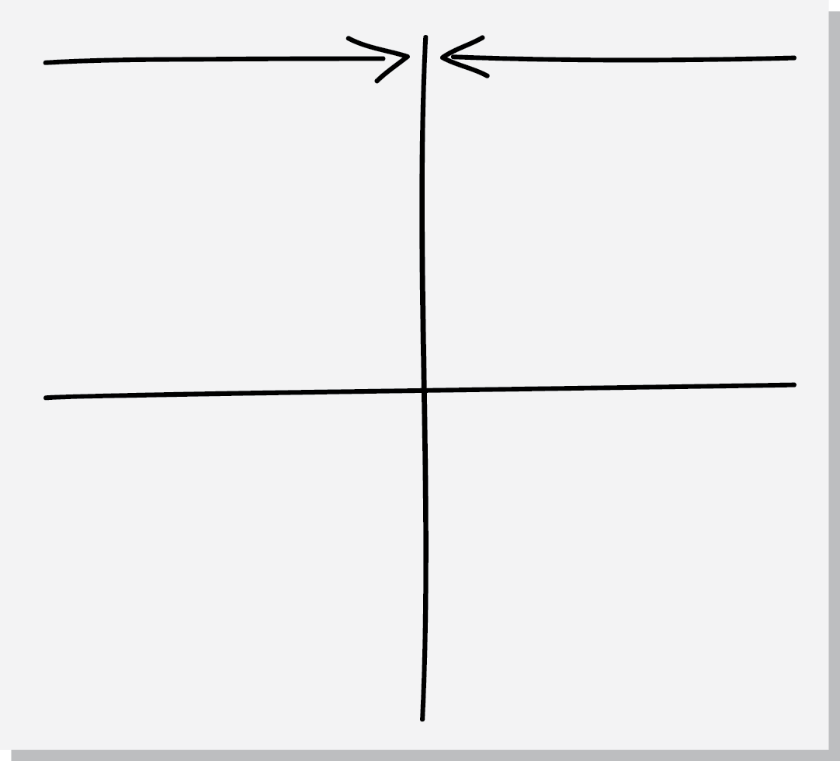
Force-Field Analysis
What is the problem/change issue?
Where are you now? Where might current situation go if no action is taken?
Where do you want to go (vision)?
What are the driving & restraining forces?
What action(s) can minimize resisting forces and maximize driving forces – recognizing that changing one might impact the others (both positively and negatively)
Discus all the forces – can they be changed? Which are the critical ones?
Driving
Restraining
Rational
facts, data, overt
Emotional
political, cultural, covert
Notes:
Set up The Force Field as a great tool for analysis and as a framework for discussion.
Illustrate importance of Rational & Emotional
------
The Force Field is a great tool for analysis and as a framework for discussion.
"Force Field" is a fancy way of saying that there are lots of different factors (or, forces) for and against making change that we need to be aware of.
Driving forces = positive forces for change
Restraining forces = obstacles to change
Orgs will always be driving forces that make change attractive to people, and restraining forces that work to keep things as they are
Successful change is achieved by strengthening the driving forces and/or weakening the restraining forces

Slide 16
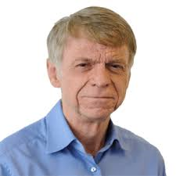
Kotter’s Eight Step Leading Change Model
Your BIG takeaways (up to 3)
Strengths of the article
Fuzzy Places (weak points)
Relationship to other articles (connect the dots)
Who are you NOW? (Show how this informs your change agent skills)
Notes:
Play the video
Developed in 80s

Slide 17
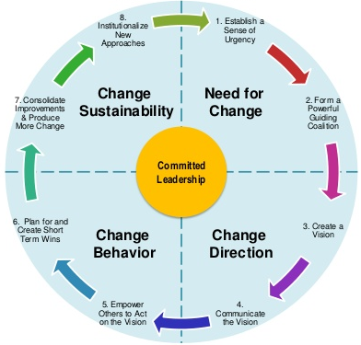
Kotter’s Eight Step Leading Change Model
Notes:
Play video from 25 seconds inwards
Warning about the tone of voice over

Slide 18
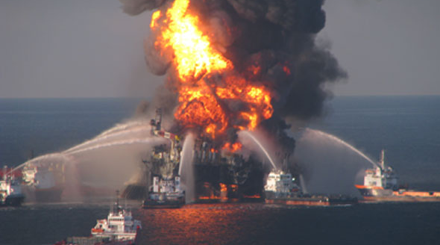

Need for Change - Kotter
Create a Sense of Urgency
Form a Powerful Enough Guiding Coalition
Examining market and competitive realities
Identifying and discussing potential crises, or major opportunities
75% of your leadership team is convinced
Assembling a group with enough power to lead the change effort
Encouraging the group to work together as a team

Slide 19


Change Direction - Kotter
Create a Vision
Communicate the Vision
Creating a vision to help direct the change effort
Developing strategies for achieving that vision
Using every possible communication channel
Teaching new behaviors by the example of the guiding coalition

Slide 20


Change Behaivour - Kotter
Empower Others to Act on the Vision
Plan for and Create Quick Wins
Remove obstacles to change
Changing systems or structures that seriously undermine vision
Encouraging risk taking and non traditional ideas, activities and actions
Planning for visible performance improvements
Creating those improvements
Recognizing and rewarding employees involved in the improvements

Slide 21
Implementing & Sustaining the Change - Kotter
Institutionalizing New Approaches
Consolidating Improvements and Producing Still More Change
Using increased credibility to change systems, structures, and policies that don’t fit the vision
Hiring, promoting, and developing employees who can implement the vision
Reinvigorating the process with new projects, teams and change projects
Articulating the connections between the new behaviors and corporate success
Developing the means for leadership succession and development

Slide 22


Organizational Change: Let’s Make a Model
Get up, stand up! Let’s organize by your birth date – month and day without speaking or writing
Now, let’s organize in stages of the change model:
Stage One
Stage Seven
Notes:
Order in order of your birthdate – month & day only NO TALKING or WRITTING

Slide 23

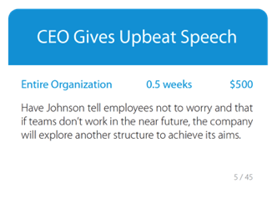

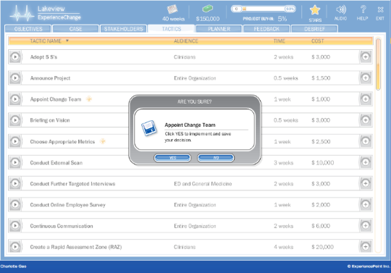
Change Team Roles
Each team to elect someone to be the:
Captain
Time keeper
Speaker
Devil’s advocate
Notes:
Plan
Time to build out a change plan, using the tactics available. In [1 hour] you should have your plan at least 80% complete
No need for a computer
Decide which tactics you will use and which ones you won’t
Expect to use 20 – 30 to hit the 60% goal*
Determine the best order for implementation
Consider time & budget constraints
Some tactics identified with a star
Means you will be asked to make additional choices
[discreetly take pictures when in this phase]

Slide 24
Experience Point Change Model

Slide 25



Change is How We Realize Great Solutions
SOLUTION
ORGANIZATION
UNDERSTAND
ENLIST
ENVISAGE
MOTIVATE
COMMUNICATE
ACT
CONSOLIDATE
Align key stakeholders
Engage the organization
Notes:
Bring great solutions to life with a two phase, seven step process
Use this framework to structure what we already know. Close the knowing/ doing gap.
There is no single right way that will guarantee success. Context is everything. The key is to consider each unique situation and create the appropriate model/ framework for planning.
This change model is designed to maximize commitment and minimize resistance to change.
Optional Exercise:
Assign 1 – 2 stages/ group. Hand-out large tactic cards for full details.
Think of some stories of change done well & not so well.
Teach back through storytelling.

Slide 26
Change is How We Realize Great Solutions
SOLUTION
ORGANIZATION
UNDERSTAND
ENLIST
ENVISAGE
MOTIVATE
COMMUNICATE
ACT
CONSOLIDATE
Align key stakeholders
Engage the organization
Notes:
Align Key Stakeholders is the first phase of the model.

Slide 27
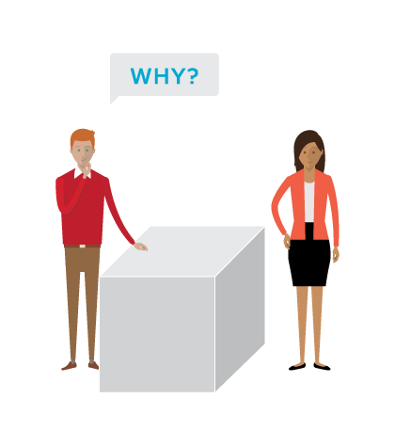
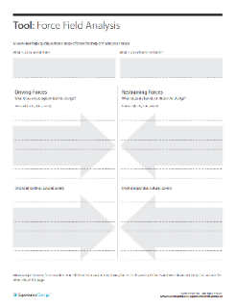
1. Understand
Gather and share information with key stakeholders to help them understand and align around the problem. This often occurs at a senior level, depending on the challenge.
Gather information
Interviews with leaders, managers, and front-line employees.
Engage with customers and non-customers.
Benchmark competitors and other organizations.
Identify the Problem
Determine root causes
and not symptoms.
Assess Stakeholder Support
Map support to understand readiness, willingness and ability to change.
Share information with key stakeholders
Create alignment with key stakeholders by sharing an honest assessment of the current state.
TOOLS
Force Field
Notes:
Suggested prompts for stories:
"Has anyone been involved in a project and wondered, why, from a business point of view, it was initiated?
Has anyone been involved in a project that was poorly conceived?
.... a project that addressed a symptom or even worse, it addressed the wrong problem?
The understand phase helps us to understand the root problem (or opportunity) and define, in business terms, 'why' we are doing this.
Identification of an issue/need/problem can occur at any level in the organization (and often the front line knows about it before the senior leadership does.)
----
Root causes will never be as apparent as symptoms
Must dig to the root of problems to generate effective solutions
“You can’t change what you don’t understand.”

Slide 28

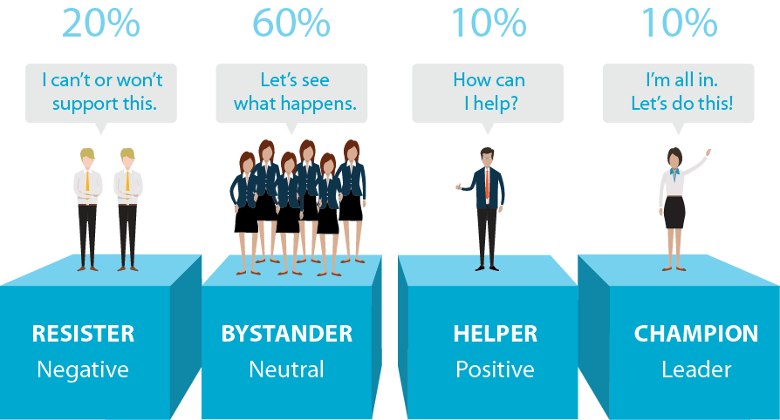
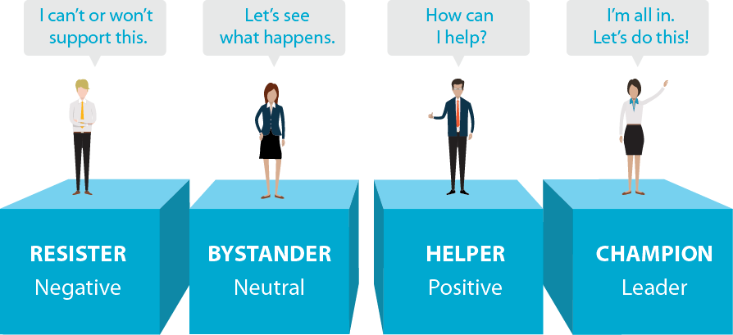
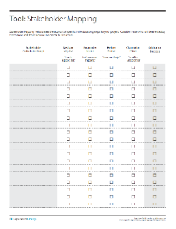
1. Understand – Assess Support
TOOLS
Stakeholder Mapping
Notes:
It is helpful to think about four categories along the resistance-support spectrum.

Slide 29




2. Enlist
Sponsor
Active, visible,
builds support, manages resistance, communicates directly.
Project Leader
Visioning,
Motivating, Empowering, Managing.
Project Team
Leadership,
Position power, Expertise, Credibility, Management.
Engage Key Stakeholders in the Process
Notes:
After you understand the need for change, enlist the support of a core team of powerful stakeholders.
Work with this team to develop a shared vision and strategy to roll out across the organization.

Slide 30
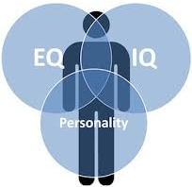
Change Team Considerations
IQ, EQ & Personality are good indicators of how we think and act
Change team membership
  Position power
  Expert power
  Credibility
  Leadership skills
  Management skills
Stages teams go through
  Forming
  Storming
  Norming
  Performing

Slide 31

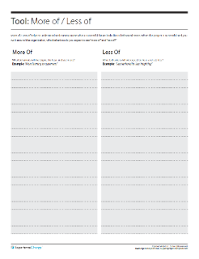
3. Envisage
Co-create the future
Involve a diverse range of relevant stakeholders in the problem solving process. Input increases commitment (and quality of the solution).
Use the right problem solving method for the situation
Need to create something new? Consider Design Thinking
Need to optimize what exists today? Consider Lean / Six Sigma
Articulate your vision: “Where are we going to go”
Make it Tangible, Desirable, Feasible & Flexible, Focused & Simple.
Great visions are behavioral at their core and translate easily into action.
Define how success is to be measured.
TOOLS
More of / Less of
Notes:
At this stage, you want to work with your core team of stakeholders to build a vision of the desired state and a strategy for getting there.
Ask –
If you are successful helping Lakeview to change, what behaviours would you expect to see 'more of' around the organization if you visited in 18 months? (examples: collaboration, transparency)
What would you expect to see less of? (silos, finger-pointing, etc)

Slide 32

Change is How We Realize Great Solutions
SOLUTION
ORGANIZATION
UNDERSTAND
ENLIST
ENVISAGE
MOTIVATE
COMMUNICATE
ACT
CONSOLIDATE
Align key stakeholders
Engage the organization
Notes:
Use this framework to structure what we already know. Close the knowing/ doing gap.
There is no single right way that will guarantee success. Context is everything. The key is to consider each unique situation and create the appropriate model/ framework for planning.
This change model is designed to maximize commitment and minimize resistance to change.
Task:
Assign 1 – 2 stages/ group. Hand-out large tactic cards for full details.
Think of some stories of change done well & not so well.
Teach back through storytelling.

Slide 33


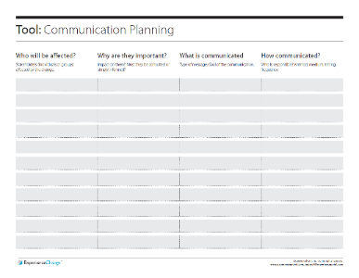
4. Motivate
The traditional view of motivation is extrinsic.
  Given by another person, typically a supervisor
  Pay raise and promotions
  Appeal to the lower needs of individuals
Today, the number one work motivator is emotion, not money. *
  Internal satisfactions a person receives in the process of performing a particular action
  Appeal to the higher needs of individuals
MAP the Drivers of Motivation: **
Mastery – the desire to get better at stuff
Autonomy – the desire to direct our own lives
Purpose – the feeling we can make a difference
TOOLS
Communication
Planning
* Source: Amabile & Kramer (Progress Principle); ** Pink (Drive)
Notes:
The traditional view of motivation: Carrots & Sticks = a combination of rewards/ benefits and punishment to induce behaviour. Interestingly, this traditional view of motivation is in reference to a cart driver dangling a carrot in front of a mule and holding a stick behind it…
What works well about this approach? (Useful for repeatable processes)
What’s challenging about it? (More complex situations, less repeatable)
Once you get past basic threshold levels (of fairness and adequacy), carrots & sticks can achieve the opposite of their intended aims. Extrinsic rewards kill intrinsic rewards (the reward becomes the key reason to do it and destroys the intrinsic enjoyment of the task itself).
Summary of the 3 Drivers of Motivation:
“People are seeking to do important work and become all they can be.”

Slide 34
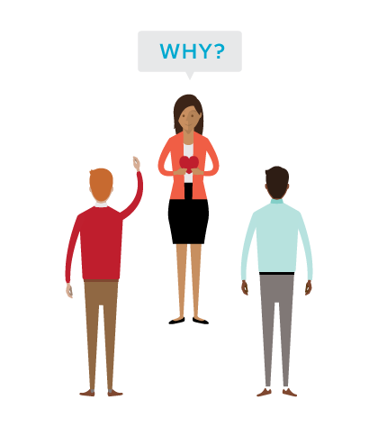
4. Motivate
Communicate ‘why’ at both a rational and emotional level.
Create sense of urgency
Consider moving towards (opportunity) vs. moving away (crisis)
Share information and communicate honestly
Ask what are the implications of status quo?
Make it personal
Why might the change be personally desirable?
MAP – Mastery, Autonomy, Purpose
Encourage input and two-way dialogue.
TOOLS
Communication
Planning
Notes:
Motivate people by creating a sense of urgency, from both a rational and an emotional perspective. Appeal to both the head and the heart.
Help stakeholders understand both the organizational and personal consequences associated with the status quo.
-----
Never underestimate the challenge of breaking people from their comfortable ways!
People often crave the security associated with the status quo
Need to be convinced that business-as-usual is not an option.

Slide 35
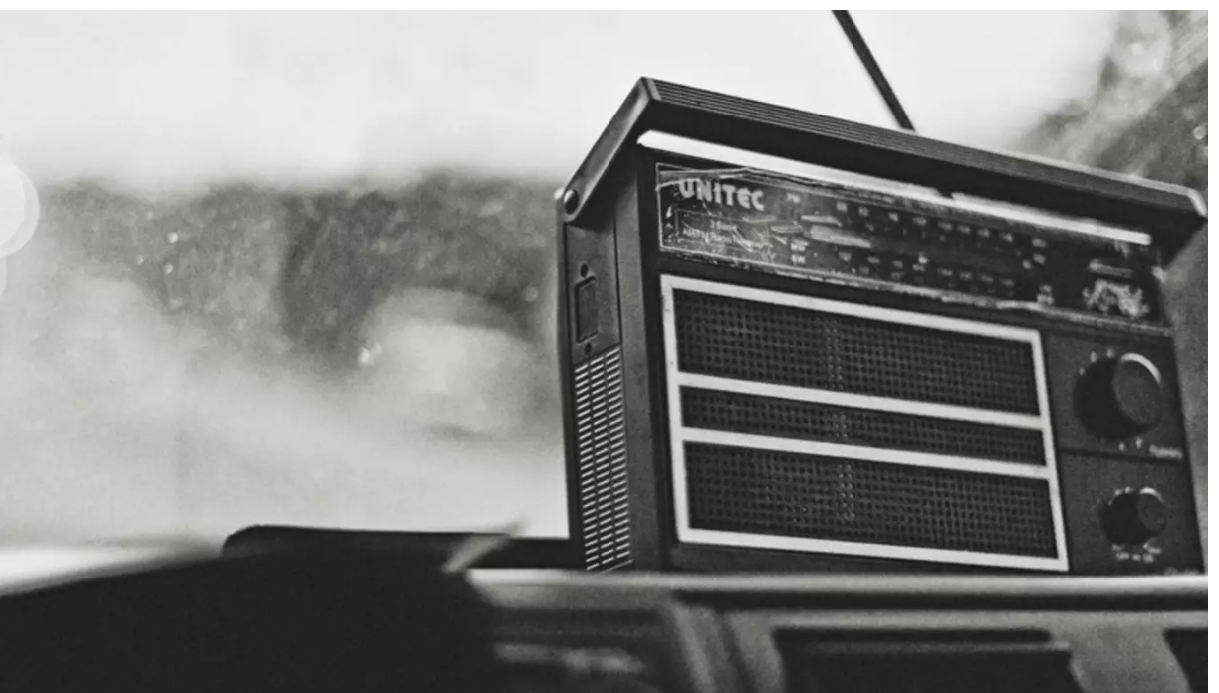
5. Communicate
Mobilize the organization around the future state.
Establish clear roles, expectations and targets
Address anxiety due to lack of certainty
Test concepts with various groups to surface barriers to adoption.
Once identified, seek to mitigate.
Communicate. What are some particularly effective methods you’ve seen?
TOOLS
In times of Change, “What’s In It For Me?” Is the Questions You Need to Answer
Communication
Planning
Notes:
Soon after a sense of urgency spreads through the organization, but before any action is taken to change systems, structures and processes, communicate the vision to affected stakeholders.
The vision provides a guiding path for understanding all ensuing change
This will help promote clarity despite organizational instability.
We communicate at every stage. BUT at this stage, it’s what we’re communicating – the solution.
Ask
What are the various communication methods you’ve seen?
How much communication is enough? As the saying goes… “Tell them what you’re going to tell them. Tell them. Then tell them what you told them.”
There's no such thing as over-communicating. Under communicating is deadly

Slide 36
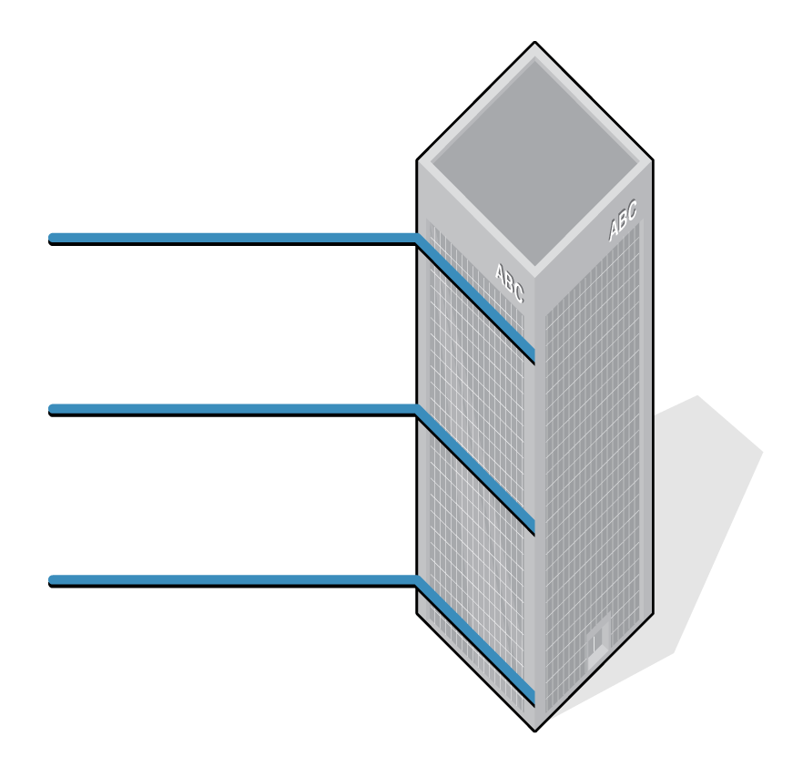
5. Communicate
WIIFM, WIIFT, WIIFO
What’s best for Org
Annual: Profit, Mkt. Share, Sustainability, Customer
What’s best for Team
Quarterly: Targets, Motivation, Teamwork, Inter-unit Cooperation
What’s best for Me
Monthly: Targets, Goals, Development Plans, Growth
Notes:
Motivate people by creating a sense of urgency, from both a rational and an emotional perspective. Appeal to both the head and the heart.
Help stakeholders understand both the organizational and personal consequences associated with the status quo.

Slide 37
Three things to remember for successfully enacting change …
Communication …
Communication …
Communication.

Slide 38
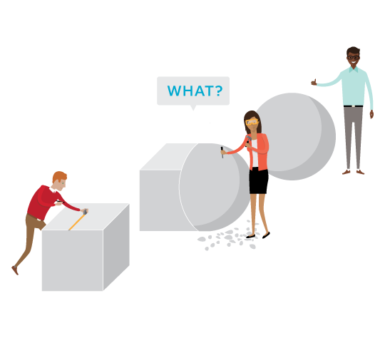
6. Act
Encourage an experimental mindset. Test ideas. Try things out in the spirit of learning.
Make structures compatible with the vision: LEAN PRACTICES
Align practices, policies, systems.
Provide the training employees need.
Generate and publicize short-term wins. “Story tell” success.
Deal with those who undercut needed change.
Notes:
Sum: Try things out… experiment
Take steps to align the organization (systems, structures, processes) with the new vision and strategy.
Test ideas (e.g., pilot projects)
Generate short-term wins

Slide 39
6. Act – Lean Practices
Lean Philosophy
Respect for people
Relentless elimination of waste through continuous improvement
Focus on adding value from the customer’s perspective
Waste = Opportunity
Wait times
Unnecessary movement
Repeated steps
etc.
Notes:
Sum: Try things out… experiment
Take steps to align the organization (systems, structures, processes) with the new vision and strategy.
Test ideas (e.g., pilot projects)
Generate short-term wins

Slide 40
6. Act – Lean Practices
Define value: by the consumer of the process
Value stream: focus on improving end-to-end flow
Flow: line up all of the essential steps into a steady continuous flow (no interruptions, no batches, and no queues)
Pull: don’t do anything until it is needed
Seek perfection: continuous improvement through scientific methodology (metrics)
Define Value
Value Stream
Flow
Pull
Seek Perfection
Source: Womack and Jones, Lean Thinking
Notes:
Sum: Try things out… experiment
Take steps to align the organization (systems, structures, processes) with the new vision and strategy.
Test ideas (e.g., pilot projects)
Generate short-term wins

Slide 41

7. Consolidate
Move into a continuous improvement loop.
How might we make things better?
Continue to review which things are working and action which things are not.
Accelerate storytelling with qualitative and quantitative success stories.
Encourage, reward and celebrate successes.
Capture lessons learned for future projects.
Notes:
Sum: Make those things that work well, stick
Institutionalize and reinforce the change
Understand and make further improvements until the change becomes part of the organization’s culture.
Celebrate successes
----
By the time organizations reach the Consolidate stage, the change program has been alive in the org for some time
- Employee stress caused less from uncertainty
- More from burnout
- Work hard to maintain the momentum of change through proper pacing

Slide 42
Next Steps
Next Class
Review the theory
Read the case
Force Field analysis
Change implementation plan - draft
Next Week
Change implementation plan - final
Come ready to play

Slide 43
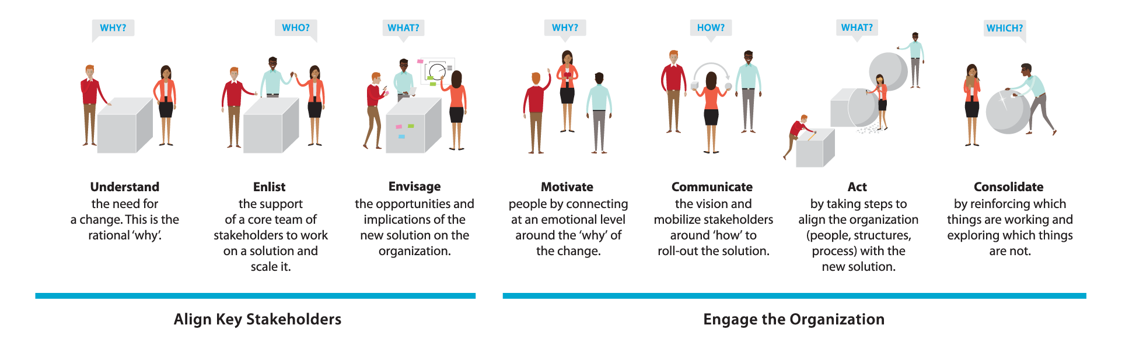
Change is How We Realize Great Solutions

Slide 44
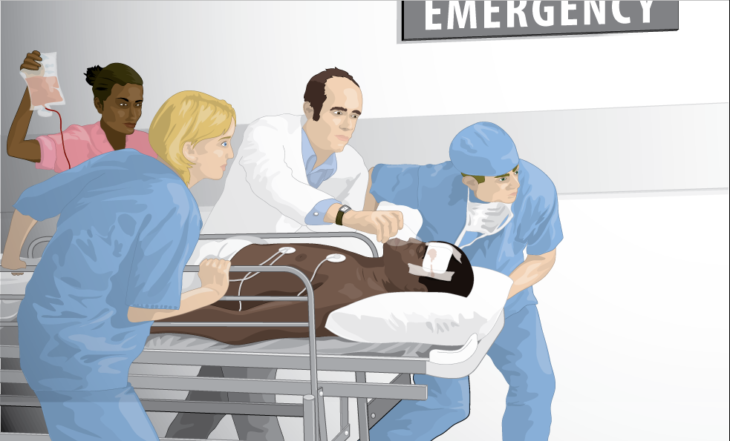
ExperienceChange: Lakeview
You are the newly hired VP
Patient Services for Lakeview Regional Hospital.
Lakeview has recently received bad press highlighting long wait times in the ED.
You’ve been asked by the Hospital’s CEO to lead a team to reduce wait times in the ED.
Notes:
Lakeview may, at first glance, look different than your organization, but let’s get to know Lakeviewand I think we may uncover a number of similarities.

Slide 45
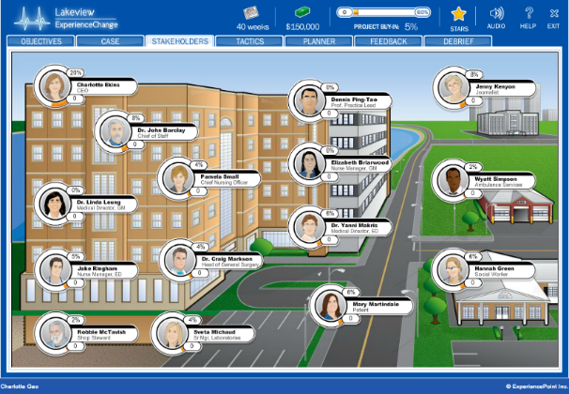
Assess the Situation at Lakeview
Review the Lakeview case
Interview stakeholders and take notes
Assess the organization for
      Driving forces for change
      Restraining forces
Notes:
Start by interviewing stakeholders to understand the forces driving (i.e. supporting) and restraining (i.e. against) change.
Return to the main classroom in [60/75 mins] and be prepared to present your assessment of the situation.
Interview Brian
Funny remark that you get to cut off the Executives
Don’t seem to mind…!
19 Stakeholders in total
Start wherever you like.
Each stakeholder provides a different perspective.
8 possible questions to ask each
Ask as many questions as you’d like but won’t have time for all so use your time wisely.
Capture notes in the Player’s Guide.

Slide 46
Force Field for Lakeview
Driving
Restraining
Rational
facts, data, overt
Emotional
political, cultural, covert
Notes:
Diving group into 4, assigning 1 quadrant to each to “own” and present.
Top forces Driving Change = Levers we want to pull
Top forces Restraining Change = Barriers we most need to pull the Levers for
Driving Forces (Rational)
Market – shifting from military (shrinking) to commercial (growing)
Financial – about 18 mos left
Driving (Emotional)
Workforce – high quality
People – Jennifer Smith respected
Restraining Forces (Rational)
Structure – siloed org
Budgets – shrinking
Workforce – union negotiations on horizon
Restraining (Emotional)
Workforce – morale suffering
Culture – finger-pointing, blame game
Why might this be useful in a change situation to do?
Helps to focus on the right things
Helps size up the situation

Slide 47
Force Field for Lakeview
Restraining
Driving
Board / CEO support Pressure from peer hospitals - Urgency created by declining numbers | Lack of cooperation Across departments Silo mentality – not my problem Lack of one team focus Inefficient processes: Triage, Lab, imaging, bed turnaround Active resisters: Medical Director & RN Manager (GM) Bad experience with change in the past
The problem is real and public Common desire to improve patient care Delivering consistent quality of care Some are engaged in the problem and some ideas exist to improve transfer and flow | Lack of single, shared vision Perceived lack of resources (HR, beds, $) Lack of buy-in from physicians & others Limited knowledge in the org about Lean Denial: Lack of understanding the “efficiency” enhancements would help patients and costs Change fatigue Lack of credibility from past
Rational
facts, data, overt
Emotional
political, cultural, covert
Notes:
Diving group into 4, assigning 1 quadrant to each to “own” and present.
Top forces Driving Change = Levers we want to pull
Top forces Restraining Change = Barriers we most need to pull the Levers for
Driving Forces (Rational)
Market – shifting from military (shrinking) to commercial (growing)
Financial – about 18 mos left
Driving (Emotional)
Workforce – high quality
People – Jennifer Smith respected
Restraining Forces (Rational)
Structure – siloed org
Budgets – shrinking
Workforce – union negotiations on horizon
Restraining (Emotional)
Workforce – morale suffering
Culture – finger-pointing, blame game
Why might this be useful in a change situation to do?
Helps to focus on the right things
Helps size up the situation

Slide 48
The Journey from Challenge to Impact is Not Linear
IMPACT
What do we expect?
Performance
(Productivity, Revenue, Margin, etc.)
CHALLENGE
Time
Notes:
Many changes come about from a desire to improve performance - like improving offers to customers or efficiencies delivering these offers.
When we undertake a challenge, what direction do we expect our organization's performance to go?
["Up, hopefully"]
By addressing this challenge we expect to achieve improved performance (higher, better, faster) in a certain period of time (6 months, 1 or 3 years).

Slide 49
The Journey from Challenge to Impact …
What actually happens?
Performance
(Productivity, Revenue, Margin, etc.)
WHY?
Time
Notes:
Q: Does the line go straight up? What actually happens?
["It often goes down"]
That's right, this is a phenomenon known as "the dip".
Q: Why does the Dip take place?
["There's a disruption in what we're doing today that requires people to adapt to a new way of doing things."]

Slide 50



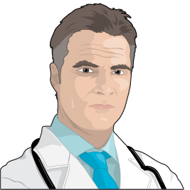
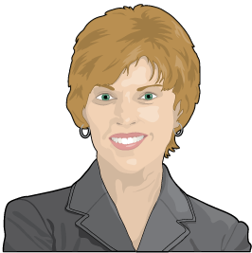
Feeling the Dip
COMMITMENT
DENIAL
At Lakeview,
who might we find
in each stage?
Charlotte Ekins
CEO
Elizabeth Briarwood
Nurse Manager, GM
EXPERIMENTATION
RESISTANCE
Jake Ringham
Nurse Manager, ED
Dr. Craig Markson
Head of General Surgery
Pamela Small
Chief Nursing Offier
DISORIENTATION
Notes:
Many of us will be familiar with the Dip. If you're familiar with the grief cycle as described by Elisabeth Kübler-Ross, you're familiar with the dip. [https://en.wikipedia.org/wiki/K%C3%BCbler-Ross_model]
There are many variations with different labels, but generally speaking, all of us move through these phases when going through change.
Even positive changes involve some sort of journey along this curve. Imagine receiving a promotion. What emotions go through your head?
Let’s think about Lakeview. Who might be in each category?
Optional Table Discussion
Split the three questions among the teams and ask to report back in 5 mins.
What kinds of questions might we ask of people who are on the down side of the slope - who are letting go?
How do you feel?; What’s unclear?; What excites you?; What concerns you?; How’s it going to affect you personally?
What kinds of questions might we ask of people who are at the bottom in the neutral zone?
Roles you could play?; Do differently?; Barriers to excitement?; Questions? Worries?; How’s it going to affect you personally?
What kinds of questions might we ask of people who are moving their way up the curve into commitment?
Continue to do?; What energizes?; Former concerns that are now allayed?; What are you most proud of?

Slide 51
Moderating the Dip
People who know
what to do (models & tools) and how to be (mindsets & reflexes) can moderate the dip and achieve impact earlier and more often.
“Success in management requires learning as fast as the world is changing”
Warren Bennis
Notes:
The Dip is natural, but it can be moderated. That's what change is all about - seeking to minimize the appitude and duration of the Dip.

Slide 52
Plan & Implement Change
Plan your change with tactic cards
Which tactics? What order?
Budget: $150,000
Timeline: 40 weeks
Implement your plan in the simulation
Be mindful of
Feedback (consider the source!)
Buy-in (60% is the goal)
Budget and time remaining
Notes:
Plan
Time to build out a change plan, using the tactics available. In [1 hour] you should have your plan at least 80% complete
No need for a computer
Decide which tactics you will use and which ones you won’t
Expect to use 20 – 30 to hit the 60% goal*
Determine the best order for implementation
Consider time & budget constraints
Some tactics identified with a star
Means you will be asked to make additional choices
[discreetly take pictures when in this phase]

Slide 53
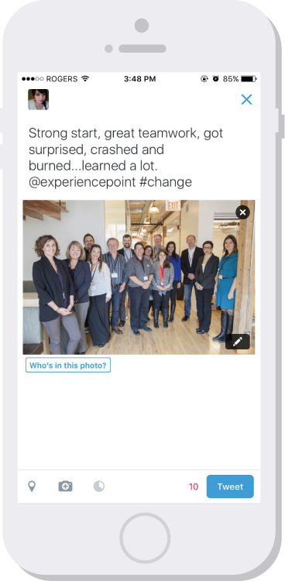
When We Regroup …
In your teams, summarize your team experience into a 280 character “tweet”. We’ll share as a part of our report-in.
Extra applause for wit!

Slide 54
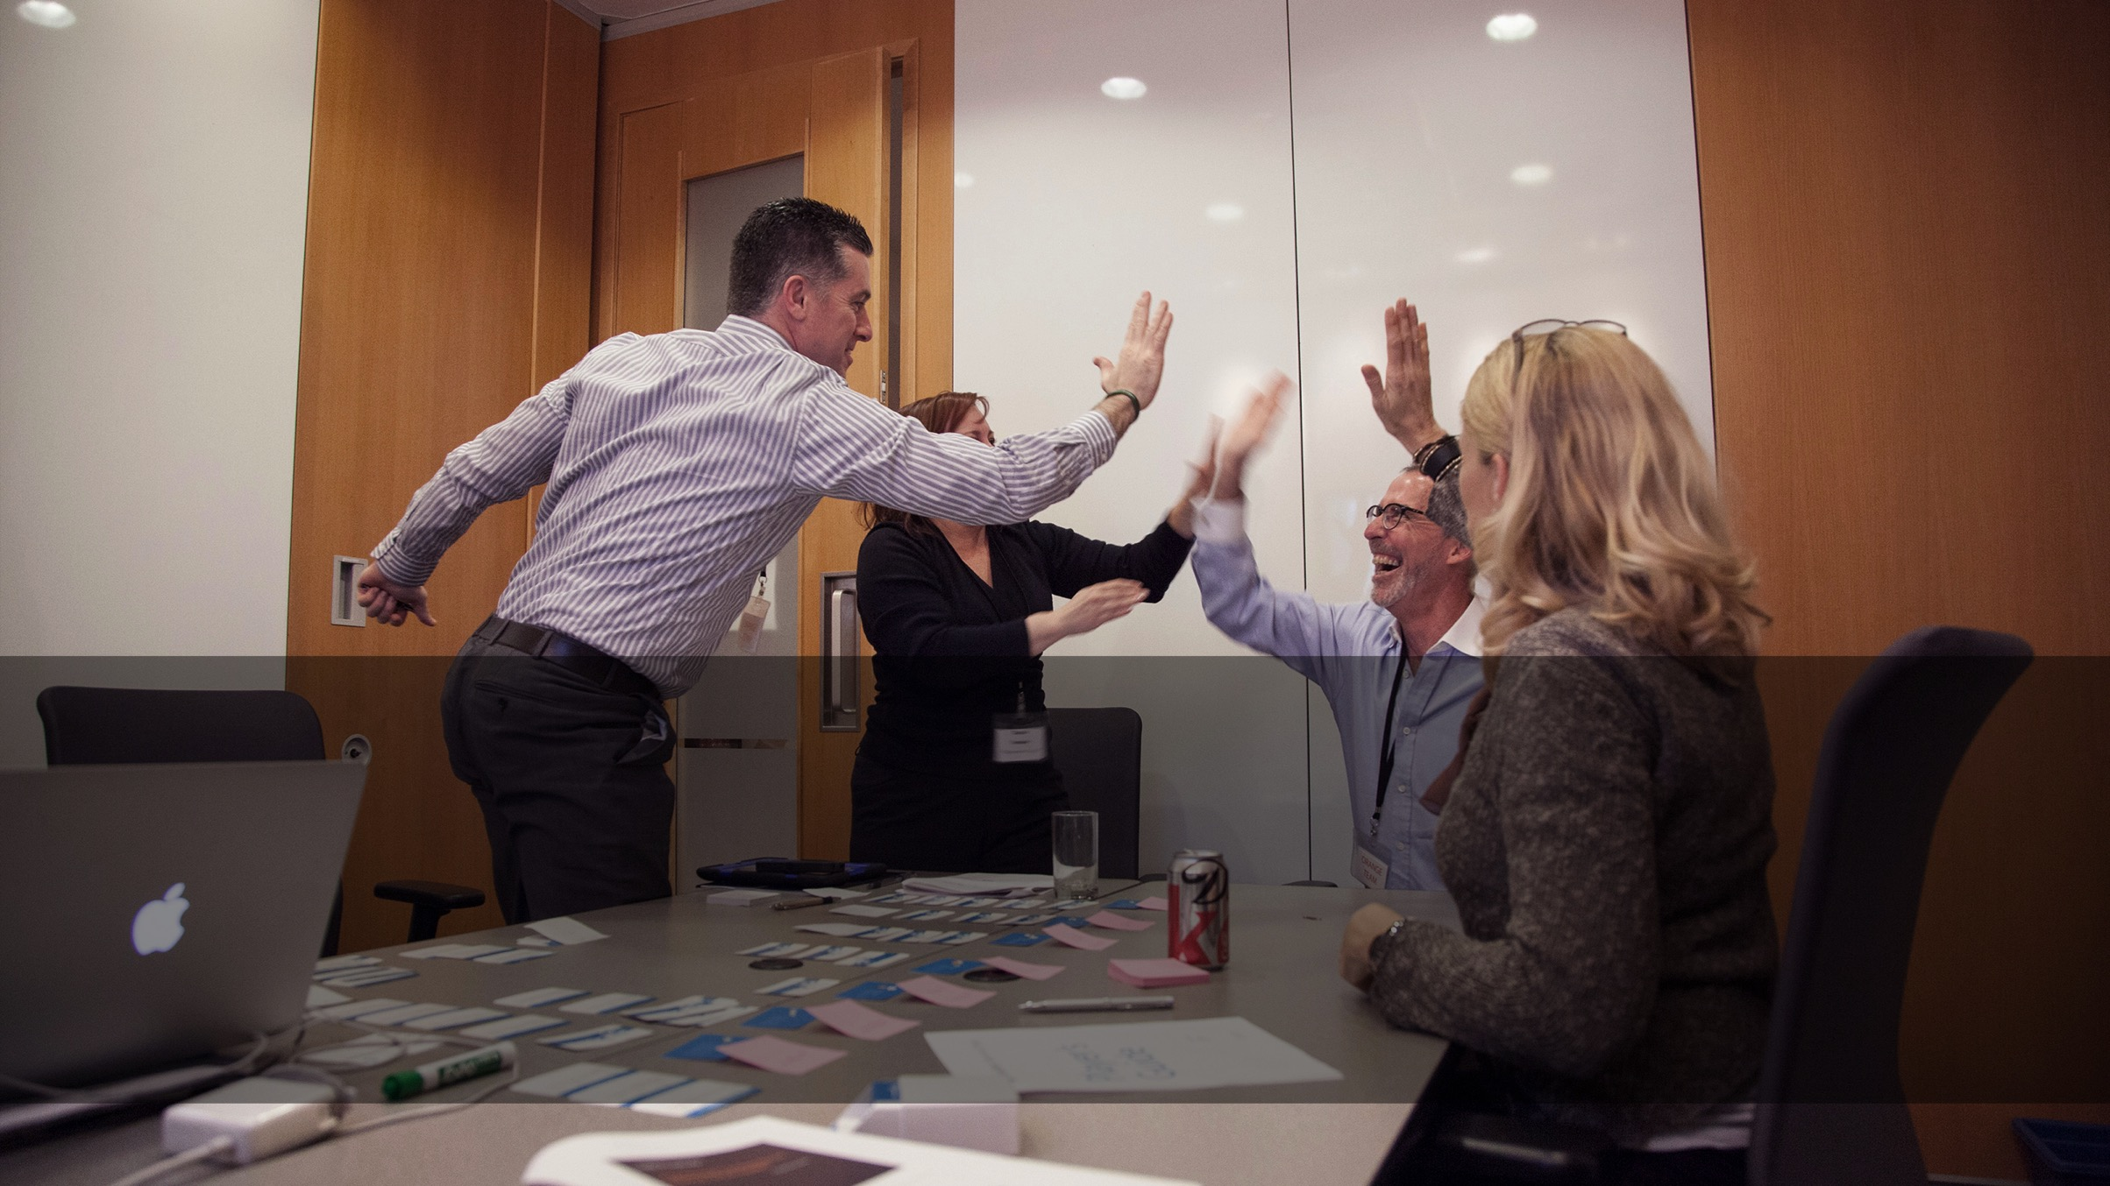
Debrief

Slide 55
Report-in on Your Change Initiative
Which tactics generated the most discussion?
What decision outcomes surprised you?

Slide 56
Your Opinion On …
How was this like your experience in the real world?

Slide 57
Change is How We Realize Great Solutions
SOLUTION
ORGANIZATION
UNDERSTAND
ENLIST
ENVISAGE
MOTIVATE
COMMUNICATE
ACT
CONSOLIDATE
Align key stakeholders
Engage the organization
Notes:
Use this framework to structure what we already know. Close the knowing/ doing gap.
There is no single right way that will guarantee success. Context is everything. The key is to consider each unique situation and create the appropriate model/ framework for planning.
This change model is designed to maximize commitment and minimize resistance to change.
Task:
Assign 1 – 2 stages/ group. Hand-out large tactic cards for full details.
Think of some stories of change done well & not so well.
Teach back through storytelling.

Slide 58
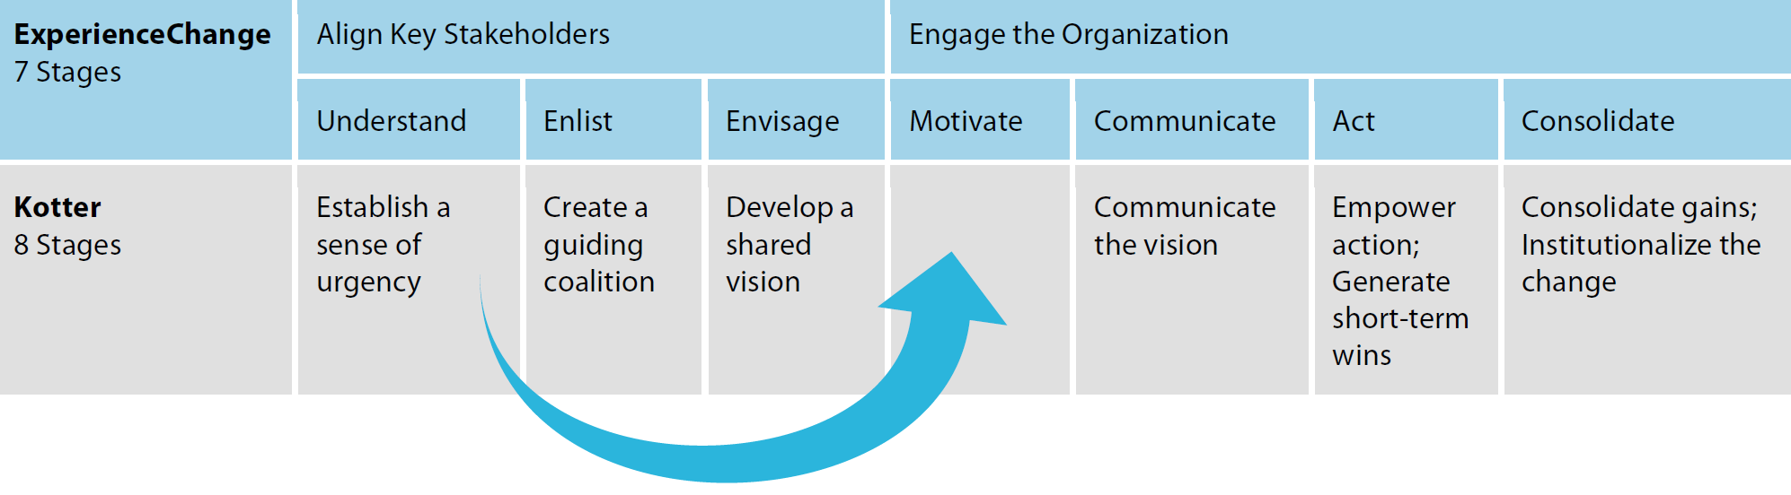
Kotter & EC
Kotter builds on a good understanding of the problem.

Slide 59
Models Reviewed
The Medicine Wheel – an Indigenous Tool for Change
McKinsey / Waterman & Peters 7S Framework
Lewin’s 3 Step Change Model
Kotter’s 8 Step Leading Change Model
ExperiencePoint’s 7 Step Change Model
The (wRight) Change Model*

Slide 60
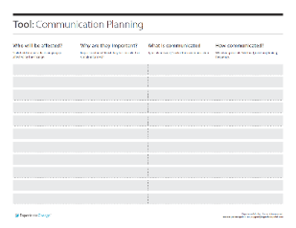
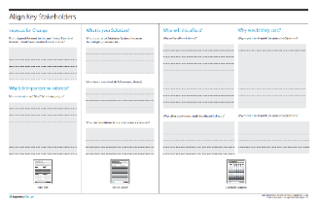
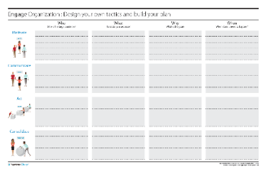
Summary: Models & Tools
Use a Model … any model (maybe even the (w)Right™ one)!
Start with Why, and not a baked solution
Go slow to go fast. Build a solid foundation
Resist urge to jump from Vision (Solution)
to Action
Engage heads and hearts
Intrinsic > Extrinsic
Plan for quick wins to learn and
build momentum
Force Field
Stakeholder Mapping
Communication
Planning
More of, Less of
Align
Engage

Slide 61
Summary: Mindsets
Learning
Orientation
Listen Carefully
Do to Learn
Lean into Ambiguity
Human-Centered
Involve others
Be Open
Be Positive
Meaningful Motion
Focus Sharply
Be Intentional
Be Patient
Notes:
Change done well is managed messiness.

Slide 62
Summary: Reflexes
Ask
“Why?” and be prepared to answer.
“Who do we need to involve?”
“What’s important to you?”
“Who else needs to know?”
“What do you think?”
Say
Inclusive, not exclusive language. “We” instead
of “me”.
Avoid “my idea”.
Use Gestalt language, where you can. “In my experience …”

Slide 63
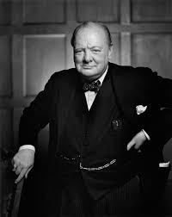
Access to Simulation
You’ll have access to the simulation for 90 days
“Success is not final, failure is not fatal: it is the courage to continue that counts” W. Churchill

Slide 64
The (w)Right Change Model TM
Me: Trust, Leadership Skills, Sharpen the Saw
Marshall: Urgency-Opportunity, Focus, Bright spots, Coalitions/Networks
Map: Political Terrain (Stakeholders), Disruptive Technologies,
Message: Vision, Values
Motivate: Communicate with the Elephant & Rider, Path, Small Wins
Manage: Clear Hurdles, Overcome Resistance, Keep an eye out for Grendel’s Mother

Slide 65
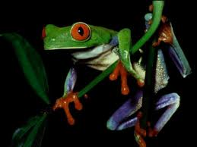
2) Marshall: Urgency - Opportunity
Discovery process step back and examine the big picture to identify critical issues
Understand the vulnerability in the organization (or, create it - Cortez)
Who are the antagonists (unite against)?
Achieved when 75% of your leadership team is honestly convinced

Slide 66
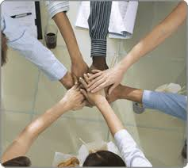
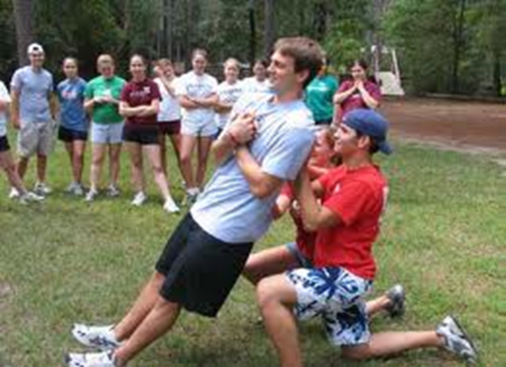
2) Marshall:
Create a Powerful Coalition
High Performance Teams
they contain people with special skills
they commit to a common purpose, establish specific goals
they have the leadership and structure to provide focus and direction
they hold themselves accountable at both the individual and team levels
there is high mutual trust among members
  Size 5-7 people
Spirit of Cooperation
Swift Trust: Leaders go first

Slide 67

3) MAP: Forces of Change
Task: What ‘environmental’ forces are causing organizations to change? (now / future)
  Economic
  Political/Legal
  Technology
  Social/Demographic
  Other?

Slide 68
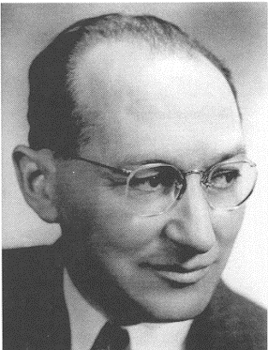
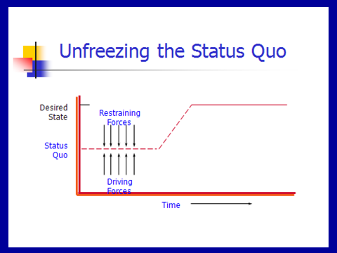
3) MAP: Force Field Analysis
Kurt Lewin

Slide 69
Lewin’s Force Field Steps
Understand / Describe Current Situation
Identify where current situation will go if no action taken
List forces driving change / restraining forces
Discuss all the forces – can they be changed? Which are the critical ones?
Determine if you can negate the restraining / enhance the driving
Recognize that changing one might impact the others (both positively and negatively)

Slide 70

Reflection Time
You are driving and as you turn the corner you drive into fog – what do you do?

Slide 71

4) Message: Inspire a Shared Vision
You first need to develop a clear vision of the future
Then share it with others to “enlist them”

Slide 72
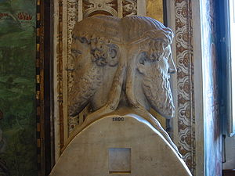


Vision: on a clear day you can see forever
Visions are about possibilities, about desired futures.
Discovery Points
  Janusian Thinking (Past/Future)
  Imagine the Ideal: what is the best that could happen?
  Discover the Theme: what / who are you passionate about?

Slide 73
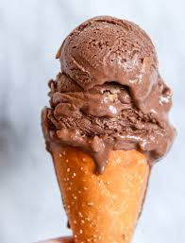
Strategic Visioning
Henry Mintzberg (1994) strategy should involve intuitive glimpses of possibility: The anticipatory principle - ongoing projection of a future image (vision)
  Taking back the RED
  Magical – on purpose or on task

Slide 74
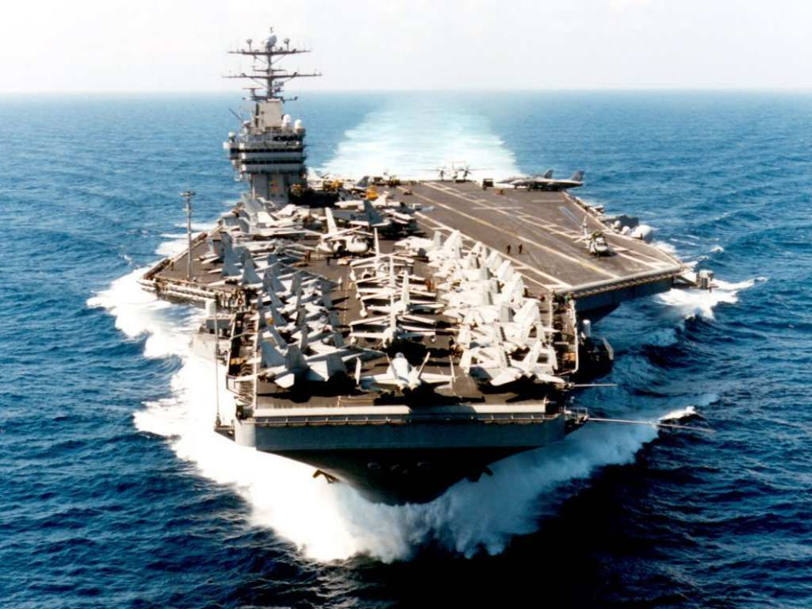
Vision: Cheering About Key Values
Aircraft Carrier
“the lost wrench”
What did the Captain do?
What does this story reinforce?
What are your Values and how will you Cheer?

Slide 75
Enlist Others
Develop a shared sense of destiny
Reminder!
Listen deeply to others - what excites them?
  Find the common ground
Discover and appeal to a common purpose
  A chance to be tested, take part in a social experiment, to do something well, do something positive, a chance to change the way things are
Give life to vision by communicating expressively
  Use powerful language – use the three peat, speak from the heart, image-analogy-feel,

Slide 76
Language of Change Leaders:
Enlist Others
Reminder!
Jay Conger
How things are framed makes a difference
  Focus on intrinsically appealing goals (+) and values
  Highlight the significance of the project (answer WHY)
  Who are the key antagonists
  Highlight why it will succeed
  Use analogies, stories, metaphors to make your point
  Allow your own emotions to surface when you speak

Slide 77

Power of Emotional Appeals
Emotional Arguments – danger, loss, unpleasantness, risk
Metaphors – machine, family, turn out the lights
Emotional Modes – pictures, slogans, music, colour
Humour – appropriate / un
Display emotions – smiles, speech tone, expressive

Slide 78
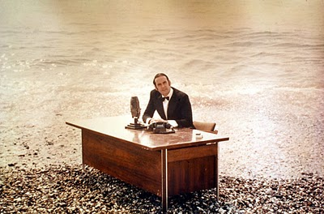
And now for something …
… completely different

Slide 79
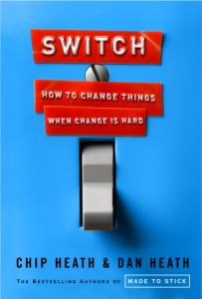
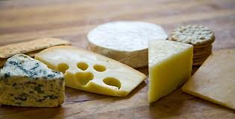
5 Motivate:
Direct the Rider
Motivate the Elephant
Shape the Path

Slide 80

Direct the Rider analytical / rational
Follow the Bright Spots: find out what’s working and clone it (story: malnutrition)
Point to the Destinations: Know where you are heading and why it’s worth it (story: destination card – ROUTE NHS, New Car)
Script the Critical Moves: Think Specific a-b-c (story: 125 calls / month, cite colleagues research)

Slide 81
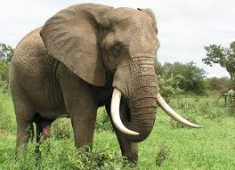
Direct the Elephant:
Putting Feelings First
Our elephant is lazy and skittish: seeking short-term benefits vs. short-term sacrifices to gain long-term benefits.
  So MOTIVATE the Elephant:
  Find the Feeling: Make people feel something (Red is fading)
  Shrink the Change: Break down the change (Head-start car wash)
  Grow your People: Cultivate a sense of identity (ST. Lucia parrot)

Slide 82


Shape the Path
Tweak the Environment: Change the situation (wearing safety glasses / cross the line)
Build Habits: rider is not taxed (action triggers, meatless Mondays)
Rally the Herd: Behaviour is contagious (majority of guests reuse their towel…)

Slide 83
Commercial Break
Think about what disturbs you, how you are being changed by the times in which we live, and how you can best cope with the times in which we live.

Slide 84
Exploring personal readiness for Change
Tolerance for Change Test
Please read the following statements. Circle the letter that best describes how you would feel in response to each statement.
A I would enjoy this very much, it’s completely acceptable
B This would be enjoyable and acceptable most of the time
C I would have no reaction to this feature one way or another
D This feature would be somewhat unpleasant for me
E This feature would be very unpleasant for me

Slide 85
Examples
I would like to live in a foreign country for a while.
It is more fun to tackle a complicated problem than to solve a simple one.
What we are used to is always preferable to what is unfamiliar (R).
Many of our most important decisions are based on insufficient information.
Teachers or supervisors who hand out vague assignments give one a chance to show initiative and originality.

Slide 86
Individual Reactions to Change
4 Stages:
Shock – perceive it as a threat
Defensive – cling to old ways
Loss of Confidence
Disrupted Habits
Individual
resistance
Fear of
the unknown
Loss of Control /
Security
Loss of
Face

Slide 87
Individual Reactions
3. Acknowledgement – sense of grief and sadness but start to be open to making things work
Adaptation and Change – ready to establish new routines and help others.
Knowing how to deal with this …

Slide 88
6) Manage: Cynicism about Change
25-40% will respond cynically to the next change
Why?
  Uninformed – lack of communication
    Action: Over-communicate – credible spokespersons, positive messages, multiple channels / repetition, two-way communication, Find the Feeling
  Previous experience
    Action: Deal with the past
  Negative disposition
    Action: Hire well
    Action: See world from employees perspective
  Lack of opportunity to be involved
    Action: Keep them involved – ask for input

Slide 89
Random Reminders and Insights …
Arouse dissatisfaction with the current state
  tell them about deficiencies in organization
Use participation in decision making
  get people involved
Build in rewards
  tie rewards to change/use recognition, status symbols, praise to get people to go along

Slide 90
Additional …
Establish goals
  e.g. achieve retention targets at end of next year
Institute smaller, acceptable changes that reinforce and support change
  e.g. procedures and rules, job descriptions, reporting relationships
Develop management structures for change
  e.g. plans, strategies, mechanisms that ensure change occurs
Maintain open, two-way communication
Notes:
This material is found on page 362-364.

Slide 91
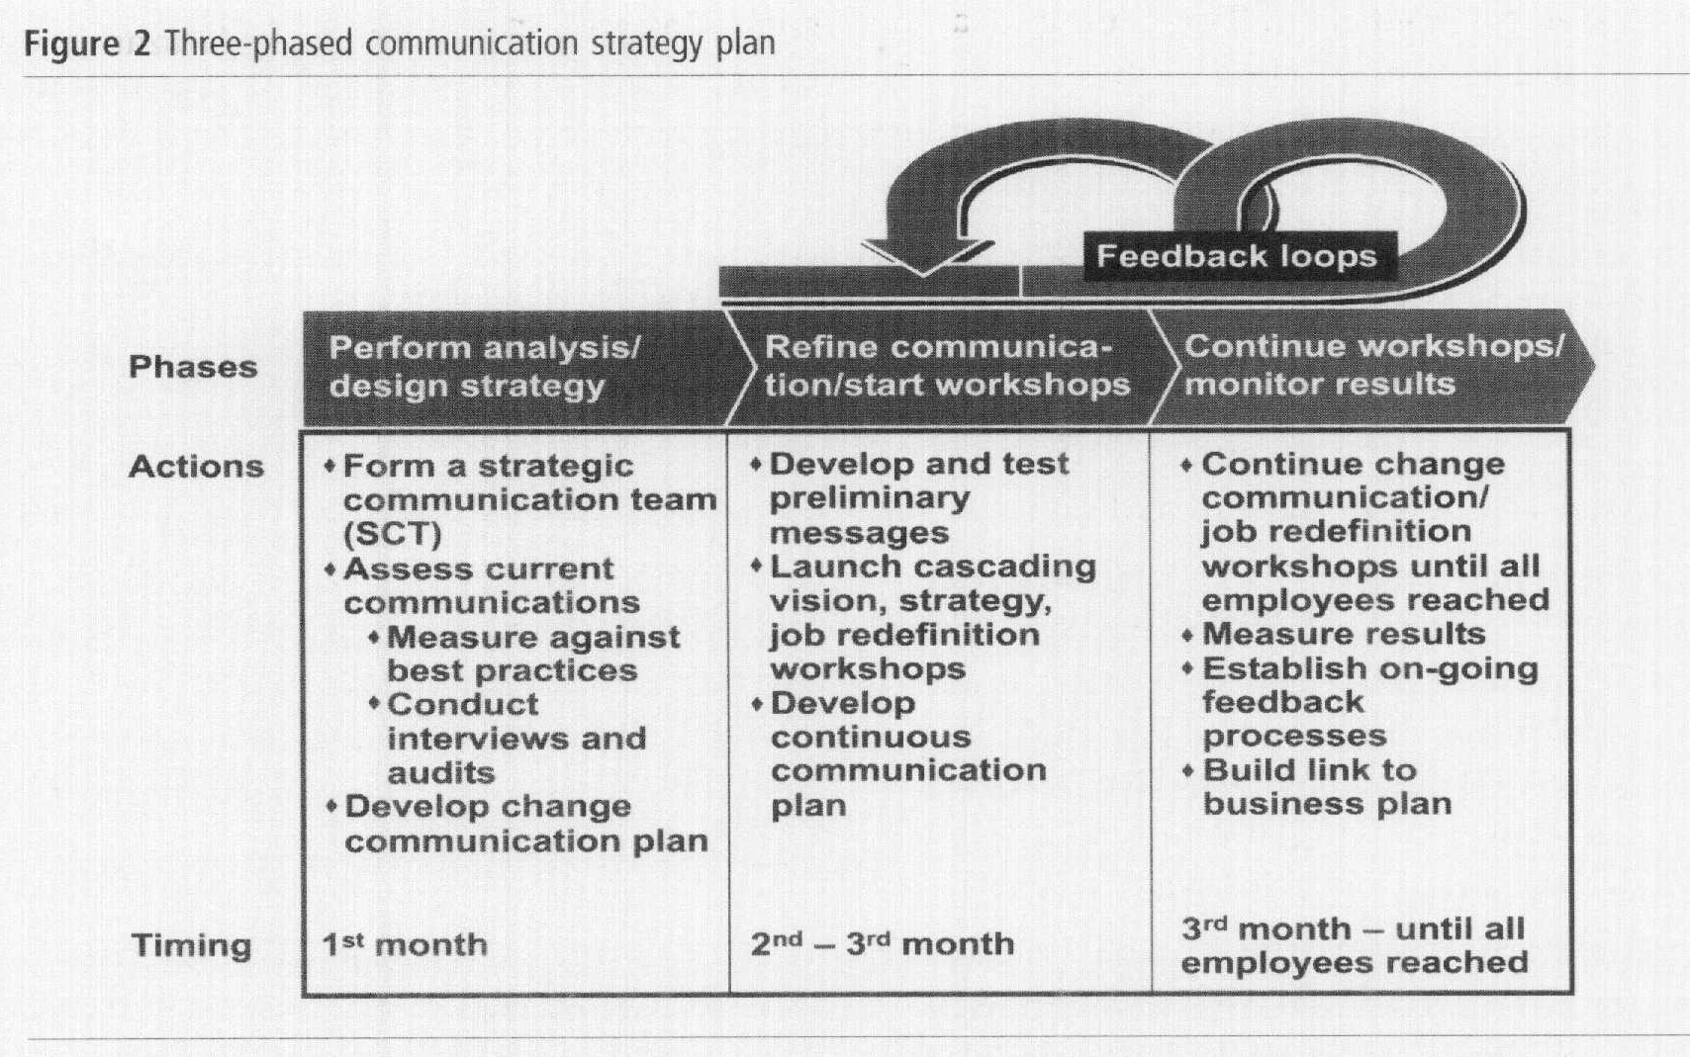
Communication: Barrett

Slide 92
Reflection Questions
What critical forces that are causing you to change?
How will you dissatisfy people from the current state?
What driving forces do you need to Enhance? Restrain?
What is your sense of urgency / opportunity?
Who is in your Powerful Coalition?
What is your vision – few words?
What’s your key value(s)?
How are you communicating
with your people?
What’s the feeling?
How are you shaping the path?
What hot spots are you focusing on? What’s your first small win?

Slide 93
Now the edgy stuff
Chaos Theory
Tipping Point
Grendel’s Mother
Darkest at Dawn

Slide 94
Tipping Point Leadership
Kim and Mauborgne HBR, 2003
Bill Bratton – Police Leader
Cognitive Hurdle
  Get people to agree on current problem (face-to-face with problems)
  Bratton began requiring that all transit police officials-beginning with himself-ride the subway to work, to meetings, and at night

Slide 95
Tipping Point Leadership
Resource Hurdle
Focus on “hot spots” and bargain with partner organizations (concentrate resources)
de-emphasizing or virtually eliminating some traditional features of transit police work while increasing emphasis on others or creating new ones - introducing mobile processing centers known as "bust buses."

Slide 96
Tipping Point Leadership
Motivational Hurdle
Put the stage lights on and frame the challenge to match organizations values
Bratton had selected precinct commanders called before a panel of the senior staff (the selected officer was given only two days' notice, in order to keep all the commanders on their toes). The commander in the spotlight was questioned by both the panel and other commanders about the precinct's performance (KEY: based on fair processes and known goals: "block by block, precinct by precinct, and borough by borough.

Slide 97
Tipping Point Leadership
Political Hurdle
Identify and silence internal opponents and isolate external ones
Bratton's alliance with the mayor's office and the New York Times isolated the courts which had opposed his zero-tolerance policing out of fear that it would clog court schedules. And, large cars.

Slide 98

Grendel’s Mother (Beowulf)
Hero – Beowulf
Grendel – monster who eats men
Beowulf mortally wounds Grendel
Happy days
Grendel’s Mother
Visit her lair
New tools

Slide 99
Change’s path
The learning curve
Successful Change
Change
Doubt
Point
Failed Change
Escalating Commitment or
Darkest before the Dawn?

Slide 100
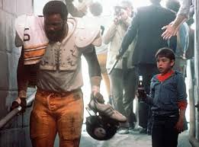

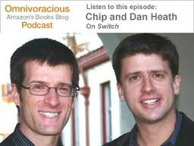
Final Exam …
Why is change so hard to enact?
Who would you rather spend an hour in conversation with – Chip or Dan Heath?
Who are you now? What are your three?

Slide 101
The (w)Right Change Model TM
Me: Trust, Leadership Skills, Sharpen the Saw
Marshall: Urgency-Opportunity, Focus, Bright spots, Coalitions/Networks
Map: Political Terrain (Stakeholders), Disruptive Technologies,
Message: Vision, Values
Motivate: Communicate with the Elephant & Rider, Path, Small Wins
Manage: Clear Hurdles, Overcome Resistance, Keep an eye out for Grendel’s Mother

