Slide 1
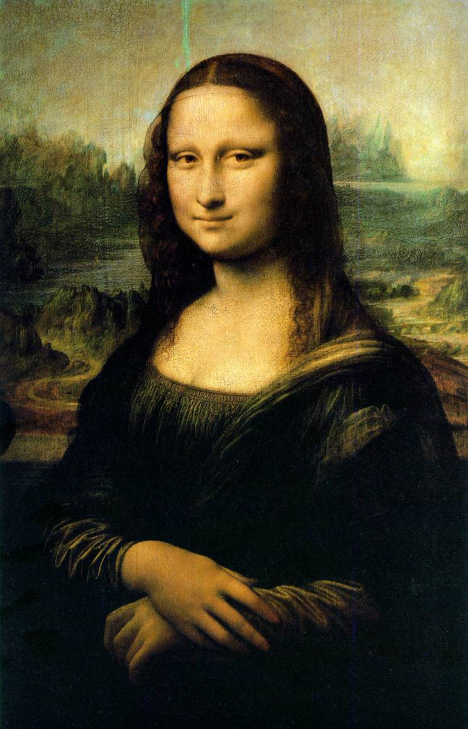
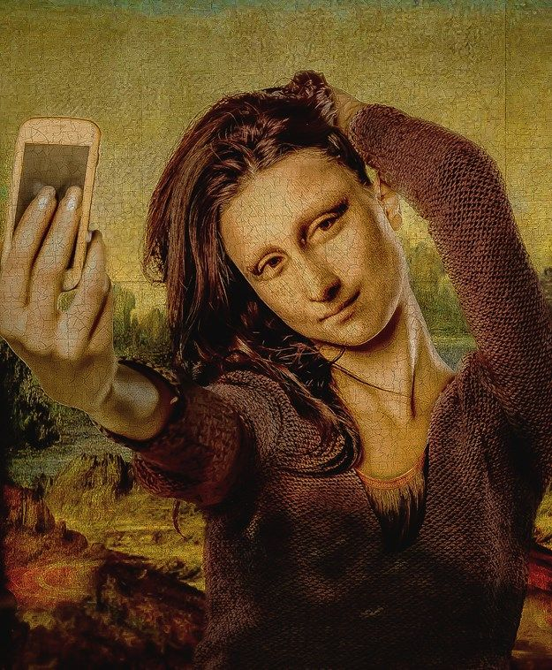
Change
Let’s change it up …

Slide 2
Answer with the first thing that comes to mind …
If Change were a colour – what colour would it be and why?
If Change were an animal – what animal would it be and why?
If Change were a sound – what sound and why?
If Change were a movie – what movie and why?

Slide 3

What insights …
Who are you now?

Slide 4

Transformational Leadership Development and CHANGE
Big Insight? (So What Moment)
BIG questions about the study?
Takeaways – who are you now?

Slide 5

Next Class
Barry’s 6 M model
Prep – bring your updated ‘cheat sheet’ to add your insights to the model (based upon your change agent skill set)

