Slide 1
(Successfully) Enacting Organizational Change
Barry Wright
Goodman School
Brock University

Slide 2
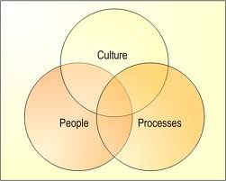
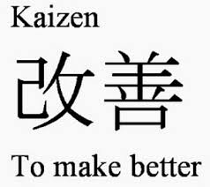
Develop your own Change Path
Team (perspective) get in groups of four or five
Draw from theories, principles, models to guide our journey (W)Right Model
Goal: Start the planning process

Slide 3
The (w)Right Change Model TM
Me: Trust, Leadership Skills, Sharpen the Saw
Marshall: Urgency-Opportunity, Focus, Bright spots, Coalitions/Networks
Map: Political Terrain (Stakeholders), Disruptive Technologies,
Message: Vision, Values
Motivate: Communicate with the Elephant & Rider, Path, Small Wins
Manage: Clear Hurdles, Overcome Resistance, Keep an eye out for Grendel’s Mother

Slide 4

1) ME: What do followers want from (change) leaders?
Honest - consistency
Forward Looking - vision
Inspiring - cheerleader, excited, passionate
Competent - record of achievement
Credible - Trustworthy

Slide 5

Credible Leader
People will first follow the leader – then they follow the plan.
DWYSYWD

Slide 6
Credibility Insight
First Law of Leadership
“If we don’t believe in the messenger, we won’t believe in the message

Slide 7
The (w)Right Change Model TM
Me: Trust, Leadership Skills, Sharpen the Saw
Marshall: Urgency-Opportunity, Focus, Bright spots, Coalitions/Networks
Map: Political Terrain (Stakeholders), Disruptive Technologies,
Message: Vision, Values
Motivate: Communicate with the Elephant & Rider, Path, Small Wins
Manage: Clear Hurdles, Overcome Resistance, Keep an eye out for Grendel’s Mother

Slide 8
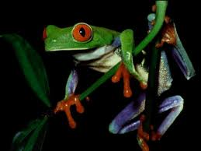
2) Marshall: Urgency - Opportunity
Discovery process step back and examine the big picture to identify critical issues
Understand the vulnerability in the organization (or, create it - Cortez)
Who are the antagonists (unite against)?
Achieved when 75% of your leadership team is honestly convinced

Slide 9
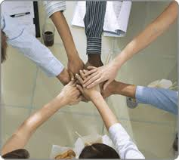
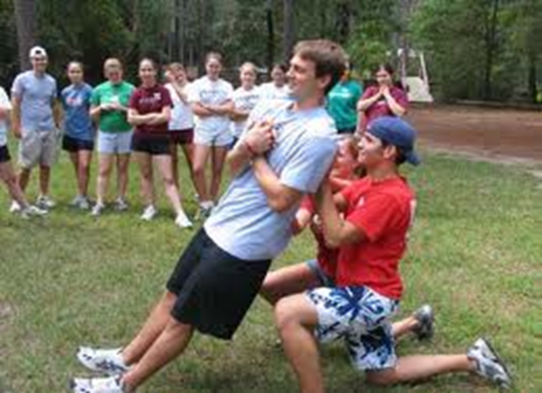
2) Marshall:
Create a Powerful Coalition
High Performance Teams
they contain people with special skills
they commit to a common purpose, establish specific goals
they have the leadership and structure to provide focus and direction
they hold themselves accountable at both the individual and team levels
there is high mutual trust among members
  Size 5-7 people
Spirit of Cooperation
Swift Trust: Leaders go first

Slide 10
The (w)Right Change Model TM
Me: Trust, Leadership Skills, Sharpen the Saw
Marshall: Urgency-Opportunity, Focus, Bright spots, Coalitions/Networks
Map: Political Terrain (Stakeholders), Disruptive Technologies,
Message: Vision, Values
Motivate: Communicate with the Elephant & Rider, Path, Small Wins
Manage: Clear Hurdles, Overcome Resistance, Keep an eye out for Grendel’s Mother

Slide 11

3) MAP: Forces of Change
Task: What ‘environmental’ forces are causing the organization to change? (now / future)
  Economic
  Political/Legal
  Technology
  Social/Demographic
  Other?

Slide 12
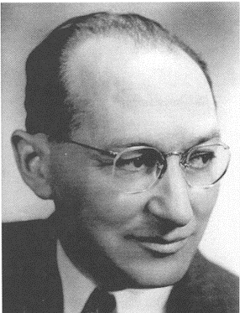
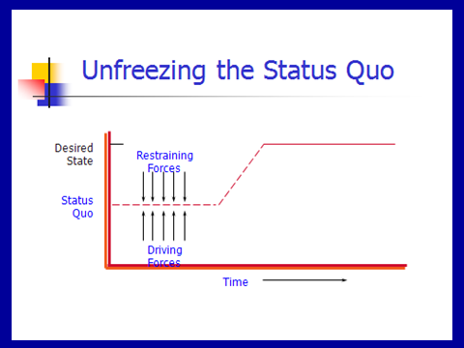
3) MAP: Force Field Analysis
Kurt Lewin

Slide 13
Lewin’s Force Field Steps
Understand / Describe Current Situation
Identify where current situation will go if no action taken
List forces driving change / restraining forces
Discuss all the forces – can they be changed? Which are the critical ones?
Determine if you can negate the restraining / enhance the driving
Recognize that changing one might impact the others (both positively and negatively)

Slide 14

Reflection Time
You are driving and as you turn the corner you drive into fog – what do you do?

Slide 15


4) Message: Inspire a Shared Vision
You first need to develop a clear vision of the future
Then share it with others to “enlist them”

Slide 16
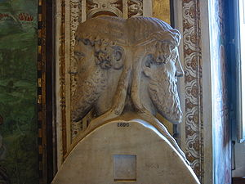
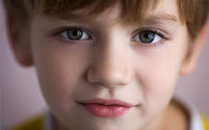
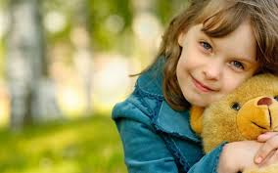
Vision: on a clear day you can see forever
Visions are about possibilities, about desired futures.
Discovery Points
  Janusian Thinking (Past/Future)
  Imagine the Ideal: what is the best that could happen?
  Discover the Theme: what / who are you passionate about?

Slide 17
Strategic Visioning
Henry Mintzberg (1994) strategy should involve intuitive glimpses of possibility: The anticipatory principle - ongoing projection of a future image (vision)
  Taking back the RED
Let’s have some fun!

Slide 18
Write down the First thing that comes to mind …
If ORG were an ….
ANIMAL – what would it be? (And Why?)
SOUND?
COLOUR?
What should the ORG be
ANIMAL
SOUND
COLOUR

Slide 19
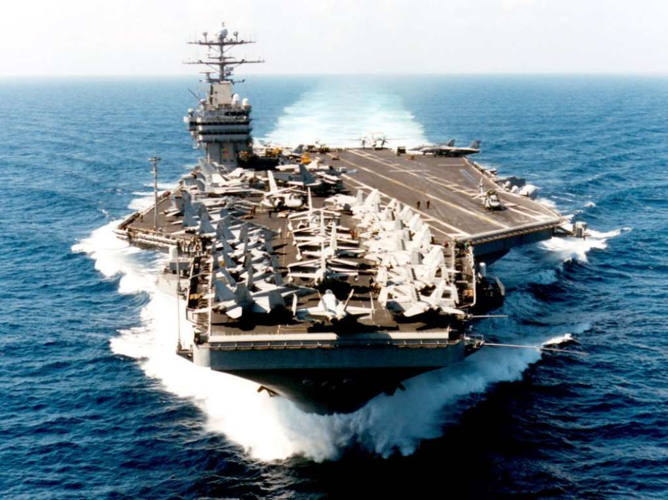
Vision: Cheering About Key Values
Aircraft Carrier
“the lost wrench”
What did the Captain do?
What does this story reinforce?
What are Sofna’s Values and how will you Cheer?

Slide 20
Enlist Others
Develop a shared sense of destiny
Reminder!
Listen deeply to others - what excites them?
  Find the common ground
Discover and appeal to a common purpose
  A chance to be tested, take part in a social experiment, to do something well, do something positive, a chance to change the way things are
Give life to vision by communicating expressively
  Use powerful language – use the three peat, speak from the heart, image-analogy-feel,

Slide 21
Language of Change Leaders:
Enlist Others
Reminder!
Jay Conger
How things are framed makes a difference
  Focus on intrinsically appealing goals (+) and values
  Highlight the significance of the project (answer WHY)
  Who are the key antagonists
  Highlight why it will succeed
  Use analogies, stories, metaphors to make your point
  Allow your own emotions to surface when you speak

Slide 22

Power of Emotional Appeals
Emotional Arguments – danger, loss, unpleasantness, risk
Metaphors – machine, family, turn out the lights
Emotional Modes – pictures, slogans, music, colour
Humour – appropriate / un
Display emotions – smiles, speech tone, expressive

Slide 23
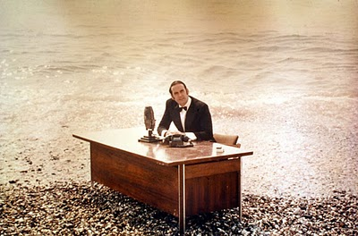
And now for something …
… completely different

Slide 24

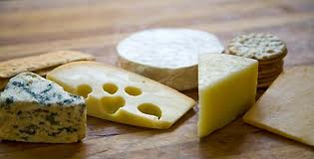
5 Motivate:
Direct the Rider
Motivate the Elephant
Shape the Path

Slide 25

Direct the Rider analytical / rational
Follow the Bright Spots: find out what’s working and clone it (story: malnutrition)
Point to the Destinations: Know where you are heading and why it’s worth it (story: destination card – ROUTE NHS, New Car)
Script the Critical Moves: Think Specific a-b-c (story: 125 calls / month, cite colleagues research)

Slide 26
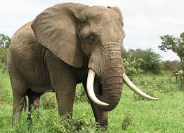
Direct the Elephant:
Putting Feelings First
Our elephant is lazy and skittish: seeking short-term benefits vs. short-term sacrifices to gain long-term benefits.
  So MOTIVATE the Elephant:
  Find the Feeling: Make people feel something (Red is fading)
  Shrink the Change: Break down the change (Head-start car wash)
  Grow your People: Cultivate a sense of identity (ST. Lucia parrot)

Slide 27


Shape the Path
Tweak the Environment: Change the situation (wearing safety glasses / cross the line)
Build Habits: rider is not taxed (action triggers, meatless Mondays)
Rally the Herd: Behaviour is contagious (majority of guests reuse their towel…)

Slide 28
6) Manage: Cynicism about Change
25-40% will respond cynically to the next change
Why?
  Uninformed – lack of communication
    Action: Over-communicate – credible spokespersons, positive messages, multiple channels / repetition, two-way communication, Find the Feeling
  Previous experience
    Action: Deal with the past
  Negative disposition
    Action: Hire well
    Action: See world from employees perspective
  Lack of opportunity to be involved
    Action: Keep them involved – ask for input

Slide 29
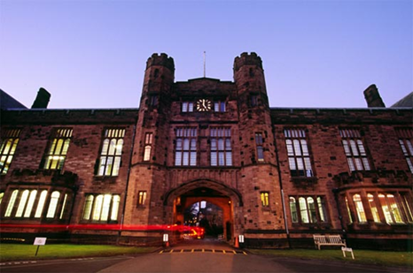
Reflection Questions
What critical forces that are causing you to change?
How will you dissatisfy people from the current state?
What driving forces do you need to Enhance? Restrain?
What is your sense of urgency / opportunity?
Who is in your Powerful Coalition?
What is your vision – few words?
What’s your key value(s)?
How are you communicating
with your people?
What’s the feeling?
How are you shaping the path?
What hot spots are you focusing on? What’s your first small win?

Slide 30
The (w)Right Change Model TM
Me: Trust, Leadership Skills, Sharpen the Saw
Marshall: Urgency-Opportunity, Focus, Bright spots, Coalitions/Networks
Map: Political Terrain (Stakeholders), Disruptive Technologies,
Message: Vision, Values
Motivate: Communicate with the Elephant & Rider, Path, Small Wins
Manage: Clear Hurdles, Overcome Resistance, Keep an eye out for Grendel’s Mother

