Slide 1
(Successfully) Enacting Organizational Change

Slide 2
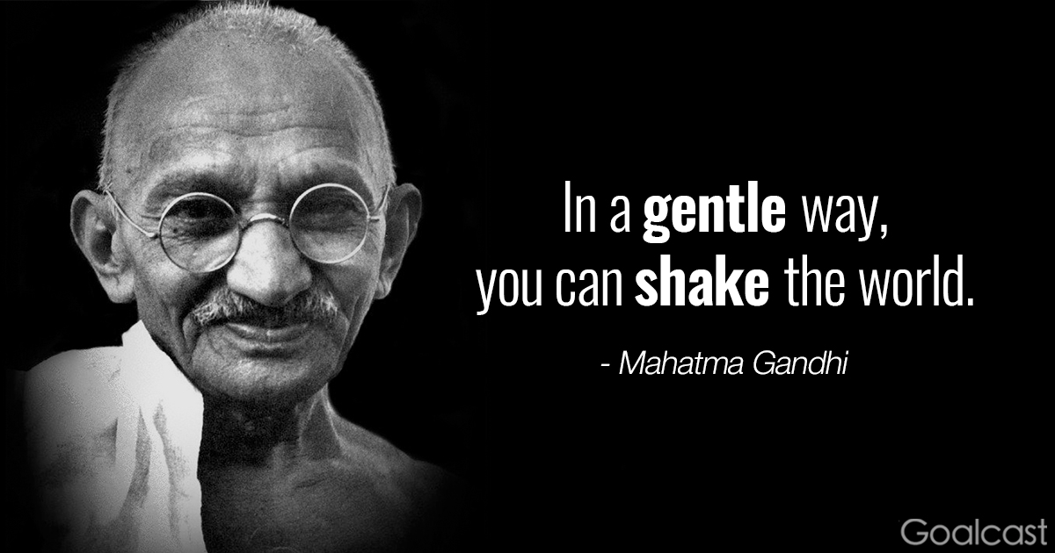
Check-In
Thoughts, Reflections, Questions?

Slide 3

Who are you now?
Insight – Reflect – Enact
What are your wisdom points

Slide 4
Innovation
Yea not busy being born – is busy dying (Bob Dylan)
Product / Process Innovation
Innovation Lab (new building)
Innovation Process: Imagine, Design, Experimentation, Feasibility, Final

Slide 5
Challenge of Change
There is nothing more difficult to take in hand, more perilous to conduct, or more uncertain in its success, than to take the lead in the introduction of a new order of things.
Nicolo Machiavelli - The Prince.

Slide 6

What is organizational change?
Organizational change occurs when an organization restructures resources to create value and improve effectiveness.

Slide 7

Change Prevelance
A recent study n=309
HRM executives
100% were going through change
  merger,
  acquisition,
  divestiture,
  global competition,
  restructuring

Slide 8

Please finish this quote
Change done to us …
Change done by us …
At the root, change done to us, we’re being asked to comply.
* People respond by doing what’s asked
Compliance
Change done by us, we’re committed to it, we’re going to get it done no matter what
* People respond by doing what it takes.
Commitment
Notes:
How does that make us feel? (show each statement)
Why is that?
At the root, change done to us, we’re being asked to comply.
* People respond by doing what’s asked
Change done by us, we’re committed to it, we’re going to get it done no matter what
* People respond by doing what it takes.
Commitment vs. compliance

Slide 9
Types of Change …
Content of Change
Radical change
Revolutionary change
Crisis situation
Top down
Rare
Episodic
Kaikaku
Examples: M&As, restructurings, change of leadership
Emergent change
Organic change
Part of daily life
Bottom up
Frequent
Continuous
Kaizen
Examples: project work, changing values
Notes:
There are many types and levels of change … but there is a simple formula

Slide 10

Discussion
A colleague has just been asked to lead a major initiative.
S/He has turned to you for advice.
Share your stories and distill into change lessons learned.
Two / Five / Three

Slide 11
Change Models
The Medicine Wheel
McKinsey / Waterman & Peters 7S Framework
Lewin’s Three Step Model of Change
Kotter’s 8 Step Leading Change Model
Experience Point’s 7 Step Change Model OR …. The (wRight) Change Model

Slide 12
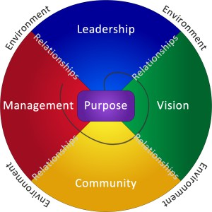
The Medicine Wheel - A Tool for Change
The particular archetypes appointed to north, east, south, west and the relationship between them, set within a mandala or circle is from the wisdom of North American Indigenous peoples.
Different Tribes and Nations have/had different interpretations and configurations.
Seven components of an organization’s operating matrix:
  Purpose, leadership, vision, community, management, relationships, and the circle of the whole within its environment.
  The order of the process of reflecting about each component was essential to obtain consistent and cross cultural results.
The Medicine Wheel – a change tool

Slide 13
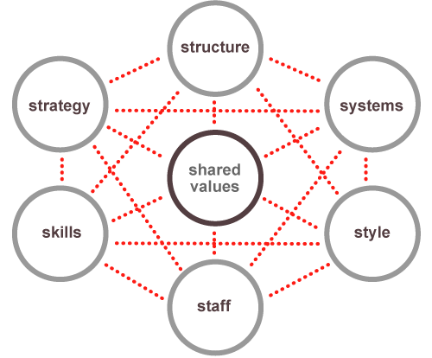
McKinsey / Waterman & Peters’ 7S Framework
Often used as a guiding map for organizational change
Examine the likely effects of future changes within
Align departments and processes during a merger or acquisition
Determine how best to implement a proposed strategy
A change in one element may impact other elements
Reference: Waterman, P., Peters, T., (1982) In Search of Excellence
Notes:
Featured in the book In Search of Excellence, by former McKinsey consultants Thomas J. Peters and Robert H. Waterman, the framework maps a constellation of interrelated factors that influence an organization's ability to change.
The lack of hierarchy among these factors suggests that significant progress in one part of the organization will be difficult without working on the others.

Slide 14
Elements of 7S Framework
Soft Elements
Hard Elements
Shared Values: Core values
Style: Leadership style
Staff: Employees as individuals and their broad abilities
Skills: The skills and competencies of employees
Strategy: Organizational plan or route-map to maintain competitive advantage
Structure: Organizational hierarchy
Systems: The day-to-day processes and procedures across the organization
https://www.mckinsey.com/business-functions/strategy-and-corporate-finance/our-insights/enduring-ideas-the-7-s-framework
Hayes (2014) The Theory and Practice of Change Management, Macmillan Education UK.

Slide 15
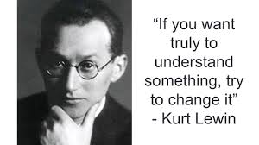
Lewin’s Three Step Change Model
The three step change model
  Unfreeze – shock a system out of stasis
  Move – make purposeful adjustments
  Refreze – consolidate change by systematically engraining adjustments
Kurt Lewin, 1890 – 1947
Founding father of social, applied and organizational pyschology
Also known for:
Gestalt Psychology
Action research
Force-field analysis
Notes:
Gestalt psychology or gestaltism is a philosophy of mind of the Berlin School of experimental psychology. Gestalt psychology is an attempt to understand the laws behind the ability to acquire and maintain meaningful perceptions in an apparently chaotic world. The central principle of gestalt psychology is that the mind forms a global whole with self-organizing tendencies.

Slide 16

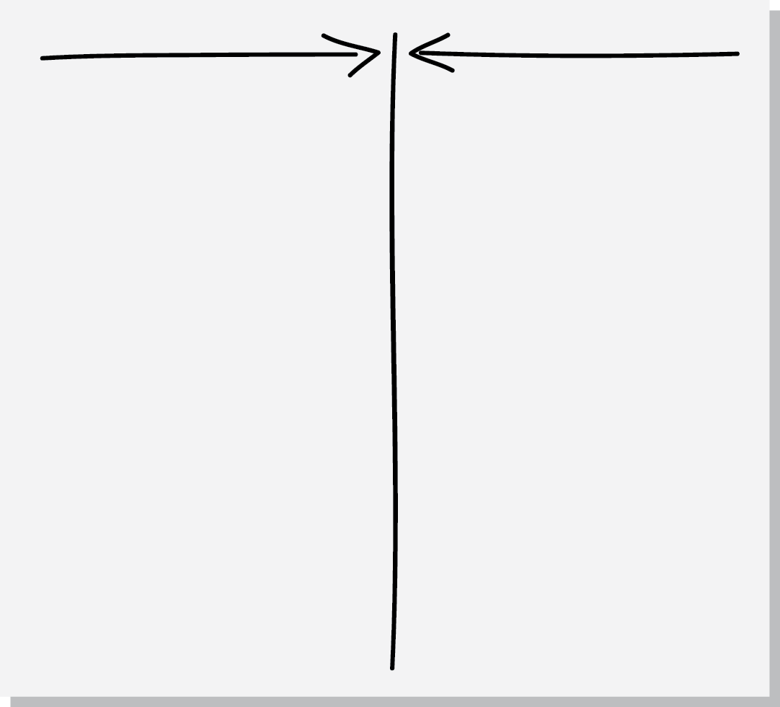
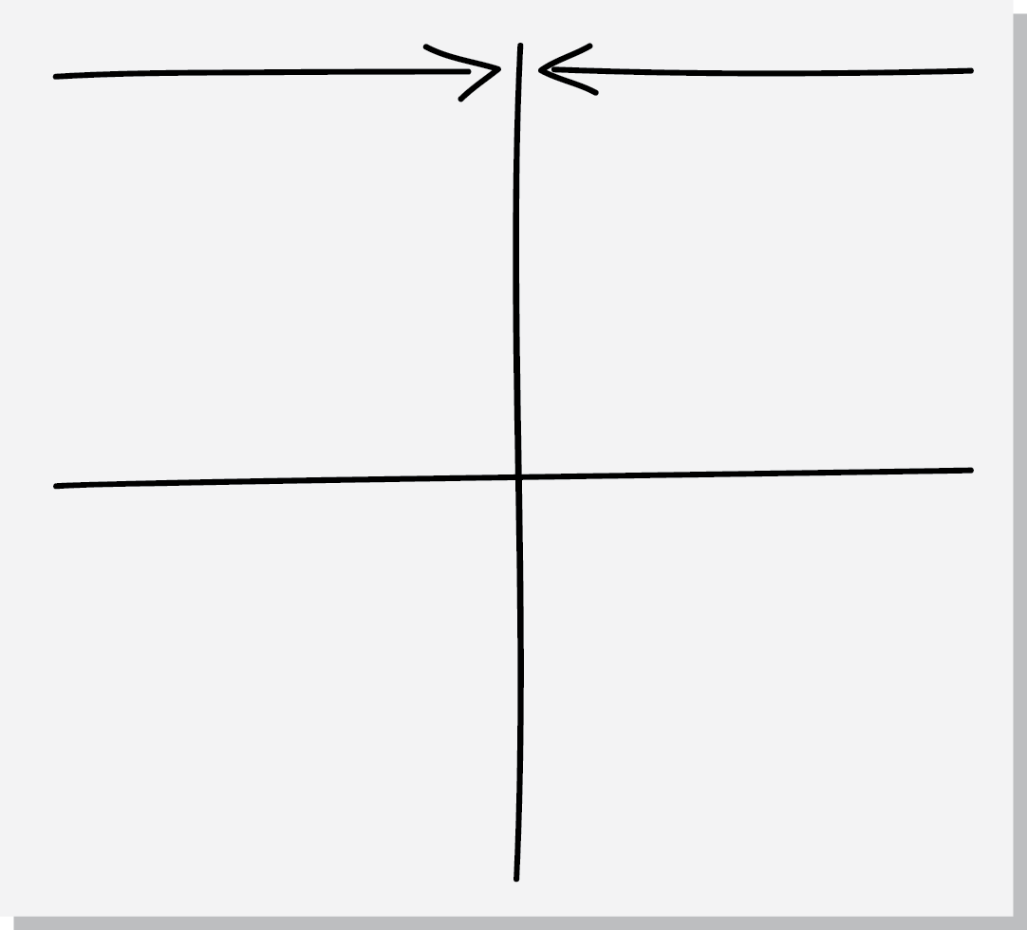
Force-Field Analysis
What is the problem/change issue?
Where are you now? Where might current situation go if no action is taken?
Where do you want to go (vision)?
What are the driving & restraining forces?
What action(s) can minimize resisting forces and maximize driving forces – recognizing that changing one might impact the others (both positively and negatively)
Discus all the forces – can they be changed? Which are the critical ones?
Driving
Restraining
Rational
facts, data, overt
Emotional
political, cultural, covert
Notes:
Set up The Force Field as a great tool for analysis and as a framework for discussion.
Illustrate importance of Rational & Emotional
------
The Force Field is a great tool for analysis and as a framework for discussion.
"Force Field" is a fancy way of saying that there are lots of different factors (or, forces) for and against making change that we need to be aware of.
Driving forces = positive forces for change
Restraining forces = obstacles to change
Orgs will always be driving forces that make change attractive to people, and restraining forces that work to keep things as they are
Successful change is achieved by strengthening the driving forces and/or weakening the restraining forces

Slide 17
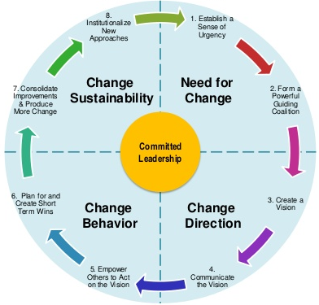
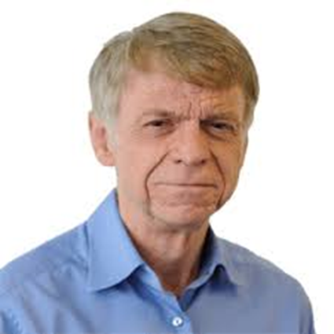
Kotter’s Eight Step Leading Change Model
Notes:
Play video from 25 seconds inwards
Warning about the tone of voice over

Slide 18
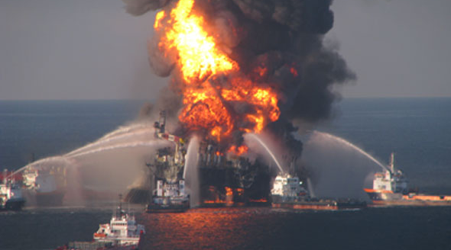

Need for Change - Kotter
Create a Sense of Urgency
Form a Powerful Enough Guiding Coalition
Examining market and competitive realities
Identifying and discussing potential crises, or major opportunities
75% of your leadership team is convinced
Assembling a group with enough power to lead the change effort
Encouraging the group to work together as a team

Slide 19


Change Direction - Kotter
Create a Vision
Communicate the Vision
Creating a vision to help direct the change effort
Developing strategies for achieving that vision
Using every possible communication channel
Teaching new behaviors by the example of the guiding coalition

Slide 20


Change Behaivour - Kotter
Empower Others to Act on the Vision
Plan for and Create Quick Wins
Remove obstacles to change
Changing systems or structures that seriously undermine vision
Encouraging risk taking and non traditional ideas, activities and actions
Planning for visible performance improvements
Creating those improvements
Recognizing and rewarding employees involved in the improvements

Slide 21
Implementing & Sustaining the Change - Kotter
Consolidating Improvements and Producing Still More Change
Institutionalizing New Approaches
Using increased credibility to change systems, structures, and policies that don’t fit the vision
Hiring, promoting, and developing employees who can implement the vision
Reinvigorating the process with new projects, teams and change projects
Articulating the connections between the new behaviors and corporate success
Developing the means for leadership succession and development

Slide 22
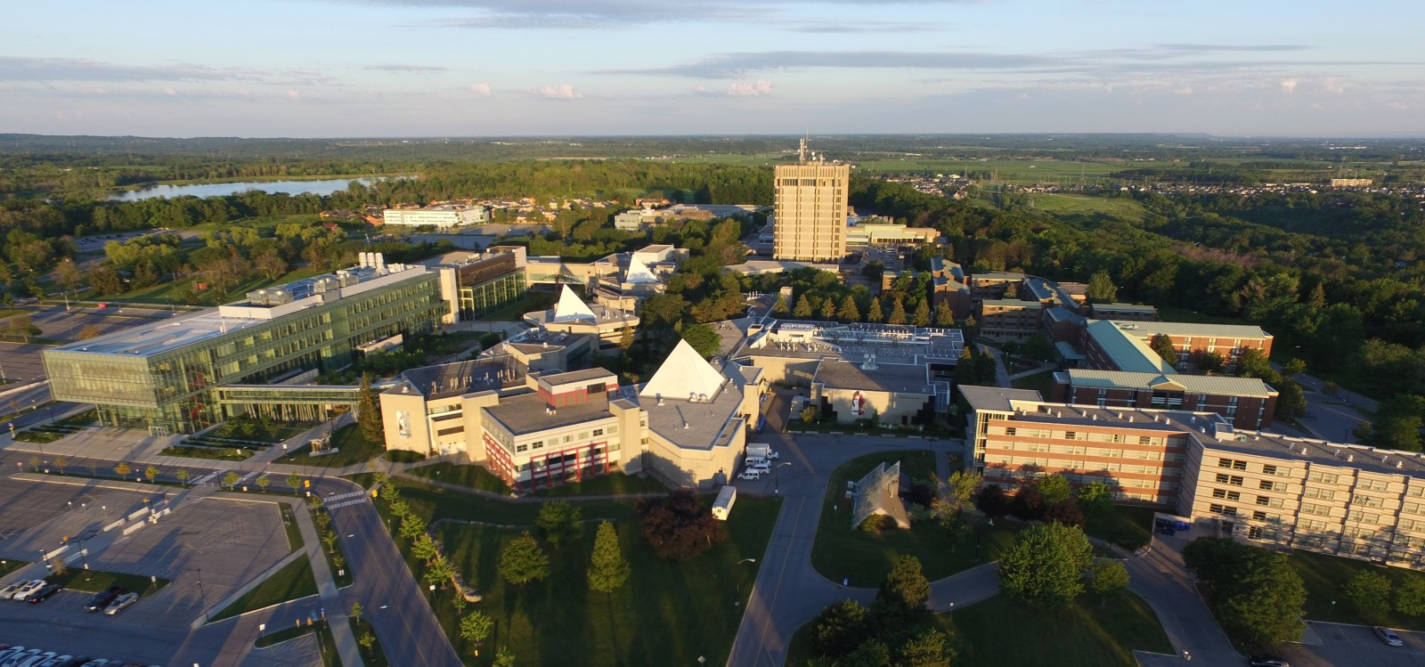

Live Case
Brock / McMaster Merger
Queen’s Park has decided that all universities will merge with their next door neighbor.
Brock and McMaster’s Board of Trustees have appointed you and your consulting team to lead the change effort.

Slide 23


Organizational Change: Let’s Make a Model
Get up, stand up! Let’s organize by your birth date – month and day without speaking or writing
Now, let’s organize in stages of the change model:
Stage One
Stage Seven
Notes:
Order in order of your birthdate – month & day only NO TALKING or WRITTING

Slide 24



Change is How We Realize Great Solutions
SOLUTION
ORGANIZATION
UNDERSTAND
ENLIST
ENVISAGE
MOTIVATE
COMMUNICATE
ACT
CONSOLIDATE
Align key stakeholders
Engage the organization
Notes:
Bring great solutions to life with a two phase, seven step process
Use this framework to structure what we already know. Close the knowing/ doing gap.
There is no single right way that will guarantee success. Context is everything. The key is to consider each unique situation and create the appropriate model/ framework for planning.
This change model is designed to maximize commitment and minimize resistance to change.
Optional Exercise:
Assign 1 – 2 stages/ group. Hand-out large tactic cards for full details.
Think of some stories of change done well & not so well.
Teach back through storytelling.

Slide 25
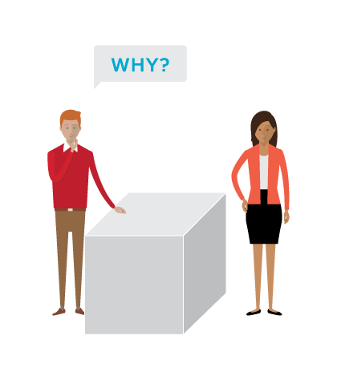
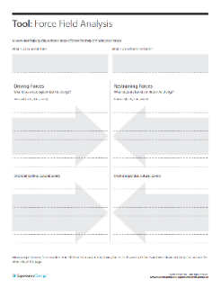
1. Understand
Gather and share information with key stakeholders to help them understand and align around the problem. This often occurs at a senior level, depending on the challenge.
Gather information
Interviews with leaders, managers, and front-line employees.
Engage with customers and non-customers.
Benchmark competitors and other organizations.
Identify the Problem
Determine root causes
and not symptoms.
Assess Stakeholder Support
Map support to understand readiness, willingness and ability to change.
Share information with key stakeholders
Create alignment with key stakeholders by sharing an honest assessment of the current state.
TOOLS
Force Field
Notes:
Suggested prompts for stories:
"Has anyone been involved in a project and wondered, why, from a business point of view, it was initiated?
Has anyone been involved in a project that was poorly conceived?
.... a project that addressed a symptom or even worse, it addressed the wrong problem?
The understand phase helps us to understand the root problem (or opportunity) and define, in business terms, 'why' we are doing this.
Identification of an issue/need/problem can occur at any level in the organization (and often the front line knows about it before the senior leadership does.)
----
Root causes will never be as apparent as symptoms
Must dig to the root of problems to generate effective solutions
“You can’t change what you don’t understand.”

Slide 26

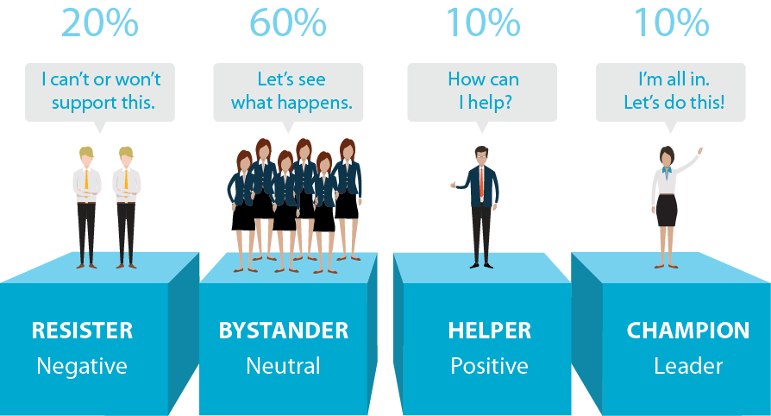
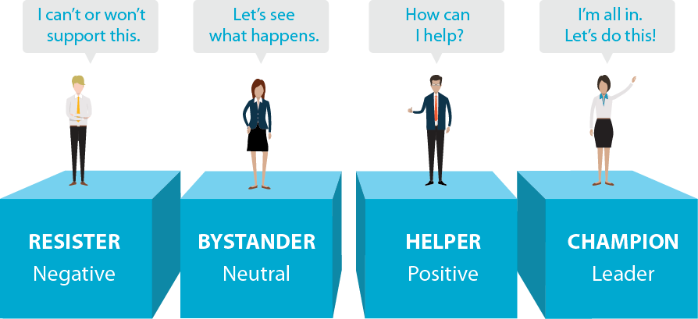
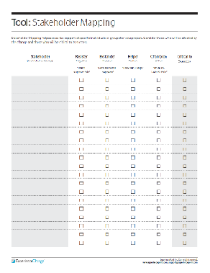
1. Understand – Assess Support
TOOLS
Stakeholder Mapping
Notes:
It is helpful to think about four categories along the resistance-support spectrum.

Slide 27




2. Enlist
Sponsor
Active, visible,
builds support, manages resistance, communicates directly.
Project Leader
Visioning,
Motivating, Empowering, Managing.
Project Team
Leadership,
Position power, Expertise, Credibility, Management.
Engage Key Stakeholders in the Process
Notes:
After you understand the need for change, enlist the support of a core team of powerful stakeholders.
Work with this team to develop a shared vision and strategy to roll out across the organization.

Slide 28
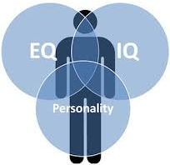
Change Team Considerations
IQ, EQ & Personality are good indicators of how we think and act
Change team membership
  Position power
  Expert power
  Credibility
  Leadership skills
  Management skills
Stages teams go through
  Forming
  Storming
  Norming
  Performing

Slide 29

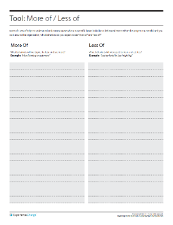
3. Envisage
Co-create the future
Involve a diverse range of relevant stakeholders in the problem solving process. Input increases commitment (and quality of the solution).
There are many excellent problem solving methods
Need to create something new? Consider Design Thinking
Need to optimize what exists today? Consider Lean / Six Sigma
Articulate your vision: “Where are we going to go”
Make it Tangible, Desirable, Feasible & Flexible, Focused & Simple.
Great visions are behavioral at their core and translate easily into action.
Define how success is to be measured.
TOOLS
More of / Less of
Notes:
At this stage, you want to work with your core team of stakeholders to build a vision of the desired state and a strategy for getting there.
Ask –
If you are successful helping Lakeview to change, what behaviours would you expect to see 'more of' around the organization if you visited in 18 months? (examples: collaboration, transparency)
What would you expect to see less of? (silos, finger-pointing, etc)

Slide 30

Change is How We Realize Great Solutions
SOLUTION
ORGANIZATION
UNDERSTAND
ENLIST
ENVISAGE
MOTIVATE
COMMUNICATE
ACT
CONSOLIDATE
Align key stakeholders
Engage the organization
Notes:
Use this framework to structure what we already know. Close the knowing/ doing gap.
There is no single right way that will guarantee success. Context is everything. The key is to consider each unique situation and create the appropriate model/ framework for planning.
This change model is designed to maximize commitment and minimize resistance to change.
Task:
Assign 1 – 2 stages/ group. Hand-out large tactic cards for full details.
Think of some stories of change done well & not so well.
Teach back through storytelling.

Slide 31


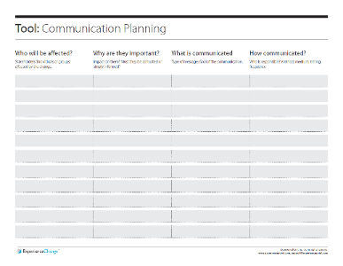
4. Motivate
The traditional view of motivation is extrinsic.
  Given by another person, typically a supervisor
  Pay raise and promotions
  Appeal to the lower needs of individuals
Today, the number one work motivator is emotion, not money. *
  Internal satisfactions a person receives in the process of performing a particular action
  Appeal to the higher needs of individuals
3 Drivers of Motivation: **
Mastery – the desire to get better at stuff
Autonomy – the desire to direct our own lives
Purpose – the feeling we can make a difference
TOOLS
Communication
Planning
* Source: Amabile & Kramer (Progress Principle); ** Pink (Drive)
Notes:
The traditional view of motivation: Carrots & Sticks = a combination of rewards/ benefits and punishment to induce behaviour. Interestingly, this traditional view of motivation is in reference to a cart driver dangling a carrot in front of a mule and holding a stick behind it…
What works well about this approach? (Useful for repeatable processes)
What’s challenging about it? (More complex situations, less repeatable)
Once you get past basic threshold levels (of fairness and adequacy), carrots & sticks can achieve the opposite of their intended aims. Extrinsic rewards kill intrinsic rewards (the reward becomes the key reason to do it and destroys the intrinsic enjoyment of the task itself).
Summary of the 3 Drivers of Motivation:
“People are seeking to do important work and become all they can be.”

Slide 32
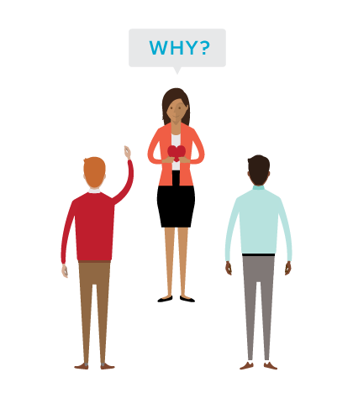
4. Motivate
Communicate ‘why’ at both a rational and emotional level.
Create sense of urgency
Consider moving towards (opportunity) vs. moving away (crisis)
Share information and communicate honestly
Ask what are the implications of status quo?
Make it personal
Why might the change be personally desirable?
MAP – Mastery, Autonomy, Purpose
Encourage input and two-way dialogue.
TOOLS
Communication
Planning
Notes:
Motivate people by creating a sense of urgency, from both a rational and an emotional perspective. Appeal to both the head and the heart.
Help stakeholders understand both the organizational and personal consequences associated with the status quo.
-----
Never underestimate the challenge of breaking people from their comfortable ways!
People often crave the security associated with the status quo
Need to be convinced that business-as-usual is not an option.

Slide 33
5. Communicate
Mobilize the organization around the future state.
Establish clear roles, expectations and targets
Address anxiety due to lack of certainty
Test concepts with various groups to surface barriers to adoption.
Once identified, seek to mitigate.
Communicate. What are some particularly effective methods you’ve seen?
Metaphors, Analogies, Stories
Face-to-face where possible
Make it involving, Leadership by example
TOOLS
Communication
Planning
Notes:
Soon after a sense of urgency spreads through the organization, but before any action is taken to change systems, structures and processes, communicate the vision to affected stakeholders.
The vision provides a guiding path for understanding all ensuing change
This will help promote clarity despite organizational instability.
We communicate at every stage. BUT at this stage, it’s what we’re communicating – the solution.
Ask
What are the various communication methods you’ve seen?
How much communication is enough? As the saying goes… “Tell them what you’re going to tell them. Tell them. Then tell them what you told them.”
There's no such thing as over-communicating. Under communicating is deadly

Slide 34
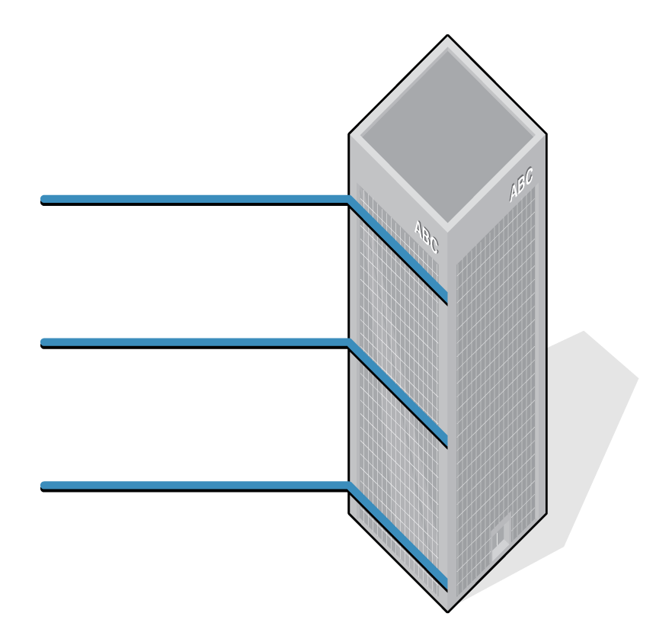
5. Communicate
What’s best for Org
Annual: Profit, Mkt. Share, Sustainability, Customer
What’s best for Team
Quarterly: Targets, Motivation, Teamwork, Inter-unit Cooperation
What’s best for Me
Monthly: Targets, Goals, Development Plans, Growth
Notes:
Motivate people by creating a sense of urgency, from both a rational and an emotional perspective. Appeal to both the head and the heart.
Help stakeholders understand both the organizational and personal consequences associated with the status quo.

Slide 35
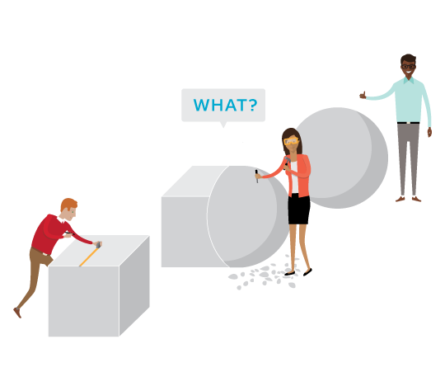
6. Act
Encourage an experimental mindset. Test ideas. Try things out in the spirit of learning.
Make structures compatible with the vision: LEAN PRACTICES
Align practices, policies, systems.
Provide the training employees need.
Generate and publicize short-term wins. “Story tell” success.
Deal with those who undercut needed change.
Notes:
Sum: Try things out… experiment
Take steps to align the organization (systems, structures, processes) with the new vision and strategy.
Test ideas (e.g., pilot projects)
Generate short-term wins

Slide 36

7. Consolidate
Move into a continuous improvement loop.
How might we make things better?
Continue to review which things are working and action which things are not.
Accelerate storytelling with qualitative and quantitative success stories.
Encourage, reward and celebrate successes.
Capture lessons learned for future projects.
Notes:
Sum: Make those things that work well, stick
Institutionalize and reinforce the change
Understand and make further improvements until the change becomes part of the organization’s culture.
Celebrate successes
----
By the time organizations reach the Consolidate stage, the change program has been alive in the org for some time
- Employee stress caused less from uncertainty
- More from burnout
- Work hard to maintain the momentum of change through proper pacing

Slide 37
The (w)Right Change Model TM
Me: Trust, Leadership Skills, Sharpen the Saw
Marshall: Urgency-Opportunity, Focus, Bright spots, Coalitions/Networks
Map: Political Terrain (Stakeholders), Disruptive Technologies,
Message: Vision, Values
Motivate: Communicate with the Elephant & Rider, Path, Small Wins
Manage: Clear Hurdles, Overcome Resistance, Keep an eye out for Grendel’s Mother

Slide 38
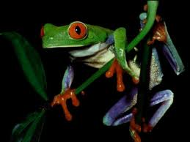
2) Marshall: Urgency - Opportunity
Discovery process step back and examine the big picture to identify critical issues
Understand the vulnerability in the organization (or, create it - Cortez)
Who are the antagonists (unite against)?
Achieved when 75% of your leadership team is honestly convinced

Slide 39
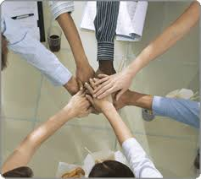
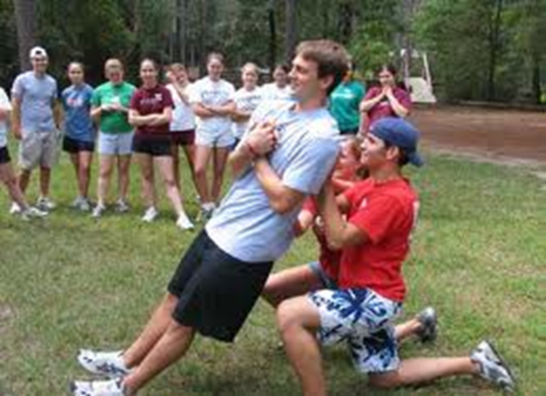
2) Marshall:
Create a Powerful Coalition
High Performance Teams
they contain people with special skills
they commit to a common purpose, establish specific goals
they have the leadership and structure to provide focus and direction
they hold themselves accountable at both the individual and team levels
there is high mutual trust among members
  Size 5-7 people
Spirit of Cooperation
Swift Trust: Leaders go first

Slide 40

3) MAP: Forces of Change
Task: What ‘environmental’ forces are causing organizations to change? (now / future)
  Economic
  Political/Legal
  Technology
  Social/Demographic
  Other?

Slide 41
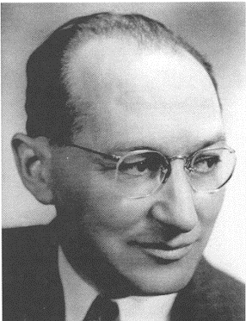
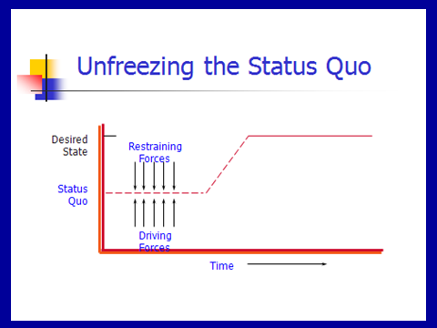
3) MAP: Force Field Analysis
Kurt Lewin

Slide 42
Lewin’s Force Field Steps
Understand / Describe Current Situation
Identify where current situation will go if no action taken
List forces driving change / restraining forces
Discuss all the forces – can they be changed? Which are the critical ones?
Determine if you can negate the restraining / enhance the driving
Recognize that changing one might impact the others (both positively and negatively)

Slide 43

Reflection Time
You are driving and as you turn the corner you drive into fog – what do you do?

Slide 44

4) Message: Inspire a Shared Vision
You first need to develop a clear vision of the future
Then share it with others to “enlist them”

Slide 45
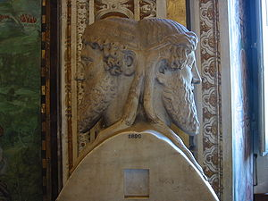


Vision: on a clear day you can see forever
Visions are about possibilities, about desired futures.
Discovery Points
  Janusian Thinking (Past/Future)
  Imagine the Ideal: what is the best that could happen?
  Discover the Theme: what / who are you passionate about?

Slide 46
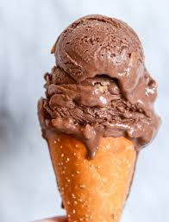
Strategic Visioning
Henry Mintzberg (1994) strategy should involve intuitive glimpses of possibility: The anticipatory principle - ongoing projection of a future image (vision)
  Taking back the RED
  Magical – on purpose or on task

Slide 47
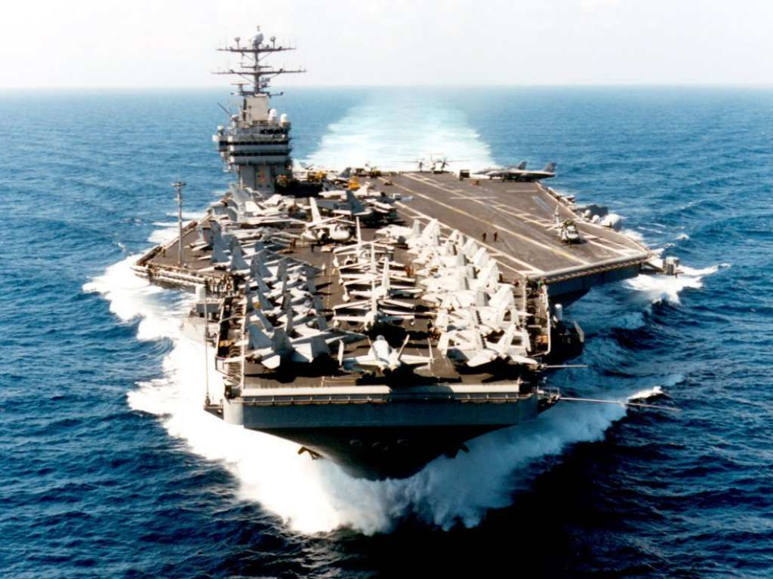
Vision: Cheering About Key Values
Aircraft Carrier
“the lost wrench”
What did the Captain do?
What does this story reinforce?
What are your Values and how will you Cheer?

Slide 48
Enlist Others
Develop a shared sense of destiny
Reminder!
Listen deeply to others - what excites them?
  Find the common ground
Discover and appeal to a common purpose
  A chance to be tested, take part in a social experiment, to do something well, do something positive, a chance to change the way things are
Give life to vision by communicating expressively
  Use powerful language – use the three peat, speak from the heart, image-analogy-feel,

Slide 49
Language of Change Leaders:
Enlist Others
Reminder!
Jay Conger
How things are framed makes a difference
  Focus on intrinsically appealing goals (+) and values
  Highlight the significance of the project (answer WHY)
  Who are the key antagonists
  Highlight why it will succeed
  Use analogies, stories, metaphors to make your point
  Allow your own emotions to surface when you speak

Slide 50

Power of Emotional Appeals
Emotional Arguments – danger, loss, unpleasantness, risk
Metaphors – machine, family, turn out the lights
Emotional Modes – pictures, slogans, music, colour
Humour – appropriate / un
Display emotions – smiles, speech tone, expressive

Slide 51
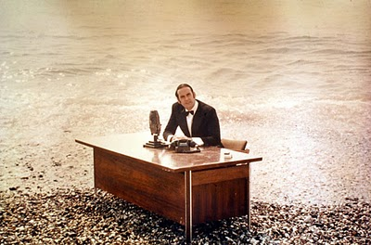
And now for something …
… completely different

Slide 52

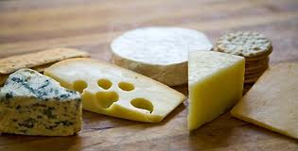
5 Motivate:
Direct the Rider
Motivate the Elephant
Shape the Path

Slide 53

Direct the Rider analytical / rational
Follow the Bright Spots: find out what’s working and clone it (story: malnutrition)
Point to the Destinations: Know where you are heading and why it’s worth it (story: destination card – ROUTE NHS, New Car)
Script the Critical Moves: Think Specific a-b-c (story: 125 calls / month, cite colleagues research)

Slide 54
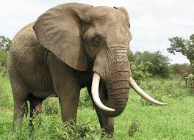
Direct the Elephant:
Putting Feelings First
Our elephant is lazy and skittish: seeking short-term benefits vs. short-term sacrifices to gain long-term benefits.
  So MOTIVATE the Elephant:
  Find the Feeling: Make people feel something (Red is fading)
  Shrink the Change: Break down the change (Head-start car wash)
  Grow your People: Cultivate a sense of identity (ST. Lucia parrot)

Slide 55


Shape the Path
Tweak the Environment: Change the situation (wearing safety glasses / cross the line)
Build Habits: rider is not taxed (action triggers, meatless Mondays)
Rally the Herd: Behaviour is contagious (majority of guests reuse their towel…)

Slide 56
Commercial Break
Think about what disturbs you, how you are being changed by the times in which we live, and how you can best cope with the times in which we live.

Slide 57
Exploring personal readiness for Change
Tolerance for Change Test
Please read the following statements. Circle the letter that best describes how you would feel in response to each statement.
A I would enjoy this very much, it’s completely acceptable
B This would be enjoyable and acceptable most of the time
C I would have no reaction to this feature one way or another
D This feature would be somewhat unpleasant for me
E This feature would be very unpleasant for me

Slide 58
Examples
I would like to live in a foreign country for a while.
It is more fun to tackle a complicated problem than to solve a simple one.
What we are used to is always preferable to what is unfamiliar (R).
Many of our most important decisions are based on insufficient information.
Teachers or supervisors who hand out vague assignments give one a chance to show initiative and originality.

Slide 59
Individual Reactions to Change
4 Stages:
Shock – perceive it as a threat
Defensive – cling to old ways
Loss of Confidence
Disrupted Habits
Individual
resistance
Fear of
the unknown
Loss of Control /
Security
Loss of
Face

Slide 60
Individual Reactions
3. Acknowledgement – sense of grief and sadness but start to be open to making things work
Adaptation and Change – ready to establish new routines and help others.
Knowing how to deal with this …

Slide 61
6) Manage: Cynicism about Change
25-40% will respond cynically to the next change
Why?
  Uninformed – lack of communication
    Action: Over-communicate – credible spokespersons, positive messages, multiple channels / repetition, two-way communication, Find the Feeling
  Previous experience
    Action: Deal with the past
  Negative disposition
    Action: Hire well
    Action: See world from employees perspective
  Lack of opportunity to be involved
    Action: Keep them involved – ask for input

Slide 62
Random Reminders and Insights …
Arouse dissatisfaction with the current state
  tell them about deficiencies in organization
Use participation in decision making
  get people involved
Build in rewards
  tie rewards to change/use recognition, status symbols, praise to get people to go along

Slide 63
Additional …
Establish goals
  e.g. achieve retention targets at end of next year
Institute smaller, acceptable changes that reinforce and support change
  e.g. procedures and rules, job descriptions, reporting relationships
Develop management structures for change
  e.g. plans, strategies, mechanisms that ensure change occurs
Maintain open, two-way communication
Notes:
This material is found on page 362-364.

Slide 64
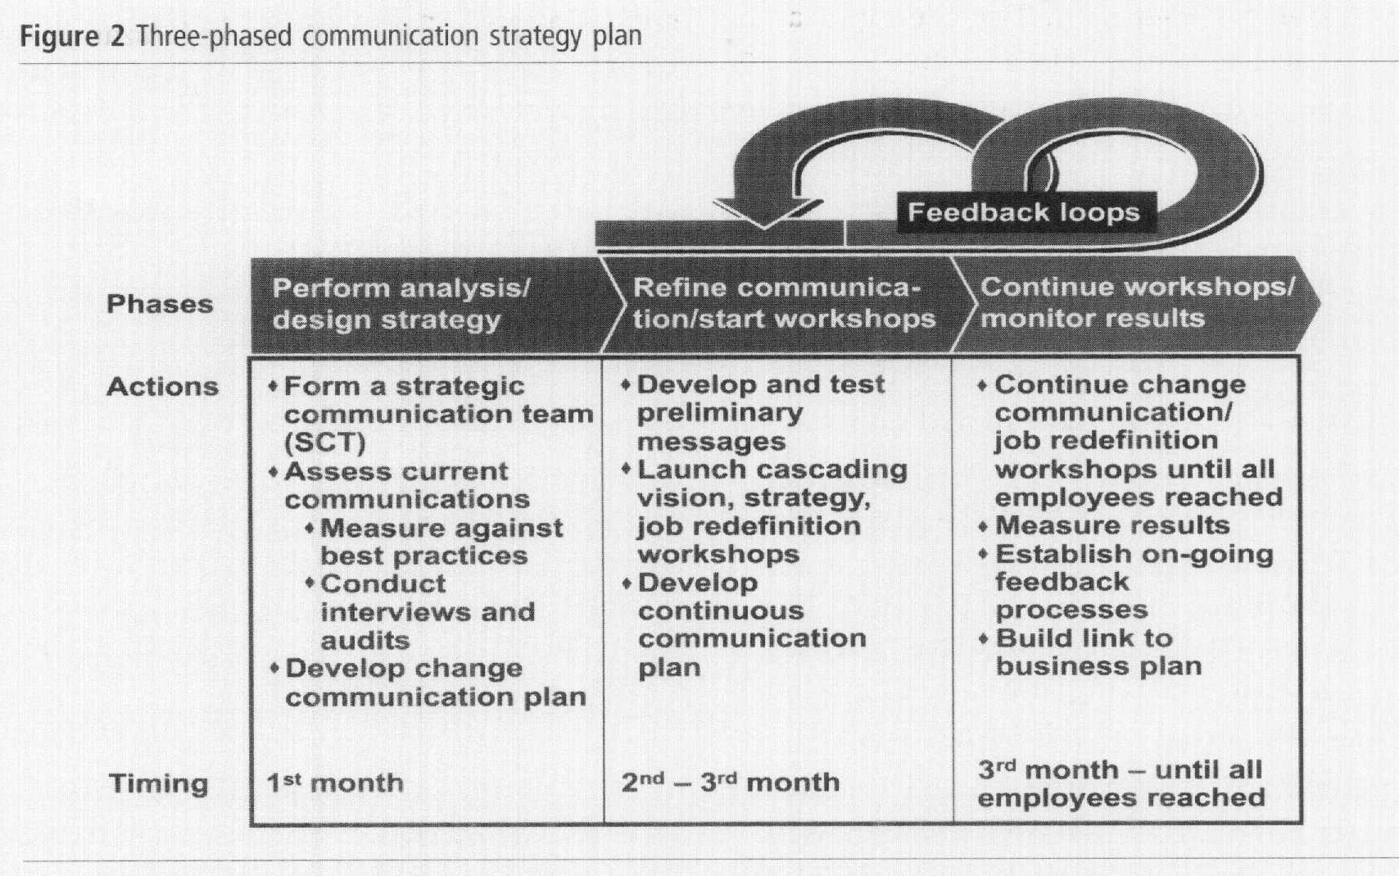
Communication: Barrett

Slide 65
Reflection Questions
What critical forces that are causing you to change?
How will you dissatisfy people from the current state?
What driving forces do you need to Enhance? Restrain?
What is your sense of urgency / opportunity?
Who is in your Powerful Coalition?
What is your vision – few words?
What’s your key value(s)?
How are you communicating
with your people?
What’s the feeling?
How are you shaping the path?
What hot spots are you focusing on? What’s your first small win?

Slide 66
Now the edgy stuff
Chaos Theory
Tipping Point
Grendel’s Mother
Darkest at Dawn

Slide 67
Tipping Point Leadership
Kim and Mauborgne HBR, 2003
Bill Bratton – Police Leader
Cognitive Hurdle
  Get people to agree on current problem (face-to-face with problems)
  Bratton began requiring that all transit police officials-beginning with himself-ride the subway to work, to meetings, and at night

Slide 68
Tipping Point Leadership
Resource Hurdle
Focus on “hot spots” and bargain with partner organizations (concentrate resources)
de-emphasizing or virtually eliminating some traditional features of transit police work while increasing emphasis on others or creating new ones - introducing mobile processing centers known as "bust buses."

Slide 69
Tipping Point Leadership
Motivational Hurdle
Put the stage lights on and frame the challenge to match organizations values
Bratton had selected precinct commanders called before a panel of the senior staff (the selected officer was given only two days' notice, in order to keep all the commanders on their toes). The commander in the spotlight was questioned by both the panel and other commanders about the precinct's performance (KEY: based on fair processes and known goals: "block by block, precinct by precinct, and borough by borough.

Slide 70
Tipping Point Leadership
Political Hurdle
Identify and silence internal opponents and isolate external ones
Bratton's alliance with the mayor's office and the New York Times isolated the courts which had opposed his zero-tolerance policing out of fear that it would clog court schedules. And, large cars.

Slide 71

Grendel’s Mother (Beowulf)
Hero – Beowulf
Grendel – monster who eats men
Beowulf mortally wounds Grendel
Happy days
Grendel’s Mother
Visit her lair
New tools

Slide 72
Change’s path
The learning curve
Successful Change
Change
Doubt
Point
Failed Change
Escalating Commitment or
Darkest before the Dawn?

Slide 73
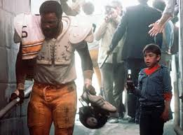

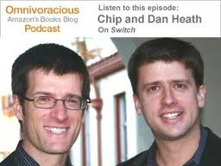
Final Exam …
Why is change so hard to enact?
Who would you rather spend an hour in conversation with – Chip or Dan Heath?
Who are you now? What are your three?

Slide 74
The (w)Right Change Model TM
Me: Trust, Leadership Skills, Sharpen the Saw
Marshall: Urgency-Opportunity, Focus, Bright spots, Coalitions/Networks
Map: Political Terrain (Stakeholders), Disruptive Technologies,
Message: Vision, Values
Motivate: Communicate with the Elephant & Rider, Path, Small Wins
Manage: Clear Hurdles, Overcome Resistance, Keep an eye out for Grendel’s Mother

