Slide 1
(Successfully) Enacting Organizational Change

Slide 2
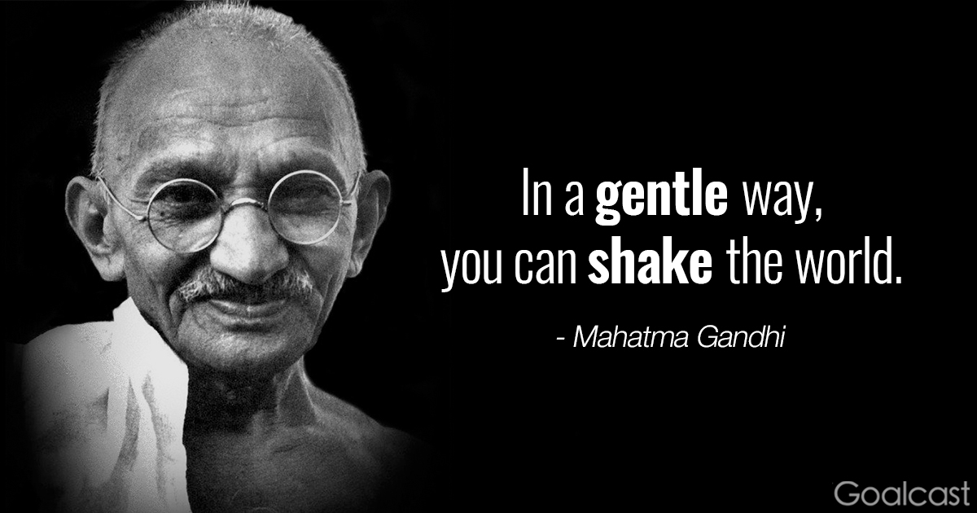
Check-In
Thoughts, Reflections, Questions?

Slide 3

Who are you now?
Insight – Reflect – Enact
What are your wisdom points

Slide 4
Innovation
Yea not busy being born – is busy dying (Bob Dylan)
Product / Process Innovation
Innovation Lab (new building)
Innovation Process: Imagine, Design, Experimentation, Feasibility, Final

Slide 5
Challenge of Change
There is nothing more difficult to take in hand, more perilous to conduct, or more uncertain in its success, than to take the lead in the introduction of a new order of things.
Nicolo Machiavelli - The Prince.

Slide 6

What is organizational change?
Organizational change occurs when an organization restructures resources to create value and improve effectiveness.

Slide 7

Change Prevelance
A recent study n=309
HRM executives
100% were going through change
  merger,
  acquisition,
  divestiture,
  global competition,
  restructuring

Slide 8
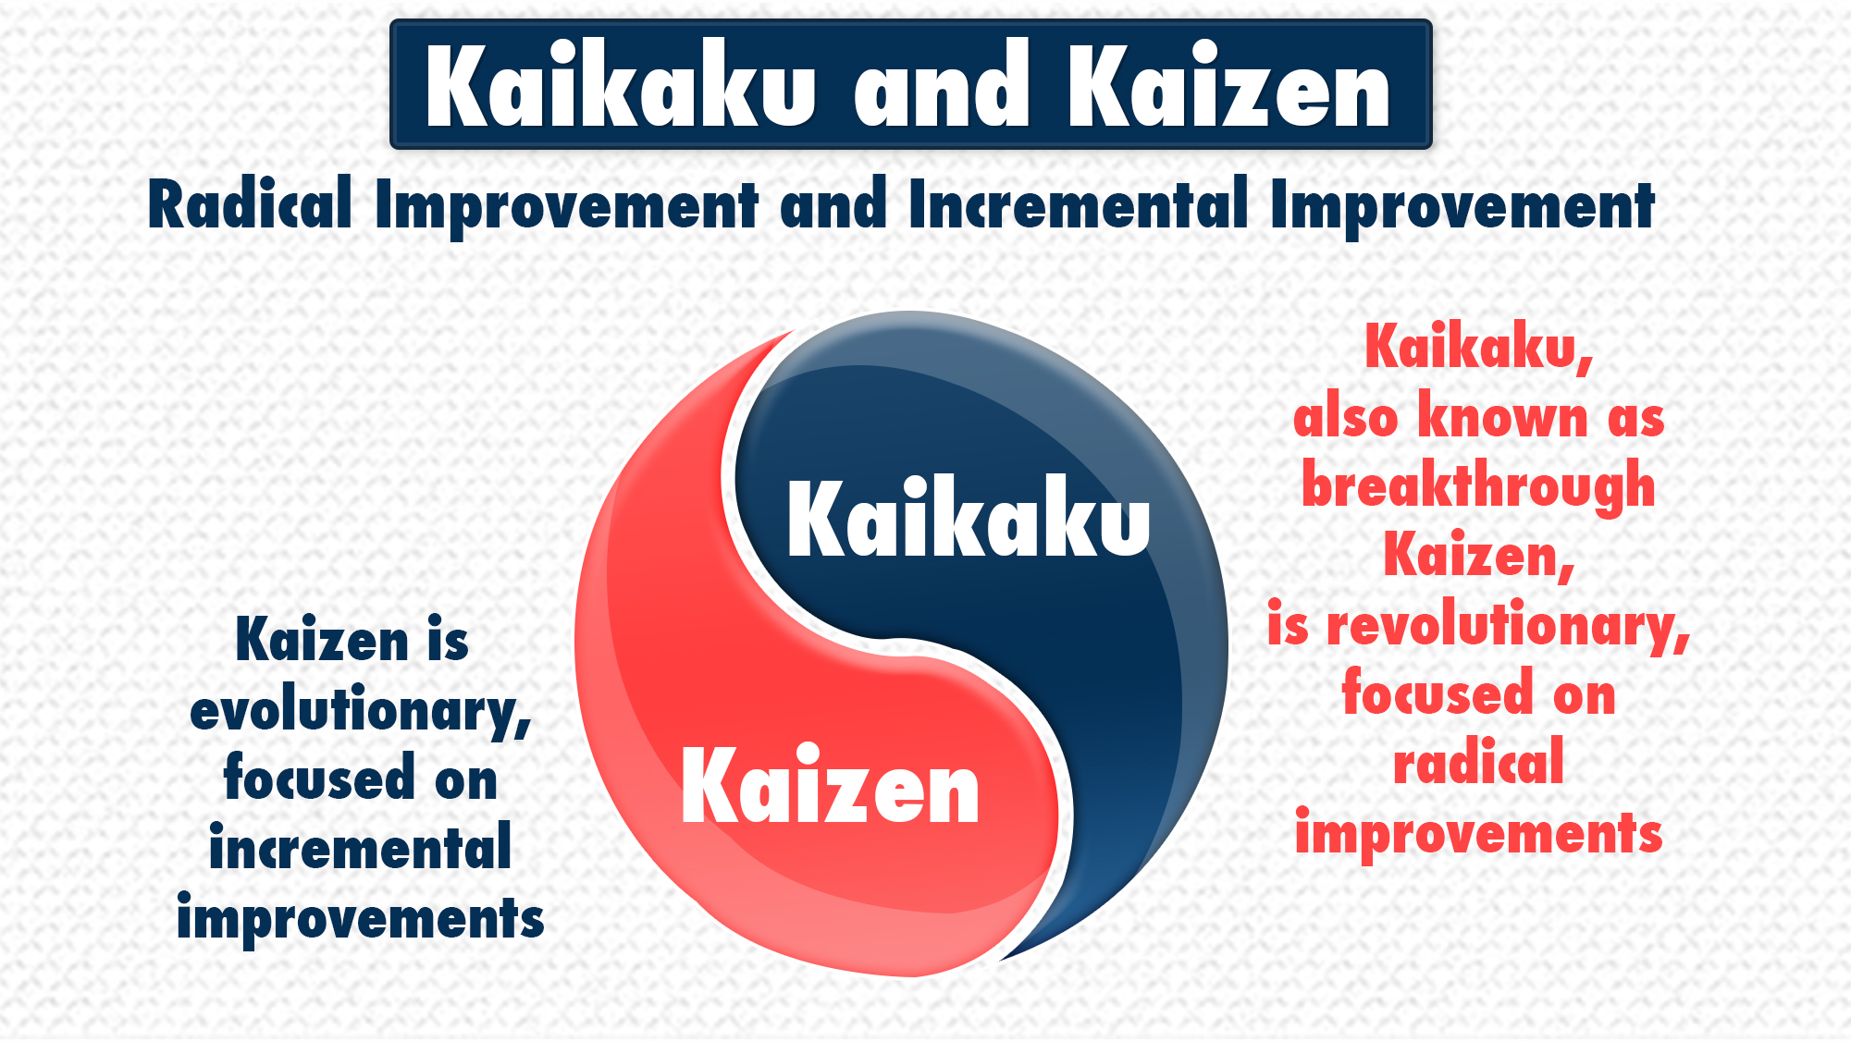
Types of Change …
Radical change
Revolutionary change
Crisis situation
Top down
Rare
Episodic
Kaikaku
  Examples: M&As, restructurings, change of leadership
Emergent change
Organic change
Part of daily life
Bottom up
Frequent
Continuous
Kaizen
  Examples: project work, changing values
Notes:
There are many types and levels of change … but there is a simple formula

Slide 9

Discussion
A colleague has just been asked to lead a major initiative.
S/He has turned to you for advice.
Share your stories and distill into change lessons learned.
Two / Five / Three

Slide 10
Change Models
The Medicine Wheel
McKinsey / Waterman & Peters 7S Framework
Lewin’s Three Step Model of Change
Kotter’s 8 Step Leading Change Model
The (wRight) Change Model

Slide 11
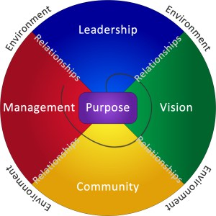
The Medicine Wheel - A Tool for Change
The particular archetypes appointed to north, east, south, west and the relationship between them, set within a mandala or circle is from the wisdom of North American Indigenous peoples.
Different Tribes and Nations have/had different interpretations and configurations.
Seven components of an organization’s operating matrix:
  Purpose, leadership, vision, community, management, relationships, and the circle of the whole within its environment.
  The order of the process of reflecting about each component was essential to obtain consistent and cross cultural results.
The Medicine Wheel – a change tool

Slide 12
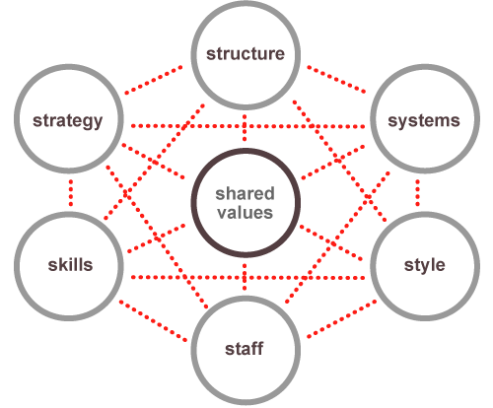
McKinsey / Waterman & Peters’ 7S Framework
Often used as a guiding map for organizational change
Examine the likely effects of future changes within
Align departments and processes during a merger or acquisition
Determine how best to implement a proposed strategy
A change in one element may impact other elements
Reference: Waterman, P., Peters, T., (1982) In Search of Excellence
Notes:
Featured in the book In Search of Excellence, by former McKinsey consultants Thomas J. Peters and Robert H. Waterman, the framework maps a constellation of interrelated factors that influence an organization's ability to change.
The lack of hierarchy among these factors suggests that significant progress in one part of the organization will be difficult without working on the others.

Slide 13
Elements of 7S Framework
Soft Elements
Hard Elements
Shared Values: Core values
Style: Leadership style
Staff: Employees as individuals and their broad abilities
Skills: The skills and competencies of employees
Strategy: Organizational plan or route-map to maintain competitive advantage
Structure: Organizational hierarchy
Systems: The day-to-day processes and procedures across the organization
https://www.mckinsey.com/business-functions/strategy-and-corporate-finance/our-insights/enduring-ideas-the-7-s-framework
Hayes (2014) The Theory and Practice of Change Management, Macmillan Education UK.

Slide 14
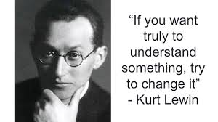
Lewin’s Three Step Change Model
The three step change model
  Unfreeze – shock a system out of stasis
  Move – make purposeful adjustments
  Refreze – consolidate change by systematically engraining adjustments
Kurt Lewin, 1890 – 1947
Founding father of social, applied and organizational pyschology
Also known for:
Gestalt Psychology
Action research
Force-field analysis
Notes:
Gestalt psychology or gestaltism is a philosophy of mind of the Berlin School of experimental psychology. Gestalt psychology is an attempt to understand the laws behind the ability to acquire and maintain meaningful perceptions in an apparently chaotic world. The central principle of gestalt psychology is that the mind forms a global whole with self-organizing tendencies.

Slide 15
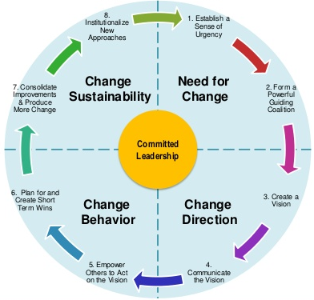
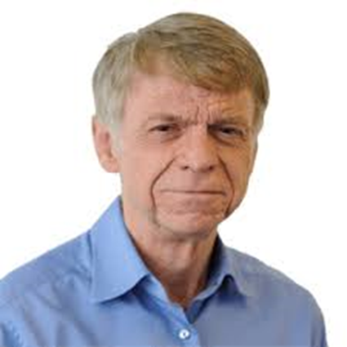
Kotter’s Eight Step Leading Change Model
Notes:
Play video from 25 seconds inwards
Warning about the tone of voice over

Slide 16
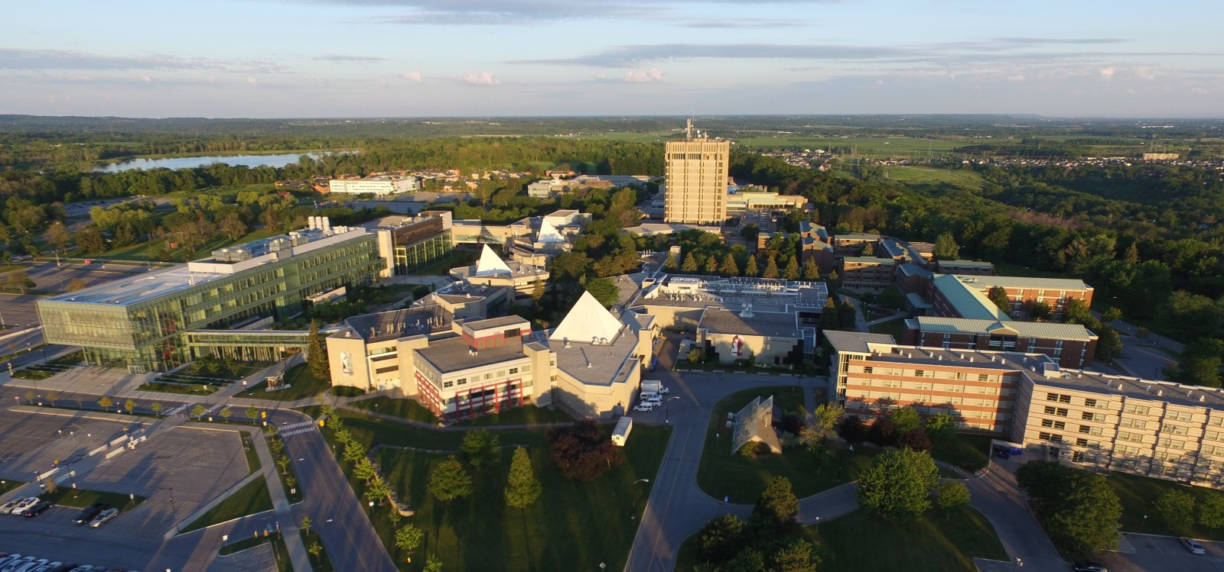

Live Case
Brock / McMaster Merger
Queen’s Park has decided that all universities will merge with their next door neighbor.
Brock and McMaster’s Board of Trustees have appointed you and your consulting team to lead the change effort.

Slide 17
The (w)Right Change Model TM
Me: Trust, Leadership Skills, Sharpen the Saw
Marshall: Urgency-Opportunity, Focus, Bright spots, Coalitions/Networks
Map: Political Terrain (Stakeholders), Disruptive Technologies,
Message: Vision, Values
Motivate: Communicate with the Elephant & Rider, Path, Small Wins
Manage: Clear Hurdles, Overcome Resistance, Keep an eye out for Grendel’s Mother

Slide 18
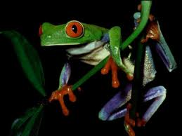
2) Marshall: Urgency - Opportunity
Discovery process step back and examine the big picture to identify critical issues
Understand the vulnerability in the organization (or, create it - Cortez)
Who are the antagonists (unite against)?
Achieved when 75% of your leadership team is honestly convinced

Slide 19
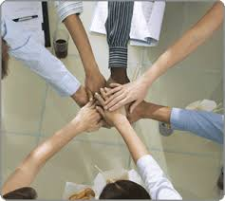
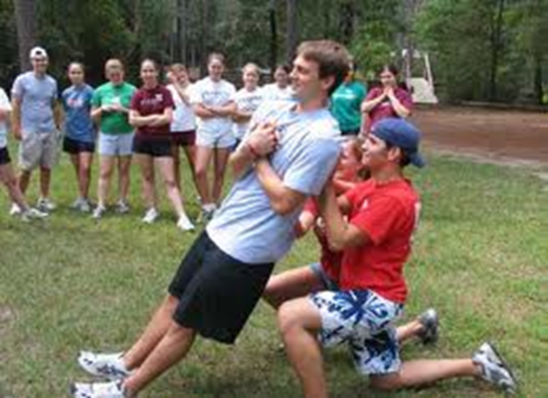
2) Marshall:
Create a Powerful Coalition
High Performance Teams
they contain people with special skills
they commit to a common purpose, establish specific goals
they have the leadership and structure to provide focus and direction
they hold themselves accountable at both the individual and team levels
there is high mutual trust among members
  Size 5-7 people
Spirit of Cooperation
Swift Trust: Leaders go first

Slide 20

3) MAP: Forces of Change
Task: What ‘environmental’ forces are causing organizations to change? (now / future)
  Economic
  Political/Legal
  Technology
  Social/Demographic
  Other?

Slide 21
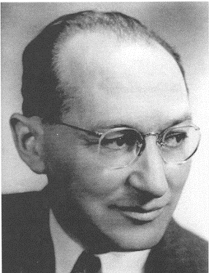
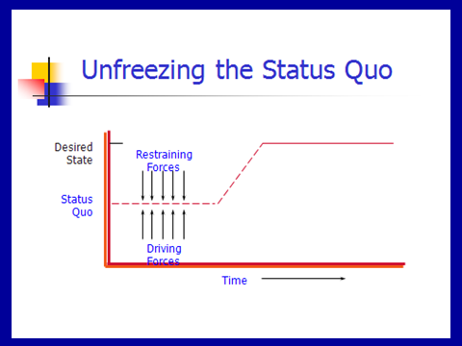
3) MAP: Force Field Analysis
Kurt Lewin

Slide 22
Lewin’s Force Field Steps
Understand / Describe Current Situation
Identify where current situation will go if no action taken
List forces driving change / restraining forces
Discuss all the forces – can they be changed? Which are the critical ones?
Determine if you can negate the restraining / enhance the driving
Recognize that changing one might impact the others (both positively and negatively)

Slide 23

Reflection Time
You are driving and as you turn the corner you drive into fog – what do you do?

Slide 24


4) Message: Inspire a Shared Vision
You first need to develop a clear vision of the future
Then share it with others to “enlist them”

Slide 25
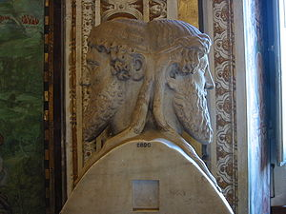


Vision: on a clear day you can see forever
Visions are about possibilities, about desired futures.
Discovery Points
  Janusian Thinking (Past/Future)
  Imagine the Ideal: what is the best that could happen?
  Discover the Theme: what / who are you passionate about?

Slide 26
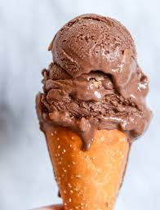
Strategic Visioning
Henry Mintzberg (1994) strategy should involve intuitive glimpses of possibility: The anticipatory principle - ongoing projection of a future image (vision)
  Taking back the RED
  Magical – on purpose or on task

Slide 27
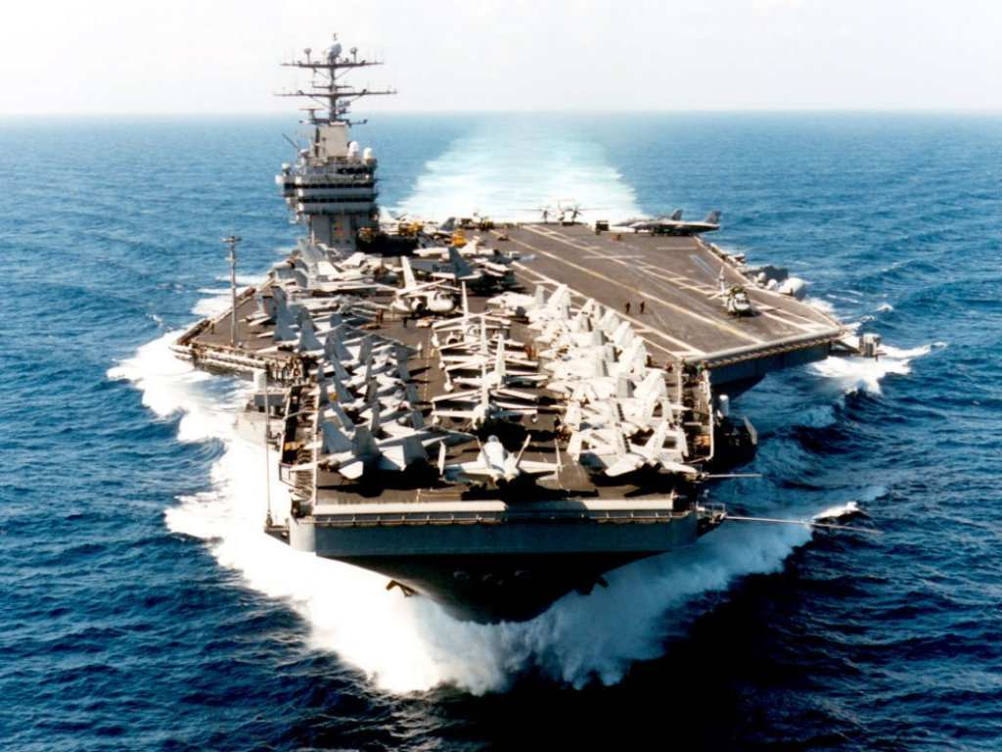
Vision: Cheering About Key Values
Aircraft Carrier
“the lost wrench”
What did the Captain do?
What does this story reinforce?
What are your Values and how will you Cheer?

Slide 28
Enlist Others
Develop a shared sense of destiny
Reminder!
Listen deeply to others - what excites them?
  Find the common ground
Discover and appeal to a common purpose
  A chance to be tested, take part in a social experiment, to do something well, do something positive, a chance to change the way things are
Give life to vision by communicating expressively
  Use powerful language – use the three peat, speak from the heart, image-analogy-feel,

Slide 29
Language of Change Leaders:
Enlist Others
Reminder!
Jay Conger
How things are framed makes a difference
  Focus on intrinsically appealing goals (+) and values
  Highlight the significance of the project (answer WHY)
  Who are the key antagonists
  Highlight why it will succeed
  Use analogies, stories, metaphors to make your point
  Allow your own emotions to surface when you speak

Slide 30

Power of Emotional Appeals
Emotional Arguments – danger, loss, unpleasantness, risk
Metaphors – machine, family, turn out the lights
Emotional Modes – pictures, slogans, music, colour
Humour – appropriate / un
Display emotions – smiles, speech tone, expressive

Slide 31
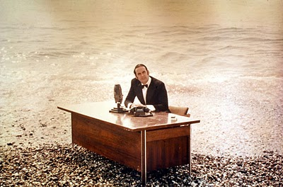
And now for something …
… completely different

Slide 32

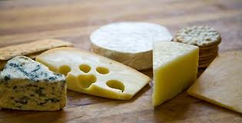
5 Motivate:
Direct the Rider
Motivate the Elephant
Shape the Path

Slide 33

Direct the Rider analytical / rational
Follow the Bright Spots: find out what’s working and clone it (story: malnutrition)
Point to the Destinations: Know where you are heading and why it’s worth it (story: destination card – ROUTE NHS, New Car)
Script the Critical Moves: Think Specific a-b-c (story: 125 calls / month, cite colleagues research)

Slide 34
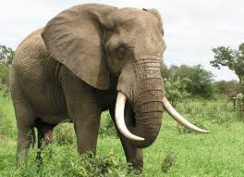
Direct the Elephant:
Putting Feelings First
Our elephant is lazy and skittish: seeking short-term benefits vs. short-term sacrifices to gain long-term benefits.
  So MOTIVATE the Elephant:
  Find the Feeling: Make people feel something (Red is fading)
  Shrink the Change: Break down the change (Head-start car wash)
  Grow your People: Cultivate a sense of identity (ST. Lucia parrot)

Slide 35


Shape the Path
Tweak the Environment: Change the situation (wearing safety glasses / cross the line)
Build Habits: rider is not taxed (action triggers, meatless Mondays)
Rally the Herd: Behaviour is contagious (majority of guests reuse their towel…)

Slide 36
Commercial Break
Think about what disturbs you, how you are being changed by the times in which we live, and how you can best cope with the times in which we live.

Slide 37
Exploring personal readiness for Change
Tolerance for Change Test
Please read the following statements. Circle the letter that best describes how you would feel in response to each statement.
A I would enjoy this very much, it’s completely acceptable
B This would be enjoyable and acceptable most of the time
C I would have no reaction to this feature one way or another
D This feature would be somewhat unpleasant for me
E This feature would be very unpleasant for me

Slide 38
Examples
I would like to live in a foreign country for a while.
It is more fun to tackle a complicated problem than to solve a simple one.
What we are used to is always preferable to what is unfamiliar (R).
Many of our most important decisions are based on insufficient information.
Teachers or supervisors who hand out vague assignments give one a chance to show initiative and originality.

Slide 39
Individual Reactions to Change
4 Stages:
Shock – perceive it as a threat
Defensive – cling to old ways
Loss of Confidence
Disrupted Habits
Individual
resistance
Fear of
the unknown
Loss of Control /
Security
Loss of
Face

Slide 40
Individual Reactions
3. Acknowledgement – sense of grief and sadness but start to be open to making things work
Adaptation and Change – ready to establish new routines and help others.
Knowing how to deal with this …

Slide 41
6) Manage: Cynicism about Change
25-40% will respond cynically to the next change
Why?
  Uninformed – lack of communication
    Action: Over-communicate – credible spokespersons, positive messages, multiple channels / repetition, two-way communication, Find the Feeling
  Previous experience
    Action: Deal with the past
  Negative disposition
    Action: Hire well
    Action: See world from employees perspective
  Lack of opportunity to be involved
    Action: Keep them involved – ask for input

Slide 42
Random Reminders and Insights …
Arouse dissatisfaction with the current state
  tell them about deficiencies in organization
Use participation in decision making
  get people involved
Build in rewards
  tie rewards to change/use recognition, status symbols, praise to get people to go along

Slide 43
Additional …
Establish goals
  e.g. achieve retention targets at end of next year
Institute smaller, acceptable changes that reinforce and support change
  e.g. procedures and rules, job descriptions, reporting relationships
Develop management structures for change
  e.g. plans, strategies, mechanisms that ensure change occurs
Maintain open, two-way communication
Notes:
This material is found on page 362-364.

Slide 44
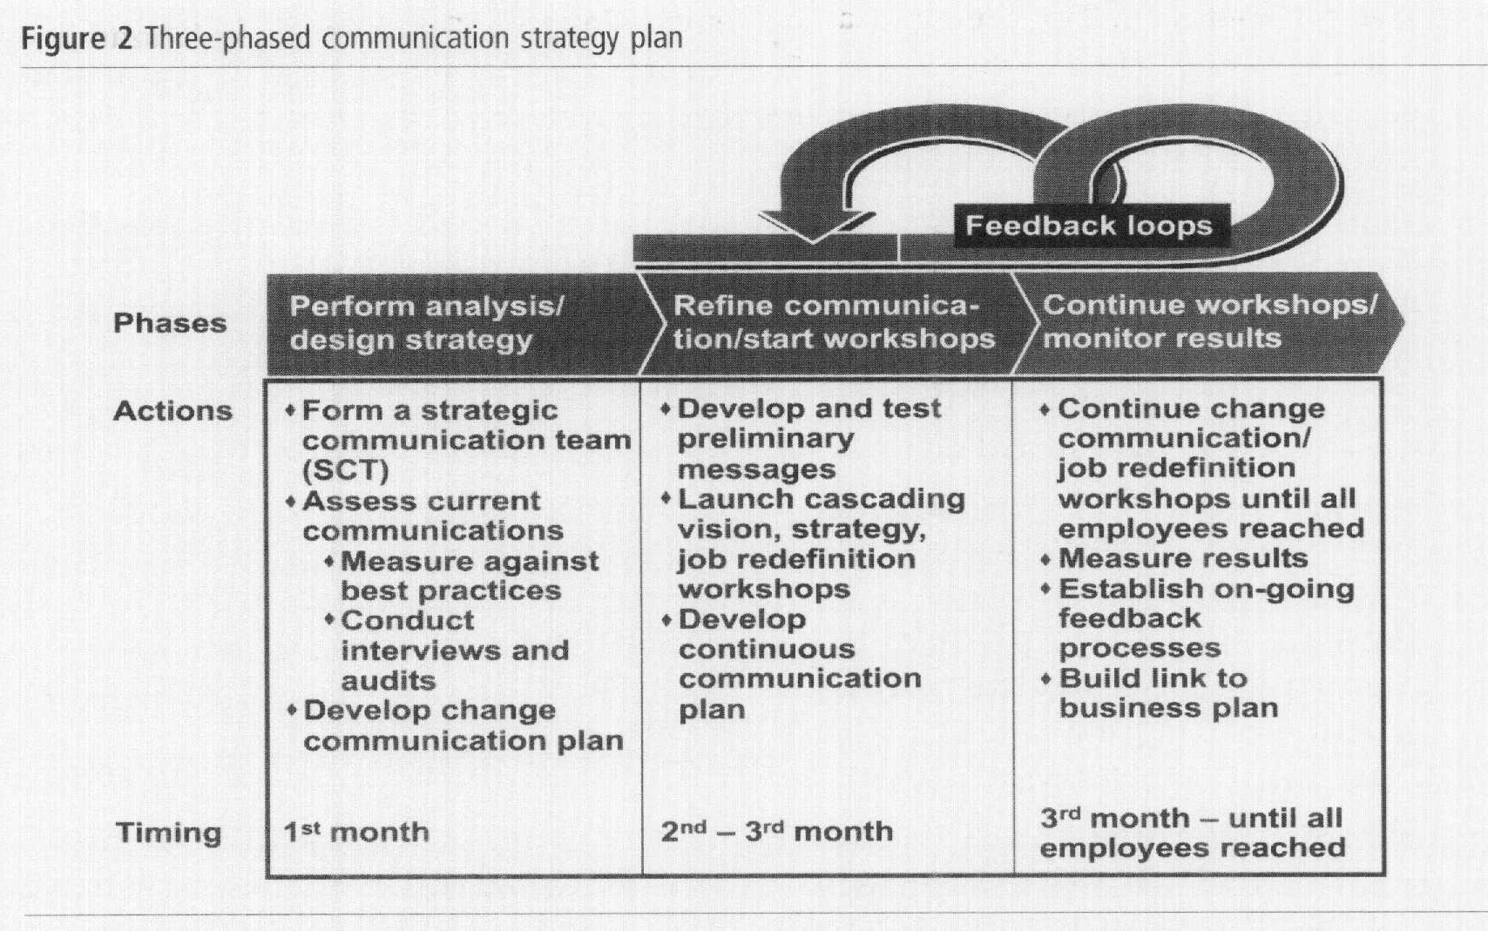
Communication: Barrett

Slide 45
Reflection Questions
What critical forces that are causing you to change?
How will you dissatisfy people from the current state?
What driving forces do you need to Enhance? Restrain?
What is your sense of urgency / opportunity?
Who is in your Powerful Coalition?
What is your vision – few words?
What’s your key value(s)?
How are you communicating
with your people?
What’s the feeling?
How are you shaping the path?
What hot spots are you focusing on? What’s your first small win?

Slide 46
Now the edgy stuff
Chaos Theory
Tipping Point
Grendel’s Mother
Darkest at Dawn

Slide 47
Tipping Point Leadership
Kim and Mauborgne HBR, 2003
Bill Bratton – Police Leader
Cognitive Hurdle
  Get people to agree on current problem (face-to-face with problems)
  Bratton began requiring that all transit police officials-beginning with himself-ride the subway to work, to meetings, and at night

Slide 48
Tipping Point Leadership
Resource Hurdle
Focus on “hot spots” and bargain with partner organizations (concentrate resources)
de-emphasizing or virtually eliminating some traditional features of transit police work while increasing emphasis on others or creating new ones - introducing mobile processing centers known as "bust buses."

Slide 49
Tipping Point Leadership
Motivational Hurdle
Put the stage lights on and frame the challenge to match organizations values
Bratton had selected precinct commanders called before a panel of the senior staff (the selected officer was given only two days' notice, in order to keep all the commanders on their toes). The commander in the spotlight was questioned by both the panel and other commanders about the precinct's performance (KEY: based on fair processes and known goals: "block by block, precinct by precinct, and borough by borough.

Slide 50
Tipping Point Leadership
Political Hurdle
Identify and silence internal opponents and isolate external ones
Bratton's alliance with the mayor's office and the New York Times isolated the courts which had opposed his zero-tolerance policing out of fear that it would clog court schedules. And, large cars.

Slide 51

Grendel’s Mother (Beowulf)
Hero – Beowulf
Grendel – monster who eats men
Beowulf mortally wounds Grendel
Happy days
Grendel’s Mother
Visit her lair
New tools

Slide 52
Change’s path
The learning curve
Successful Change
Change
Doubt
Point
Failed Change
Escalating Commitment or
Darkest before the Dawn?

Slide 53
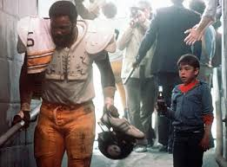

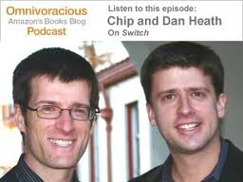
Final Exam …
Why is change so hard to enact?
Who would you rather spend an hour in conversation with – Chip or Dan Heath?
Who are you now? What are your three?

Slide 54
The (w)Right Change Model TM
Me: Trust, Leadership Skills, Sharpen the Saw
Marshall: Urgency-Opportunity, Focus, Bright spots, Coalitions/Networks
Map: Political Terrain (Stakeholders), Disruptive Technologies,
Message: Vision, Values
Motivate: Communicate with the Elephant & Rider, Path, Small Wins
Manage: Clear Hurdles, Overcome Resistance, Keep an eye out for Grendel’s Mother

