Slide 1
Experiential Education

Slide 2
Experiential Learning in Goodman
Connecting students with community partners in a variety of ways
  Service-Learning
  Live Case Studies
  Simulations
  Field Courses
The goal is to provide students with a hands-on approach to learning with relevant projects and experiences.
Experiential can take on different forms depending on which program/course you’re in.

Slide 3
What Students report getting out of Experiential Projects
Students report:
Work experience on my resume.
Have a new understanding of services in my community.
Have a better understanding of course material
Have something I could speak about in a job interview about how I have applied my business skills.
Feel good knowing I made a difference for a community serving organization.
I’m more motivated by this type of project.

Slide 4
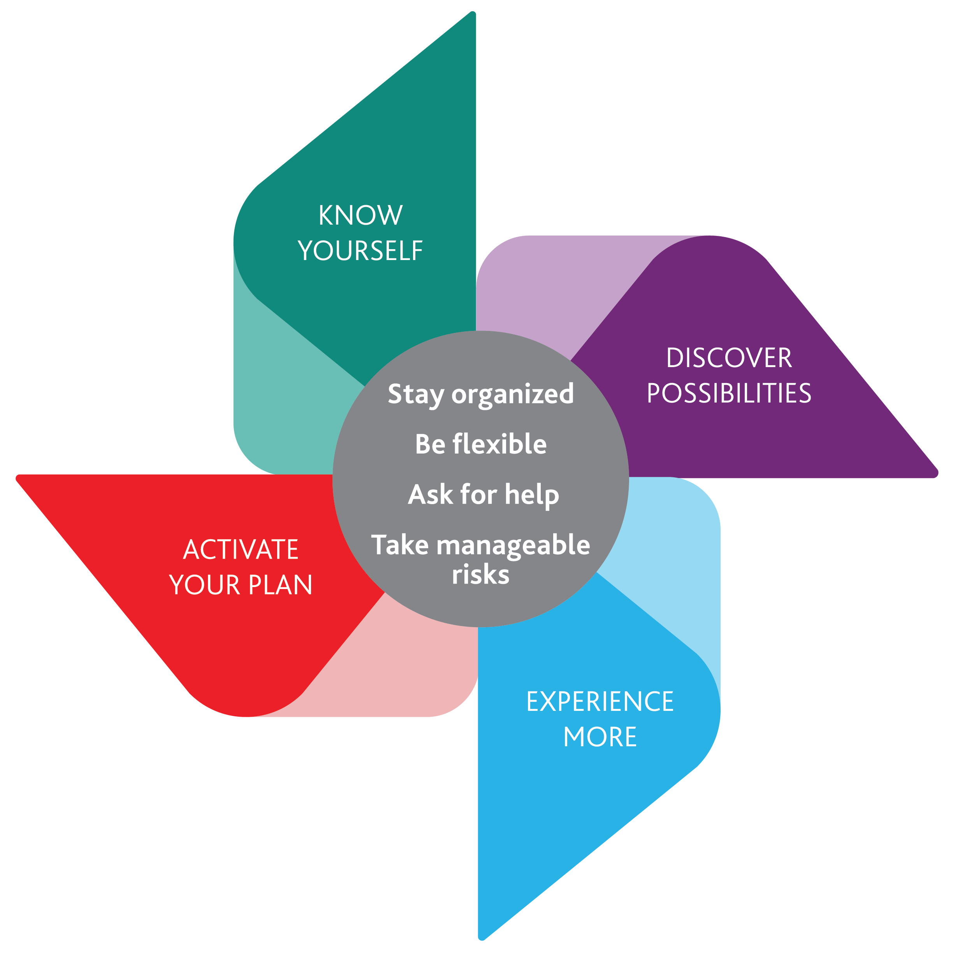
CCEE Career Model – Experiential and your Career
How can you develop your own…
Curiosity – explore new learning opportunities
  Career path exploration, engaging with your course material in a new way.
Persistence – make an effort despite setbacks
  Use problem solving when dealing with roadblocks.
Flexibility – be flexible to changing attitudes and circumstances.
  Adaptability in your team and with your community partner.
Optimism – consider new opportunities as possibilities and achievable
  View this opportunity as a semester long interview.
Risk Taking – take action even in uncertain situations.
  See opportunities beyond your project for employment.
Notes:
Community Partners for Experiential projects are also co-op, summer job and career employers.
Experiential projects are a great way to showcase your skills to a community partner that may be interested in hiring.
View this experience as semester long interview.
If you see the opportunity to continue working with your community partner. Let us know!
Three students obtained full-time positions as a direct result of their projects last year.

Slide 5
Skills Acquired May Include:
Positive attitude
Communication skills
Teamwork/collaboration
Strong work ethic
Interpersonal/relationship-building skills
Adaptability
What’s the connection between EE, your academics, and the job market?
Skills in demand*
*Source: CERIC survey and Developing Canada’s Future Workforce 2016 report
Notes:
These are the skills that are employers are looking for, these are points you would want to high-light when you’re talking about these projects in an interview.

Slide 6
Experiential & Your Portfolio
Showcasing your experiential project on your resume/LinkedIN is a great way to differentiate yourself from other job applicants.
It is important to list these experiences appropriately.
  Please refer to the documents on Sakai before you list any of your experiences.
Highlight the skills that employers are looking for.
If you are unsure, please reach out to the experiential team to review before you finalize.
Utilize the career resources on campus!
  Goodman Career & CareerZone

Slide 7
Goodman Career
2018/19 Events
Etiquette Dinner – October 24th
Exploring Careers In…
  Consulting – October 17th
  Analytics – November 7th
  Accounting and Finance - January 23rd
  Small & Medium Sized Enterprises – February 13th
Questions/Comments…
Ask us a Question at portal.bus.brocku.ca
Or Book an Appointment on CareerZone

Slide 8
Agenda
Project description & Timeline
Communication Strategies
3 experiential hang ups/roadblocks
Community Partner(s)
Drop in Session
Extra Resources

Slide 9
Project Description – Service Learning
Organizational Behaviour/HRM Project:
For this project, you will be using course concepts to analyze challenges that managers face in relation to the behavioural aspects and other Human Resource management issues within an organization.
Challenges may include:
Workplace emotions, attitudes and stress
Strategies for motivating employees
Decision making and creativity in the workplace
Communication strategies within an organization
Applied Performance Practices
Presentation of solution to Client and Professor
Final report – To be given to your community partner.
Final step – Self Assessment

Slide 10
Timeline
Experiential Introduction – Today
Community partner visit – Mon. Oct. 1st
Upload Team Contracts & NDA package to Sakai – TBD
Progress Presentation – Nov. 12th
Final presentations – Dec. 3rd
*Additional time to contact/meet with your community partner to be determined.

Slide 11
Communication strategy
CHALLENGE: Many of our community partners have multiple teams.
Single point of contact for the team
  Someone who regularly checks email
Team ID in email subject
  Eg. “Project Name – Team Name” Not just once… but every time you email
  Continuous email stream… explain the strategy to client so they understand the importance too
First email
  Introduce the team + meeting goals
  Give 2-3 potential dates/times for a site visit
Thank you email… details in project outline
Interim Report… summary of action plan in email body… attach full report
NOTE: not all team members must be present at client meetings but the workload needs to be balanced.

Slide 12
3 SL Concerns from Students: Go to whom for what?
        Connection to course Professor
        material
Concerns about Dan or David
team function
Community partner Dan or David
communication concerns

Slide 13
Community Partner – Community Living Fort Erie
Community Living ~ Fort Erie is a non-profit organization with 60 years experience providing advocacy for, and support to, individuals who have intellectual challenges, and their families.
80+ employees
Have gone through major restricting of employees, prompted by need to cut costs, improve service delivery. Unionized environment, residential services and the difficulties associated with that. New home purchases required a re-staffing of those sites. This stirred up a lot of emotions within the staff. How do we reengage the staff who remain? MGMT has backed off completely and are letting employees ease in with new teams.
How to deal with employees in this new structure, dealing with new team members, understanding new strengths. Starting to see generational diversity as they move forward. Would love to see strategies on how to get generations to work together and work off of each other’s strengths.
Workplace emotions, attitudes and stress
Strategies for Employee Motivation

Slide 14
Community Partner – de la Terre
de la Terre specializes in organic artisan breads and pastries made in-house and features coffee and tea & espresso-based drinks. de la terre is deeply committed to foregrounding locally produced foods and their producers, as well as encouraging consumer support of organic and sustainable agricultural practices. In this spirit, we use biodegradable and compostable take-out containers, cutlery, and napkins. We purchase our flour and produce from small independent farmers wherever possible.
Approaching 30 staff members, mainly at 2 retail locations, front of house staff is split 50/50 between full-time and part-time.
Front of house employees not taking initiative with making decision on products that are on shelf or going bad. How is management portraying behaviours and are they empowering the employees? What are the managers missing that is not translating?
Workplace emotions, attitudes and stress
Strategies for employee motivation
Trouble keeping staff
Internal communication strategies, leadership and planning
  Monthly managers meetings
  Sometimes staff meetings are held once per year
  Communication is typically verbal or left by notes
Managing organizational change
  Plans to consolidate 2 retail locations
  Major org. restructure

Slide 15
Drop-in Presentation Session
Book a 15 minute consultation with EEC’s on November 15th from 1:00-4:30pm.
Run through your slides and receive feedback on your presentation skills/style.
Receive helpful tips about presentation day and pitching to your community partner.
Ask questions about formatting, presentation flow, team dynamics, slide style.
Registering for this session has no impact on your grade.
A registration link will be made available to you in early October, spots will be limited. First come, first served.

Slide 16
Extra Resources
Posted on Sakai
  These slides
  Confidentiality Agreement & Team Contract
  Resume & LinkedIN Resources
  Career Action Plan Worksheet

Slide 17
Contact Info
Dan Lonergan
dlonergan@brocku.ca
GSB 333
Ext.5023
David DiPietro
ddipietro@brocku.ca
MC B213
Ext. 5933
Follow us on Twitter!
@BrockExpEd

