Slide 1
EQ and YOU
Barry Wright
Goodman School
Brock University

Slide 2
EQ and YOU
Who are you now?
Pick Three things

Slide 3


Emotions at Work
Jan comes in to her office and throws her papers on her desk.
Claude comes in with coffee for both.
“Could you just fix the messed up Jackson file and have it on my desk by noon.”
Claude walks out with a three letter look.

Slide 4
Emotions at Work (backstory)
Bad mood rising – Jan’s morning
Son failed exam – disappointment
Anger for not having paid attention
Anger for arguing with partner
Anger at driver who cut her off
Anger when walking in – reception area is messy
Jan: Not recognizing these emotions in self.
Claude: Not understanding how to deal with emotional signals.
Result: Awkward moment and resulting poor productivity from Jan (and Claude).
PS Ever experienced something like this?

Slide 5
Outcomes from Today
Self-Leadership: Awareness of self
Communication: Sending clear and convincing messages.
Political and Emotional Awareness: Reading individual and group’s emotional currents and power relationships. Negotiating and resolving disagreements.
Leadership: Inspiring and guiding groups and people.

Slide 6


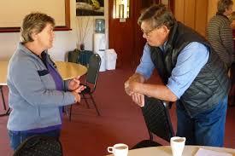


Partner-Up

Slide 7
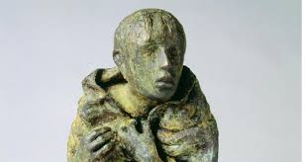
What feeling does this photo illicit? Discuss

Slide 8
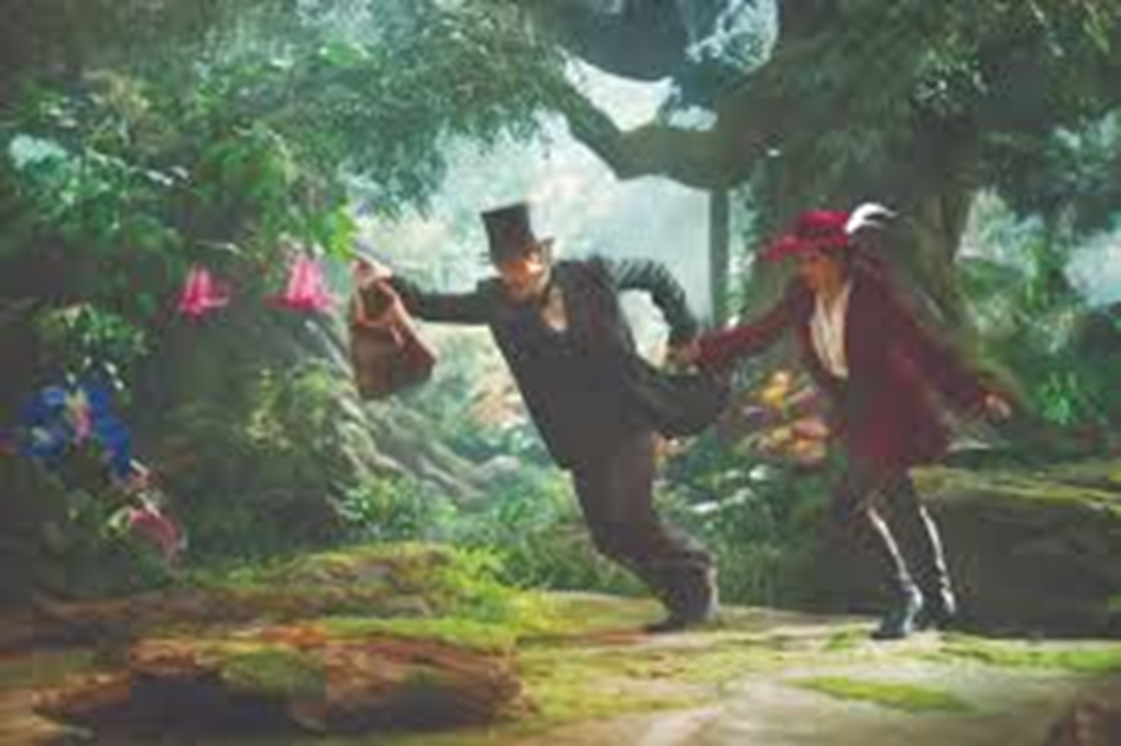
What feeling does this photo illicit? Discuss

Slide 9
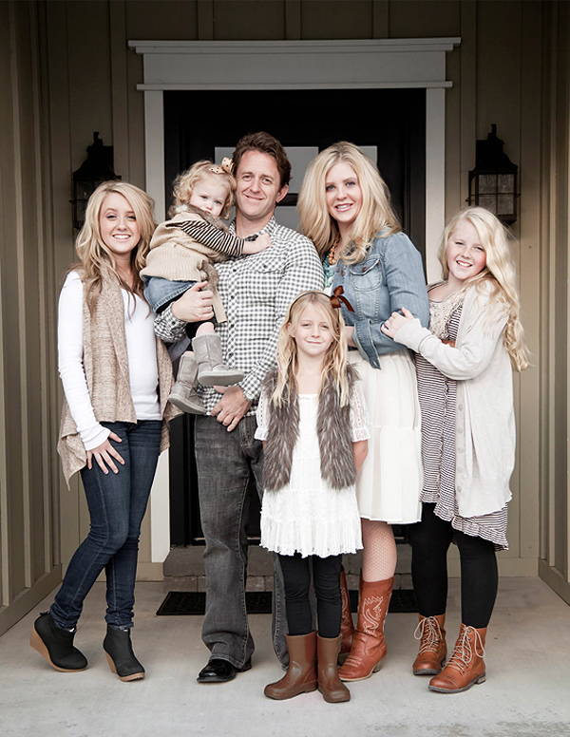
What feeling does this photo illicit? Discuss

Slide 10

What feeling does this photo illicit? Discuss

Slide 11
Individually List …
A variety of shades of White
A host of different Emotions

Slide 12
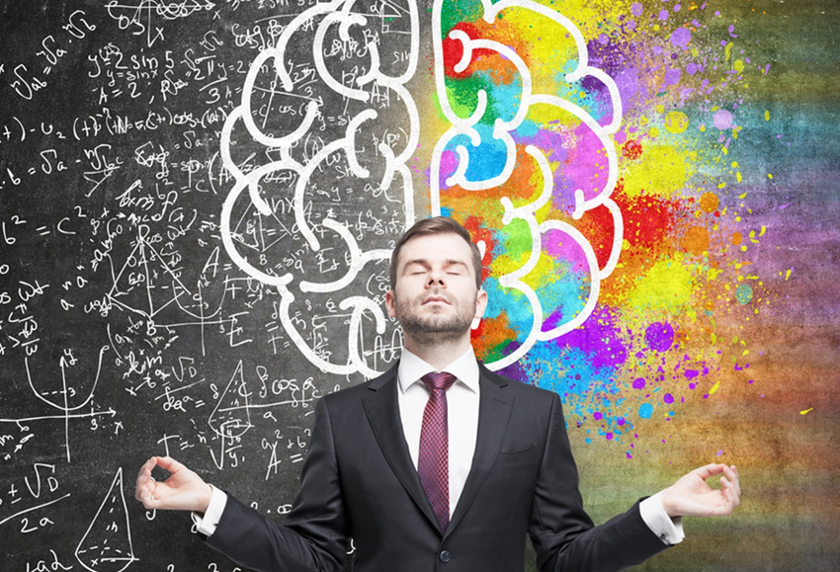
List …
A variety of shades of White:
White, really white
Beige, creamy, ivory, lace, melon tint, paper-white, welcome-white, dover-white, pure-white, extra-white, ecru, nonchalant
A host of different Emotions:
Happy, Mad
Agitated, alarmed, amused, angry, annoyed, anxious, awed, bitter, bored, bewildered, calm, cautious, comfortable, confused, constrained

Slide 13
Emotional Intelligence (EQ)
Model theoretically developed and empirically tested now it has also been popularized
Focus:
  Understanding self: your intentions, responses, behaviour and feelings.
  Understanding others: and their feelings.

Slide 14
EQ Business Case (Why important)
Experienced partners in a multinational consulting firm were assessed on the EI competencies plus three others. Partners who scored above the median on 9 or more of the 20 competencies delivered $1.2 million more profit from their accounts than did other partners – a 139 percent incremental gain (Boyatzis, 1999).
In complex jobs, a top EI performer is 127 percent more productive than an average performer (Hunter, Schmidt, & Judiesch, 1990).
After supervisors in a manufacturing plant received training in emotional competencies such as how to listen better and help employees resolve problems on their own, lost-time accidents were reduced by 50 percent, formal grievances were reduced from an average of 15 per year to 3 per year, and the plant exceeded productivity goals by $250,000 (Pesuric & Byham, 1996).

Slide 15
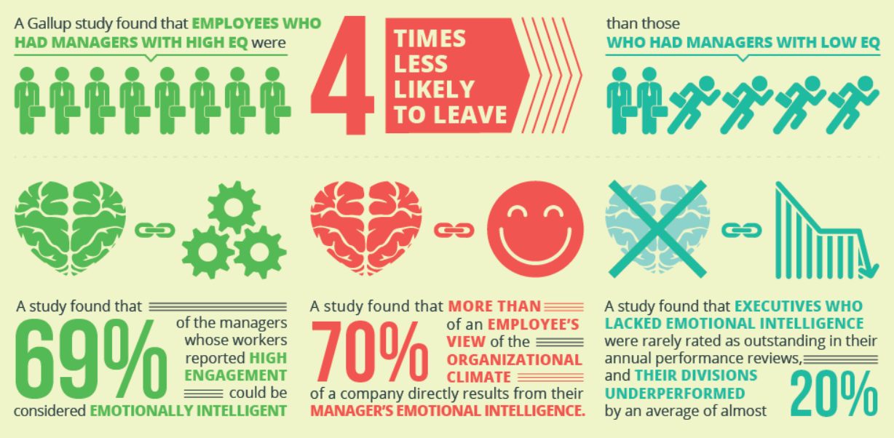
Now as a picture …

Slide 16
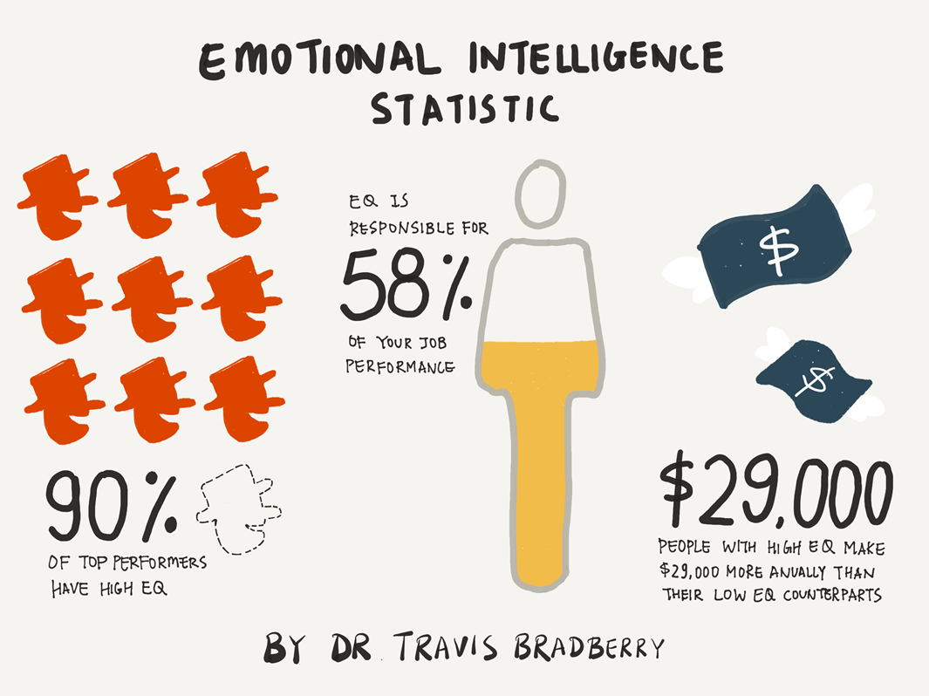
Now as in what does that mean for me …

Slide 17
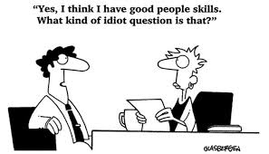
Who are you now?
Please take out your phone …
https://globalleadershipfoundation.com/geit/eitest.html

Slide 18
Emotional Intelligence: The 4 Branch Model
Branch Name | Brief Description of Skills Involved
1. Perceiving Emotion (Self-Awareness) | Ability to identify emotions in oneself and others (as well as in objects, art, stories, music, other stimuli)
2. Understanding Emotion (Social Awareness) | Ability to comprehend emotional information, how emotions combine and progress through relationship transitions and to appreciate emotional meaning
3. Managing Emotion (Self-Management) | Ability to be aware of own feelings, to regulate them in oneself and help others to do this as well to promote personal understanding and growth
4. Using Emotion to Facilitate Action (Relationship Management) | Ability to generate, use and feel emotion as necessary to communicate feelings, or use them in other cognitive processes

Slide 19
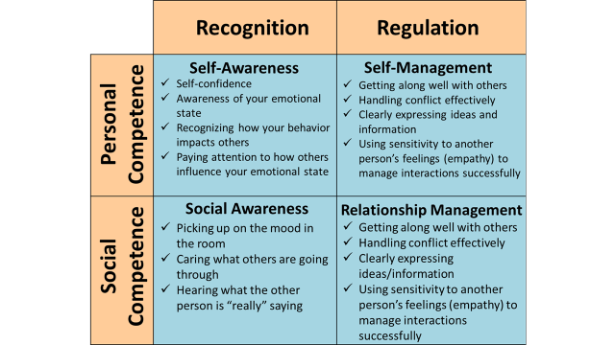

Slide 20
Partner-Up (new partner)

Slide 21
1. Exercises for Self-Awareness
Reflect on your four scores – surprises? Discuss
Reflect on how you feel right now? Discuss
Visit your values – what do you stand for (stand against) – pick 3! Discuss
Homework: Make a list of your daily emotions list on the left by the hour / list on the right the context that surrounded them
  Outcome: Awareness of how you are feeling. Reflect on why you do the things that you do?

Slide 22
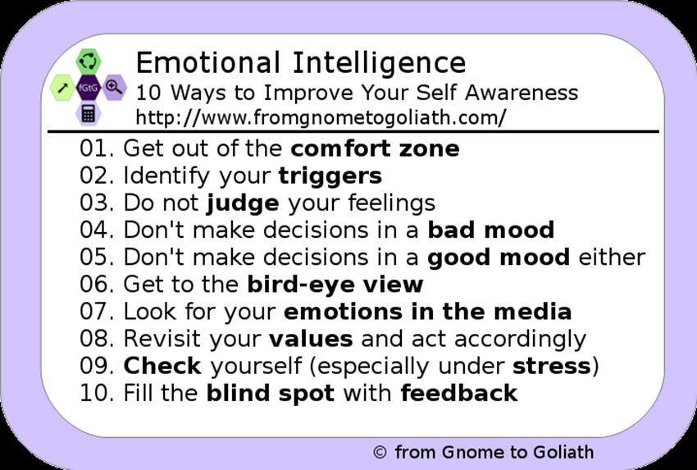

Slide 23
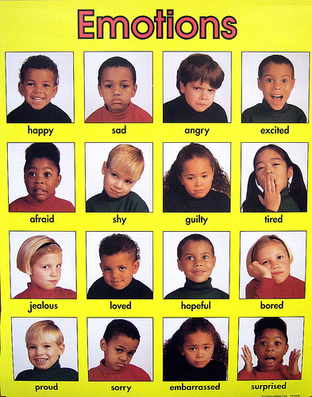
2. All talk and no feelings …
Perceiving emotions (others)
Determine what
Emotions are
Being displayed

Slide 24
2. All talk and with feelings

Slide 25

2. Understanding Emotion
Sensing others’ feelings and perspective, and taking an active interest in their concerns.
Attentive to emotional cues and listen well.
What are the emotional clues we / you attend to?

Slide 26
2. Emotional Clues
Eyes, mouth, speed, voice, tone, posture
Culture :) :( (^_^) (;_;)
Commercial: Looking for a mate who in everyday conversation can pick up even your most subtle emotional cues?
A. Find a musician.

Slide 27
2. Time for some Emotional Exercises
Small group discussion
Should Management receive bonuses based upon short-term company performance?

Slide 28
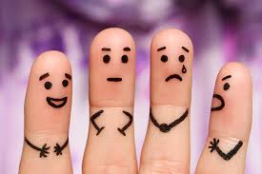
Debrief
Did we recognize the emotions in others?
And the academy award goes to …

Slide 29
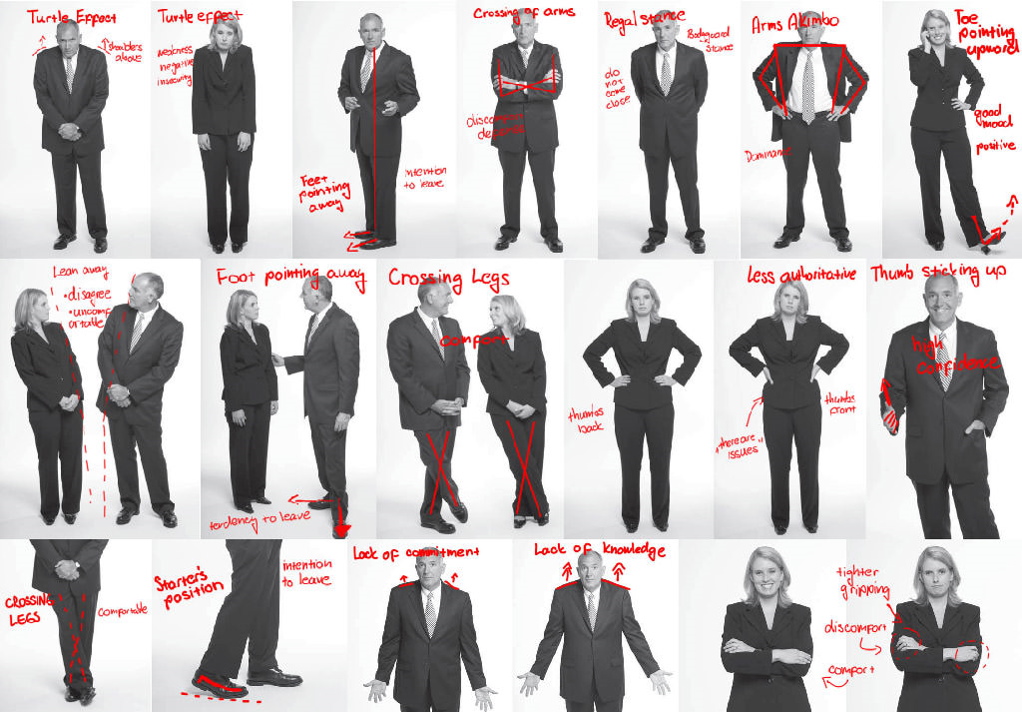
Body Language

Slide 30
2. Exercises for Social Awareness
Live in the Moment: In whatever situation, just be present, don't think about the past or the future, fully experience what is happening now.
Tour around for 15 minutes: observe the behaviour around you
Develop a back-pocket question: “What do you think about _____?”

Slide 31
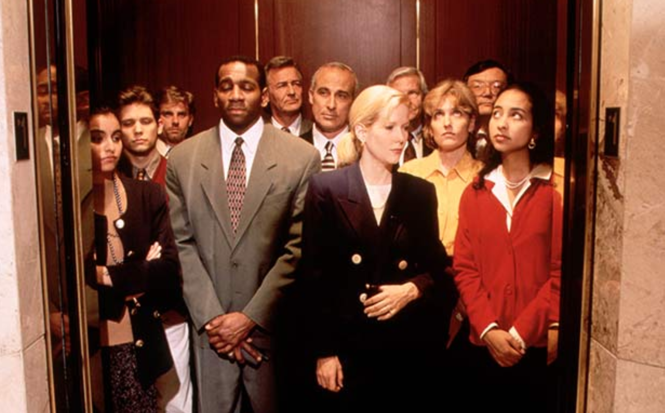
3. Manage Your Emotions
Sticky Hot
Get on, More squeeze in
Poke in the back
Twice
Thrice
Anger builds
Turn to face

Slide 32
3. Manage your emotions
Become emotionally literate. Label your feelings, rather than labeling people or situations.
“I feel impatient” vs “This is ridiculous.”
Use your feelings to help make decisions.
“How will I feel if I do this?” “How will I feel if I don’t?”
Examine how you react to stressful situations. Take more responsibility for your feelings.
“I feel angry” vs “You are making me angry.”
Find a way to stay calm.

Slide 33
3. EQ: Self-control
Be Aware
Stay composed, positive, and unflappable even in trying moments
Helicopter effect – rise above
Breathe

Slide 34


Relaxation Exercise

Slide 35
4. Relationship Management
Impressions carry the day – be excited; message is secondary (emotion > facts)
  Consumers buy on emotion
What are our strongest emotions?
  Hope, fear, joy, sadness
Task: Create an emotional argument to get your neighbour to do something.

Slide 36
Emotional Words
Alarmed, angry, apprehensive, awkward
Bitter, bored, cheerful, curious, cynical
Delighted, discouraged, eager, enraged, excited
Frustrated, fatigued, grouchy, happy, hopeful,
Irked, intense, joyous, jealous, loving, lonely
Mad, miserable, numb, nice, overwhelmed
Pleased, proud, puzzled, queasy, rejected, sad
Safe, scared, shy, shocked, sorry, surprised
Troubled, upset, victorious, excited, yucky, zany

Slide 37
Exercises for Relationship Management
Remember the little things: please, thankyou, I’m sorry, say names.
When you care, show it: small gestures to express your feelings and gratitude.
Explain your decisions, don't just make them: explain why.

Slide 38
Tough Conversation
Anyone have one lately?
Partner up

Slide 39
Task:
Tackle tough conversations
First, start with an agreement - what's the shared ground?
Then ask the person to share their side or point of view. Resist speaking up, listen fully to understand the other person, don't go on the defensive right away.
Now help the other person understand your side - describe discomfort, thoughts, ideas, reasons etc.
Move the conversation forward by finding common ground again based on what you've learned about each other's views.
Keep in touch after this conversation and check in on progress made that you agreed upon together.

Slide 40
Skill Development Opportunity
Pat calls Chris into his/her office to discuss a challenge – Chris has not been performing well lately. His/her performance has dropped off. Pat is confident that Chris can do better.
Chris feels that Pat is unappreciative of the substantial progress s/he has made.
Before assuming the roles imagine how you would feel in such a circumstance - plan your thoughts and then play the role.

Slide 41
EQ Takeaway Lessons
Rather than seeing jobs as purely rational undertakings, you need to assess the ‘emotional impact’ of each employee's job, and to design job assignments that take this into account.
Organizations are not cold places that people enter just to work. Managers need to create a positive and friendly emotional climate, and to model this through their own behavior.

Slide 42
3. Selection of employees and teams needs to be based, in part, on a positive emotional attitude. Managers should select employees on the basis of their record for engendering a positive emotional attitude in their work teams.
4. Managers should seek to train their employees to improve their emotional intelligence skills and to engage in healthy emotional expression at work.

Slide 43
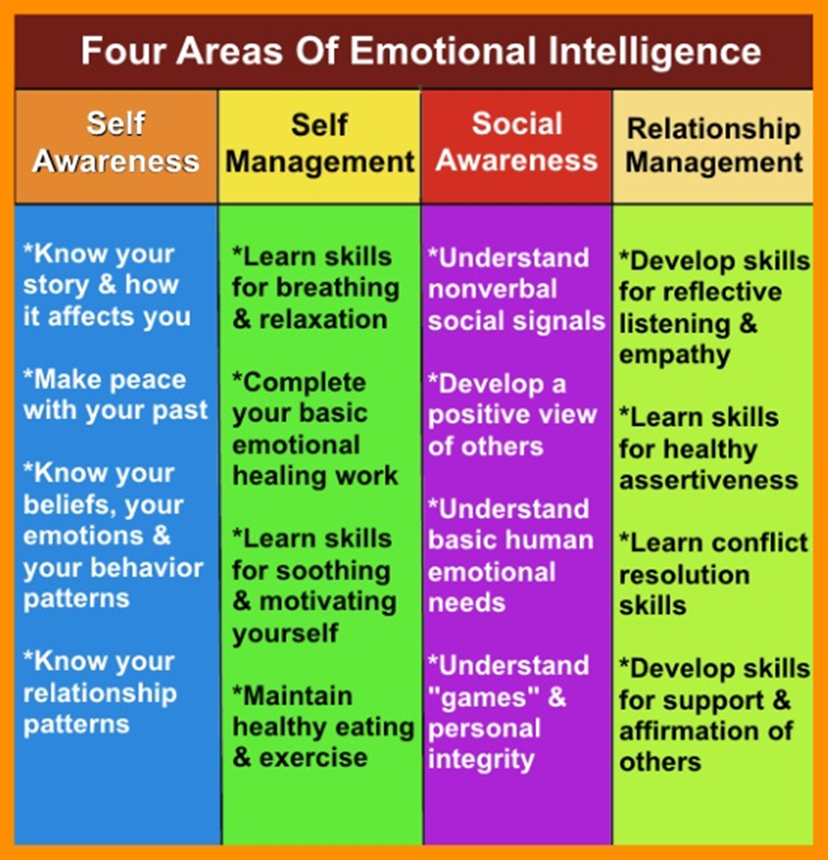
What are your Three?

Slide 44
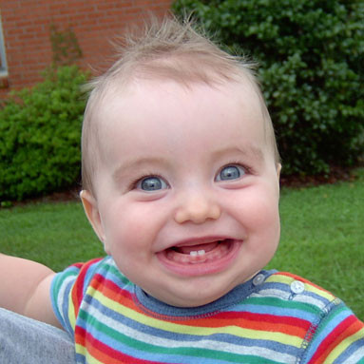
Have a great day!
bwright@brocku.ca

