Slide 1
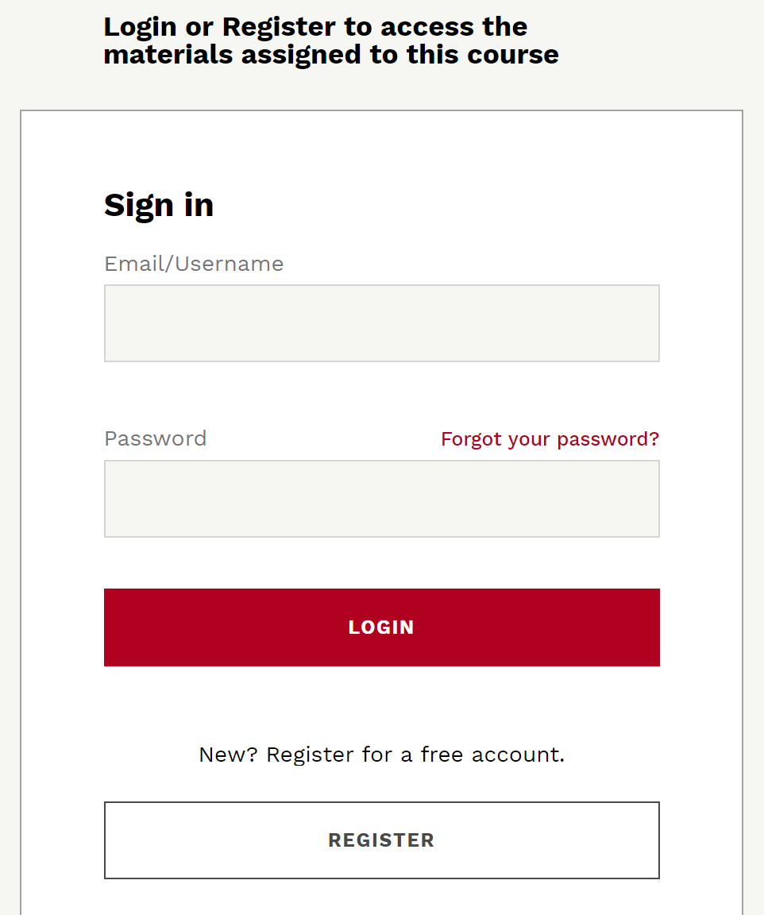
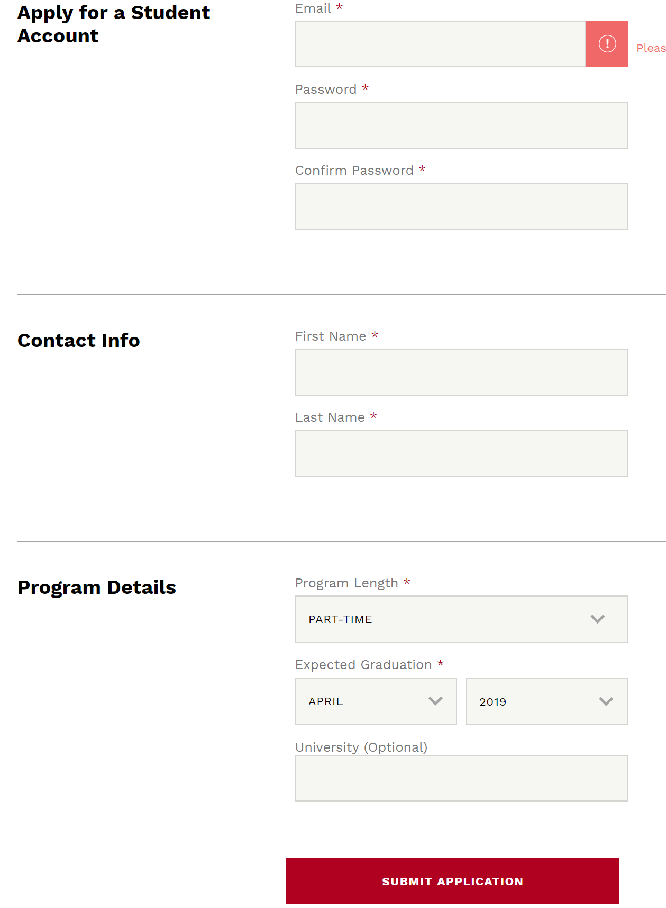
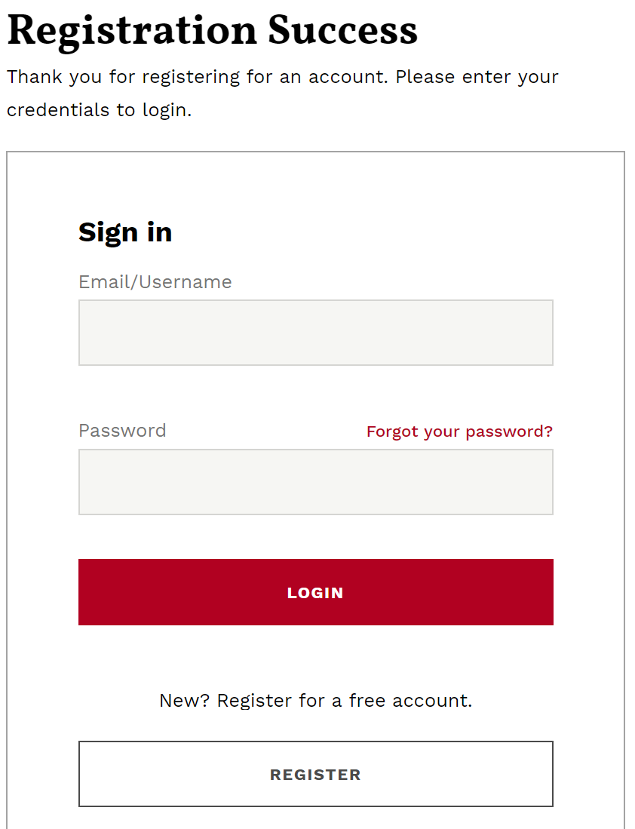
How to Access the Simulation
Copy and paste the e-mailed coursepack link using a Chrome or Safari browser.
Click on Register
Program Length: Part-time
Expected Graduation: April 2019
Sign in using your credentials

Slide 2

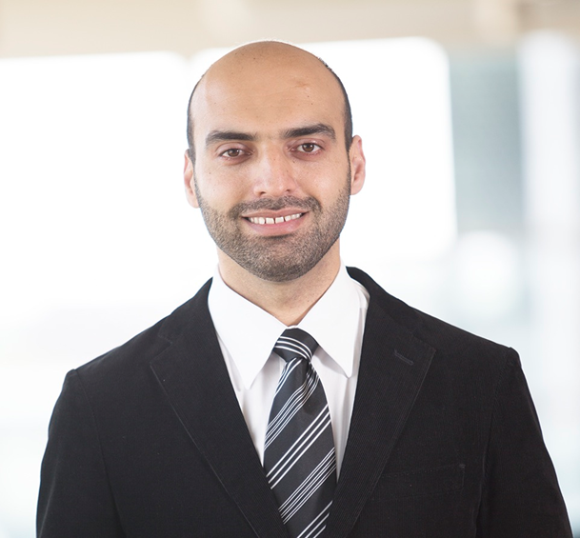
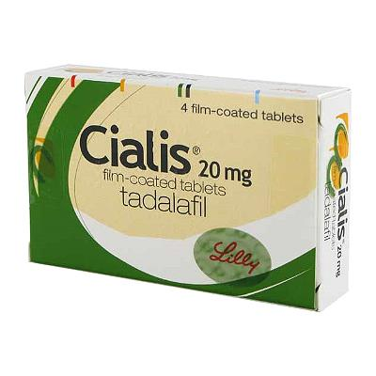
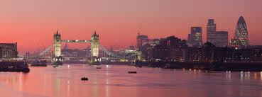
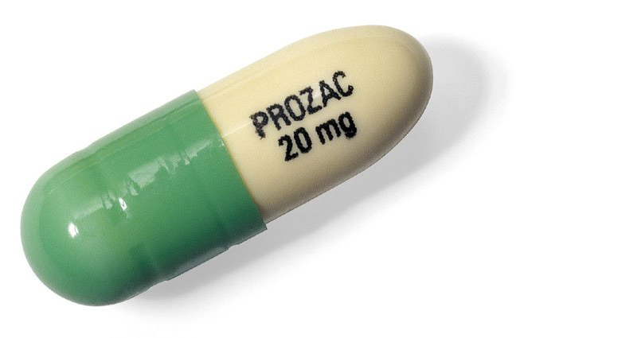
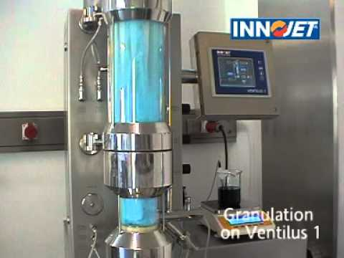
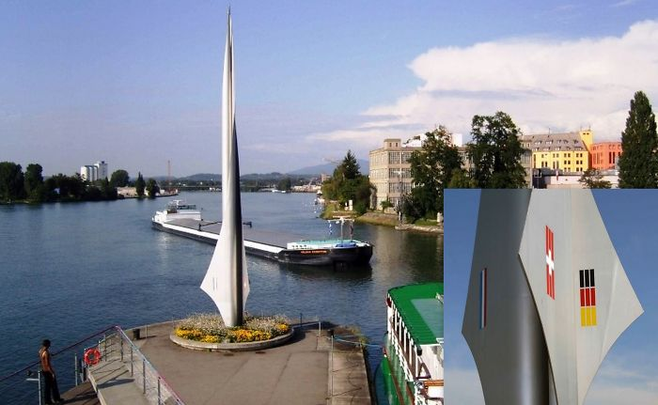
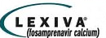



Abdul R. Rahimi
Notes:
A graduate of the Goodman School of Business MBA program and was inducted into Beta Gamma Sigma. Previously,
I completed a Masters of Pharmaceutical Technology and a Bachelors of Pharmaceutical Science in the UK. Prior to this position, I worked for the Goodman Consulting group and I’ve held a number of technical and leadership roles within the pharmaceutical industry across the UK including, transfer manager, process development & validation specialist, capital project management and industrialization lead. My specializations include; project management, operations management and product development.
Fosamprenavir (Lexiva in the U.S. and Telzir in Europe) is a drug for the treatment of HIV infections. It is a pro-drug of the protease inhibitor and antiretroviral drug amprenavir. The FDA approved it October 20, 2003, while the EMA approved it on July 12, 2004. The human body metabolizes fosamprenavir in order to form amprenavir, which is the active ingredient. That metabolization increases the duration that amprenavir is available, making fosamprenavir a slow-release version of amprenavir and thus reducing the number of pills required versus standard amprenavir.
Pazopanib (trade name Votrient) a potent and selective multi-targeted receptor tyrosine kinase inhibitor that blocks tumour growth and inhibits angiogenesis. It has been approved for renal cell carcinoma and soft tissue sarcoma

Slide 3
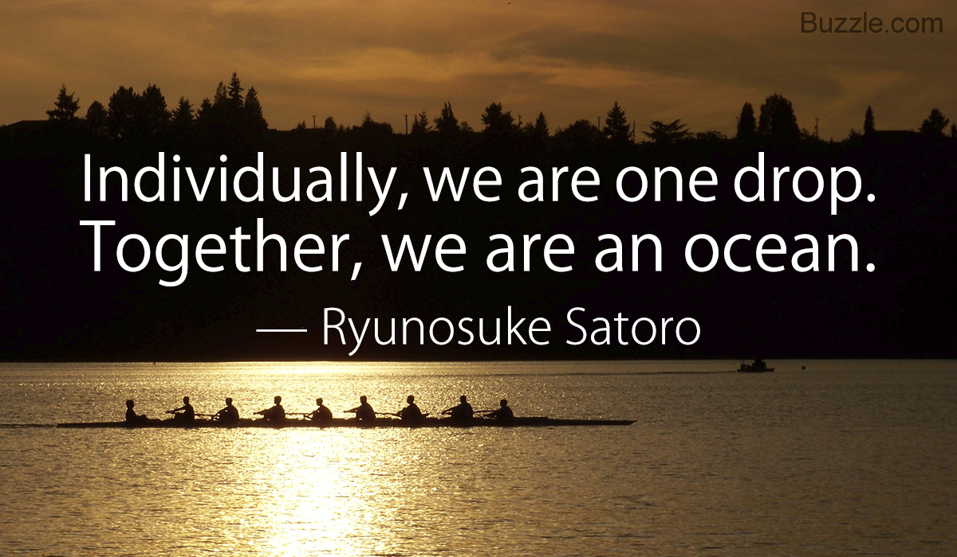
Team Work

Slide 4

Agenda: Topics
Purpose
Build Teamwork Skills
How
Stand on the shoulders of giants:
  Review Team Research
  Summit Series
  Summit Everest
What
Draw from the Themes – Draw from your Wisdom – Draw from each Other
28-8 Teammates

Slide 5
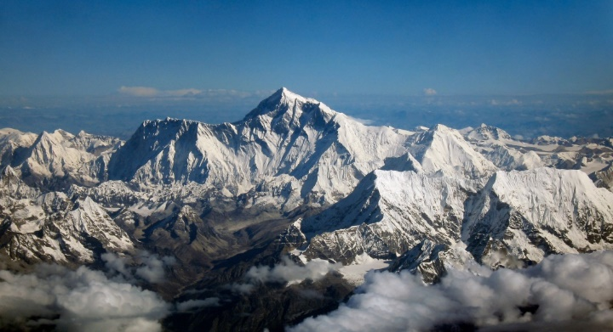
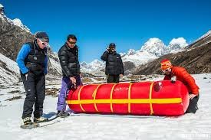

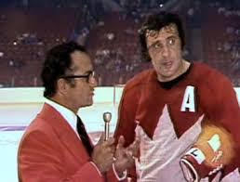
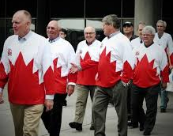
Agenda: Timeline
Introduction
Lunch
Debrief
Research
Team 72 Canada
Climbing Mount Everest
Notes:
The majority of today will be hands-on learning in your simulation teams where you will be leading a change project.
“What other expectations that you have of me to keep in mind in terms of how we run the day?”

Slide 6
Learning Objectives
Learn about building, participating in, and leading effective teams
Learn how teams can solve problems and make decisions more effectively
Learn how to find purpose, come ready to play, overcome adversity, and be
28-8 Teammates
Notes:
Provide a list of learning outcomes and seminar objectives.

Slide 7

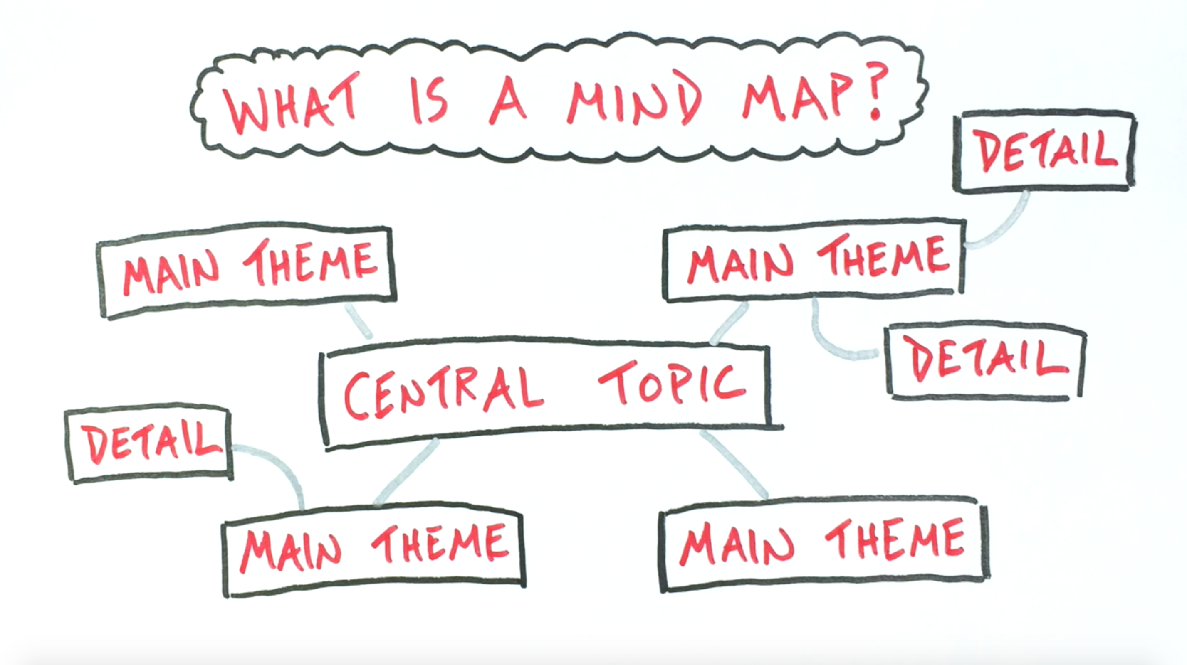
Summit Session Takeaways
Who are you now?
  3 Personal Takeaways
Find BIG Team Themes

Slide 8
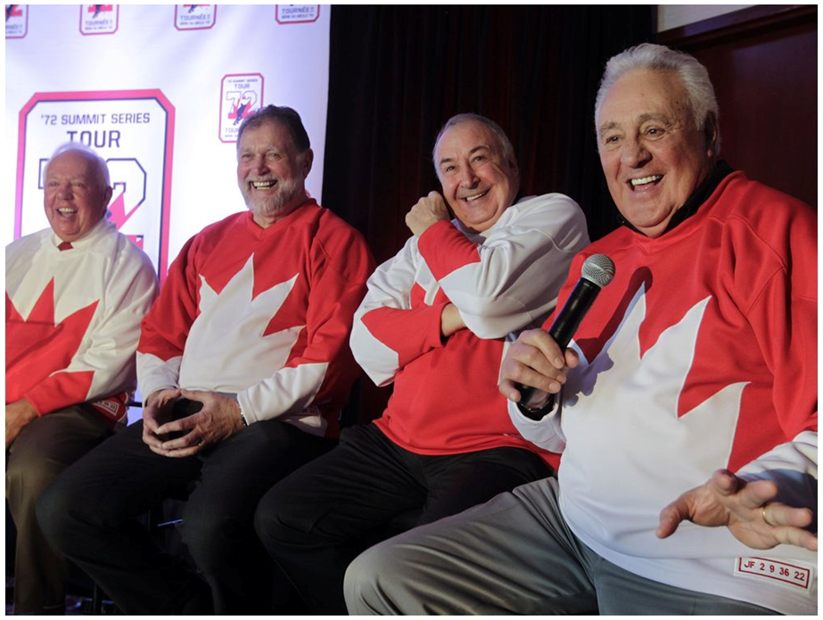
Personal Experience with Teams
Good things …
Less Good things …

Slide 9
Are authentic leaders associated with more virtuous, committed and potent teams?
Research paper insights
Your thoughts / insights? Partner-up and discuss.
Big takeaways (up to 3)
Strengths
Fuzzy Places
Relationship to other articles
Who are you NOW?

Slide 10
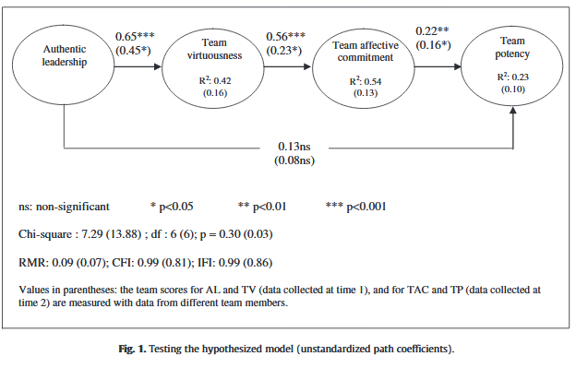
Authentic Leaders
Says exactly what he or she means
I feel ‘emotionally attached’ to this team
This team demonstrates the highest levels of integrity.
Our team has confidence in
performing the job requirements

Slide 11
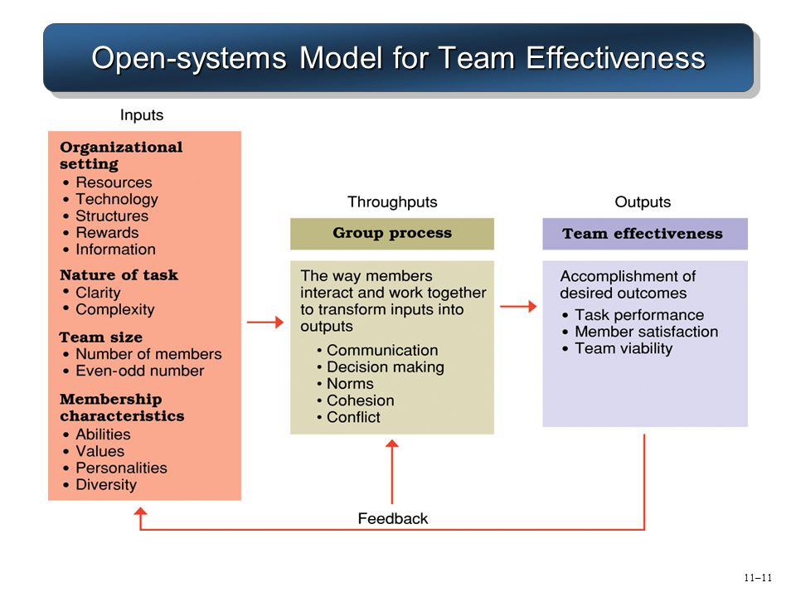
Open-systems Model for Team Effectiveness
Old but good – McGrath, 1964

Slide 12
Throughput
Direction: that energizes, orients and engages team members.
Structure: right members, right processes, right norms.
Context: right rewards, right information, right training
Mindset: common identity and common understanding
Richard Hackman’s conditions — a compelling direction, a strong structure, and a supportive context.
PLUS Shared Mindset (HBR)

Slide 13
Motivation
Why we work determines how we work.
Play is when you are motivated by the work itself.
Purpose is when the direct outcome of the work fits your identity.
Potential is when the outcome of the work benefits your identity.
Insight: Explain the why (for me and we) ’

Slide 14
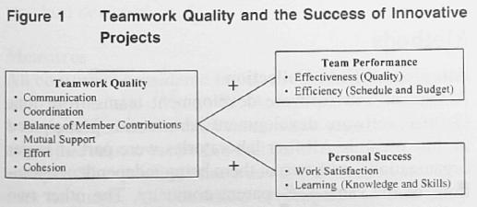
Team Research: Interactions
Quality of interactions: Most valued team skills include: active listening, collective problem solving, taking responsibility, giving positive feedback plus …

Slide 15
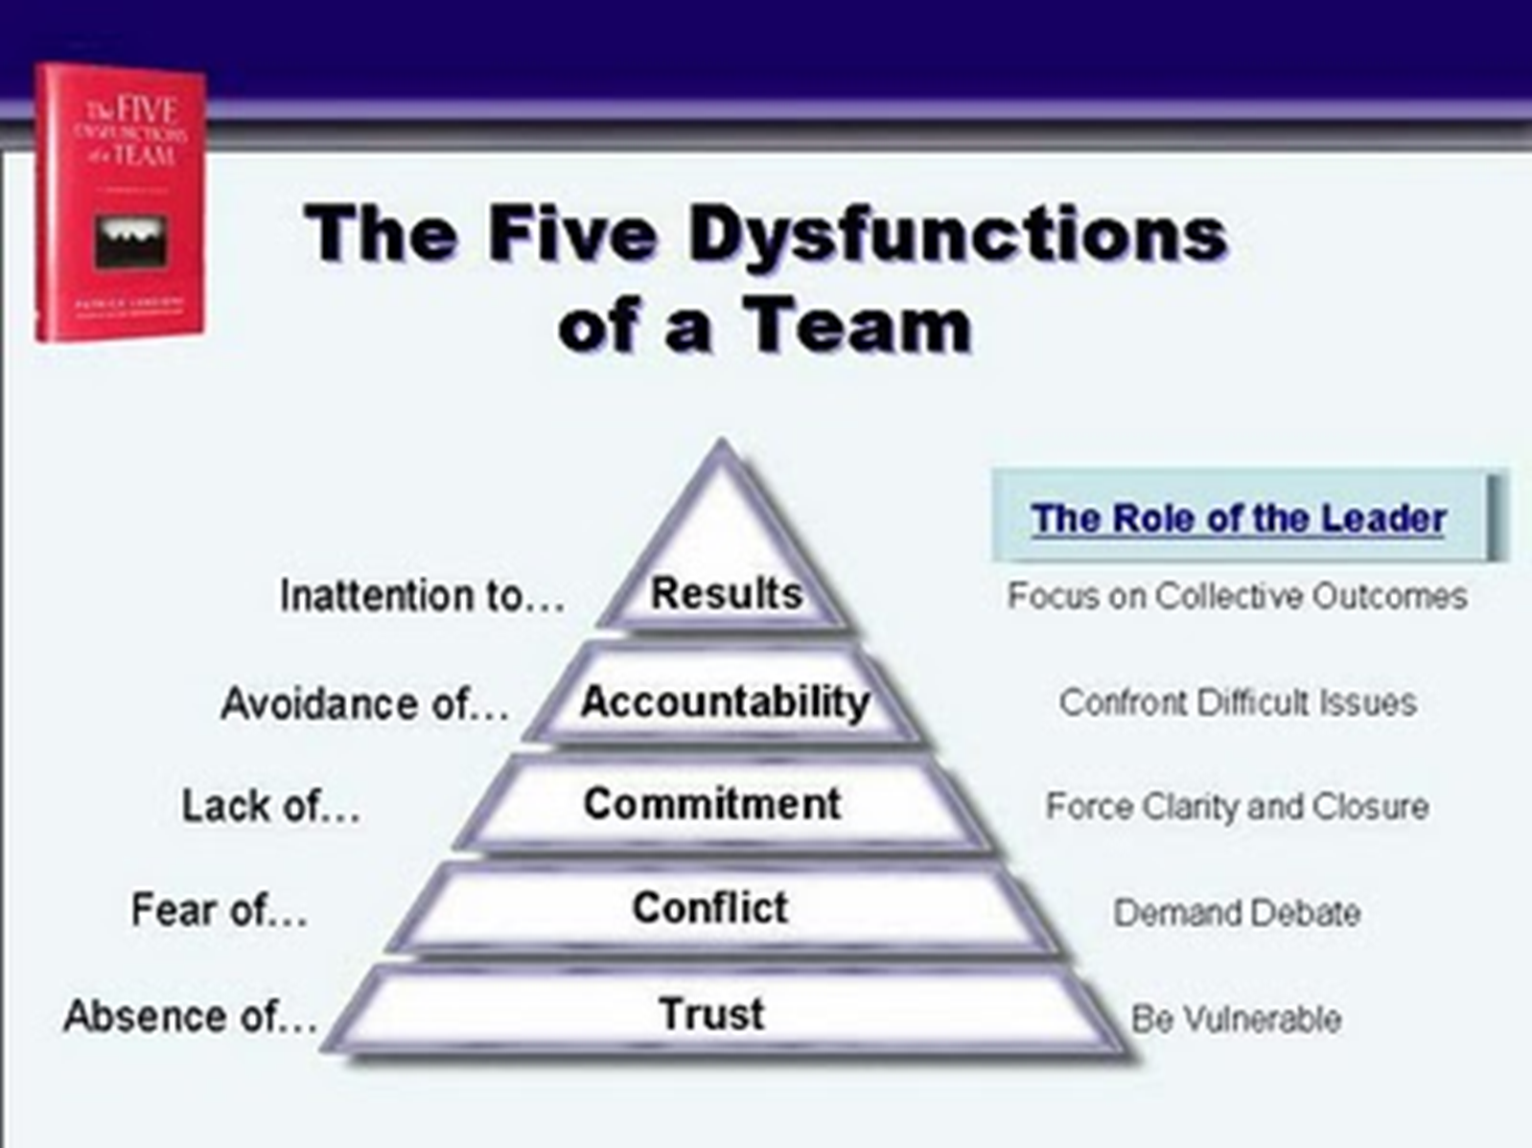
Team Research: Dysfunctions
Dysfunctional: 70% of workers say they have been on dysfunctional teams as a result of:
  absence of trust,
  high conflict,
  lack of commitment,
  low accountability,
  inattention to results

Slide 16
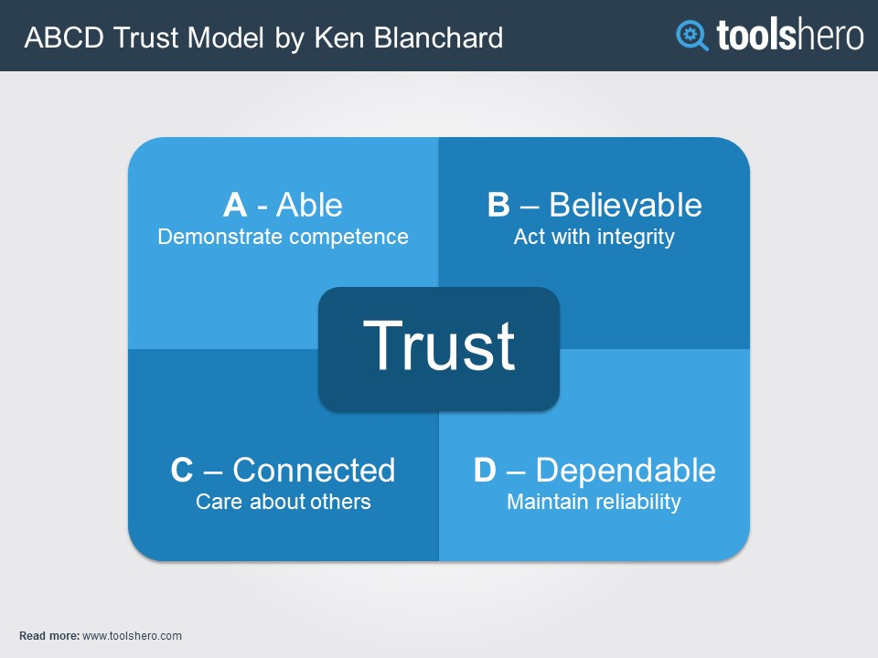
Develop Trust

Slide 17
Conflict Approaches
Avoidance - withdrawal from conflict
Accommodation - place other’s needs first
Forcing - place one’s needs first
Compromise - each gives up something of value
Collaboration - seek solution which is advantageous to all parties
Which one is BEST?

Slide 18
Conflict Approaches
high
forcing
collaborate
Satisfy own concern
compromise
avoidance
accommodate
low
low
Desire to satisfy other’s concern
high

Slide 19
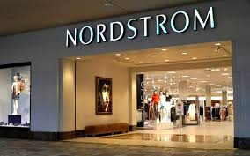

When to Use …
Avoidance – neither person nor issue important
Accommodation – person important; issue not
Forcing – person less important; issue important
Compromise – both important; time shortage
Collaboration – both important; time available

Slide 20
Interaction of Norms and Cohesiveness on Performance
Performance
High
Medium
High
Perf.
Norms
Lowest
Low
Low
Low
Cohesiveness
High

Slide 21
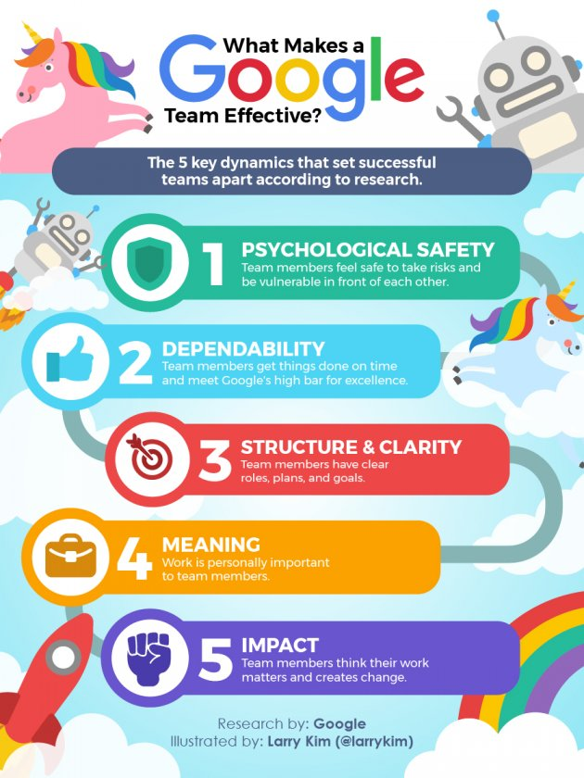
Team Work:
What might we learn from Google?

Slide 22
Summary
Your BIG Insights on ‘Teamship’ Research?
Reflect, then BIG group Share …

Slide 23
Team 72 Canada
“Everyone one of us guys, thirty-five guys who came out to play for Team Canada. We did it because we love our country and not for any other reason.” Phil Esposito

Slide 24
The Best Team Ever.
“Everyone one of us guys, thirty-five guys who came out to play for Team Canada. We did it because we love our country and not for any other reason.” Phil Esposito
In 1972 we overcame incredible adversity to emerge victorious.
To do so we had to become a team, not just a collection of talented individuals.
We have looked back and extracted the lessons learned to help organizations to unleash the Power of 28-8 Teamwork.

Slide 25
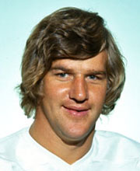
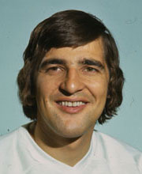
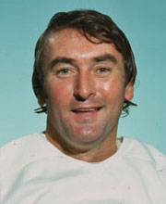

The Power of Teamwork is the Lasting Legacy of TC72
"What that team did, I don't think there has been a greater feat in sports. It was an unbelievable comeback against a great Russian team. I've never seen anything like it." Bobby Orr
"I was a member of nine Stanley Cup teams, but this was the greatest experience of my career." Serge Savard
"It turned out to be more than just a hockey series. A lot of pride came into play - pride in yourself, pride in your team, pride in your country." Ed Johnston

Slide 26
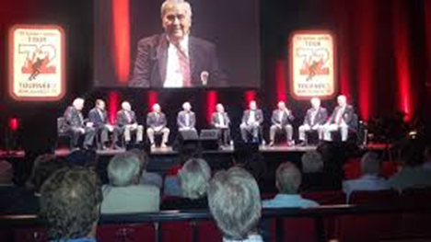
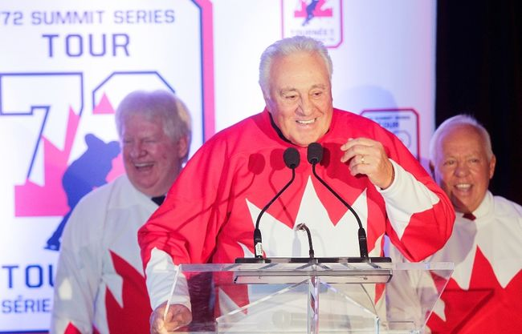
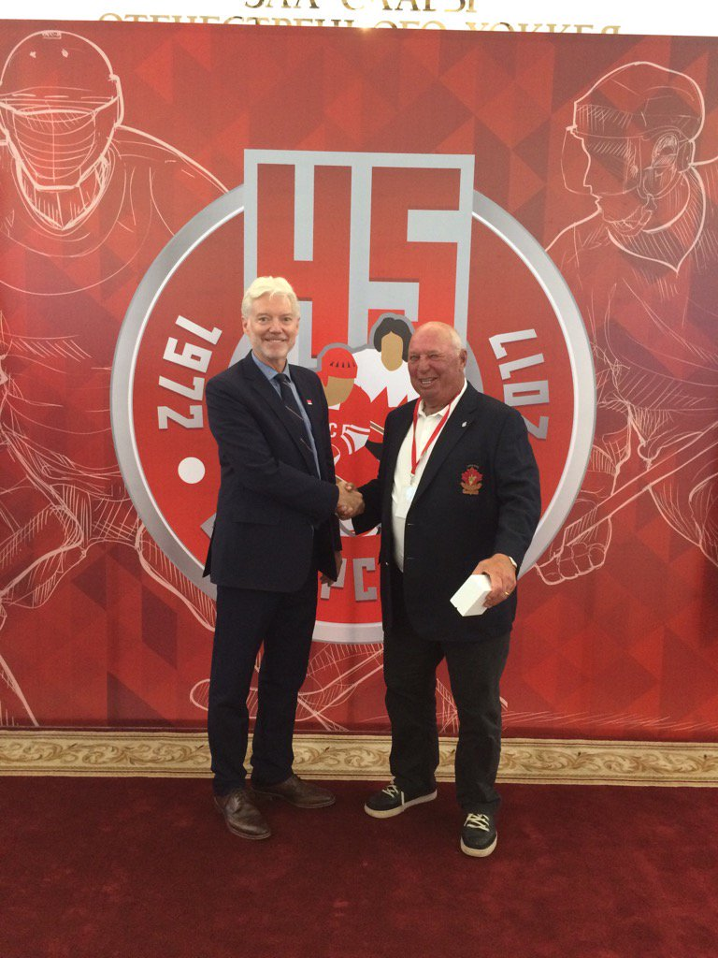
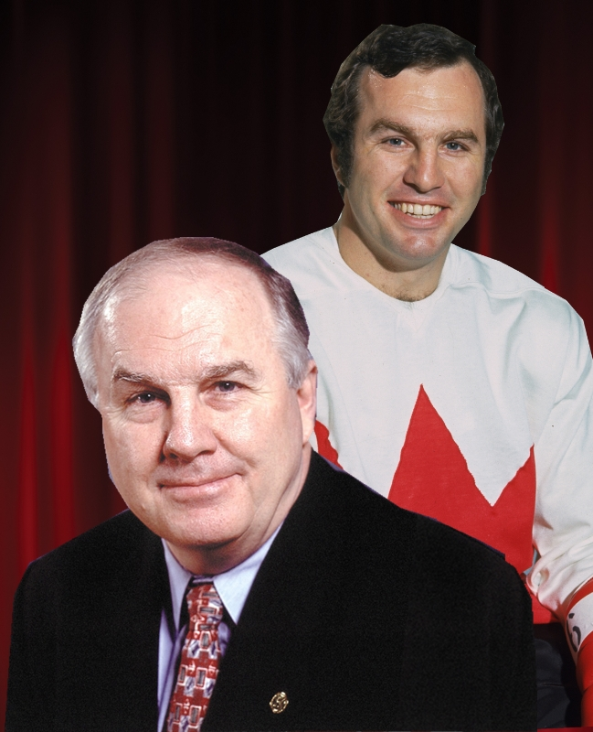
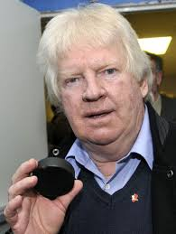
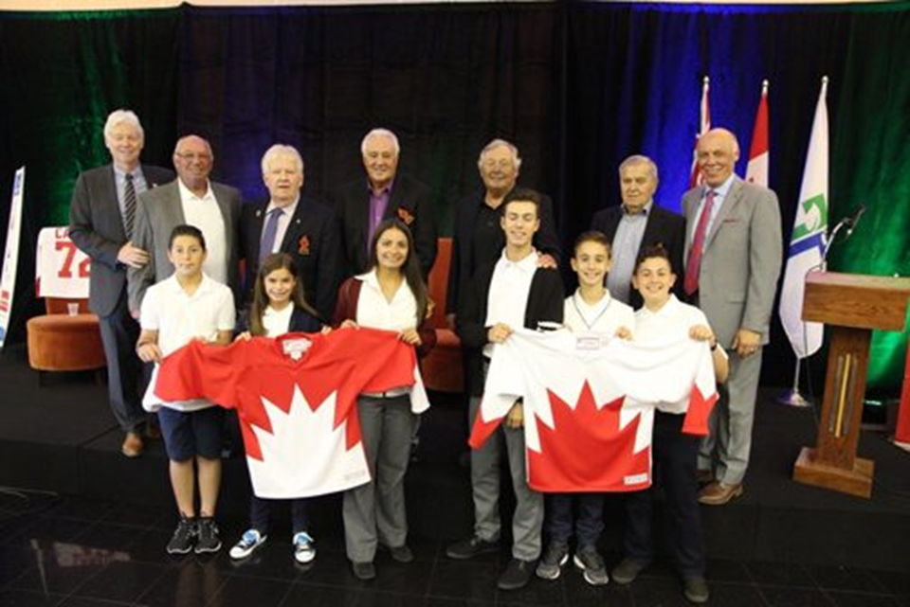
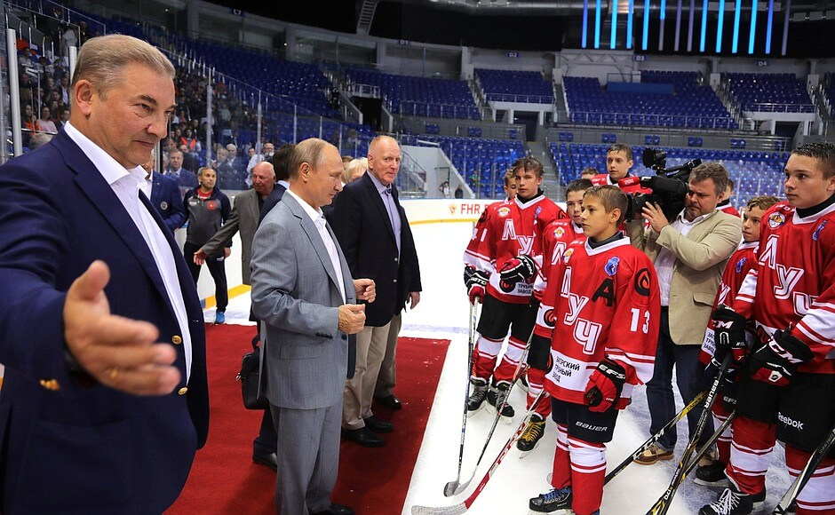
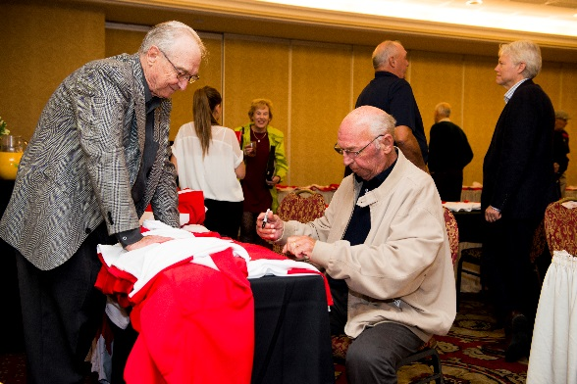
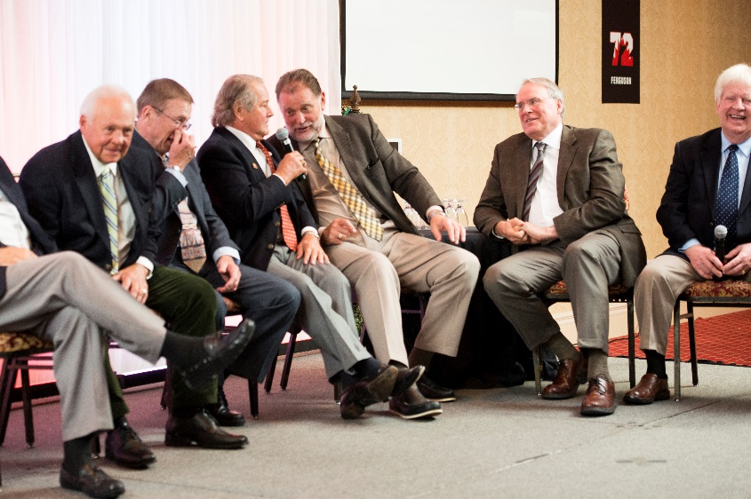
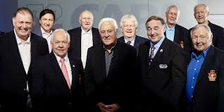

The Story behind 28-8
The Tour
The Proud Grad
The Call
The Puck
28-8 Legacy Program
The Start

Slide 27
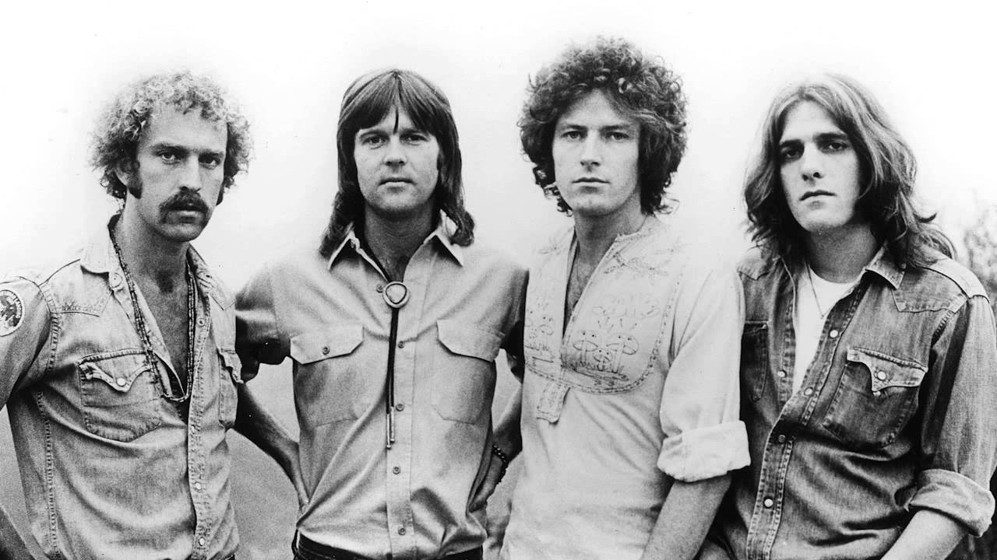
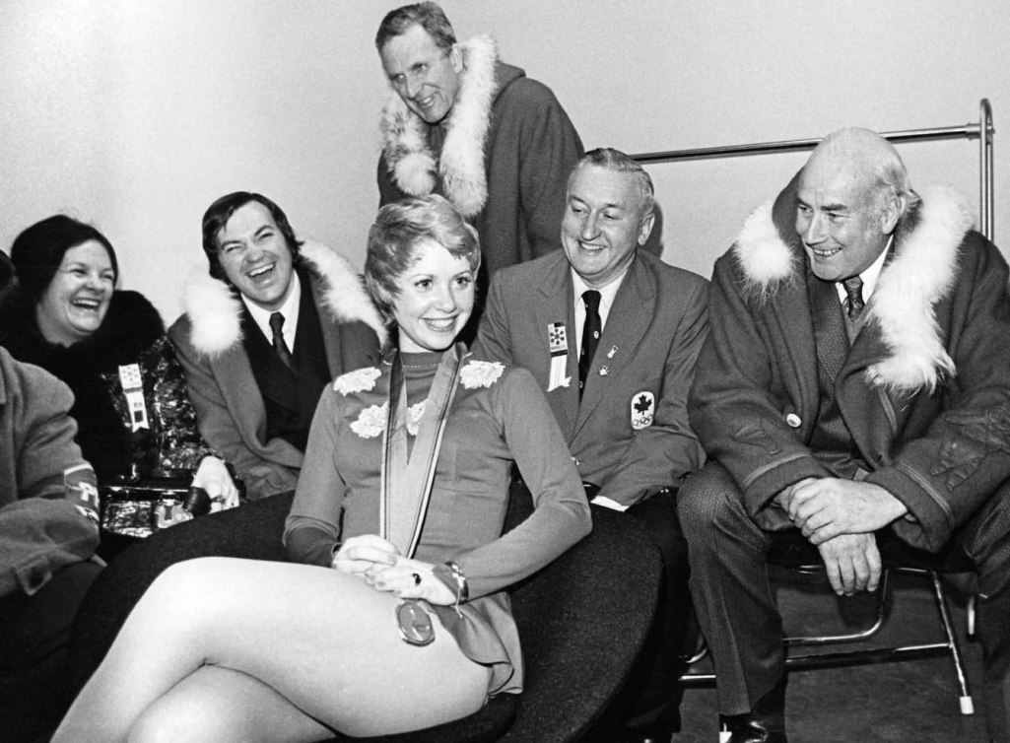
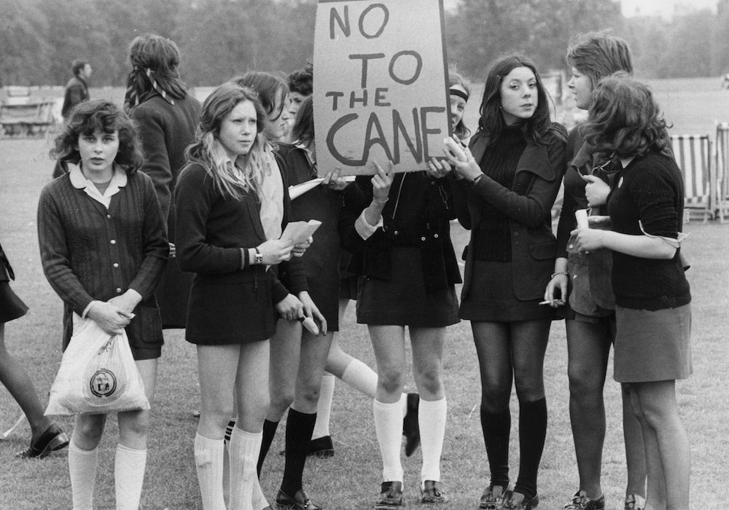

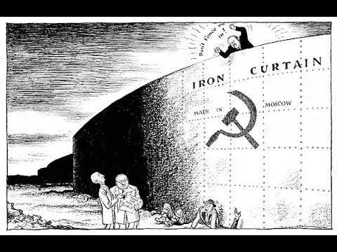
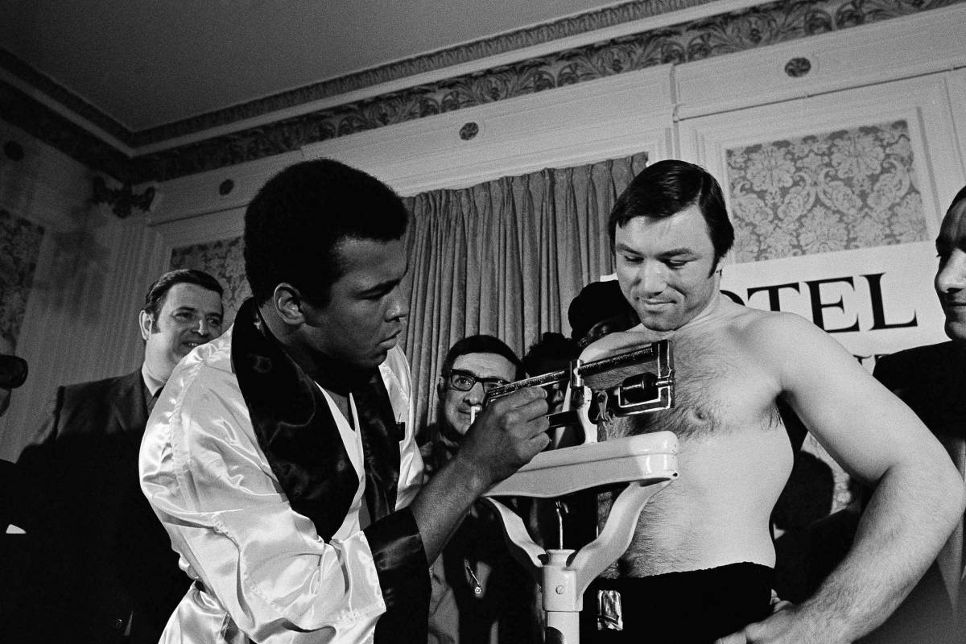
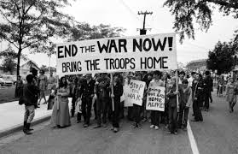
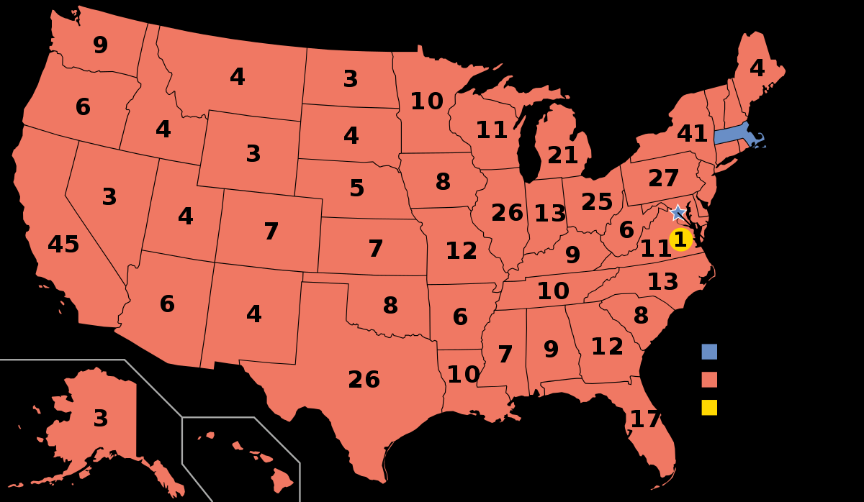
Set the Stage …

Slide 28
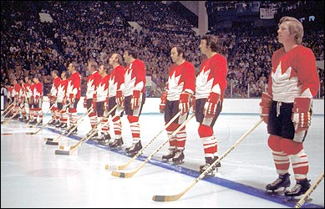
September 1972
Task:
Team Lessons Learned
Training Camp – Game 1
Games 2 – 3 – 4
Sweden and Moscow 5 – 6 – 7
Moscow 8 and Home

Slide 29
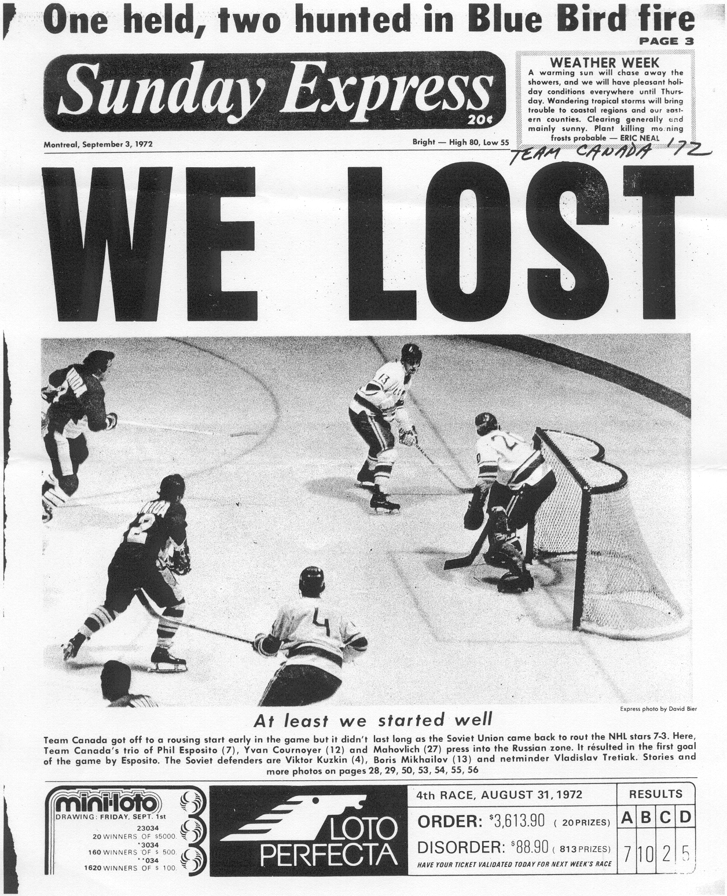
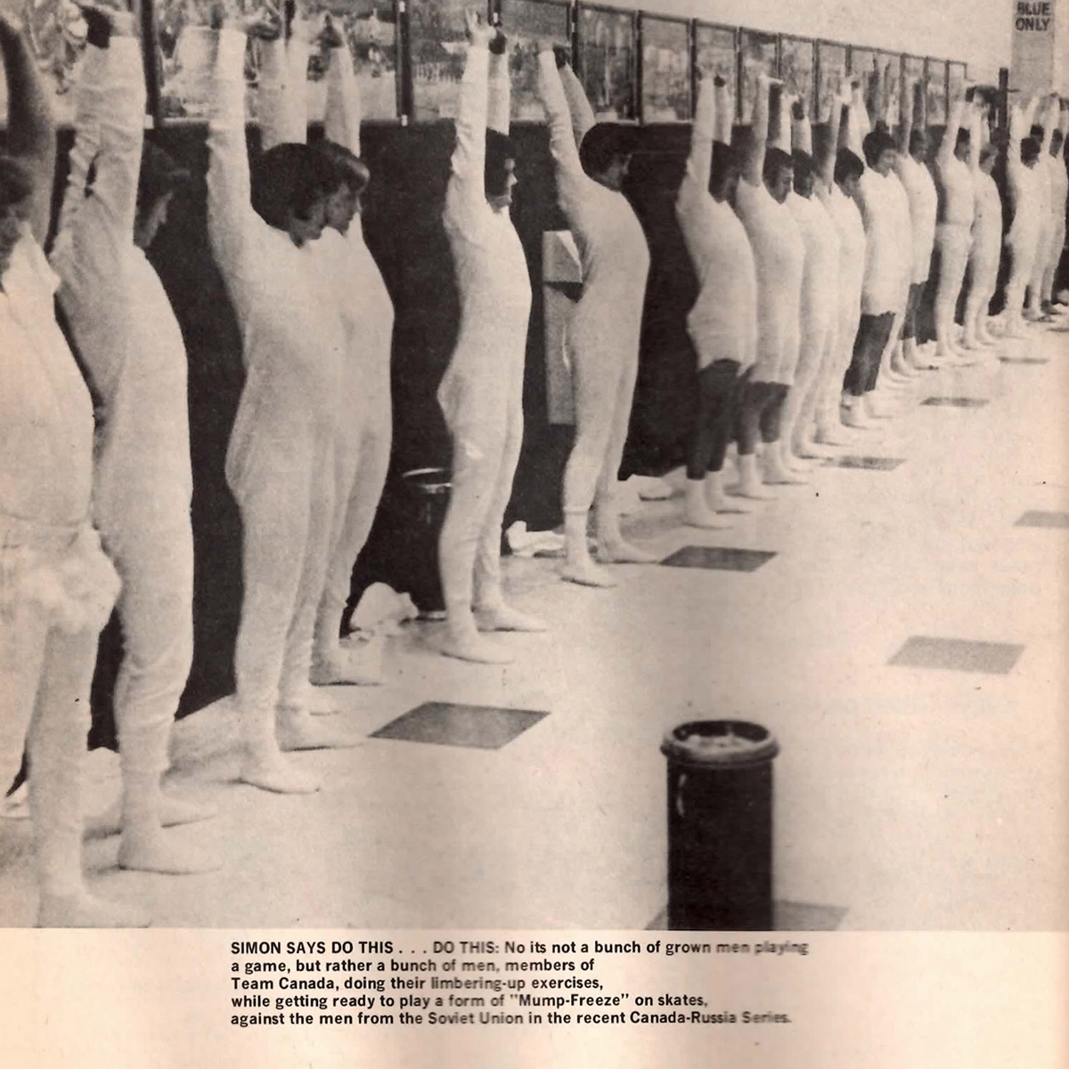
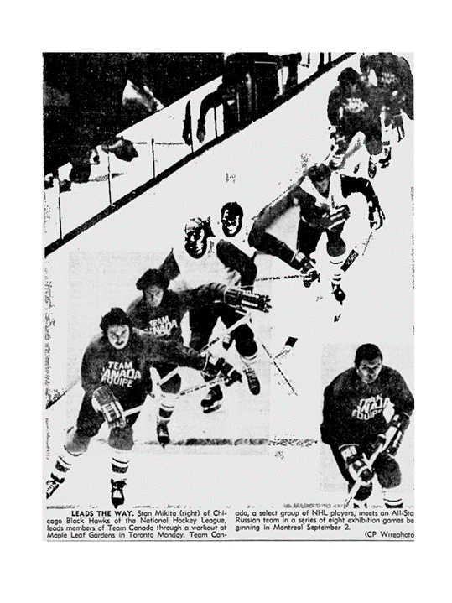
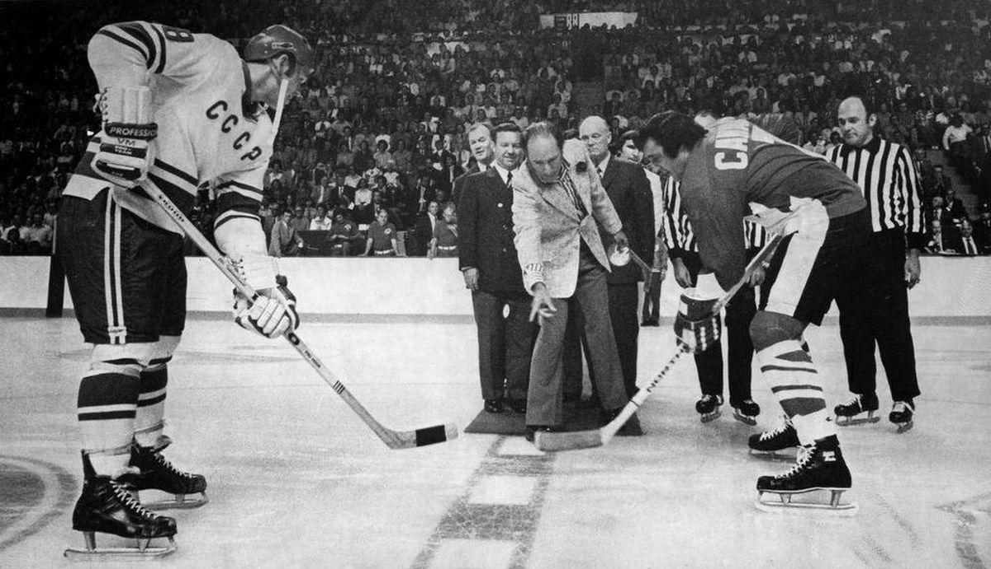
Lessons Learned

Slide 30
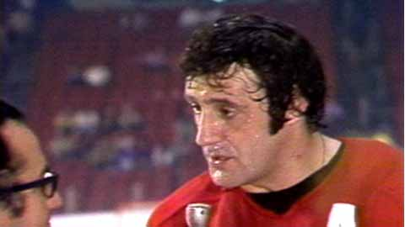



Lessons learned

Slide 31





Lessons Learned

Slide 32








Lessons Learned

Slide 33

Team of the Century

Slide 34




1999: Voted “The Team of the Century” by the Canadian Press/La Press Canadienne
2000: Team Canada 1972 Royal Mint Millennium Tribute Monument
2005: Team Canada 1972 is inducted into the Canada’s Sports Hall of Fame, the first team to be inducted into the Hall
2012: Presented with a Star on Canada’s Walk of Fame
2017: Canada Post honours Team Canada 1972
2017: Thirteen team members are recognized as members of the NHL’s Top 100 Players

Slide 35
Team Canada 72 Value Proposition
Find Purpose: Ignite your O’Canada moment
Come Ready to Play: Prepared, Engaged, Produce
From Many to ONE: Own Your Role PLUS Cohesion, Selflessness, Trust
Overcome Adversity: Perseverance, Grit, Passion
Playing to Win: 28-8 Teammates
The Team Canada 72 Teamwork Model will help you leverage the power of teamwork.

Slide 36

In September 1972, at the height of the Cold War, over 1,750 hockey fans from Canada fly to Moscow on a package tour offered by Air Canada to watch the remaining four Summit Series games at the Luzhniki Ice Palace. The package (offered in conjunction with Hockey Canada) includes transportation, accommodation and meals – and some of the best hockey ever played! On September 22, in game five, Canada led 4–1, but ended up losing 5–4. Despite the loss, all 3,000 Canadian fans sang the national anthem as Team Canada left the ice. Canada won the remaining three games in a row, to take the series.

Slide 37



Find Purpose
TC72: Playing for Canada
Igniting Purpose by finding the Catalyst (vision)
Coach: Find ways to Embrace the Catalyst (vision)

Slide 38
Come Ready to Play: Add PEP
Prepared: Understand that we need to Add Value; Draw from your Strengths; Have a Growth Mindset;
Engaged: Have non-negotiable daily routines; Span Boundaries – connect with others; (Recognize the challenge of The Bad Apple – start by looking at self)
Produce: Create a daily goal; We are all Responsible for our own Work Ethic; Positive Self-Talk;
Coach: Principled leadership.

Slide 39



Slide 40
Teamwork Time
Build on ‘Come Ready to Play’ theme
Take out your phone (aka camera)
FIVE minutes to take FIVE pictures that represent …
  A personal strength
  When you are at your best
  A learning point from today
  Area of personal challenge
  A creative Selfie

Slide 41




Come Ready to Play

Slide 42
From Many to One (Play the COST)
Cohesion/Build Belonging:
  Shared values and standards;
  Many lines of sight results in diversity of thought;
  Stronger together (individual stick versus bundle).
Ownership:
  Know and own your ROLE – play to your strengths;
  Focused on team performance norms (make a contract).
Selflessness/Build belonging:
  Dedicated to Team success;
  The best Team members anticipate the needs of one another;
  Continually communicate the Why.
Trust:
  Count on each other when it counts (DWYSYWD);
  High integrity always.
Coach: Building TEAM Culture by helping them perform a ‘Work with Excellence’ approach.

Slide 43

Teamwork time
Build on the “From many to One” theme.

Slide 44




From Many to ONE
Team
Purpose

Slide 45


Added Insight:
Draw upon the Power of Teams in Two, Three, Six or more… , Six, 37.
Stapleton and White
Ellis, Clarke and Henderson
Park, Savard, Esposito, Cournoyer, Hull, and Dryden

Slide 46

Overcoming Adversity: Can-Do Attitude
Grit: Everyone has a bad day; Get up; Surgite.
Perseverance: Scoreboard – adjust when we know where we stand (results driven).
Passion: Self-talk; Team Talk – build each other up.
Coach: External support and encouragement.
Time for an EE

Slide 47

Teamwork time
Build on the “Overcoming Adversity – Can-DO” Theme.
10 different NHL cultures – fractured group
Underprepared physically nor emotionally – friendly series
Poor scouting reports
Different game – stick work, ice surface
Injuries
Booed on home ice; Ambassador name calling
Desertion – Strangers in a Strange land
Officiating – two referees (i.e. 31 versus 4)
Stolen food, early morning phone calls, bugged rooms
Broken promises

Slide 48

28-8 Teammates: Playing to Win

Slide 49



28-8 Teammates: Playing to Win
Fixed on the Goal (3 Priorities):
Design your own Summit Series Challenge

Slide 50

Lunch

Slide 51

Mt. Everest / Sagarmatha

Slide 52
How to Access the Simulation
Copy and paste the e-mailed coursepack link using a Chrome or Safari browser.
Click on Register
Program Length: Part-time
Expected Graduation: April 2019
Sign in using your credentials

Slide 53

In Your Experience of Teamwork
True or False…
Information privately held by individual team members, rather than shared by all, is often ignored or downplayed in team decisions to the detriment of team performance.
True or False?
Why / Why not?
Information privately held by individual team members, rather than shared by all, is often ignored or downplayed in team decisions to the detriment of team performance.
Notes:
Common information effect
Why / why not?

Slide 54

Everest Leadership & Team Simulation
Sim focus
Challenging expedition towards Mount Everest
Series of critical decisions about timing and execution of climbing along to successive camps as you ascent
6-day ascent to summit of mount Everest – there is one buffer round
Discrete challenges – may require calculation, analysis …
Do not disengage if you are rescued – your team will still need your input
Five roles in teams of 5 or 6 – critically analyze role & situational info
Notes:
You have one buffer round
Challenges: some could be analytical and some may required calculation
- Physician: You don’t have to stay together, but you cannot receive medical supplies if you are separated from the Physician.

Slide 55


Everest Simulation Tips
Embrace your ROLE!
The first two rounds are less eventful - FSNP
Take notes – and/or use flipcharts
Individual and team decisions to be made:
  Review, Collate and Analyze available information, diagnose, recommend solution
Access the simulation in Chrome, Safari … only open it on one browser tab at a time
Complete surveys (Day 3 & 6)
Much like a true Everest climb, small mistakes can be costly
Mange the TIME – the Sun also SETS
Strategically choose when to Call a Friend
Notes:
Wolfgang Bosbach
Edmund Hillary & Tenzing Norgay

Slide 56
Leadership & Teamwork Simulation
Teams of 5 or 6
  Team leader
    Advances the simulation to the next round
  Marathoner
    Predicts weather
  Photographer
    Tweeter/Speaker
  Environmentalist
    Time keeper
  Physician
  Dispenses medical supplies
  N.B. Don’t have to stay together, but cannot receive medical supplies if separated from the physician
Notes:
Mountaineers! Pick your roles

Slide 57

When We Regroup …
In your teams, summarize your team experience into a 280 character “tweet”. We’ll share as a part of our report-in.
Extra applause for wit!

Slide 58


Slide 59


Everest / Sagarmatha Simulation
Day 1: 10 mins
Day 2: 10 mins
Day 3: 15 mins
Day 4: 20 mins
Day 5: 20 mins
Day 6: 15 mins

Slide 60

Debrief

Slide 61

Debrief
Did your team perform effectively during the simulation?
  Why / why not
What were the success factors/impediments to team effectiveness?
How would you revise your approach if you had a second opportunity to work together on this type of challenge?

Slide 62
Common Information Effect
True
Information privately held by individual team members, rather than shared by all, is often ignored or downplayed in team decisions to the detriment of team performance.
True or False?
Why / Why not?
Information privately held by individual team members, rather than shared by all, is often ignored or downplayed in team decisions to the detriment of team performance.
Notes:
Common information effect
Why / why not?

Slide 63
Common Information Effect
Three Possible Initial-Distribution Conditions
A,D
A,C,B,D
A,B,C,D,E,F
A,C,B,E
A,C,D,F
A,B,C,D,E,F
A,B,C,D,E,F
B,E
C,F
A,C: Common to all three people
B,D: Shared by two people
E,F: Unique to one person
All information fully-shared
by all three people.
No overlap of information
between three people
Groups tend to spend too little time discussing unshared (unique, uncommon) information.

Slide 64
Why the Discussion Bias?
Probability
2. Mutual Enhancement
  Discussing shared information feels good!
  Members are judged as more task competent & credible after discussing shared instead of unshared information.
  Shared information is judged as more important, accurate, and decision-relevant than unshared info.
3. Bias for Preference-consistent Information
  Members prefer to discuss information that is consistent with their preferences (an example of the confirmation bias)
Some Groups Miss Optimal Solutions:
Tapping into unshared information supports the best option
Notes:
Use of only shared information supports a less optimal decision alternative whereas tapping into unshared information supports the best option.
Failure to discuss unshared info thus harms group decision quality

Slide 65

Common Information Effect
Mitigation Strategies:
  Team leader is information manager - increase focus on unique information
  Suspend initial judgment
  Frame as an information-sharing problem, rather than a judgment to be made
  Minimize status differences

Slide 66

Team Lessons Learned
Find (Common) Purpose – O’Canada Moment
  Successful teams share a clear understanding of and commitment to the goals of the team and the overall strategic approach to the task at hand
Come Ready to Play - Resource Inventory
  We focus on what we bring, which we might over- or under-estimate
  Unearth what each member brings – members interview each other

Slide 67
Team Lessons Learned
From Many to ONE - Team Norms
  Operating Principles - Definite Dos and Don’ts
  Constructive Conflict: Healthy debate vs. bogged down in personality differences
  Exploration & Execution: Balance on the idea generation-implementation spectrum given the task & team stage
  A system for calling out violations & enforcing boundaries - Team Contract

Slide 68
Team Lessons Learned
Overcome Adversity
  Uses its time together well: Progresses towards team’s goal at an appropriate speed … milestones reached
  Perseverance – what happened when time got tight or a challenge was faced?
  Information Processing Challenges – Incomplete/Ambiguous, Overload, Asymmetric Distribution
  Psychological Safety - Is the team atmosphere conducive to expression of “risky” ideas, diverging opinions, a variety of skills, and the forgiveness of mistakes?

Slide 69
Team Lessons Learned
Playing to Win - Performance Strategy
  How are we going to go about tackling the task?
  Periodic assessments and recalibration of that performance strategy
  Impact of Involvement:
    Short-Term vs. Long-Term Effectiveness
    Achieved Consensus or was Overruled (on important decisions)
    Perception of FAIRNESS
Fact
Perception

Slide 70

The Power of Teamwork
Two Final Tasks …

Slide 71
Your Experience Today
  Please reflect quietly …
… please take a minute to write down your thoughts.
  What are your 3 personal key take aways?
  What things
  you will do differently
  in the next 3 weeks?

Slide 72


Team Themes
What are your three TEAM themes?

Slide 73
Tomorrow
Read, Reflect, Report (2 plus 1)
Team Experiential Activity Memo
Questions?

