Slide 1
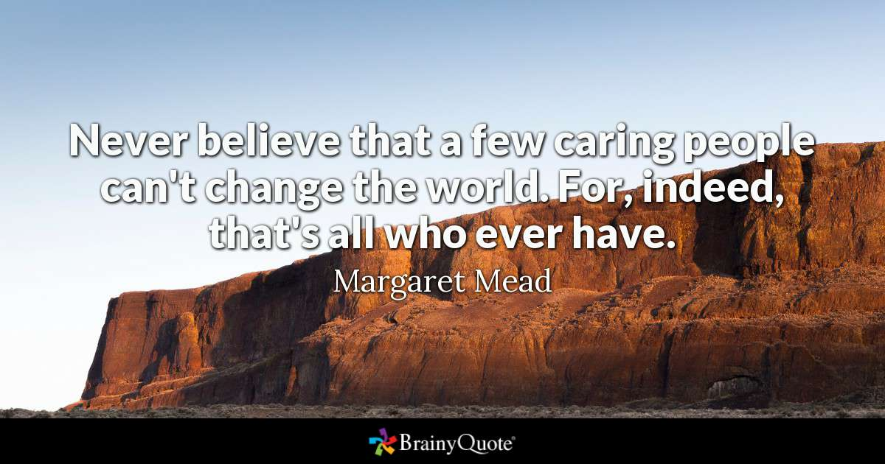
Day 3 Check-In
Agenda: Managing the Unexpected, HRO, EQ
Thoughts, Reflections, Questions?

Slide 2
Managing the Unexpected
High Performance in a Complex World
Goal: Three Things

Slide 3
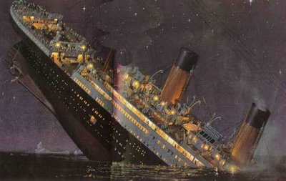
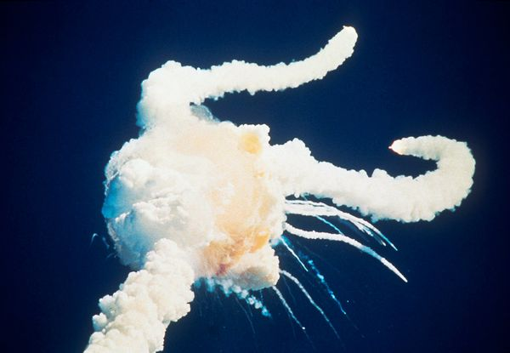
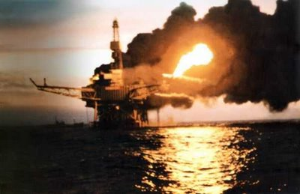
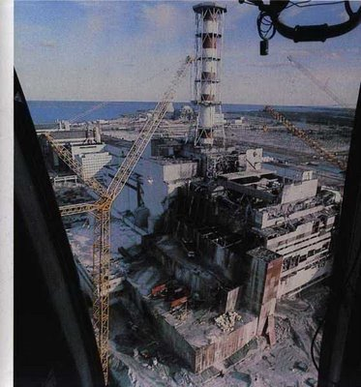
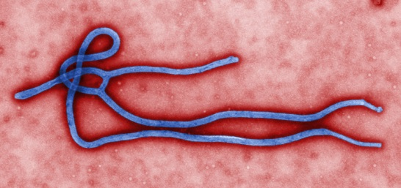
Unexpected: YES YET Not on Your Watch
Q. What might be unexpected in the business world?

Slide 4
Managing the Unexpected
The best way for an organization -- and its people -- to respond to predictable or more importantly to unpredictable challenges is by building a Highly Reliable Organization (HRO) that expertly spots the unexpected when it crops up and then quickly adapts to meet the changing environment.

Slide 5
1 point for "Not at all,"
2 points for "To some extent,"
3 points for "A great deal."
1. There is an organization-wide sense of vulnerability to the unexpected.
2. Everyone feels accountable for reliability.
3. Leaders pay as much attention to managing unexpected events as they do to achieving formal organizational goals.
4. People at all levels of our organization value quality.
5. We have spent time identifying how our activities could potentially harm our organization, employees, customers, other interested parties, and the environment at large.
6. We pay attention to when and why our employees, customers, or other interested parties might feel peeved at or disenfranchised by the organization.
7. There is widespread agreement among the firm's members on what shouldn't go wrong.
8. There is widespread agreement among the firm's members on what could go wrong.

Slide 6
HROs exhibit "mindfulness."
Mindfulness indicates a combination of high alertness, flexibility, and adaptability.
A total score higher than 16 indicates an exemplarily mindful infrastructure in your organization (that’s great – listen up and share your best practices).
A score lower than 10 suggests a need for immediate improvement (time to really pay attention).

Slide 7
Article Discussions
Karl Weick
  Sensemaking
  5 Habits of a HRO

Slide 8

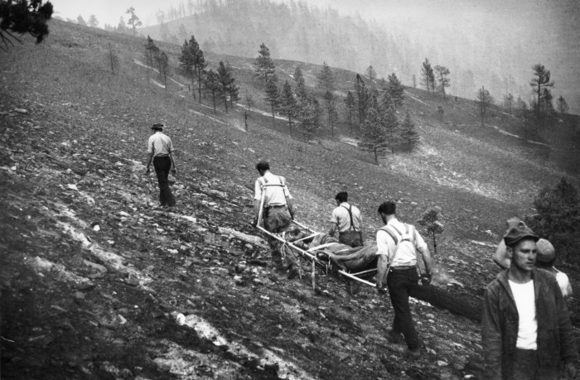
Mann Gulch Disaster

Slide 9
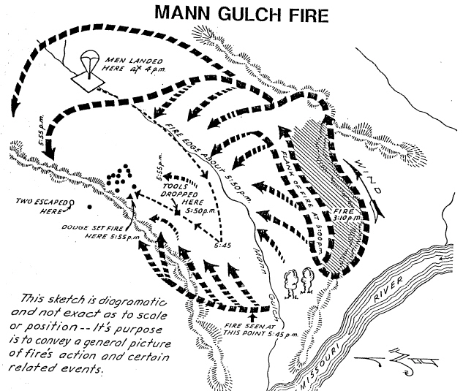

Slide 10
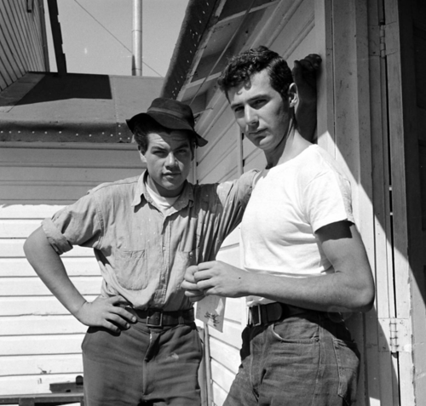
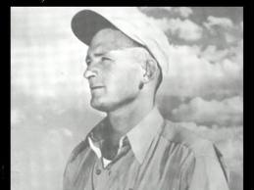
LLL
Speed relating
Share yours; Listen for theirs
Whole class discussion – you highlight what you have learned from others!
Walter Rumsey and Robert Sallee
Robert Wagner Dodge

Slide 11
The Leadership Moment by Michael Useem
As amazing as Wag Dodge's innovation was, the life-saving concept did not achieve its intended purpose.
Why didn't Dodge's well-trained team heed his instructions?
Some argue that in the jump crew's eyes Dodge had lost credibility during their two hours on the ground.
For starters, Dodge had left his post at the front of the group early in the fire fight;
Later, when he instructed the team to drop their equipment, he failed to realize that he was asking them to give up a significant part of what defined them as a fire jump crew: their uniform;
Ultimately, some argue that Dodge's historically soft spoken leadership, his desire to lead by example, impeded the group's ability to understand their leader's thought process and realize what he was intending when he lit his innovative and life-saving escape fire.
The Wag Dodge Mann Gulch incident not only illustrates the relationship between panic and performance (the idea that the crew, as they neared Dodge's escape fire, were too panicked to process new information correctly), but also demonstrates the importance of recognizing leadership as a dynamic interaction, one that is sensitive (with the potential to deteriorate) to a changing environment.

Slide 12
Aftermath
450 men fought for five more days to get the fire, which had spread to 18 km² (4500 acres), under control.
Wagner Dodge survived unharmed and died five years later of Hodgkin's disease.
Thirteen crosses were erected to mark the locations where the thirteen firefighters who died fighting the Mann Gulch Fire fell. However, one of the smokejumpers who died in the Mann Gulch Fire was David Navon, who was Jewish. In 2011 the cross marking the location where Navon died was replaced with a marker bearing a Star of David^{[2]}
Several months following the fire, fire scientist Harry Gisborne, from the US Forest Service Research Center at Priest River, came to examine the damage. Having a history of heart problems, he nevertheless conducted an on-ground survey of the fire site. He suffered a heart attack and died while finishing the day’s research.
Gisborne had forwarded theories as to the cause of the blowup prior to his arrival on site. Once there, he discovered several conditions, which caused him to change his concepts of fire activity particularly those pertaining to fire "blow-ups". He noted this to his companion just before his death on 9 November 1949.
There was some controversy about the fire, with a few parents of the men trying to sue the government. One charge was that the 'escape fire' had actually burned the men.
Lessons learned from the Mann Gulch fire had a great impact on firefighter training. However, some of the lessons were forgotten and the tragedy would be repeated in the South Canyon Fire of 1994, in which 14 firefighters died.

Slide 13
Crisis Leadership
Leadership in a (Permanent) Crisis by Ronald Heifetz, Alexander Grashow, and Marty Linsky, HBR, 2009
Crisis leadership has two distinct phases.
  Emergency phase, when your task is to stabilize the situation and buy time.
  Adaptive phase, when you tackle the underlying causes of the crisis and build the capacity to thrive in a new reality.

Slide 14
Crisis Leadership: Emergency Phase
Figure out what is going on – take time to understand what’s happening
Remember that speed counts – attack it as quickly as possible
Remember that slow counts too – know when to back off and wait for a better opportunity
Respect the danger of the unfamiliar – vu jade
Value the skeptic – listen to the black hat (self/others)
Be ready to ‘fight fire with fire’
Schermerhorn & Wright (2018)

Slide 15
Crisis Leadership: Adaptive phase
Develop next practices (beyond today’s best practices)
Distinguish the essential from expendable (run experiments)
Embrace Disequilibrium – orchestrate (depersonalized) conflict, chaos and confusion (courageous conversations) to allow people to see this as productive
Distributive Leadership – mobilize everyone for solutions
Leadership in a (Permanent) Crisis by Ronald Heifetz, Alexander Grashow, and Marty Linsky, HBR, 2009

Slide 16
Article Discussions
Karl Weick
  Sensemaking
  5 Habits of a HRO

Slide 17
Avoiding the Crises …
Mindfulness and HRO
Aren’t tricked by success
Defer to experts – on the front line
Let unexpected circumstances provide your solution
Embrace complexity
Anticipate – but anticipate your limits

Slide 18

5 Mindful Habits of HRO
Don't be tricked by your success.
  Don't gloat over successes. In fact, it's just the opposite – HROs are preoccupied with their failures.
  If you have a gut feeling that something isn't right – pay attention, something is likely wrong.
  Listen to other people’s gut feelings (experience)
  Q – how often do you pick up on small downward deviations.

Slide 19

5 Mindful Habits of HRO
2. Defer to your Experts on the Front Line.
  People at the top may think that they have the big picture. More accurately, we have a picture, certainly not the picture, and certainly not bigger in the sense that it includes more data.
  The picture that frontline workers see is different. It is drawn from their firsthand knowledge of the organization's operations, strengths, and weaknesses.
  Q - How often do you let your supervisor know when something ‘different’ happens?

Slide 20
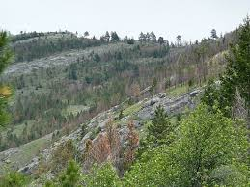
5 Mindful Habits of HRO
3. Let the unexpected circumstances provide your solution.
  When something out of the ordinary happens, your stress level rises. What will happen is that your perception will narrow -- you will get tunnel vision -- and you will miss a lot of stuff.
  Resist that dramatic narrowing of cues -- because within everything that is happening unexpectedly, you will find what you need for a remedy. (Fight fire with fire: Dodge)
  Q. How often do you actually take time to reflect?

Slide 21
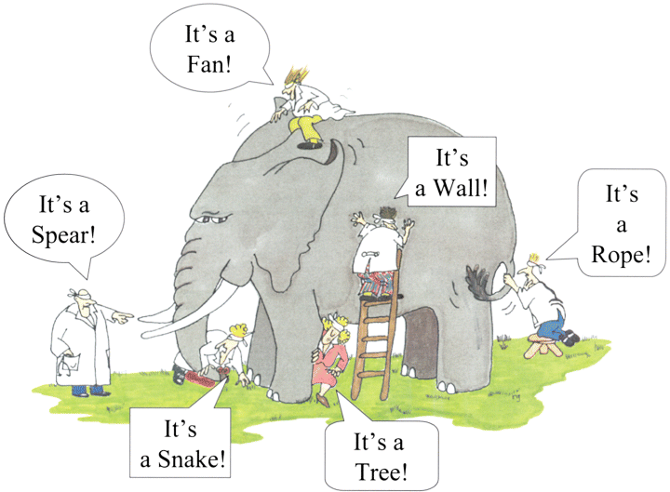
5 mindful Habits of HRO
4. Embrace complexity.
  In the face of all of this complexity, HROs are reluctant to accept simplification; understand that it takes complexity to sense complexity.
  Insight and understanding develops when people attend to more things, entertain a greater variety of interpretations, differentiate their ideas, argue, listen to one another, work to reconcile differences, and commit to revisiting and updating.
  Q. – How often do you get together to argue, listen, and understand?

Slide 22

5 mindful Habits of HRO
5. Anticipate -- but also anticipate your limits.
  We can't anticipate everything. There's such a premium on planning, on budgeting, on making the numbers. In the face of all that, the notion of resilience has an affirming quality: You don't have to get it all right in advance.
  That doesn't mean you should stop anticipating. But you should add in two subtleties. First, focus your attention on key mistakes that you do not want to make (never events). Second, trust your anticipations, but be wary of their accuracy. You can't see the whole context that is developing.
  Q. How do you work on building capacity for resilience?

Slide 23
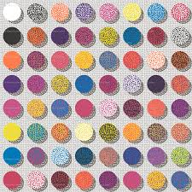
Mindfulness Is About Connecting
To make sense is to connect the abstract with the concrete. And, do this wisely involve a community of sensemakers.

Slide 24
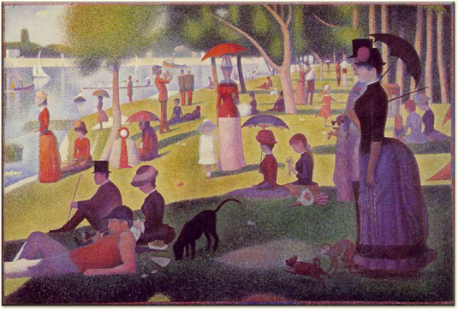
One point to many …3,456,000

Slide 25

Mindfulness Is About Action
If the first question of mindfulness is “what’s going on here?,” (The Picture)
The second, equally important question is “what do I do next?” (Action)

Slide 26
“When it comes to the future, there are three kinds of people: those who let it happen, those who make it happen, and those who wonder what happened.”
John M. Richardson Jr.

Slide 27
Summary
Mindful of Failure: Focus upon small differences (trust your gut feelings / experience)
Defer to Experts: Listen to the troops – they know the terrain best – and let them lead
Be Resilient: Be flexible and always look for new answers or ways (keep getting better)
Embrace Complexity: Hold big tent meetings – and create conversations
Anticipate and be Ready: Look ahead but be prepared and willing to act quickly (organizational slack)
Mindfulness Tools: policy and planning (not the plan), training (alertness, flexibility, and adaptability), communicate, communicate, communicate

Slide 28
The “So What” Moment
Who are you now?
What are you going to continue to do?
What are you going to do differently?
And the Magic Number is …

Slide 29

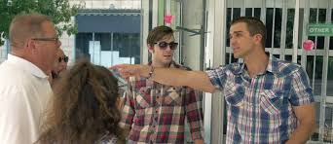
Team Time

Slide 30
EQ and YOU

Slide 31


Emotions at Work
Jan comes in to her office and throws her papers on her desk.
Claude comes in with coffee for both.
“Could you just fix the messed up Jackson file and have it on my desk by noon.”
Claude walks out with a three letter look.

Slide 32
Emotions at Work (backstory)
Bad mood rising – Jan’s morning
Son failed exam – disappointment
Anger for not having paid attention
Anger for arguing with partner
Anger at driver who cut her off
Anger when walking in – reception area is messy
Jan: Not recognizing these emotions in self.
Claude: Not understanding how to deal with emotional signals.
Result: Awkward moment and resulting poor productivity from Jan (and Claude).
PS Ever experienced something like this?

Slide 33
Outcomes for This afternoon
Self-Leadership: Awareness of self
Communication: Sending clear and convincing messages.
Political and Emotional Awareness: Reading individual and group’s emotional currents and power relationships. Negotiating and resolving disagreements.
Leading Change: Inspiring and guiding groups and people.

Slide 34

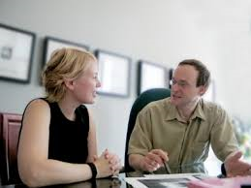
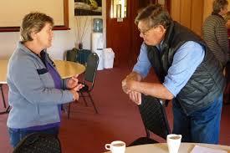


Partner-Up

Slide 35

What feeling does this photo illicit? Discuss

Slide 36
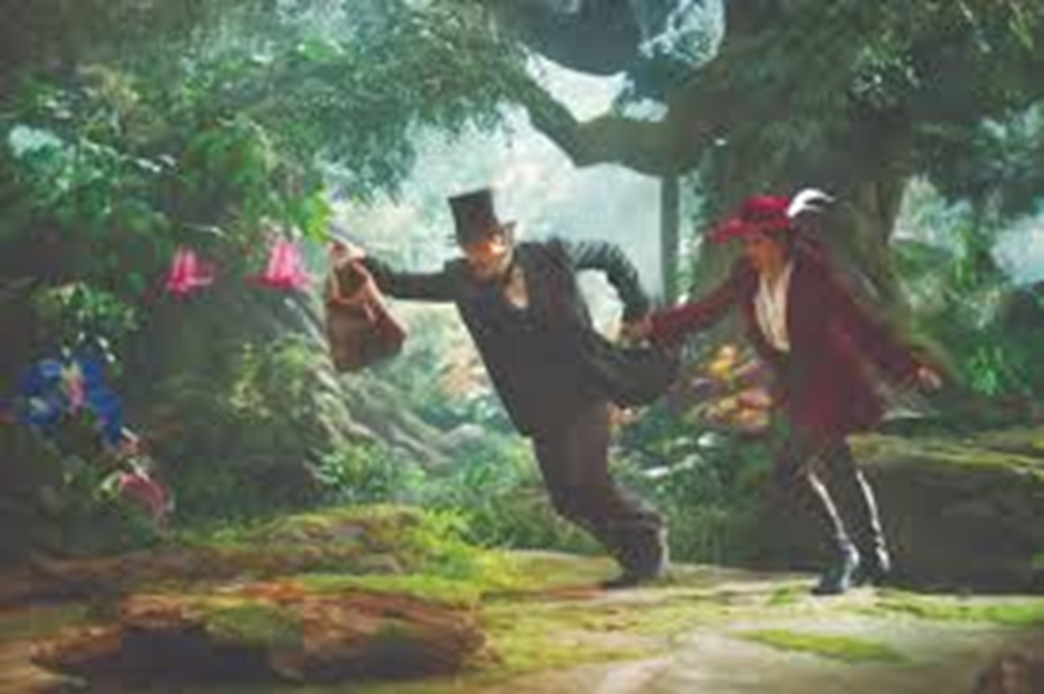
What feeling does this photo illicit? Discuss

Slide 37
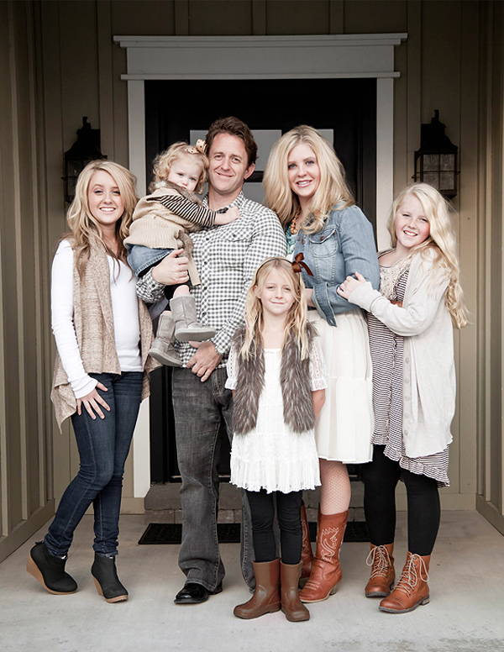
What feeling does this photo illicit? Discuss

Slide 38
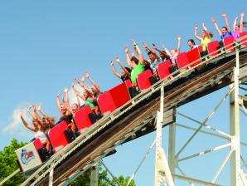
What feeling does this photo illicit? Discuss

Slide 39
Individually List …
A variety of shades of White
A host of different Emotions

Slide 40

List …
A variety of shades of White:
White, really white
Beige, creamy, ivory, lace, melon tint, paper-white, welcome-white, dover-white, pure-white, extra-white, ecru, nonchalant
A host of different Emotions:
Happy, Mad
Agitated, alarmed, amused, angry, annoyed, anxious, awed, bitter, bored, bewildered, calm, cautious, comfortable, confused, constrained

Slide 41
Emotional Intelligence (EQ)
Model theoretically developed and empirically tested now it has also been popularized
Focus:
  Understanding self: your intentions, responses, behaviour and feelings.
  Understanding others: and their feelings.

Slide 42
EQ Business Case (Why important)
Experienced partners in a multinational consulting firm were assessed on the EI competencies plus three others. Partners who scored above the median on 9 or more of the 20 competencies delivered $1.2 million more profit from their accounts than did other partners – a 139 percent incremental gain (Boyatzis, 1999).
In complex jobs, a top EI performer is 127 percent more productive than an average performer (Hunter, Schmidt, & Judiesch, 1990).
After supervisors in a manufacturing plant received training in emotional competencies such as how to listen better and help employees resolve problems on their own, lost-time accidents were reduced by 50 percent, formal grievances were reduced from an average of 15 per year to 3 per year, and the plant exceeded productivity goals by $250,000 (Pesuric & Byham, 1996).

Slide 43
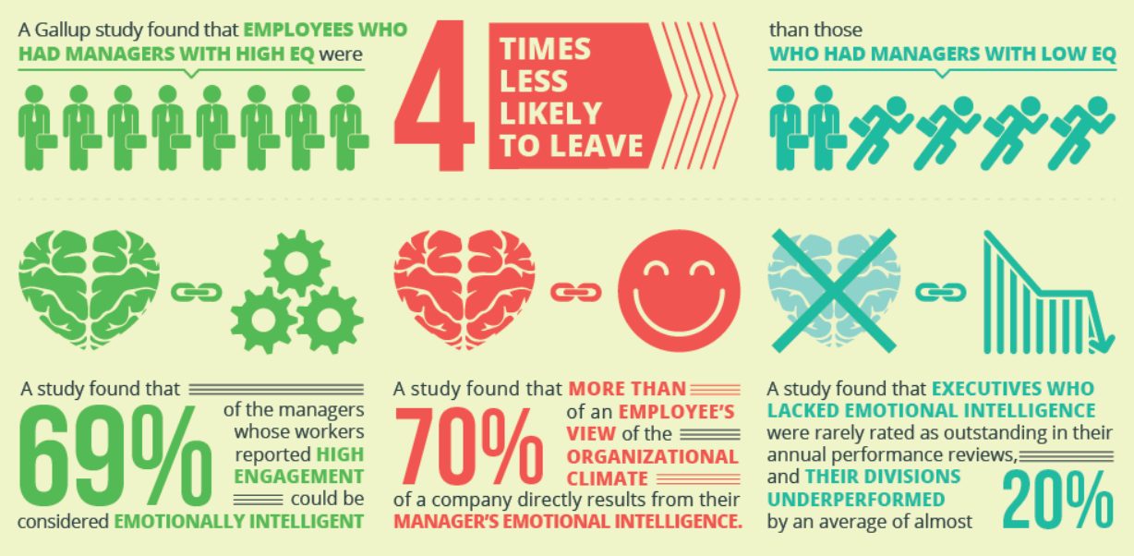
Now as a picture …

Slide 44
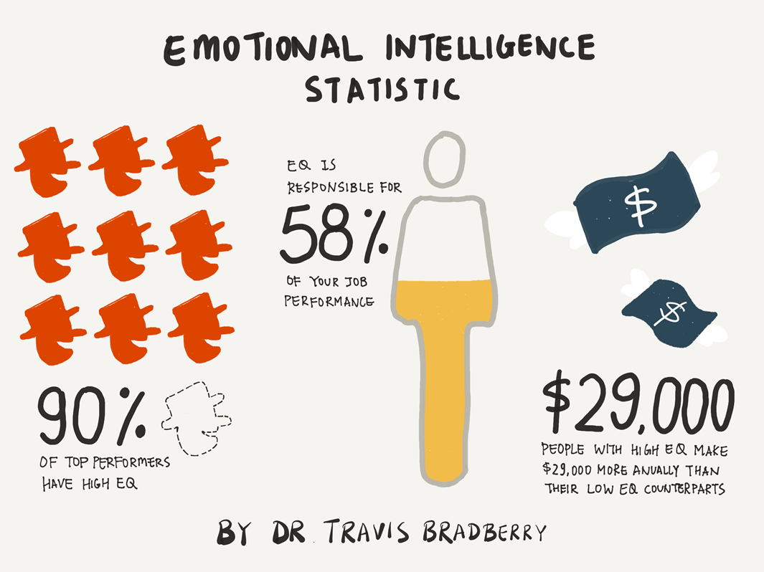
Now as in what does that mean for you …

Slide 45
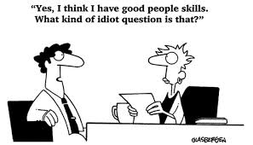
Who are you now?
Please take out your phone …
https://globalleadershipfoundation.com/geit/eitest.html

Slide 46
Emotional Intelligence: The 4 Branch Model
Branch Name | Brief Description of Skills Involved
1. Perceiving Emotion (Self-Awareness) | Ability to identify emotions in oneself and others (as well as in objects, art, stories, music, other stimuli)
2. Understanding Emotion (Social Awareness) | Ability to comprehend emotional information, how emotions combine and progress through relationship transitions and to appreciate emotional meaning
3. Managing Emotion (Self-Management) | Ability to be aware of own feelings, to regulate them in oneself and help others to do this as well to promote personal understanding and growth
4. Using Emotion to Facilitate Action (Relationship Management) | Ability to generate, use and feel emotion as necessary to communicate feelings, or use them in other cognitive processes

Slide 47
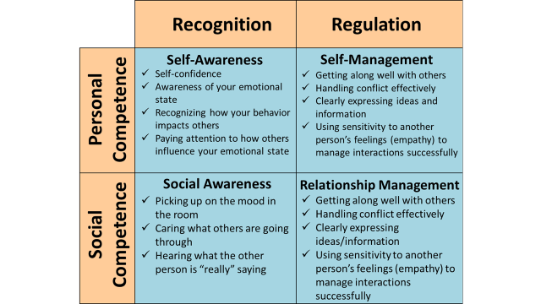

Slide 48
Partner-Up (new partner)

Slide 49
1. Exercises for Self-Awareness
Reflect on your four scores – surprises? Discuss
Reflect on how you feel right now? Discuss
Visit your values – what do you stand for (stand against) – pick 3! Discuss
Homework: Make a list of your daily emotions list on the left by the hour / list on the right the context that surrounded them
  Outcome: Awareness of how you are feeling. Reflect on why you do the things that you do?

Slide 50
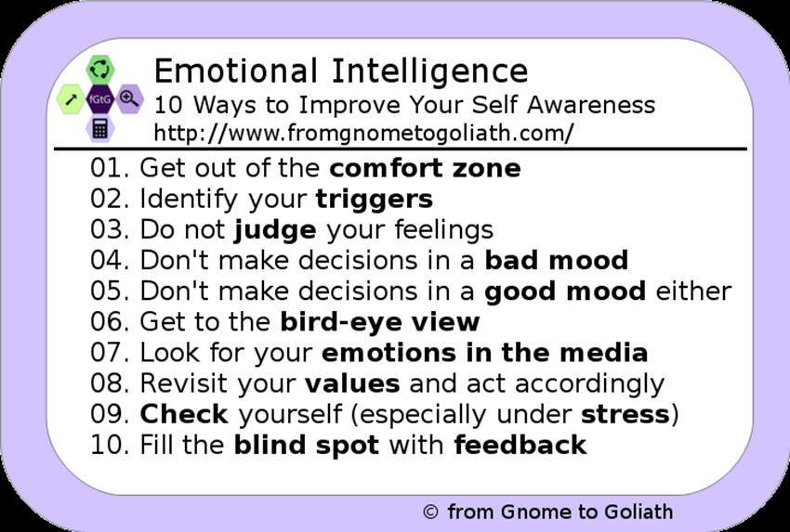

Slide 51
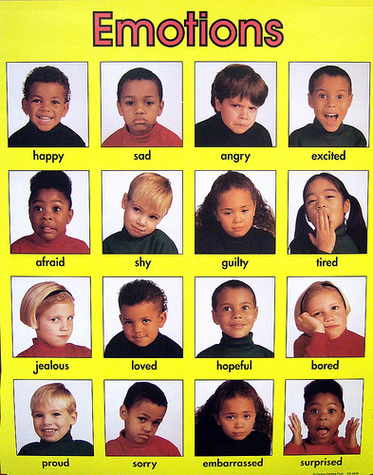
2. All talk and no feelings …
Perceiving emotions (others)
Determine what
Emotions are
Being displayed

Slide 52
2. All talk and with feelings

Slide 53

2. Understanding Emotion
Sensing others’ feelings and perspective, and taking an active interest in their concerns.
Attentive to emotional cues and listen well.
What are the emotional clues we / you attend to?

Slide 54
2. Emotional Clues
Eyes, mouth, speed, voice, tone, posture
Culture :) :( (^_^) (;_;)
Commercial: Looking for a mate who in everyday conversation can pick up even your most subtle emotional cues?
A. Find a musician.

Slide 55
2. Time for some Emotional Exercises
Small group discussion
Should Management receive bonuses based upon short-term company performance?
Individually, stop by and pick up a note from me prior to starting your exercise.

Slide 56
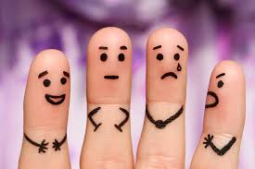
Debrief
Did we recognize the emotions in others?
And the academy award goes to …

Slide 57
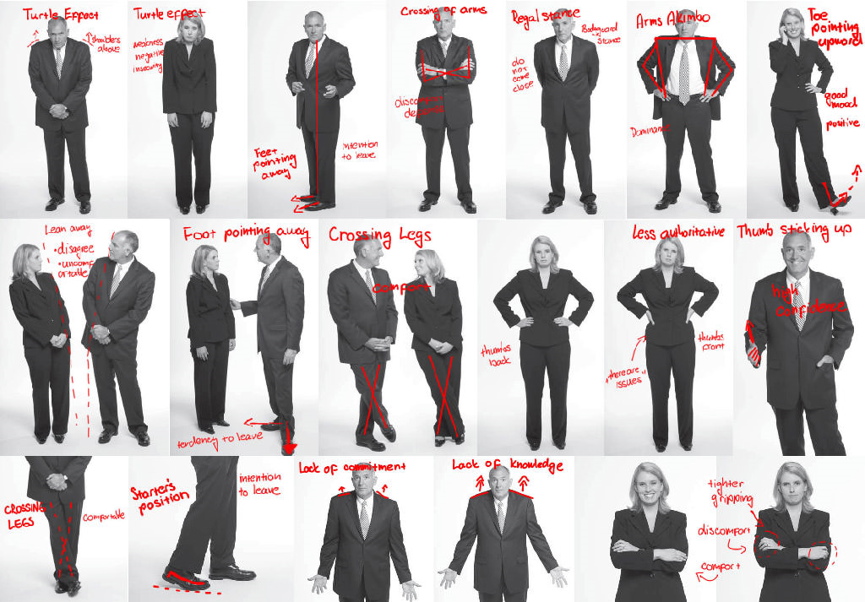
Body Language

Slide 58
2. Exercises for Social Awareness
Live in the Moment: In whatever situation, just be present, don't think about the past or the future, fully experience what is happening now.
Tour around for 10 minutes: observe the behaviour around you

Slide 59
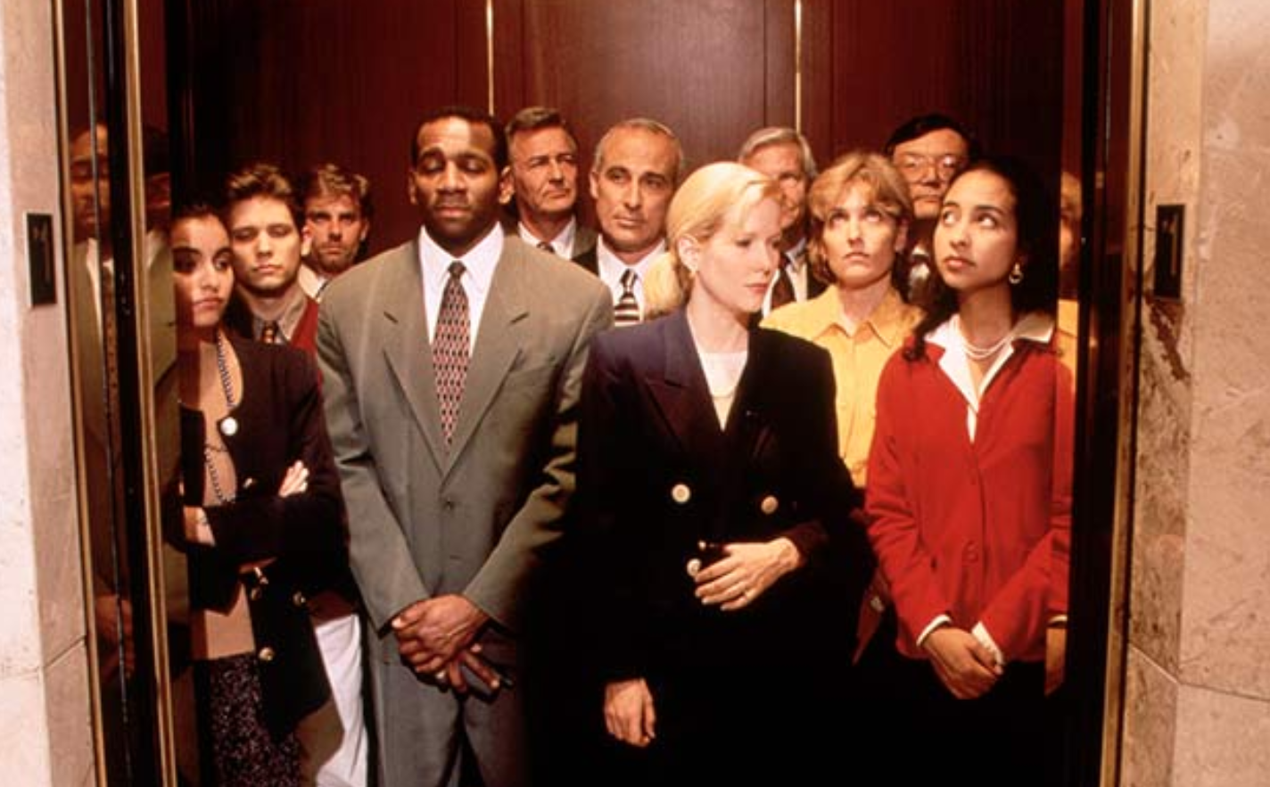
3. Manage Your Emotions
Sticky Hot
Get on, More squeeze in
Poke in the back
Twice
Thrice
Anger builds
Turn to face

Slide 60
3. Manage your emotions
Become emotionally literate. Label your feelings, rather than labeling people or situations.
“I feel impatient” vs “This is ridiculous.”
Use your feelings to help make decisions.
“How will I feel if I do this?” “How will I feel if I don’t?”
Examine how you react to stressful situations. Take more responsibility for your feelings.
“I feel angry” vs “You are making me angry.”
Find a way to stay calm.

Slide 61
3. EQ: Self-control
Be Aware
Stay composed, positive, and unflappable even in trying moments
Helicopter effect – rise above
Breathe

Slide 62


Relaxation Exercise

Slide 63
4. Relationship Management
Impressions carry the day – be excited; message is secondary (emotion > facts)
  Consumers buy on emotion
What are our strongest emotions?
  Hope, fear, joy, sadness
Task: Create an emotional argument to get your neighbour to do something.

Slide 64
Emotional Words
Alarmed, angry, apprehensive, awkward
Bitter, bored, cheerful, curious, cynical
Delighted, discouraged, eager, enraged, excited
Frustrated, fatigued, grouchy, happy, hopeful,
Irked, intense, joyous, jealous, loving, lonely
Mad, miserable, numb, nice, overwhelmed
Pleased, proud, puzzled, queasy, rejected, sad
Safe, scared, shy, shocked, sorry, surprised
Troubled, upset, victorious, excited, yucky, zany

Slide 65
Exercises for Relationship Management
Remember the little things: please, thankyou, I’m sorry, say names.
When you care, show it: small gestures to express your feelings and gratitude.
Explain your decisions, don't just make them: explain why.

Slide 66
Tough Conversation
Anyone have one lately?
Partner up

Slide 67
Task: Tackle tough conversations
First, start with an agreement - what's the shared ground?
Then ask the person to share their side or point of view. Resist speaking up, listen fully to understand the other person, don't go on the defensive right away.
Now help the other person understand your side - describe discomfort, thoughts, ideas, reasons etc.
Move the conversation forward by finding common ground again based on what you've learned about each other's views.
Keep in touch after this conversation and check in on progress made that you agreed upon together.

Slide 68
Skill Development Opportunity
Pat calls Chris into his/her office to discuss a challenge – Chris has not been performing well lately. His/her performance has dropped off. Pat is confident that Chris can do better.
Chris feels that Pat is unappreciative of the substantial progress s/he has made.
Before assuming the roles imagine how you would feel in such a circumstance - plan your thoughts and then play the role.

Slide 69
EQ Takeaway Lessons
Rather than seeing jobs as purely rational undertakings, you need to assess the ‘emotional impact’ of each employee's job, and to design job assignments that take this into account.
Organizations are not cold places that people enter just to work. Managers need to create a positive and friendly emotional climate, and to model this through their own behavior.

Slide 70
3. Selection of employees and teams needs to be based, in part, on a positive emotional attitude. Managers should select employees on the basis of their record for engendering a positive emotional attitude in their work teams.
4. Managers should seek to train their employees to improve their emotional intelligence skills and to engage in healthy emotional expression at work.

Slide 71
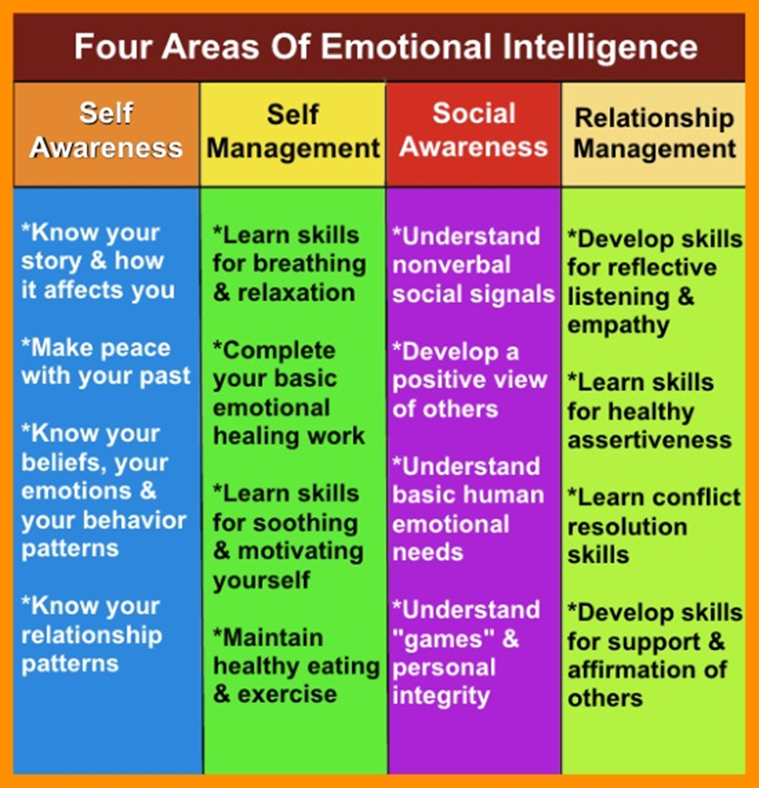
What are your Three?

Slide 72
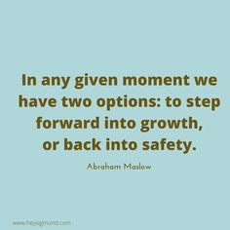
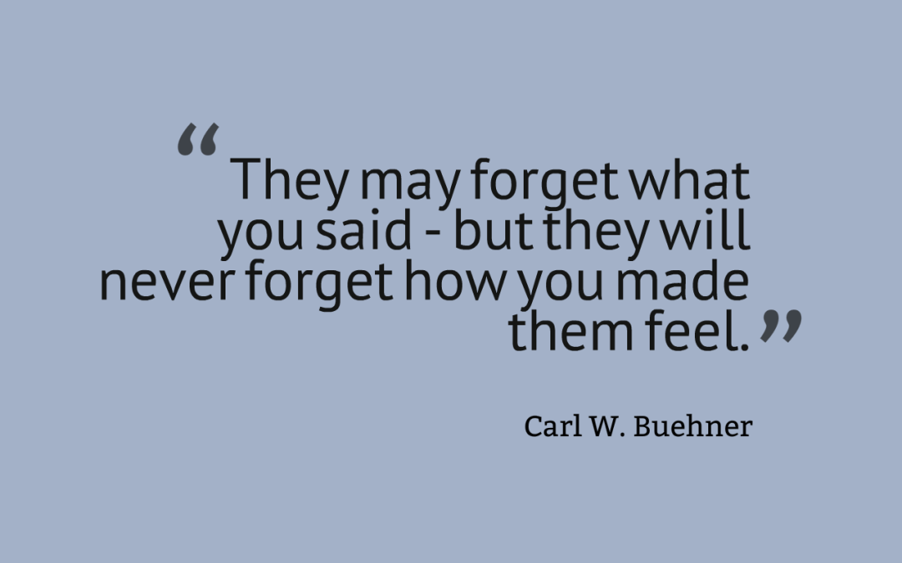
Reflection Time

Slide 73

Team Time …
Have a great Rest of the day!

