Slide 1
(Successfully) Enacting Organizational Change
Day 4

Slide 2
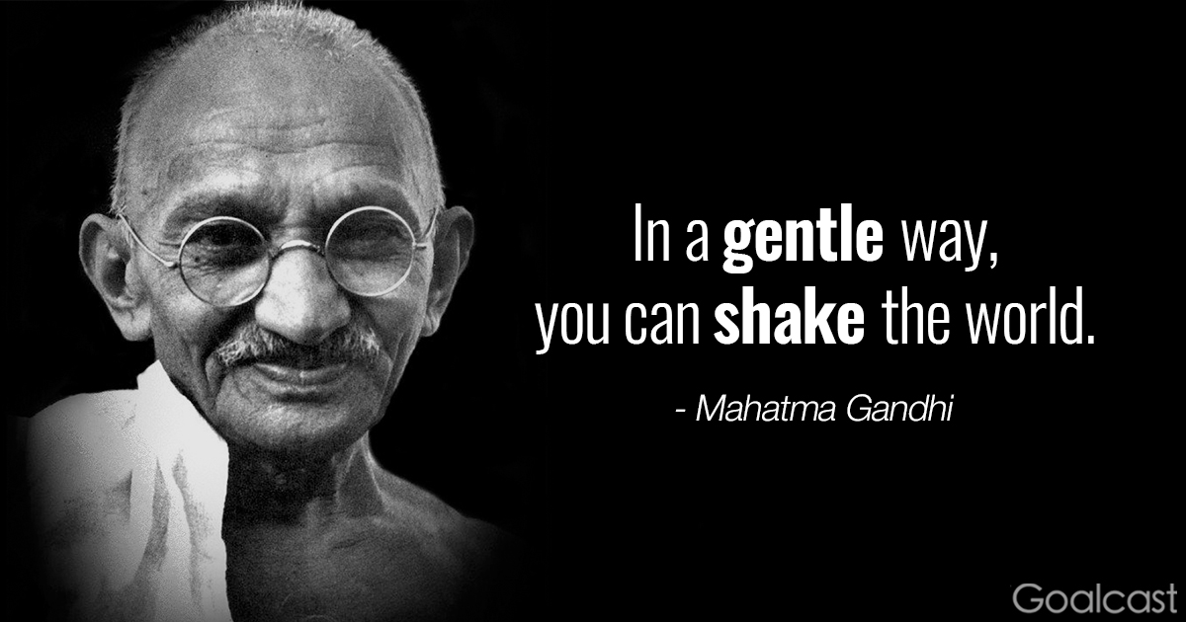
Check-In
Thoughts, Reflections, Questions?

Slide 3

Who are you now?
Insight – Reflect – Enact
What are your wisdom points

Slide 4
Challenge of Change
There is nothing more difficult to take in hand, more perilous to conduct, or more uncertain in its success, than to take the lead in the introduction of a new order of things.
Nicolo Machiavelli - The Prince.

Slide 5

What is organizational change?
Organizational change occurs when an organization restructures resources to create value and improve effectiveness.

Slide 6

Please finish this quote
Change done to us …
Change done by us …
Notes:
How does that make us feel? (show each statement)
Why is that?
At the root, change done to us, we’re being asked to comply.
* People respond by doing what’s asked
Change done by us, we’re committed to it, we’re going to get it done no matter what
* People respond by doing what it takes.
Commitment vs. compliance

Slide 7
生き甲斐
Good at
Get paid for
Love
Needed
Notes:
Who can read Japanese … I’ve already given you a hint
So, I got this morning up and I am here today because I love what I do, I get paid for it, there is a need for learning, especially change process and you can tell me if I am good at it.
So right here and right now, with you is my Ikigai.
So let me tell you a bit about me

Slide 8
生き甲斐
IKIGAI (Ick-ee-guy)
‘purpose in life’, or
‘thing that you live for’, or
‘thing that gets you out of bed in the morning’
Japanese population amongst the longest living worldwide
Love
Good at
IKIGAI
Need
$$$
https://www.ted.com/talks/dan_buettner_how_to_live_to_be_100
Finding your ikigai: the Japanese secret to health and happiness
http://www.telegraph.co.uk/health-fitness/mind/finding-ikigai-japanese-secret-health-happiness/
Notes:
Who can read Japanese … I’ve already given you a hint
So, I got this morning up and I am here today because I love what I do, I get paid for it, there is a need for learning, especially change process and you can tell me if I am good at it.
So right here and right now, with you is my Ikigai.
So let me tell you a bit about me

Slide 9
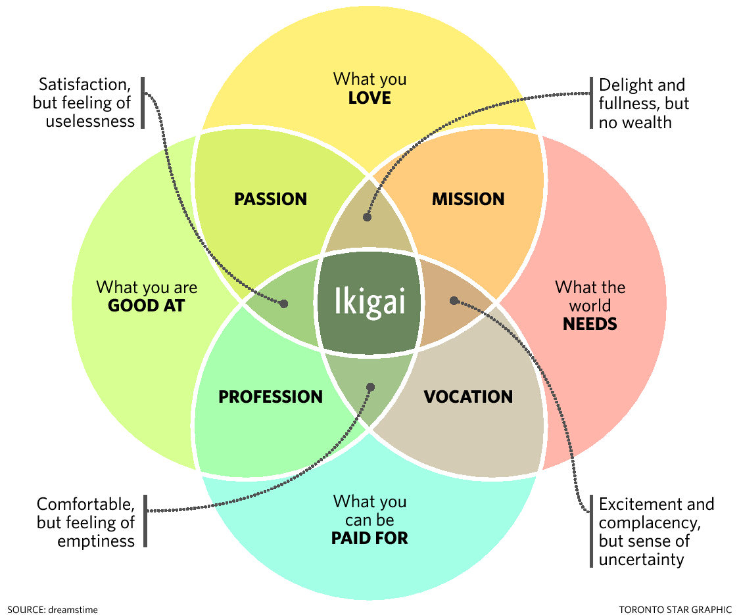
生き甲斐
Notes:
What is your purpose in life?
Ikigai is “purpose in action,”
In a 2001 research paper on ikigai, co-author Akihiro Hasegawa, a clinical psychologist and associate professor at Toyo Eiwa University, placed the word ikigai as part of everyday Japanese language. It is composed of two words: iki, which means life and gai, whichdescribes value or worth.
Hasegawa points out that in English, the word life means both lifetime and everyday life. So, ikigai translated as life’s purpose sounds very grand. “But in Japan we have jinsei, which means lifetime and seikatsu, which means everyday life,” he says. The concept of ikigai aligns more to seikatsu and, through his research, Hasegawa discovered that Japanese people believe that the sum of small joys in everyday life results in more fulfilling life as a whole.
ikigai is about feeling your work makes a difference in people’s lives.

Slide 10
What to Expect
Expect to be challenged …
to be put out of your comfort zone …
… and to have fun!
Notes:
List core topics / concepts covered.

Slide 11
Topics Covered
Review commonly used change models & practice with a proven framework
Learn about some
Lean practices
Listen and share
real-world experiences – what’s worked, what hasn’t
Notes:
Provide a list of learning outcomes and seminar objectives.

Slide 12

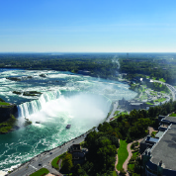


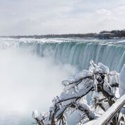
Agenda
Review
Relevant
Theories
Assess for Change
Implement
The change
Review
Case
Construct
Change
Plan
Debrief plus
Edgy Stuff
Notes:
The majority of today will be hands-on learning in your simulation teams where you will be leading a change project.
“What other expectations that you have of me to keep in mind in terms of how we run the day?”

Slide 13

Change Prevelance
A recent study n=309
HRM executives
100% were going through change
  merger,
  acquisition,
  divestiture,
  global competition,
  restructuring

Slide 14
Please finish this quote
Change done to us …
Change done by us …
At the root, change done to us, we’re being asked to comply.
* People respond by doing what’s asked
Compliance
Change done by us, we’re committed to it, we’re going to get it done no matter what
* People respond by doing what it takes.
Commitment
Notes:
How does that make us feel? (show each statement)
Why is that?
At the root, change done to us, we’re being asked to comply.
* People respond by doing what’s asked
Change done by us, we’re committed to it, we’re going to get it done no matter what
* People respond by doing what it takes.
Commitment vs. compliance

Slide 15
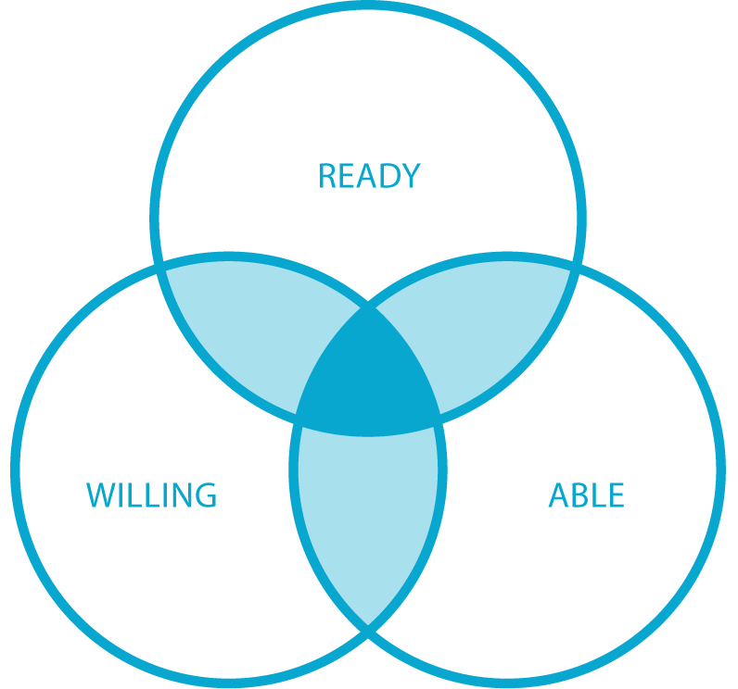
What is Change?
Change as a discipline refers
to the collection of tools, techniques, and mindsets that help organizations ensure their people are ready to engage, willing to commit and able to do what it takes to realize the full potential of great solutions.
Notes:
Commitment (Willingness) is a big part of change, but it’s not everything.
People also need to be ‘ready’ – have the capacity to change.
And they need to be ‘able’ – have the capability (skills, knowledge) to change.
What does not able sound like? “I can’t”
What does not ready sound like? “I won’t”
What does not ready sound like? “Not now”

Slide 16
Types of Change …
Content of Change
Radical change
Revolutionary change
Crisis situation
Top down
Rare
Episodic
Kaikaku
Examples: M&As, restructurings, change of leadership
Emergent change
Organic change
Part of daily life
Bottom up
Frequent
Continuous
Kaizen
Examples: project work, changing values
Notes:
There are many types and levels of change … but there is a simple formula

Slide 17

A Formula for Change
Choice of Change Strategy =
f(Content of Change, Organization’s DNA)
Notes:
So lets review a few change models – strategic tools

Slide 18
Change Models
The Medicine Wheel
McKinsey / Waterman & Peters 7S Framework
Lewin’s Three Step Model of Change
Kotter’s 8 Step Leading Change Model
ExperiencePoint’s 7 Step Change Model
The (wRight) Change Model

Slide 19
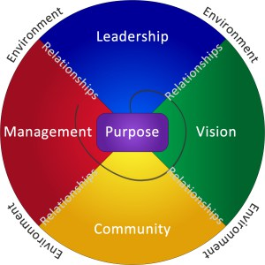
The Medicine Wheel - A Tool for Change
The particular archetypes appointed to north, east, south, west and the relationship between them, set within a mandala or circle is from the wisdom of North American Indigenous peoples.
Different Tribes and Nations have/had different interpretations and configurations.
Seven components of an organization’s operating matrix:
  Purpose, leadership, vision, community, management, relationships, and the circle of the whole within its environment.
  The order of the process of reflecting about each component was essential to obtain consistent and cross cultural results.
The Medicine Wheel – a change tool

Slide 20
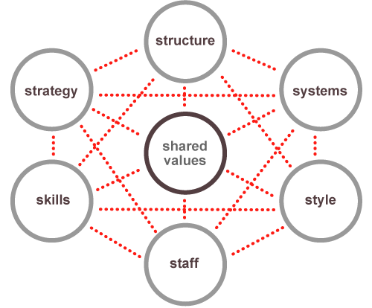
McKinsey / Waterman & Peters’ 7S Framework
Often used as a guiding map for organizational change
Examine the likely effects of future changes within
Align departments and processes during a merger or acquisition
Determine how best to implement a proposed strategy
A change in one element may impact other elements
Reference: Waterman, P., Peters, T., (1982) In Search of Excellence
Notes:
Featured in the book In Search of Excellence, by former McKinsey consultants Thomas J. Peters and Robert H. Waterman, the framework maps a constellation of interrelated factors that influence an organization's ability to change.
The lack of hierarchy among these factors suggests that significant progress in one part of the organization will be difficult without working on the others.

Slide 21
Elements of 7S Framework
Soft Elements
Hard Elements
Shared Values: Core values
Style: Leadership style
Staff: Employees as individuals and their broad abilities
Skills: The skills and competencies of employees
Strategy: Organizational plan or route-map to maintain competitive advantage
Structure: Organizational hierarchy
Systems: The day-to-day processes and procedures across the organization
https://www.mckinsey.com/business-functions/strategy-and-corporate-finance/our-insights/enduring-ideas-the-7-s-framework
Hayes (2014) The Theory and Practice of Change Management, Macmillan Education UK.

Slide 22
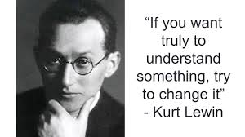
Lewin’s Three Step Change Model
The three step change model
  Unfreeze – shock a system out of stasis
  Move – make purposeful adjustments
  Refreze – consolidate change by systematically engraining adjustments
Kurt Lewin, 1890 – 1947
Founding father of social, applied and organizational pyschology
Also known for:
Gestalt Psychology
Action research
Force-field analysis
Notes:
Gestalt psychology or gestaltism is a philosophy of mind of the Berlin School of experimental psychology. Gestalt psychology is an attempt to understand the laws behind the ability to acquire and maintain meaningful perceptions in an apparently chaotic world. The central principle of gestalt psychology is that the mind forms a global whole with self-organizing tendencies.

Slide 23

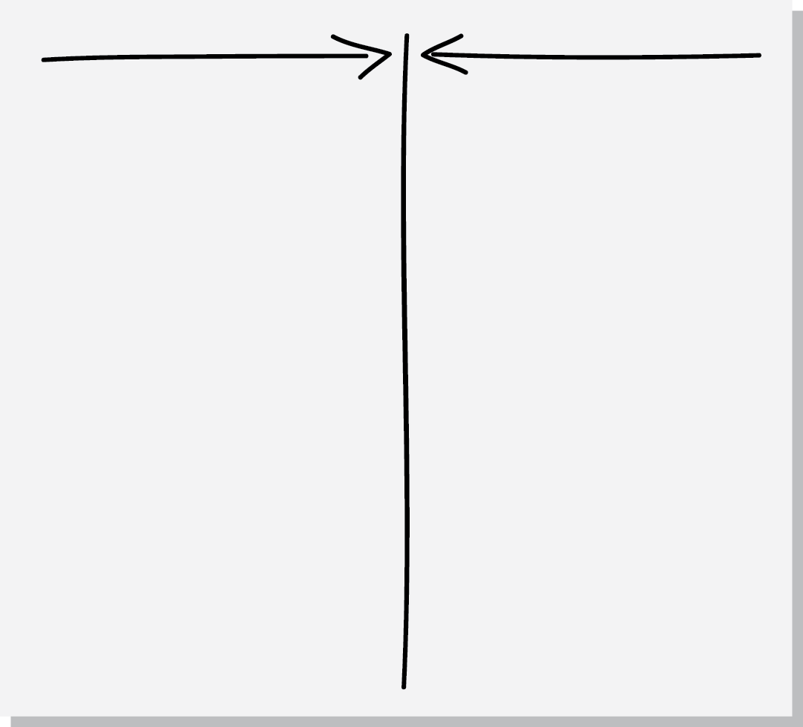
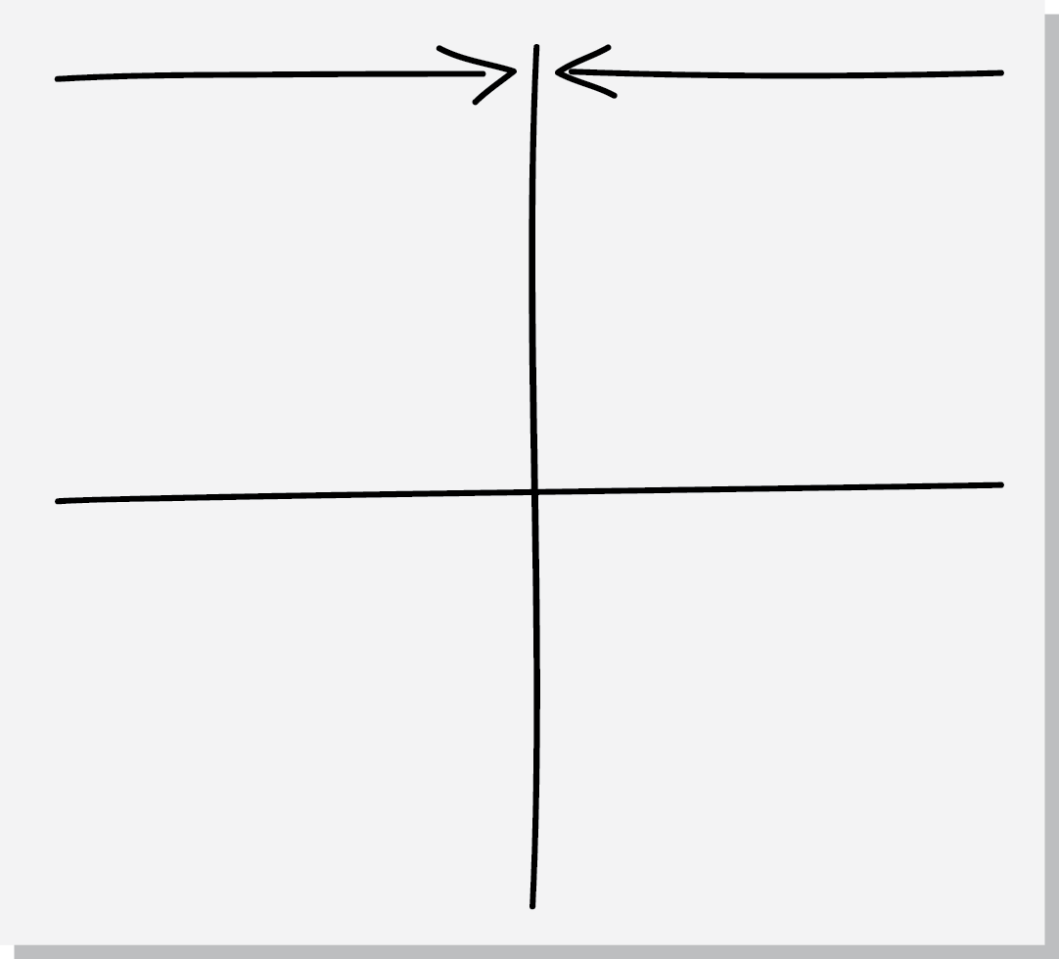
Force-Field Analysis
What is the problem/change issue?
Where are you now? Where might current situation go if no action is taken?
Where do you want to go (vision)?
What are the driving & restraining forces?
What action(s) can minimize resisting forces and maximize driving forces – recognizing that changing one might impact the others (both positively and negatively)
Discus all the forces – can they be changed? Which are the critical ones?
Driving
Restraining
Rational
facts, data, overt
Emotional
political, cultural, covert
Notes:
Set up The Force Field as a great tool for analysis and as a framework for discussion.
Illustrate importance of Rational & Emotional
------
The Force Field is a great tool for analysis and as a framework for discussion.
"Force Field" is a fancy way of saying that there are lots of different factors (or, forces) for and against making change that we need to be aware of.
Driving forces = positive forces for change
Restraining forces = obstacles to change
Orgs will always be driving forces that make change attractive to people, and restraining forces that work to keep things as they are
Successful change is achieved by strengthening the driving forces and/or weakening the restraining forces

Slide 24
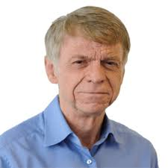
Kotter’s Eight Step Leading Change Model
Your BIG takeaways (up to 3)
Strengths of the article
Fuzzy Places (weak points)
Relationship to other articles (connect the dots)
Who are you NOW? (Show how this informs your change agent skills)
Notes:
Play the video
Developed in 80s

Slide 25
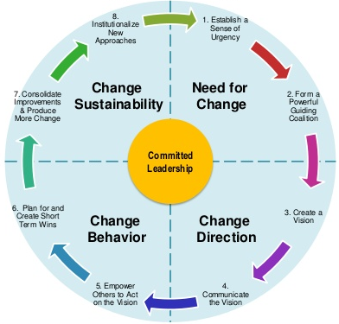
Kotter’s Eight Step Leading Change Model
Notes:
Play video from 25 seconds inwards
Warning about the tone of voice over

Slide 26
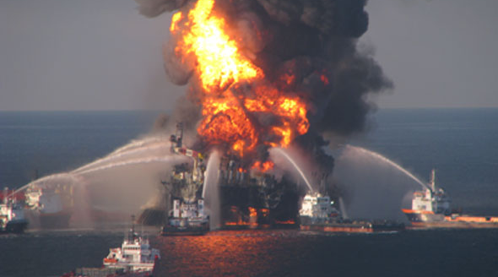

Need for Change - Kotter
Create a Sense of Urgency
Form a Powerful Enough Guiding Coalition
Examining market and competitive realities
Identifying and discussing potential crises, or major opportunities
75% of your leadership team is convinced
Assembling a group with enough power to lead the change effort
Encouraging the group to work together as a team

Slide 27


Change Direction - Kotter
Create a Vision
Communicate the Vision
Creating a vision to help direct the change effort
Developing strategies for achieving that vision
Using every possible communication channel
Teaching new behaviors by the example of the guiding coalition

Slide 28


Change Behaivour - Kotter
Empower Others to Act on the Vision
Plan for and Create Quick Wins
Remove obstacles to change
Changing systems or structures that seriously undermine vision
Encouraging risk taking and non traditional ideas, activities and actions
Planning for visible performance improvements
Creating those improvements
Recognizing and rewarding employees involved in the improvements

Slide 29
Implementing & Sustaining the Change - Kotter
Consolidating Improvements and Producing Still More Change
Institutionalizing New Approaches
Using increased credibility to change systems, structures, and policies that don’t fit the vision
Hiring, promoting, and developing employees who can implement the vision
Reinvigorating the process with new projects, teams and change projects
Articulating the connections between the new behaviors and corporate success
Developing the means for leadership succession and development

Slide 30


Organizational Change: Let’s Make a Model
Get up, stand up! Let’s organize by your birth date – month and day without speaking or writing
Now, let’s organize in stages of the change model:
Stage One
Stage Seven
Notes:
Order in order of your birthdate – month & day only NO TALKING or WRITTING

Slide 31
Experience Point Change Model

Slide 32
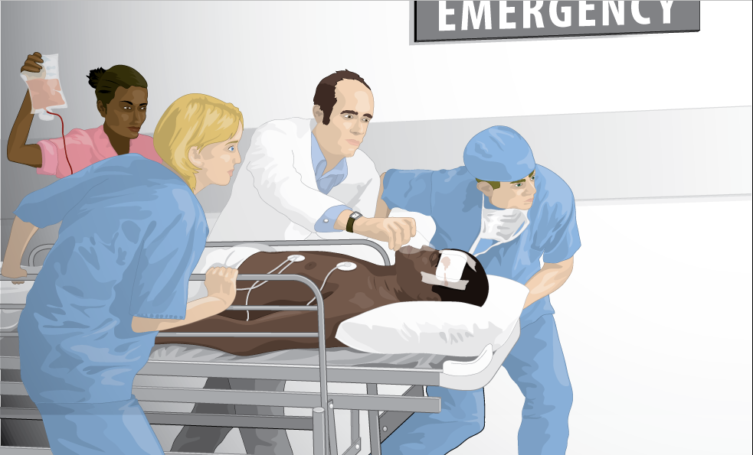
ExperienceChange: Lakeview
You are the newly hired VP
Patient Services for Lakeview Regional Hospital.
Lakeview has recently received bad press highlighting long wait times in the ED.
You’ve been asked by the Hospital’s CEO to lead a team to reduce wait times in the ED.
Notes:
Lakeview may, at first glance, look different than your organization, but let’s get to know Lakeviewand I think we may uncover a number of similarities.

Slide 33

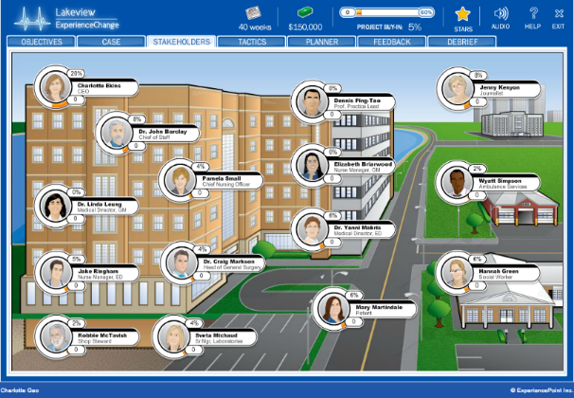
Assess the Situation at Lakeview
Review the Lakeview case
Interview stakeholders and take notes
Assess the organization for
      Driving forces for change
      Restraining forces
Notes:
Start by interviewing stakeholders to understand the forces driving (i.e. supporting) and restraining (i.e. against) change.
Return to the main classroom in [60/75 mins] and be prepared to present your assessment of the situation.
Interview Brian
Funny remark that you get to cut off the Executives
Don’t seem to mind…!
19 Stakeholders in total
Start wherever you like.
Each stakeholder provides a different perspective.
8 possible questions to ask each
Ask as many questions as you’d like but won’t have time for all so use your time wisely.
Capture notes in the Player’s Guide.

Slide 34
Force Field for Lakeview
Driving
Restraining
Rational
facts, data, overt
Emotional
political, cultural, covert
Notes:
Diving group into 4, assigning 1 quadrant to each to “own” and present.
Top forces Driving Change = Levers we want to pull
Top forces Restraining Change = Barriers we most need to pull the Levers for
Driving Forces (Rational)
Market – shifting from military (shrinking) to commercial (growing)
Financial – about 18 mos left
Driving (Emotional)
Workforce – high quality
People – Jennifer Smith respected
Restraining Forces (Rational)
Structure – siloed org
Budgets – shrinking
Workforce – union negotiations on horizon
Restraining (Emotional)
Workforce – morale suffering
Culture – finger-pointing, blame game
Why might this be useful in a change situation to do?
Helps to focus on the right things
Helps size up the situation

Slide 35
The Journey from Challenge to Impact is Not Linear
IMPACT
What do we expect?
Performance
(Productivity, Revenue, Margin, etc.)
CHALLENGE
Time
Notes:
Many changes come about from a desire to improve performance - like improving offers to customers or efficiencies delivering these offers.
When we undertake a challenge, what direction do we expect our organization's performance to go?
["Up, hopefully"]
By addressing this challenge we expect to achieve improved performance (higher, better, faster) in a certain period of time (6 months, 1 or 3 years).

Slide 36
The Journey from Challenge to Impact …
What actually happens?
Performance
(Productivity, Revenue, Margin, etc.)
WHY?
Time
Notes:
Q: Does the line go straight up? What actually happens?
["It often goes down"]
That's right, this is a phenomenon known as "the dip".
Q: Why does the Dip take place?
["There's a disruption in what we're doing today that requires people to adapt to a new way of doing things."]

Slide 37



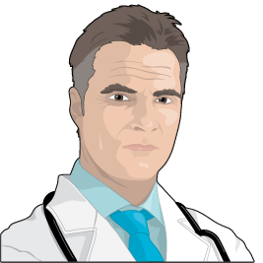
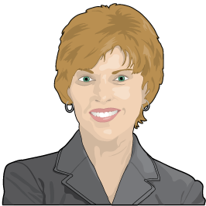
Feeling the Dip
COMMITMENT
DENIAL
At Lakeview,
who might we find
in each stage?
Charlotte Ekins
CEO
Elizabeth Briarwood
Nurse Manager, GM
EXPERIMENTATION
RESISTANCE
Jake Ringham
Nurse Manager, ED
Dr. Craig Markson
Head of General Surgery
Pamela Small
Chief Nursing Offier
DISORIENTATION
Notes:
Many of us will be familiar with the Dip. If you're familiar with the grief cycle as described by Elisabeth Kübler-Ross, you're familiar with the dip. [https://en.wikipedia.org/wiki/K%C3%BCbler-Ross_model]
There are many variations with different labels, but generally speaking, all of us move through these phases when going through change.
Even positive changes involve some sort of journey along this curve. Imagine receiving a promotion. What emotions go through your head?
Let’s think about Lakeview. Who might be in each category?
Optional Table Discussion
Split the three questions among the teams and ask to report back in 5 mins.
What kinds of questions might we ask of people who are on the down side of the slope - who are letting go?
How do you feel?; What’s unclear?; What excites you?; What concerns you?; How’s it going to affect you personally?
What kinds of questions might we ask of people who are at the bottom in the neutral zone?
Roles you could play?; Do differently?; Barriers to excitement?; Questions? Worries?; How’s it going to affect you personally?
What kinds of questions might we ask of people who are moving their way up the curve into commitment?
Continue to do?; What energizes?; Former concerns that are now allayed?; What are you most proud of?

Slide 38
Moderating the Dip
People who know
what to do (models & tools) and how to be (mindsets & reflexes) can moderate the dip and achieve impact earlier and more often.
“Success in management requires learning as fast as the world is changing”
Warren Bennis
Notes:
The Dip is natural, but it can be moderated. That's what change is all about - seeking to minimize the appitude and duration of the Dip.

Slide 39

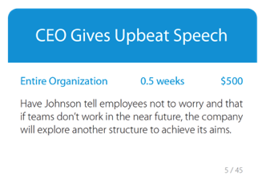
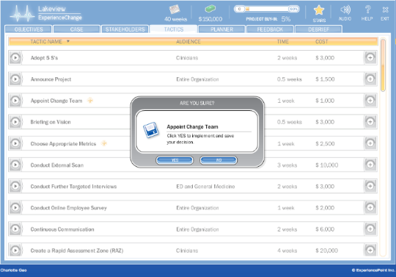
Change Team Roles
Each team to elect someone to be the:
Captain
Time keeper
Speaker
Devil’s advocate
Notes:
Plan
Time to build out a change plan, using the tactics available. In [1 hour] you should have your plan at least 80% complete
No need for a computer
Decide which tactics you will use and which ones you won’t
Expect to use 20 – 30 to hit the 60% goal*
Determine the best order for implementation
Consider time & budget constraints
Some tactics identified with a star
Means you will be asked to make additional choices
[discreetly take pictures when in this phase]

Slide 40
Plan & Implement Change
Plan your change with tactic cards
Which tactics? What order?
Budget: $150,000
Timeline: 40 weeks
Implement your plan in the simulation
Be mindful of
Feedback (consider the source!)
Buy-in (60% is the goal)
Budget and time remaining
Notes:
Plan
Time to build out a change plan, using the tactics available. In [1 hour] you should have your plan at least 80% complete
No need for a computer
Decide which tactics you will use and which ones you won’t
Expect to use 20 – 30 to hit the 60% goal*
Determine the best order for implementation
Consider time & budget constraints
Some tactics identified with a star
Means you will be asked to make additional choices
[discreetly take pictures when in this phase]

Slide 41
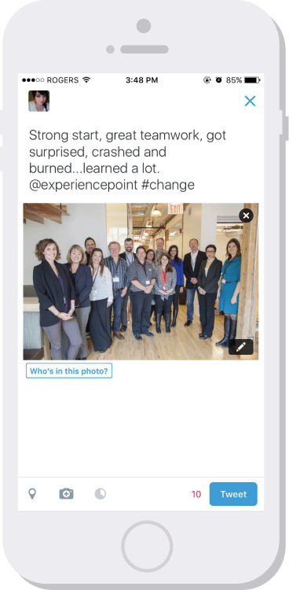
When We Regroup …
In your teams, summarize your team experience into a 280 character “tweet”. We’ll share as a part of our report-in.
Extra applause for wit!

Slide 42
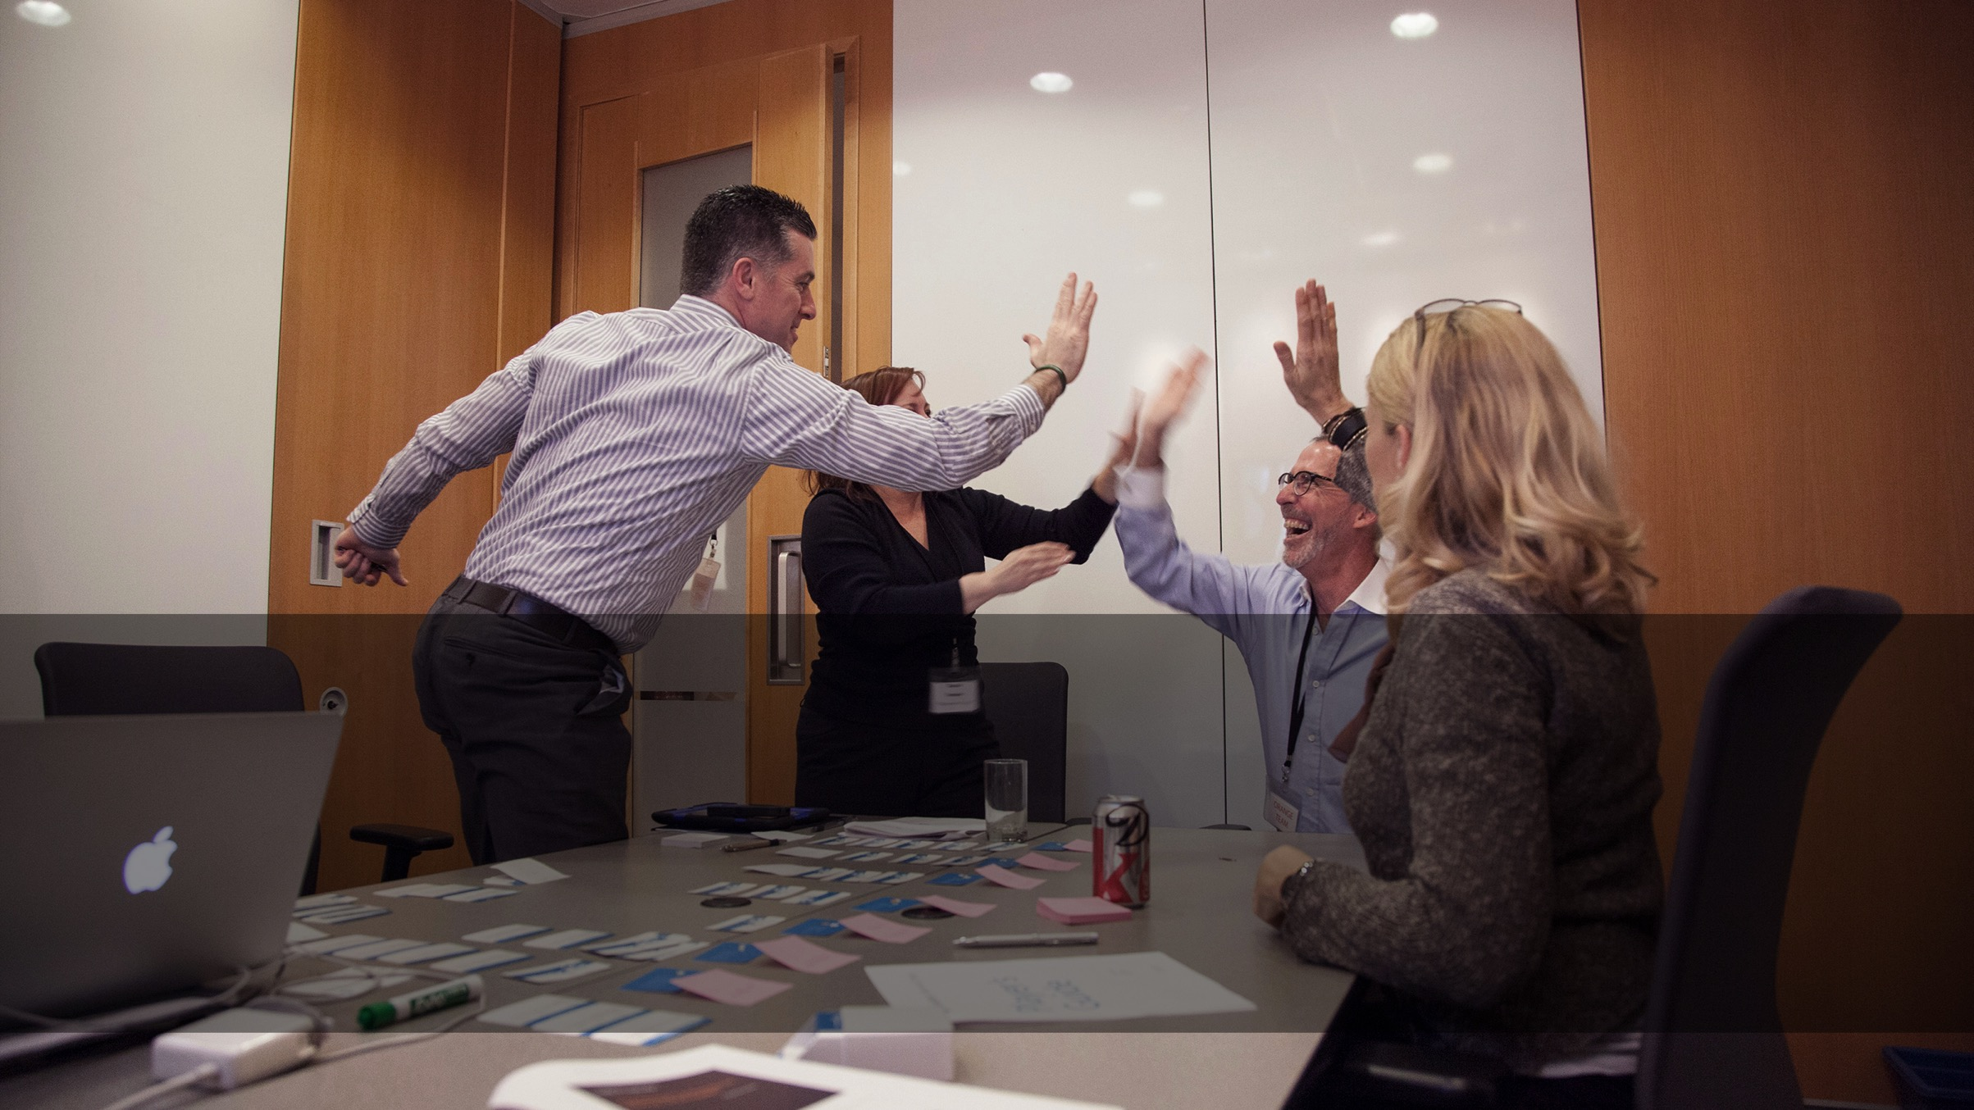
Debrief

Slide 43
Report-in on Your Change Initiative
Which tactics generated the most discussion?
What decision outcomes surprised you?

Slide 44
Your Opinion On …
How was this like your experience in the real world?

Slide 45
Models Reviewed
The Medicine Wheel – an Indigenous Tool for Change
McKinsey / Waterman & Peters 7S Framework
Lewin’s 3 Step Change Model
Kotter’s 8 Step Leading Change Model
ExperiencePoint’s 7 Step Change Model

Slide 46
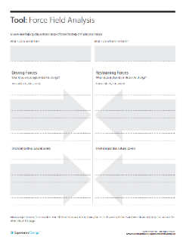
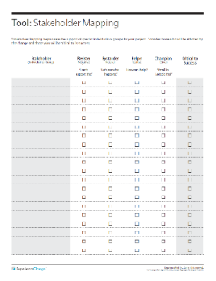
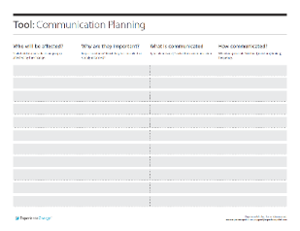
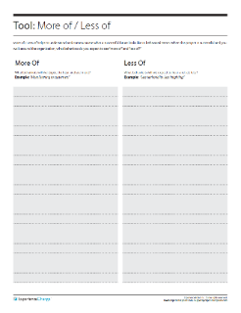
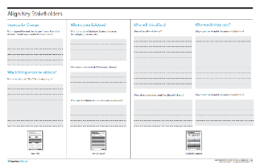
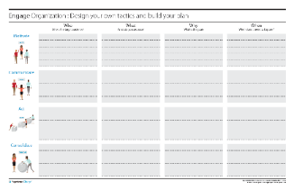
Summary: Models & Tools
Use a Model … any model (maybe even the (w)Right™ one)!
Start with Why, and not a baked solution
Go slow to go fast. Build a solid foundation
Resist urge to jump from Vision (Solution)
to Action
Engage heads and hearts
Intrinsic > Extrinsic
Plan for quick wins to learn and
build momentum
Force Field
Stakeholder Mapping
Communication
Planning
More of, Less of
Align
Engage

Slide 47
Summary: Mindsets
Learning Orientation
Listen Carefully
Do to Learn
Lean into Ambiguity
Human-Centered
Involve others
Be Open
Be Positive
Meaningful Motion
Focus Sharply
Be Intentional
Be Patient
Notes:
Change done well is managed messiness.

Slide 48
Summary: Reflexes
Ask
“Why?” and be prepared to answer.
“Who do we need to involve?”
“What’s important to you?”
“Who else needs to know?”
“What do you think?”
Say
Inclusive, not exclusive language. “We” instead
of “me”.
Avoid “my idea”.
Use Gestalt language, where you can. “In my experience …”

Slide 49
Supplemental Material

Slide 50
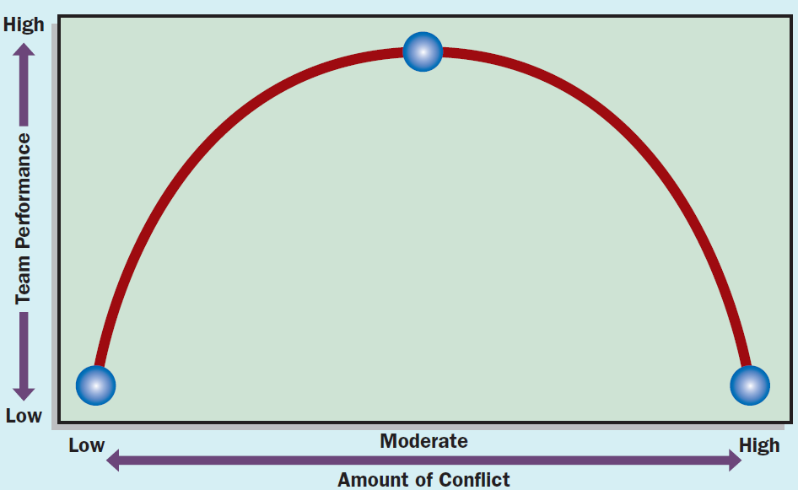
Conflict vs. Performance & Change
Conflict: Antagonistic interaction in which one party attempts to thwart the intentions or goals of another
  Task: Disagreement among people about the goals to be achieved or the content of the tasks to be performed
  Relationship: Personal incompatibility that creates tension and feelings of personal animosity among people
A moderate level of conflict is a good thing

Slide 51
Access to Simulation
You’ll have access to the simulation for 90 days
Take your username
Follow the on screen instructions
“Success is not final, failure is not fatal: it is the courage to continue that counts”
  W. Churchill

Slide 52


Reflection
Experience Plus Reflection Equals Growth
John Dewey, philosopher and educator
Photo by Dhilung Kirat / CC BY 2.0
Notes:
“Don’t have the experience and lose the learning.”

Slide 53
The (w)Right Change Model TM
Me: Trust, Leadership Skills, Sharpen the Saw
Marshall: Urgency-Opportunity, Focus, Bright spots, Coalitions/Networks
Map: Political Terrain (Stakeholders), Disruptive Technologies,
Message: Vision, Values
Motivate: Communicate with the Elephant & Rider, Path, Small Wins
Manage: Clear Hurdles, Overcome Resistance, Keep an eye out for Grendel’s Mother

Slide 54
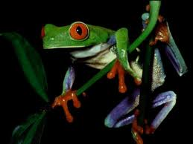
2) Marshall: Urgency - Opportunity
Discovery process step back and examine the big picture to identify critical issues
Understand the vulnerability in the organization (or, create it - Cortez)
Who are the antagonists (unite against)?
Achieved when 75% of your leadership team is honestly convinced

Slide 55
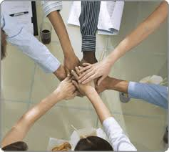
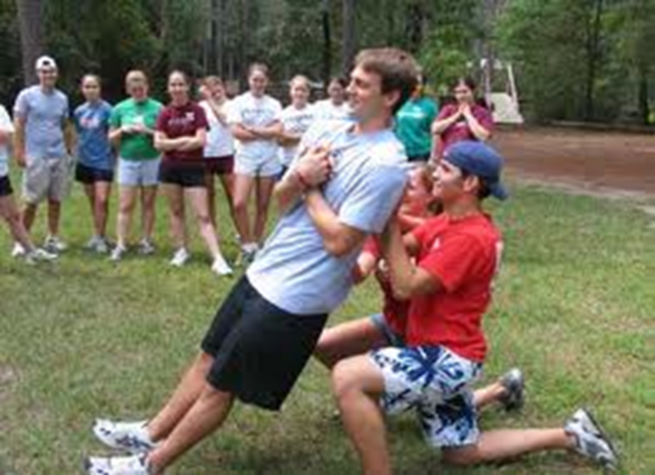
2) Marshall:
Create a Powerful Coalition
High Performance Teams
they contain people with special skills
they commit to a common purpose, establish specific goals
they have the leadership and structure to provide focus and direction
they hold themselves accountable at both the individual and team levels
there is high mutual trust among members
  Size 5-7 people
Spirit of Cooperation
Swift Trust: Leaders go first

Slide 56

3) MAP: Forces of Change
Task: What ‘environmental’ forces are causing organizations to change? (now / future)
  Economic
  Political/Legal
  Technology
  Social/Demographic
  Other?

Slide 57
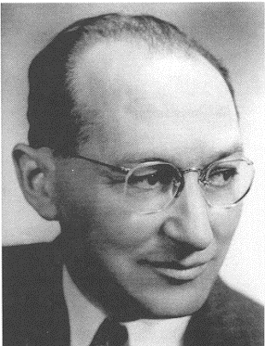
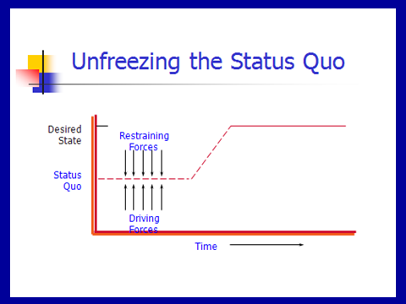
3) MAP: Force Field Analysis
Kurt Lewin

Slide 58
Lewin’s Force Field Steps
Understand / Describe Current Situation
Identify where current situation will go if no action taken
List forces driving change / restraining forces
Discuss all the forces – can they be changed? Which are the critical ones?
Determine if you can negate the restraining / enhance the driving
Recognize that changing one might impact the others (both positively and negatively)

Slide 59

Reflection Time
You are driving and as you turn the corner you drive into fog – what do you do?

Slide 60

4) Message: Inspire a Shared Vision
You first need to develop a clear vision of the future
Then share it with others to “enlist them”

Slide 61
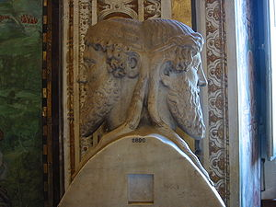


Vision: on a clear day you can see forever
Visions are about possibilities, about desired futures.
Discovery Points
  Janusian Thinking (Past/Future)
  Imagine the Ideal: what is the best that could happen?
  Discover the Theme: what / who are you passionate about?

Slide 62
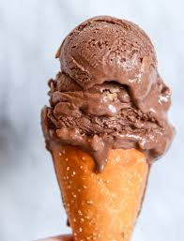
Strategic Visioning
Henry Mintzberg (1994) strategy should involve intuitive glimpses of possibility: The anticipatory principle - ongoing projection of a future image (vision)
  Taking back the RED
  Magical – on purpose or on task

Slide 63
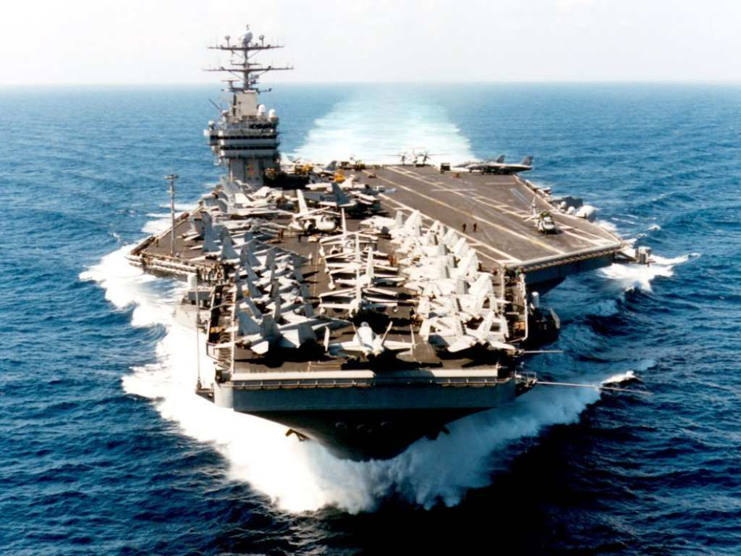
Vision: Cheering About Key Values
Aircraft Carrier
“the lost wrench”
What did the Captain do?
What does this story reinforce?
What are your Values and how will you Cheer?

Slide 64
Enlist Others
Develop a shared sense of destiny
Reminder!
Listen deeply to others - what excites them?
  Find the common ground
Discover and appeal to a common purpose
  A chance to be tested, take part in a social experiment, to do something well, do something positive, a chance to change the way things are
Give life to vision by communicating expressively
  Use powerful language – use the three peat, speak from the heart, image-analogy-feel,

Slide 65
Language of Change Leaders:
Enlist Others
Reminder!
Jay Conger
How things are framed makes a difference
  Focus on intrinsically appealing goals (+) and values
  Highlight the significance of the project (answer WHY)
  Who are the key antagonists
  Highlight why it will succeed
  Use analogies, stories, metaphors to make your point
  Allow your own emotions to surface when you speak

Slide 66

Power of Emotional Appeals
Emotional Arguments – danger, loss, unpleasantness, risk
Metaphors – machine, family, turn out the lights
Emotional Modes – pictures, slogans, music, colour
Humour – appropriate / un
Display emotions – smiles, speech tone, expressive

Slide 67
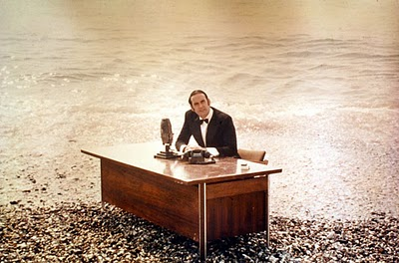
And now for something …
… completely different

Slide 68

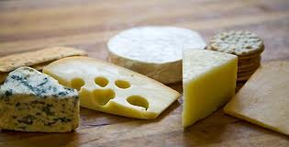
5 Motivate:
Direct the Rider
Motivate the Elephant
Shape the Path

Slide 69

Direct the Rider analytical / rational
Follow the Bright Spots: find out what’s working and clone it (story: malnutrition)
Point to the Destinations: Know where you are heading and why it’s worth it (story: destination card – ROUTE NHS, New Car)
Script the Critical Moves: Think Specific a-b-c (story: 125 calls / month, cite colleagues research)

Slide 70
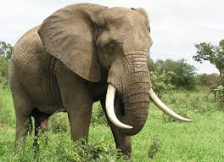
Direct the Elephant:
Putting Feelings First
Our elephant is lazy and skittish: seeking short-term benefits vs. short-term sacrifices to gain long-term benefits.
  So MOTIVATE the Elephant:
  Find the Feeling: Make people feel something (Red is fading)
  Shrink the Change: Break down the change (Head-start car wash)
  Grow your People: Cultivate a sense of identity (ST. Lucia parrot)

Slide 71


Shape the Path
Tweak the Environment: Change the situation (wearing safety glasses / cross the line)
Build Habits: rider is not taxed (action triggers, meatless Mondays)
Rally the Herd: Behaviour is contagious (majority of guests reuse their towel…)

Slide 72
Commercial Break
Think about what disturbs you, how you are being changed by the times in which we live, and how you can best cope with the times in which we live.

Slide 73
Exploring personal readiness for Change
Tolerance for Change Test
Please read the following statements. Circle the letter that best describes how you would feel in response to each statement.
A I would enjoy this very much, it’s completely acceptable
B This would be enjoyable and acceptable most of the time
C I would have no reaction to this feature one way or another
D This feature would be somewhat unpleasant for me
E This feature would be very unpleasant for me

Slide 74
Examples
I would like to live in a foreign country for a while.
It is more fun to tackle a complicated problem than to solve a simple one.
What we are used to is always preferable to what is unfamiliar (R).
Many of our most important decisions are based on insufficient information.
Teachers or supervisors who hand out vague assignments give one a chance to show initiative and originality.

Slide 75
Individual Reactions to Change
4 Stages:
Shock – perceive it as a threat
Defensive – cling to old ways
Loss of Confidence
Disrupted Habits
Individual
resistance
Fear of
the unknown
Loss of Control /
Security
Loss of
Face

Slide 76
Individual Reactions
3. Acknowledgement – sense of grief and sadness but start to be open to making things work
Adaptation and Change – ready to establish new routines and help others.
Knowing how to deal with this …

Slide 77
6) Manage: Cynicism about Change
25-40% will respond cynically to the next change
Why?
  Uninformed – lack of communication
    Action: Over-communicate – credible spokespersons, positive messages, multiple channels / repetition, two-way communication, Find the Feeling
  Previous experience
    Action: Deal with the past
  Negative disposition
    Action: Hire well
    Action: See world from employees perspective
  Lack of opportunity to be involved
    Action: Keep them involved – ask for input

Slide 78
Random Reminders and Insights …
Arouse dissatisfaction with the current state
  tell them about deficiencies in organization
Use participation in decision making
  get people involved
Build in rewards
  tie rewards to change/use recognition, status symbols, praise to get people to go along

Slide 79
Additional …
Establish goals
  e.g. achieve retention targets at end of next year
Institute smaller, acceptable changes that reinforce and support change
  e.g. procedures and rules, job descriptions, reporting relationships
Develop management structures for change
  e.g. plans, strategies, mechanisms that ensure change occurs
Maintain open, two-way communication
Notes:
This material is found on page 362-364.

Slide 80
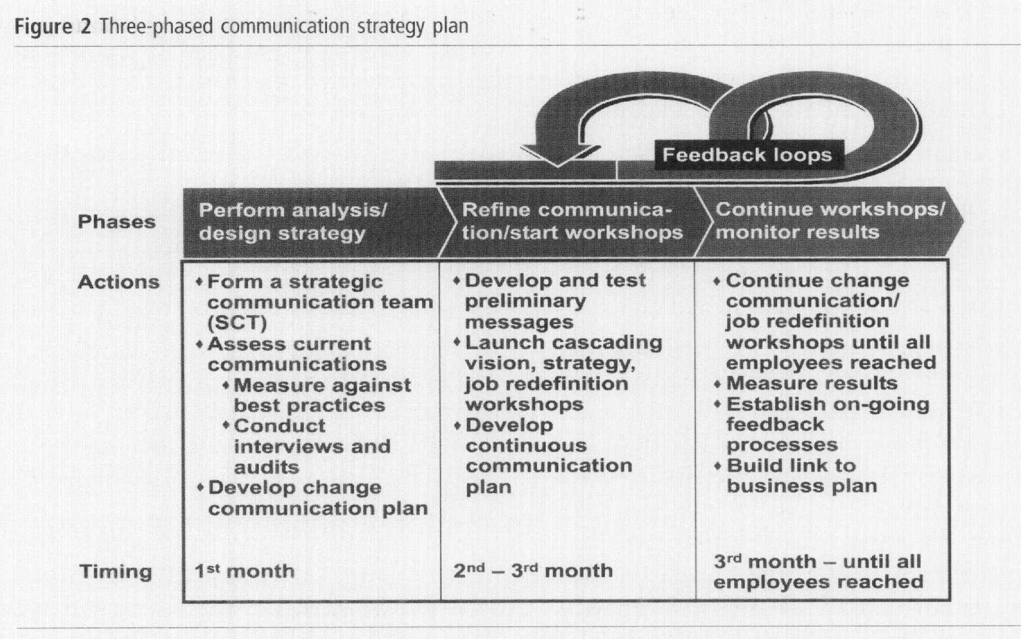
Communication: Barrett

Slide 81
Reflection Questions
What critical forces that are causing you to change?
How will you dissatisfy people from the current state?
What driving forces do you need to Enhance? Restrain?
What is your sense of urgency / opportunity?
Who is in your Powerful Coalition?
What is your vision – few words?
What’s your key value(s)?
How are you communicating
with your people?
What’s the feeling?
How are you shaping the path?
What hot spots are you focusing on? What’s your first small win?

Slide 82
Now the edgy stuff
Chaos Theory
Tipping Point
Grendel’s Mother
Darkest at Dawn

Slide 83
Tipping Point Leadership
Kim and Mauborgne HBR, 2003
Bill Bratton – Police Leader
Cognitive Hurdle
  Get people to agree on current problem (face-to-face with problems)
  Bratton began requiring that all transit police officials-beginning with himself-ride the subway to work, to meetings, and at night

Slide 84
Tipping Point Leadership
Resource Hurdle
Focus on “hot spots” and bargain with partner organizations (concentrate resources)
de-emphasizing or virtually eliminating some traditional features of transit police work while increasing emphasis on others or creating new ones - introducing mobile processing centers known as "bust buses."

Slide 85
Tipping Point Leadership
Motivational Hurdle
Put the stage lights on and frame the challenge to match organizations values
Bratton had selected precinct commanders called before a panel of the senior staff (the selected officer was given only two days' notice, in order to keep all the commanders on their toes). The commander in the spotlight was questioned by both the panel and other commanders about the precinct's performance (KEY: based on fair processes and known goals: "block by block, precinct by precinct, and borough by borough.

Slide 86
Tipping Point Leadership
Political Hurdle
Identify and silence internal opponents and isolate external ones
Bratton's alliance with the mayor's office and the New York Times isolated the courts which had opposed his zero-tolerance policing out of fear that it would clog court schedules. And, large cars.

Slide 87

Grendel’s Mother (Beowulf)
Hero – Beowulf
Grendel – monster who eats men
Beowulf mortally wounds Grendel
Happy days
Grendel’s Mother
Visit her lair
New tools

Slide 88
Change’s path
The learning curve
Successful Change
Change
Doubt
Point
Failed Change
Escalating Commitment or
Darkest before the Dawn?

Slide 89
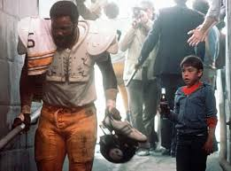

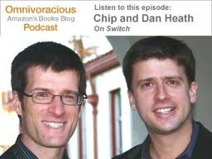
Final Exam …
Why is change so hard to enact?
Who would you rather spend an hour in conversation with – Chip or Dan Heath?
Who are you now? What are your three?

Slide 90
The (w)Right Change Model TM
Me: Trust, Leadership Skills, Sharpen the Saw
Marshall: Urgency-Opportunity, Focus, Bright spots, Coalitions/Networks
Map: Political Terrain (Stakeholders), Disruptive Technologies,
Message: Vision, Values
Motivate: Communicate with the Elephant & Rider, Path, Small Wins
Manage: Clear Hurdles, Overcome Resistance, Keep an eye out for Grendel’s Mother

